Slide 1
Network Access on Apple iOS
Configuration of iOS Devices on eduroam network

Slide 2
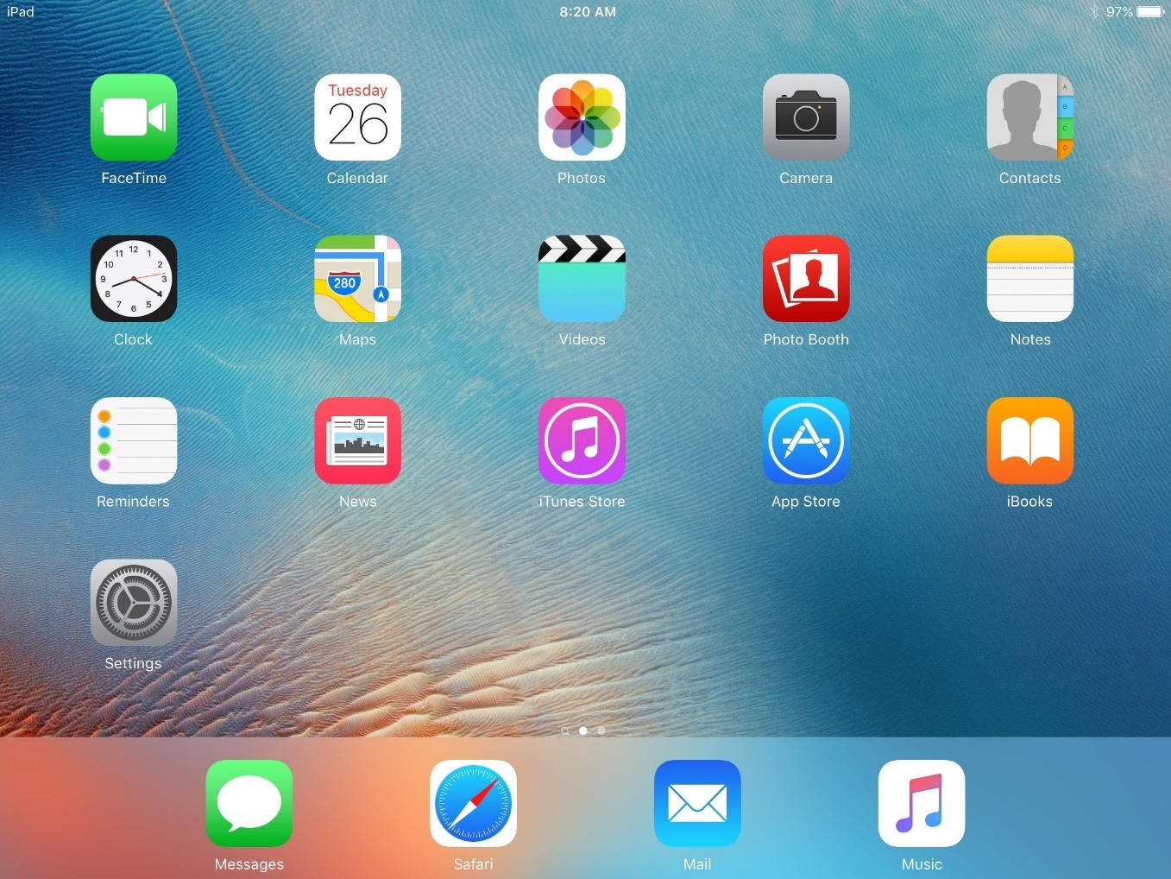
iOS Network Access Configuration
Begin by selecting the “Settings” icon on your iOS Device

Slide 3
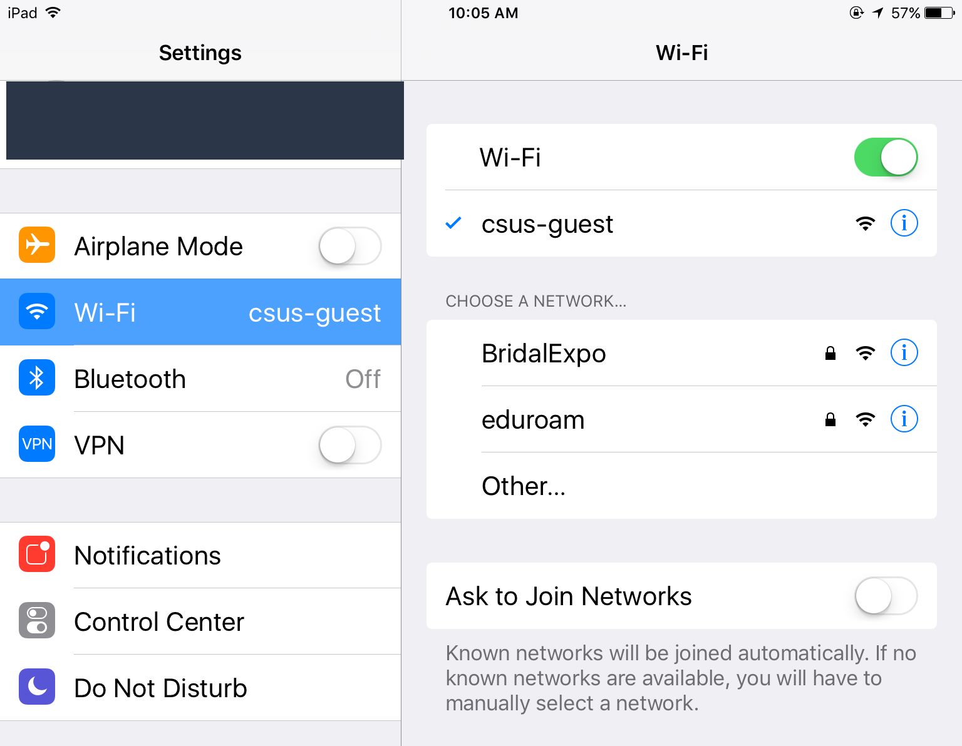
iOS Network Access Configuration
Select ‘Wi-Fi’ from the left side column
Then select the network labeled ‘csus-guest’.

Slide 4
iOS Network Access Configuration
A captive portal will automatically launch. Tap Faculty/Staff/Student Wireless Setup

Slide 5
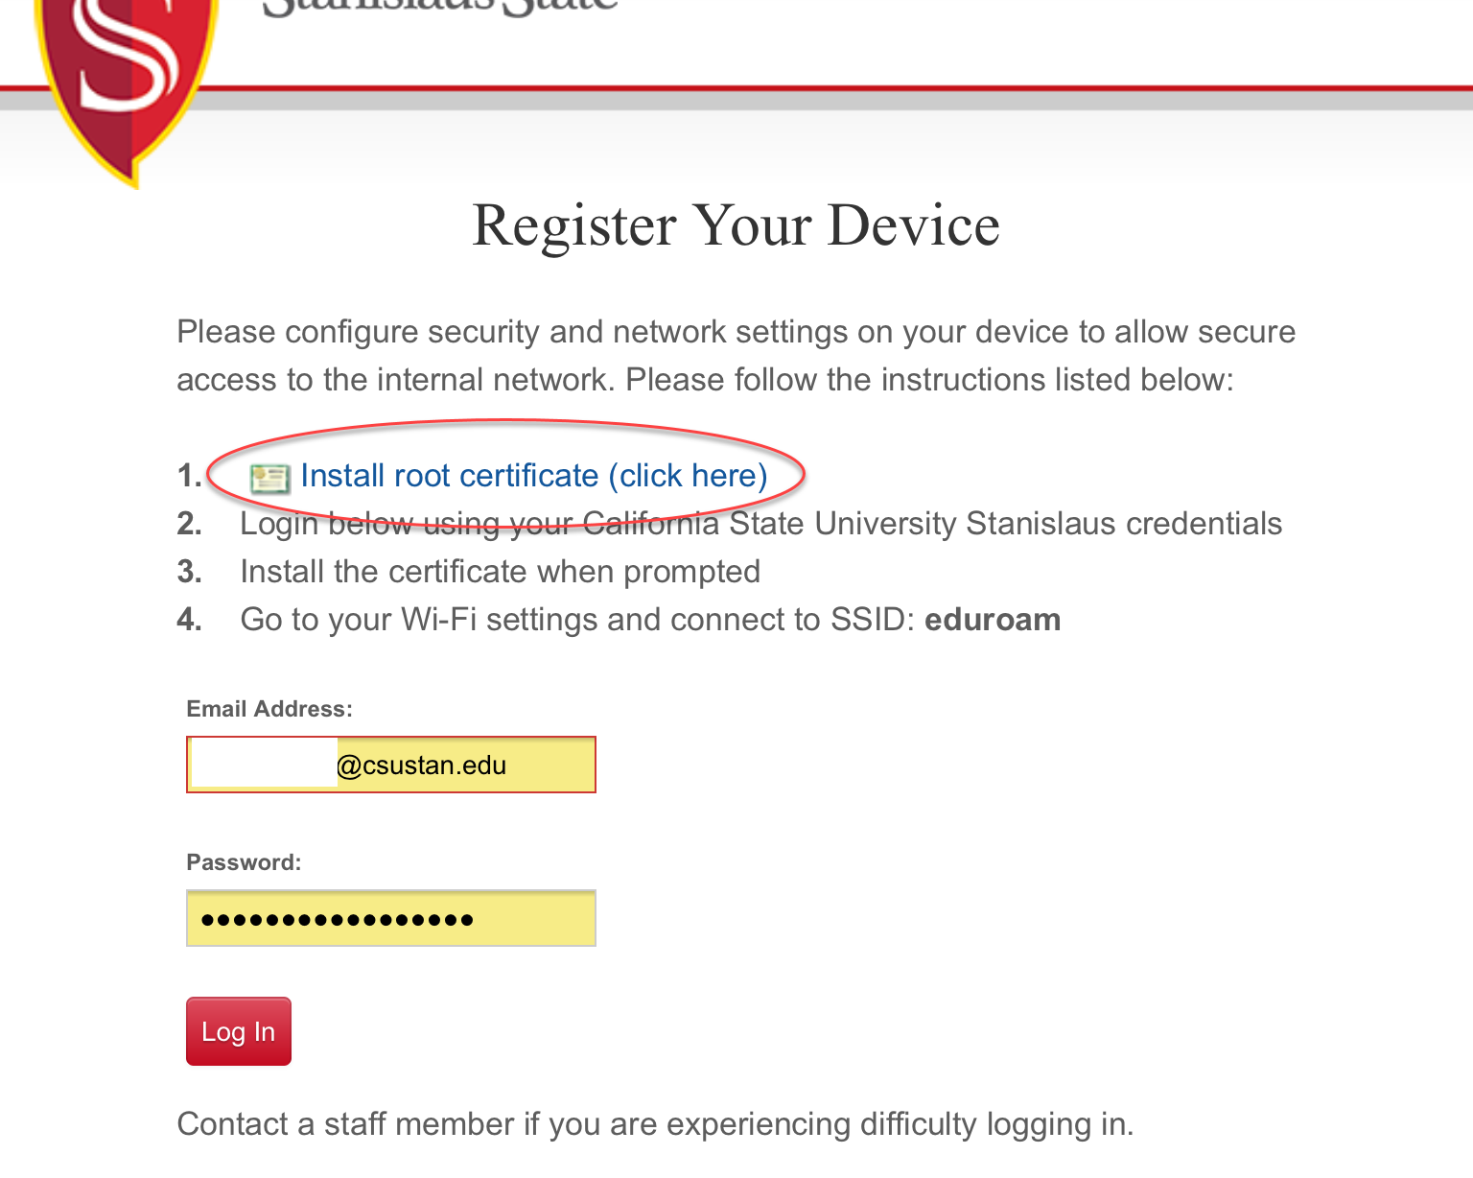
iOS Network Access Configuration
Tap on the Install root certificate (click here) to install certificates.

Slide 6
iOS Network Access Configuration
A certificate window will pop up. Tap Install to continue
Enter your device pin.
Tap Install to complete install.

Slide 7
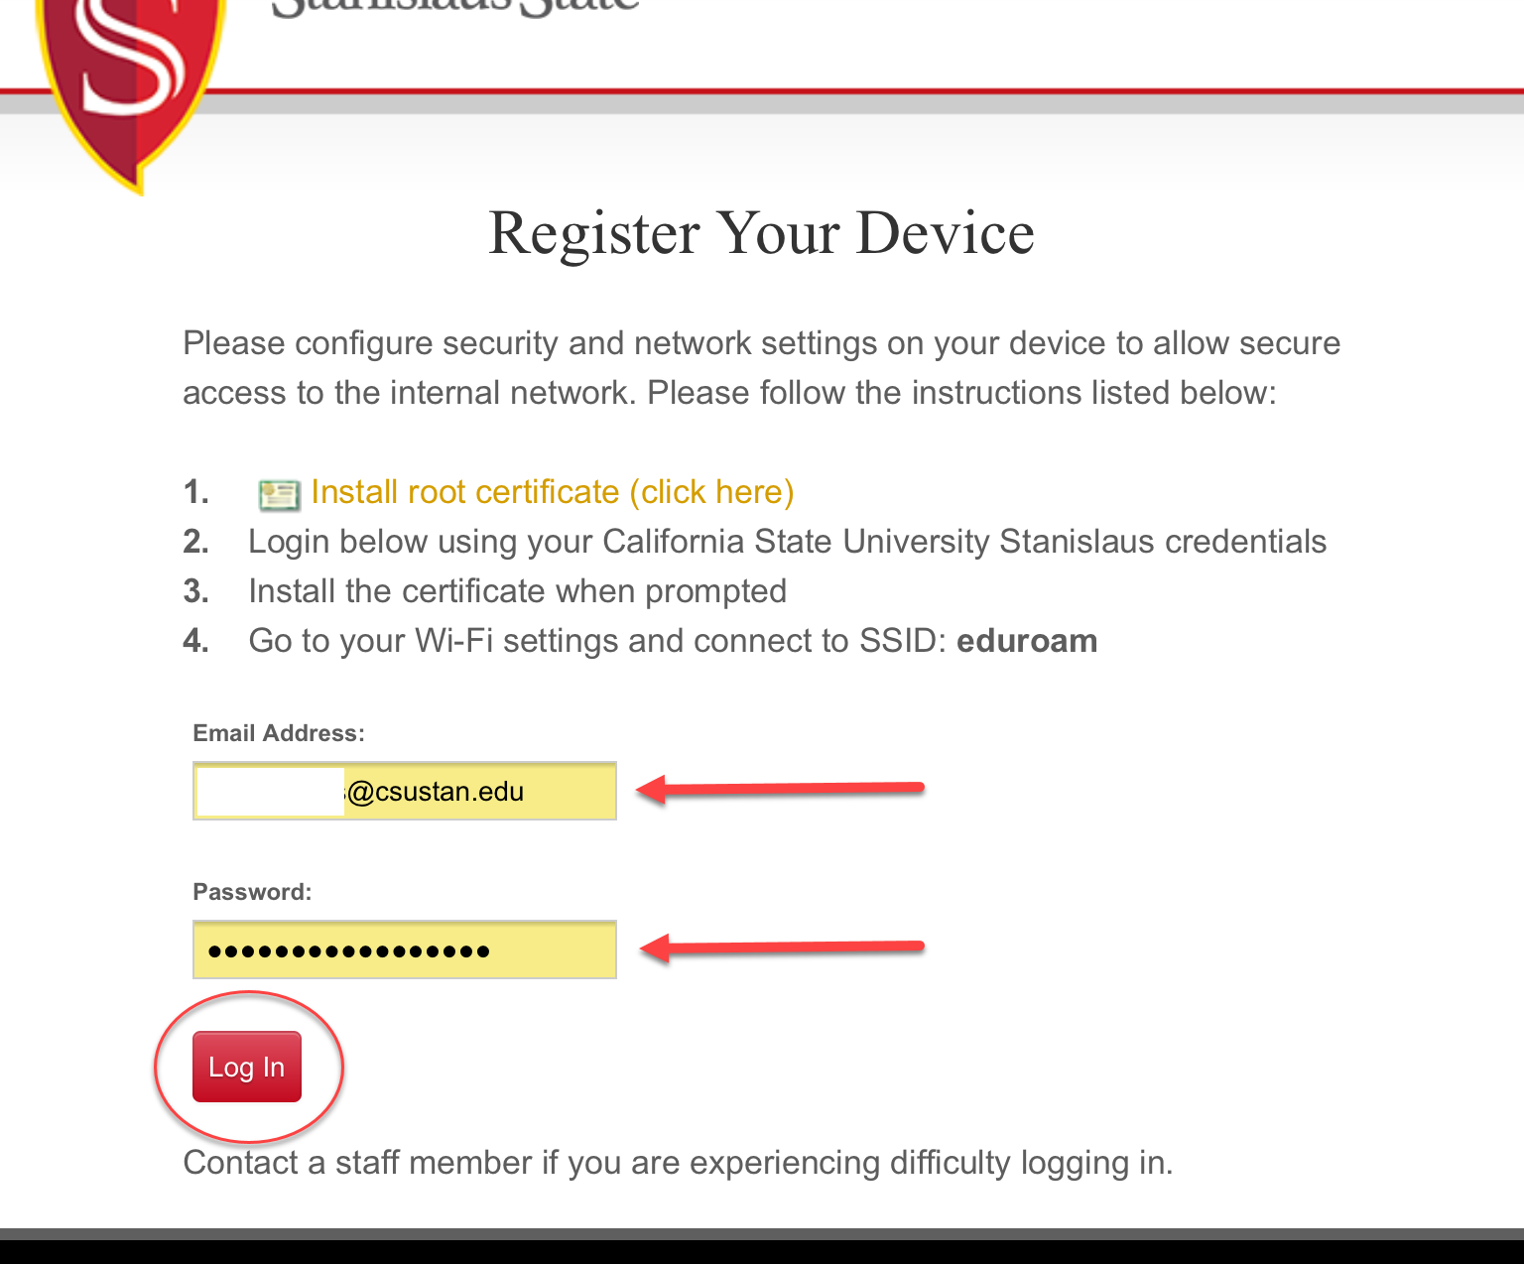
iOS Network Access Configuration
Enter your full university email and password.
Tap Log In to continue.

Slide 8
iOS Network Access Configuration
Tap Install Certificates to install a second set of certificates.

Slide 9
iOS Network Access Configuration
A certificate window will pop up. Tap Install to continue
Enter your device pin.
Tap Install to complete install.

Slide 10
iOS Network Access Configuration
Tap Install Profile.

Slide 11
iOS Network Access Configuration
An enrollment window will pop up. Tap Install to continue
Enter your device pin.
Tap Install to complete install.

Slide 12
iOS Network Access Configuration
Tap the Done button when it appears.
Device Provisioning is now complete. You may close your browser.

Slide 13
iOS Network Access Configuration
Go back to the Settings icon, tap Wi-Fi, and select eduroam.
If you received any errors during the process, please contact the Technology Support Desk at 209-667-3687 or TechSupport@csustan.edu

