Slide 1
Accessible Technology Initiative
Staff Training Series

Slide 2
Who Am I?
Tawn Gillihan
Accessible Technology Coordinator
Responsibilities
Coordinate ATI activities and increase awareness of accessibility and Universal Design across campus
Submit annual reports to the Chancellor’s Office on ATI activities
Member of the ATI Steering Committee and Chair of the Ad Hoc Communication and Awareness Subcommittee
Resource for the campus in promoting accessibility

Slide 3
ADA Laws & ATI Policies
The Americans with Disabilities Act of 1990 (ADA)
Section 508 of the 1973 Rehabilitation Act
CSU Executive Order 926
CSU Coded Memo AA-2013-03
CSU Coded Memo AA-2014-08
ADA
Section 508
EO 926
Coded Memo AA-2013-03
Coded Memo AA-2014-08

Slide 4
Recent Legal Action
University of Montana OCR Complaint
UC Berkeley Alternate Media Settlement
Louisiana Tech University
University of Maryland
Florida State University

Slide 5

Types of Disabilities
Mobility Impairments
Visual Impairments / Blindness
Hearing Impairments / Deafness
Apparent
6%
Learning Disabilities
Attention Deficit Disorder (ADD/ADHD)
Autism Spectrum Disorder
Traumatic Brain Injury (TBI)
Post Traumatic Stress Disorder (PTSD)
Mental Illness
Chronic Pain/Chronic Illness
Non-apparent
10%+

Slide 6
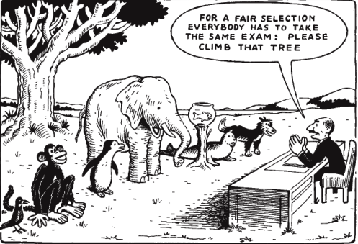
Separate but Equal is an Issue of Social Justice
The failure to address issues of accessibility for persons with physical, sensory, and cognitive disabilities ultimately threatens to segregate people with disabilities as the permanent second–class citizens of the information age.

Slide 7
So What is Assistive Technology?
Assistive Technology is a bridge between electronic information and users.
Any kind of software or hardware that provides alternate ways of accessing electronic information.
Text-to-Speech,
Voice Recognition
Literacy Support Software
Screen Reader Software
Kurzweil
JAWS
Can technology interact with the electronic content? Not Automatically!
Content must be designed to interact well with technology.

Slide 8
What is the Accessible Technology Initiative (ATI)?
Our use of technology must provide comparable functionality, affordability, timeliness, and must be delivered in as seamless a manner as possible.
Web Accessibility
Procurement (E&IT)
Instructional Materials
Communication & Awareness

Slide 9
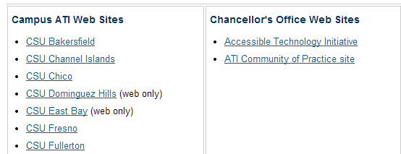
Tools for Programmers
Teaching Commons at CSU
CUDA – Center for Usability in Design and Accessibility
Usability – What is It?
Walkthrough and Heuristics Evaluations
CSU ATI Websites

Slide 10
Tools for Programmers
Online Tools
NEW – CaptionSync Smart Player
HiSoftware Compliance Sheriff Tool
HiSoftware Deputy – Coming Soon
Web Accessibility Initiative – W3C
Deque Systems
SSB Bart Group
T-Base Communications
HP Section 508 Information

Slide 11
Procurement of E&IT
E&IT refers to Electronic and Instructional Technology products
Must meet Section 508 accessibility standards
Vendor must provide a VPAT (Voluntary Product Accessibility Template)
Document any exemptions
Provide an equally effective alternative

Slide 12
Instructional Materials
List the course’s media/technology tools requirements early
Post an accessible syllabus and course materials
Include ALT tags on ALL visual elements
Caption or provide a transcript for all audio or video files (try Camtasia)
Create accessible Word/Excel/PowerPoint documents

Slide 13
Web Accessibility (Including Digital Content)
All images have alt text
Color isn’t the only indicator of meaning
Text has sufficient contrast
Use simple tables for data, not for layout, and include headers
No flashing or scrolling elements on the page
Keyboard commands are functional
Tab order is logical
Use of STYLES for headings, paragraphs, lists, emphasis, etc.
Descriptive labels for hyperlinks

Slide 14
Digital Content
Word Documents
Forms
PowerPoint Presentations
PDFs
Videos
Podcasts

Slide 15
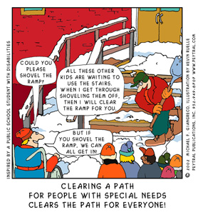
Communication & Awareness
Student: Could you please shovel the ramp?
Adult: All these kids are waiting to use the stairs. When I’m done with the stairs, I’ll clear the ramp for you.
Student: But if you shovel the ramp first, we can all get in.

Slide 16
Achieving Accessibility via Universal Design for Learning
The concept of “Universal Design for Learning” advocates that developing course materials that are universally accessible are enrichments that can benefit all learners.
Works for the widest pool of users
Easier to design it well the first time than to go back and fix it
People with disabilities don’t have to wait or ask for special help
Benefits everyone, even people without a disability

Slide 17
Examples of Inaccessible Design
Color Blindness
Color Contrast/Font Size
Category 1
Category 2
Category 3

Slide 18
Examples of Accessible Design
Color Blindness
Color Contrast
Category 1
Category 2
Category 3

Slide 19
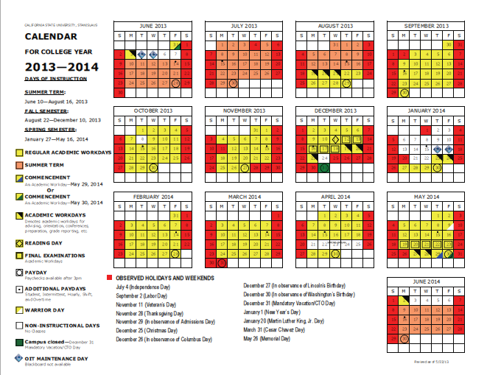
Inaccessible Digital Content

Slide 20
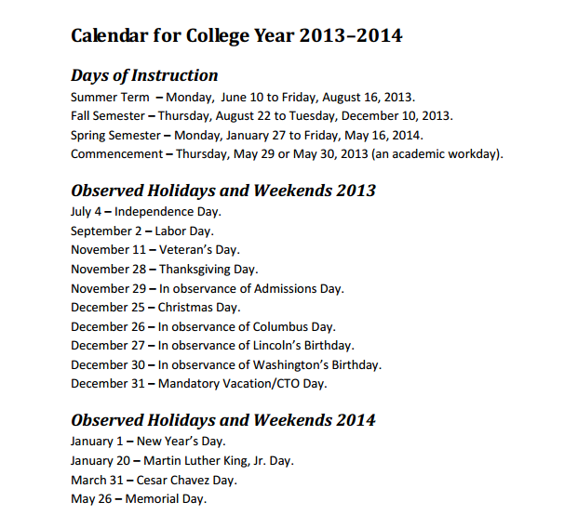
Equally Effective Digital Content
Accessible for a screen reader software application, OCR, and assistive hardware technologies

Slide 21
Summary
Plan for a diverse group of users with special needs to include as many users as possible
Purchase accessible E&IT
Design accessible web pages and digital content
Use principles of Universal Design for Learning for course and training materials
Test for accessibility

Slide 22
For More Information & Assistance
Visit the new ATI website at http://www.csustan.edu/ati
Contact the ATI Coordinator
Tawn Gillihan
Email: tgillihan@csustan.edu
Phone: (209) 667-3470
Office: L151G

