Slide 1

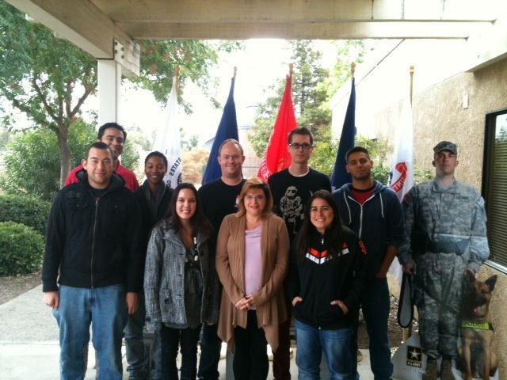
California State University, Stanislaus
Veterans Affairs Office
One University Circle
Mary Stuart Rogers Building Room 120
(209) 667-3081

Slide 2
California State University, Stanislaus
Veterans Affairs Office
Welcome,
It is our pleasure to welcome you to the campus of California State University, Stanislaus. Here at CSUS you can pursue your goal of completing your education and moving toward a successful career!
We at the Veterans Affairs Office understand that obtaining your educational goal will require hard work, and we already appreciate your ability to overcome many challenges. With that being said, we are here to assist you with all your veteran needs. Whether you want to ensure your benefits are moving along smoothly, drop a class, add a class, or are unsure about what classes to register for, the VA office can definitely assist you with these types of questions and much more. The members of the VA office are very professional and personable, some of which are veterans themselves and can truly understand and relate with you. We look forward to getting to know you on a personal basis and ensuring the benefits you receive are suitable for you.
The Veterans Affairs office is located inside the Mary Stuart Rogers building (MSR) 120, Enrollment Services office. We are open Monday through Friday, our summer hours are 7:30 a.m. - 4:00 p.m. and our fall and spring hours are from 8:00 a.m. – 5:00 p.m.. Please feel free to stop by the office for any questions you may have or if you would just like to say, “Hello!” Once again, we look forward to meeting you!

Slide 3
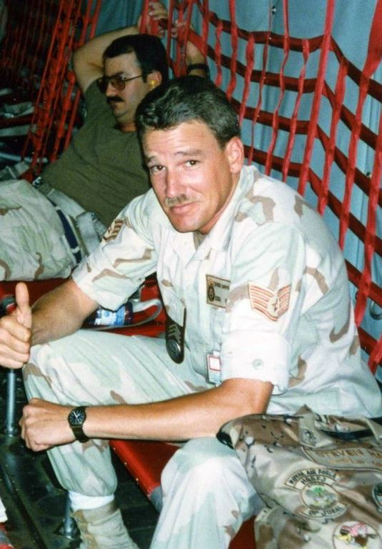
California State University, Stanislaus
Veterans Affairs Office
The following slides will cover:
Veteran Affairs Chapters
How to Apply for Educational Benefits
Educational Plans
Program Approval & Satisfactory Progress
Verification (Certification) for Educational Benefits
Military Withdrawal
Financial Aid & Types of Financial Aid
Veteran Dependent Fee Waiver
VA Work Study at CSU Stanislaus
Student Veterans Center
CSU Stanislaus Veterans Club
Warriors4Warriors Peer Mentoring Program
How to Register for Classes
Steve Harmer - Air Force
Public Administration Major
CSU Stanislaus Employee

Slide 4
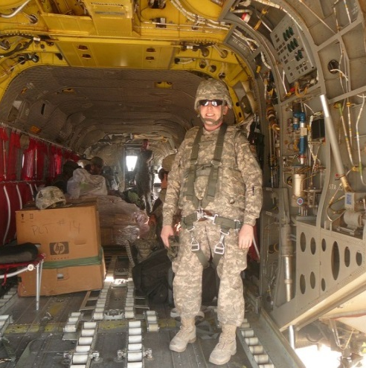
California State University, Stanislaus
Veterans Affairs Office
Chapters
Chapter 30 – Montgomery GI Bill (MGIB)
Chapter 31 – Vocational Rehabilitation
Chapter 33 – Post 9/11 GI Bill
Chapter 35 – Survivors & Dependents Educational Assistance Program
Chapter 1606 – Montgomery GI Bill – Select Reserve Educational Assistance Program
Chapter 1607 – Montgomery GI Bill – Reserve & Guard members called to active duty/deployment
Mary Signorelli – U.S. Army Veteran
Criminal Justice Major
CSU Stanislaus

Slide 5
California State University, Stanislaus
Veterans Affairs Office
How to Apply for VA Benefits
Apply to CSU Stanislaus through CSU Mentor:
http://www.csumentor.edu/
2. Contact the CSU Stanislaus Veterans Affairs Office in person or by phone. Bring a copy of your DD214, military transcripts, other college transcripts.
Military transcripts website: jst@doded.mil
Mail transcripts to: CSU Stanislaus
Attn: Admission Office
One University Circle
Turlock, CA 95382
3. If you are currently not using your VA Educational Benefits, apply online at the U.S. Department of Veterans Affairs VONAPP at www.gibill.va.gov. If you are transferring your VA Educational Benefits, you will need to fill out a VA-Form 22-1995 which you can get from CSU Stanislaus Veteran Affairs Office or website http://www.csustan.edu/VeteransAffairs/

Slide 6
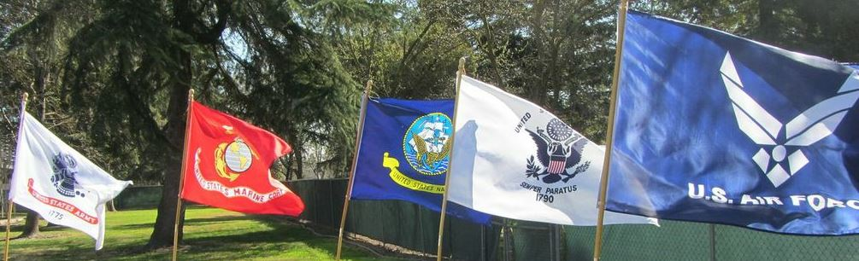
California State University, Stanislaus
Veterans Affairs Office
VA Educational Plans
All Veterans and Dependents who are using VA Educational Benefits are required to have a Veterans Major Requirement Form (Ed Plan) on file with the CSU Stanislaus Veteran Affairs Office by the end of their first semester.
The VA Ed Plan must include all required Major, Minor and/or Concentration courses needed to obtain your degree. No General Education courses are to be listed on the form.
You will be certified for your VA Educational Benefits based off of your VA Ed Plan and General Education requirements. If you take a class that is not listed, you will be contacted by our office.

Slide 7

California State University, Stanislaus
Veterans Affairs Office
Program Approvals, Satisfactory Progress & Academic Probation
Program Approvals: All Baccalaureate and Graduate degrees offered at CSU Stanislaus that are listed in the University Catalog have been approved by the Department of Veterans Affairs.
Satisfactory Progress: A student receiving VA Educational Benefits is required to make progress toward their stated educational goal. For continued VA Educational Benefits, progress is considered maintaining a 2.0 or higher cumulative grade point average.
Academic Probation: A student who is on Academic Probation or Academically Disqualified will be reported to the Department of Veterans Affairs. Students will be advised to seek counseling services to help resolve academic issues and to establish a plan for successful completion of degree.

Slide 8
California State University, Stanislaus
Veterans Affairs Office
Verification for Educational Benefits
Each semester students must submit a Yellow Enrollment Card if they are planning on using their VA Educational Benefits for the upcoming semester. If you do not submit your Yellow Enrollment Card, no benefits will be paid to you for the semester.
Once your Yellow Enrollment Card is turned into the CSU Stanislaus Veteran Affairs the certification process can take up to 4 to 8 weeks for the VA Regional Office to process our certification. You will be notified by the CSU Stanislaus Veteran Affairs Office once your certification has been submitted to the VA Regional Office. You will receive a copy your class schedule showing which classes were approved.
If you made a change or added a Major, Concentration or Minor you will need to fill out a Change of Degree form and a revised Ed Plan before the semester is over.

Slide 9
California State University, Stanislaus
Veterans Affairs Office
Military Activation Notification & Return
A Student who is called for active duty may receive a Military Leave of Absence and a Military Withdrawal at any time during the semester. Military Leave of Absence and Withdrawal will not be factored into progress probation and will be dated before the semester starts for fees to be reversed.
Military Leave of Absence form is required which must include a copy of military orders. This form will hold your catalog year and notify of your Major of your military orders. Your MyCSUSTAN account will be placed on hold until you return back to campus.
To withdraw from classes, the student must submit a copy of military orders along with a CSU Stanislaus Withdrawal form with each class listed. Return the signed Withdrawal form to the Veteran Affairs Office in MSR 120 for processing.
When returning back to CSU Stanislaus, notify the CSU Stanislaus Veteran Affairs Office and we will activate your MyCSUSTAN account.

Slide 10
California State University, Stanislaus
Veterans Affairs Office
Financial Aid
All students are encouraged to file a Free Application for Federal Student Aid (FAFSA) by March 2nd of each year regardless if you are using veteran educational benefits. There is no charge and the website is: http://www.fafsa.ed.gov/
  All financial aid is based on your Expected Family Contribution (EFC) which determines your financial need. Your previous year’s income in used in the calculation.
You do not have to choose all your financial aid. For example: you can choose all grants or scholarships and deny your loans. Any questions about your financial aid we recommend speaking to the Financial Aid Office before making your decision. For more information go to http://www.csustan.edu/FinancialAid/ or contact Tammy Worthington at (209) 667-6585.

Slide 11

California State University, Stanislaus
Veterans Affairs Office
Types of Federal Financial Aid
Scholarships – Scholarship funds are provided and administered by a variety of sources both on-campus and off-campus. Money awarded does not have to be paid back.
Grants – Pell Grant, Cal Grants, State University Grant, Supplemental Educational Opportunity Grant, Educational Opportunity Program Grant, is money awarded that does not have to be paid back.
Federal Work Study – program in which students can get campus jobs while attending school.
Loans – Federal Direct and Federal Perkins Loans, money that is borrowed and to be repaid.
For more information about the types of Financial Aid available visit their website at:
http://www.csustan.edu/FinancialAid/financialaidprograms.html

Slide 12
California State University, Stanislaus
Veterans Affairs Office
Veteran Dependent Fee Waiver
The California College Fee Waiver (Cal Vet) program benefits the spouse and children of Veterans who are California State Residents. Students meeting the eligibility criteria may get their CSU Stanislaus tuition waived for Fall and Spring semesters. CSU Stanislaus fees are the responsibility of the student as they are specific to CSU Stanislaus.
To be eligible, students must:
  Have a parent who is a disabled veteran or have a spouse or domestic partner who is service-connected deceased or rated 100% service connected disability.
  Be a child earning less than $11,945 per year (Academic Year 2013/2014). This based on student’s income only, not the parents.
  Attend a California Community College, California State University, or a University of California school.
  Provide proof of the student’s relationship to the veteran such as a copy of a birth, marriage or domestic partnership certificate.
  Turn in your California College Fee Waiver to your local County Veteran Affairs Office for processing.

Slide 13
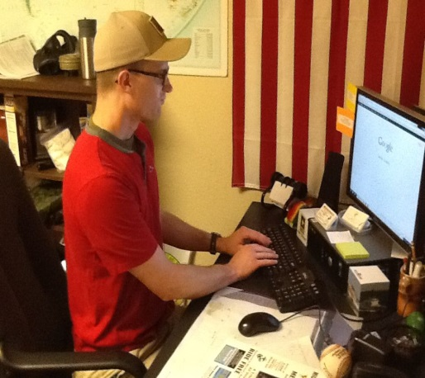
California State University, Stanislaus
Veterans Affairs Office
Veteran Affairs Work-Study Program
In order for students to use VA Work-Study, they must be receiving GI Benefits and go through a hiring process.
You must be enrolled in ¾ time (9 units) or full time (12 units) and maintain a GPA of 2.0 for both the semester and cumulative.
Students earn minimum wage of $8.00 (tax-free) per hour.
Students are limited to a maximum of 25 hours per week and may never work over 8 hours per day during Fall, Spring and Summer semester.
Matt Tieman- U.S. Marine
Criminal Justice Major
CSU Stanislaus

Slide 14
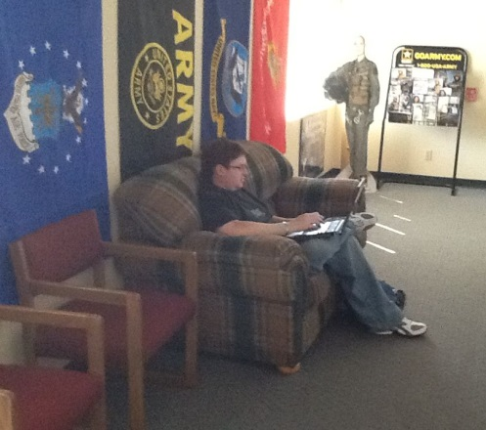
California State University, Stanislaus
Student Veteran Center
All Veteran Students are invited to check out the California State University, Stanislaus Veteran's Center. It provides a point of contact for CSU Stanislaus' veterans and their dependents, bringing together academic and student support services to promote a smooth transition from the military, provide assistance for veterans benefits, deployments, information, and referrals, as well as a place where veterans can gather for study groups and social activities.
We are located in the Student Services Building (Building 116) in Room 115. The hours of operation are Monday to Friday 9:00 a.m. to 5:00 p.m.
The following are provided at our location: Refrigerator; Microwave; Computer (with CAC Card reader); Telephone; TV; Gaming Systems; Board Games; Study area.
We are on Facebook! Feel free to look us up under FOB Stanislaus. If you have any questions, please e-mail: fobstanislaus@gmail.com.
You may also contact Nadine Kent (Veteran Affairs Coordinator) in the
Veterans Affairs office at (209) 667-3081 or stop by MSR 120 or
Michael Igoe (Veterans Advisor) at (209) 667-3304.
Gene Collins – U.S. Army
Biology Major
CSU Stanislaus

Slide 15

California State University, Stanislaus
Veterans Club
Created for Student Veterans by Student Veterans
All Veteran Students are invited to join the California State University, Stanislaus Veterans Club. Come to our meetings to see what it’s all about, hang out and meet fellow Veterans.
This is YOUR Club, come and learn how to maximize your education benefits and ensure you are aware of all the resources available to you; develop social and professional relationships/networks, continue your desire for service through Veteran support systems, while also establishing a positive presence in the local community.
If you have any questions, please e-mail the CSU Stanislaus Veterans Club at VCofCSUS@gmail.com. You may also contact Michael Igoe (Veteran Advisor) at (209) 667-3304 or Nadine Kent in the Veterans Affairs office at (209) 667-3081 or stop by MSR 120.

Slide 16

California State University, Stanislaus
Warriors 4 Warriors Peer Mentoring
Starting Fall 2013 Semester:
Warriors 4 Warriors (W4W) is a peer mentoring program for veterans who attend California State University, Stanislaus. The purpose of the W4W program is to match a current student-veteran with incoming freshman and transferring student-veterans, in an effort to support their readjustment to civilian and student life. Transition to the campus community can be eased by receiving support and resources from our group of trained student-veteran mentors. W4W aims to assist student-veterans with navigating the academic environment through friendship, camaraderie, and shared experiences to increase their success and engagement within the university.
Our goal is to increase student involvement and interaction, providing student-veterans with additional encouragement and support. by bridging the gap between their institutional services and support systems. We also intend to foster a sense of community among the student-veterans through participation in campus and community activities.

Slide 17
California State University, Stanislaus
Veteran Affairs Office
Registration Process
Step 1
Registration Notices are emailed to your University email account if you are eligible for Priority Registration. The notice will indicate your priority registration appointment start time, which is the very first appointment for Veterans and the earliest time you may access your myCSUSTAN account for registration purposes. The notice also includes any Service Indicators (or holds) that must be cleared before you will be allowed to register for any classes.
New Undergraduate Students will NOT receive a Registration Notice and must register for and attend a New Student Orientation to register for classes.
Priority Registration You are eligible for Priority Registration if 1) once you have completed one full semester, 2) you were admitted as a returning student by the Admission deadline date (October 1st for Winter/Spring or April 1st for Summer/Fall), or 3) you are a continuing student (enrolled in classes within the preceding 12 months) and have not been academically or administratively disqualified, and have not applied for graduation for a prior term.
Eligible students who do not receive an Appointment Notice three days before the beginning of Priority Registration should call the Registration Help Line at 209/667-3039.
For any questions please contact the CSU Stanislaus Veteran Affairs Office
(209) 667-3081

Slide 18
California State University, Stanislaus
Veteran Affairs Office
Selecting Courses
Step 2
Select Courses: If Advising Required is noted on your Appointment Notice, you are required to meet with your major advisor to select courses. Once you have been advised, your major department will release your advising hold and you will be enabled to register beginning at your scheduled time.
New Undergraduate Students: You must attend a New Student Orientation, during which you will receive advising, before you register. For dates, see the New Student Orientation section. Reminder: Any other Service Indicators on your Appointment Notice must be cleared or you will not be allowed to register.
Permission Numbers or a Registration Options Form are to be used to add courses under the following circumstances. Check the "Registration Activity Dates" section for all pertinent registration periods.
You must use a Registration Options form to: Change your grading option after Census Date; Register for a course as an Audit (requires instructor's signature); Add more than the allowable units (Excess Units) for that term (requires department chair's signature); Register for courses that have a Time Conflict (requires instructors' signature).
You must use a Permission Number to: Add a full class and/or a class for which you are waitlisted; Add a course which is restricted; Add a course without also adding its co-requisite course(s).
Individual Study, Cooperative Education, Thesis, Project, Internship, and Fieldwork: These courses are not specifically listed, but they are offered by most departments every semester. Students must obtain special forms from their departments, Enrollment Services, or at www.csustan.edu/enrollmentservices/forms.html to register for these courses. Completed forms, including required signatures, must be submitted to Enrollment Services no later than census date.

Slide 19
California State University, Stanislaus
Veteran Affairs Office
Final Registration Steps
Step 3
Your Time to Register: You may register on the Web at your appointment time or anytime thereafter during any scheduled Web registration period for that term. Students may not register prior to their appointment. Registering at your appointment time via the Web will give you priority in course selection for available courses. Check the "Registration Activity Dates" section for all pertinent registration periods.
For instructions on registering online click on the YouTube link below and the Enrollment Services link:
http://www.youtube.com/watch?v=xZX0fkhR9nU&feature=youtu.be http://www.csustan.edu/enrollmentservices/registration/index.html
STEP 4
Verify Your Classes: After you have registered, you may verify your complete course schedule, including Waitlisted courses, via the Web by selecting the "My Class Schedule" option from your myCSUSTAN account to see your complete course schedule.
STEP 5
Payment of fees: As a Veteran you are protected from disenrollment of non-payment while waiting for your VA Educational Benefits to pay. If you need to set up a payment plan, please contact Nadine Kent in the Veterans Affairs Office to discuss payment arrangements.
For Post 9/11 Students Only: Your tuition and fess will be submitted to the Department of Veterans Affairs once Financial Aid has paid out. If your financial aid paid your tuition and fees, you will be refunded as soon as the Department of Veterans Affairs pays CSU Stanislaus.

Slide 20
California State University, Stanislaus
Veteran Affairs Office
In closing, Did you know . . .
When you apply to CSU Stanislaus, the $55.00 application fee is waived for Veterans
Your DD214 counts towards G.E. Area E2
Your military training listed on your DD214 and SMART Transcripts (www.jst.doded.mil) are evaluated for transferable credit.
You qualify for the first day of Priority Registration after your first full semester
No waiting in line in Enrollment Services, just come up to the Veterans Affairs desk for assistance
The Enrollment Verification fee is waived
The CSU Stanislaus Veterans Affairs website and Facebook is updated on a regular basis with current events and news updates regarding YOUR Veteran Benefits. Webpage www.csustan.edu/veteransaffairs , Facebook page: CSU Stanislaus Veteran Affairs Office
Michael Igoe is your Veterans Advisor who is here to help you with your General Education Advising. He is located in the Academic Advising office in MSR 180 and can be reached at 667-3304 or MIgoe@csustan.edu.
Tammy Worthington is your Financial Aid Advisor who is here to help you with any questions regarding your CSU Stanislaus financial aid needs She is located in the Financial Aid off ice MSR100 and can be reached at (209) 664-6585 or tworthington@csustan.edu.
Check out our CSU Stanislaus Veterans Club. You can find us on Facebook at CSU Stanislaus Veterans Club or e-mail VCofCSUS@gmail.com. All are invited to our monthly meetings. Notices will be sent out via your csustan e-mail and posted around campus.
We are here to assist you in your educational needs. For any questions please contact the CSU Stanislaus Veteran Affairs Office (209) 667-3081.

