Slide 1
The Villainization of Undocumented Latinx Immigrants Isaura Patiño
Mentor: Dr. Erin Hughes

Slide 2
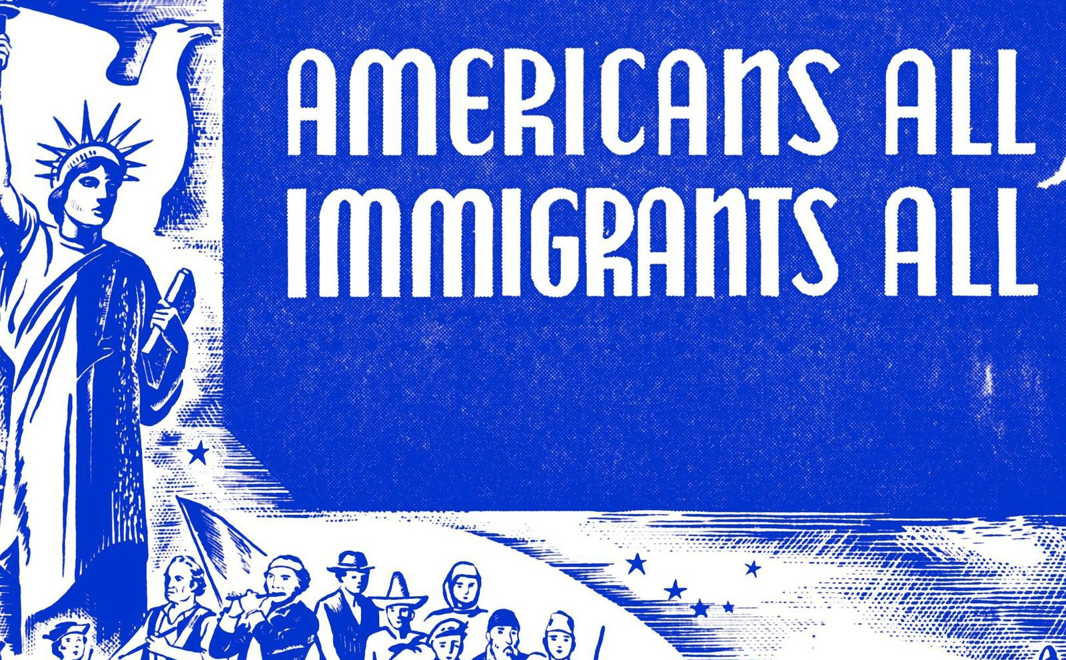
Premise
System Justification Theory (Jost, 1994)
Strenuous Socio-Politcal Conditions
Intentional Obstacles Set in Place
Graphic: WYNC, Americans All Immigrants All
Source: John T. Jost, PhD, A Theory of System Justification, American Psychological Association, 1994

Slide 3
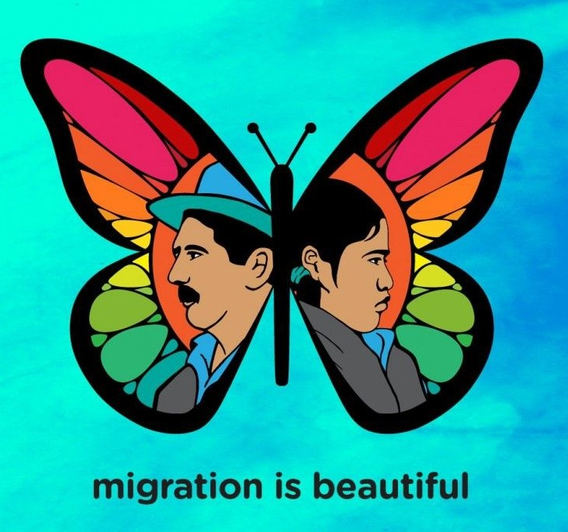
Background
Hypothesis:
I expect to conclude that undocumented Latinx immigrants are more likely to endure a more difficult life in the United States due to the lack of political clout and legislative protection.
Graphic: Ray Hernandez, Migration is Beautiful

Slide 4
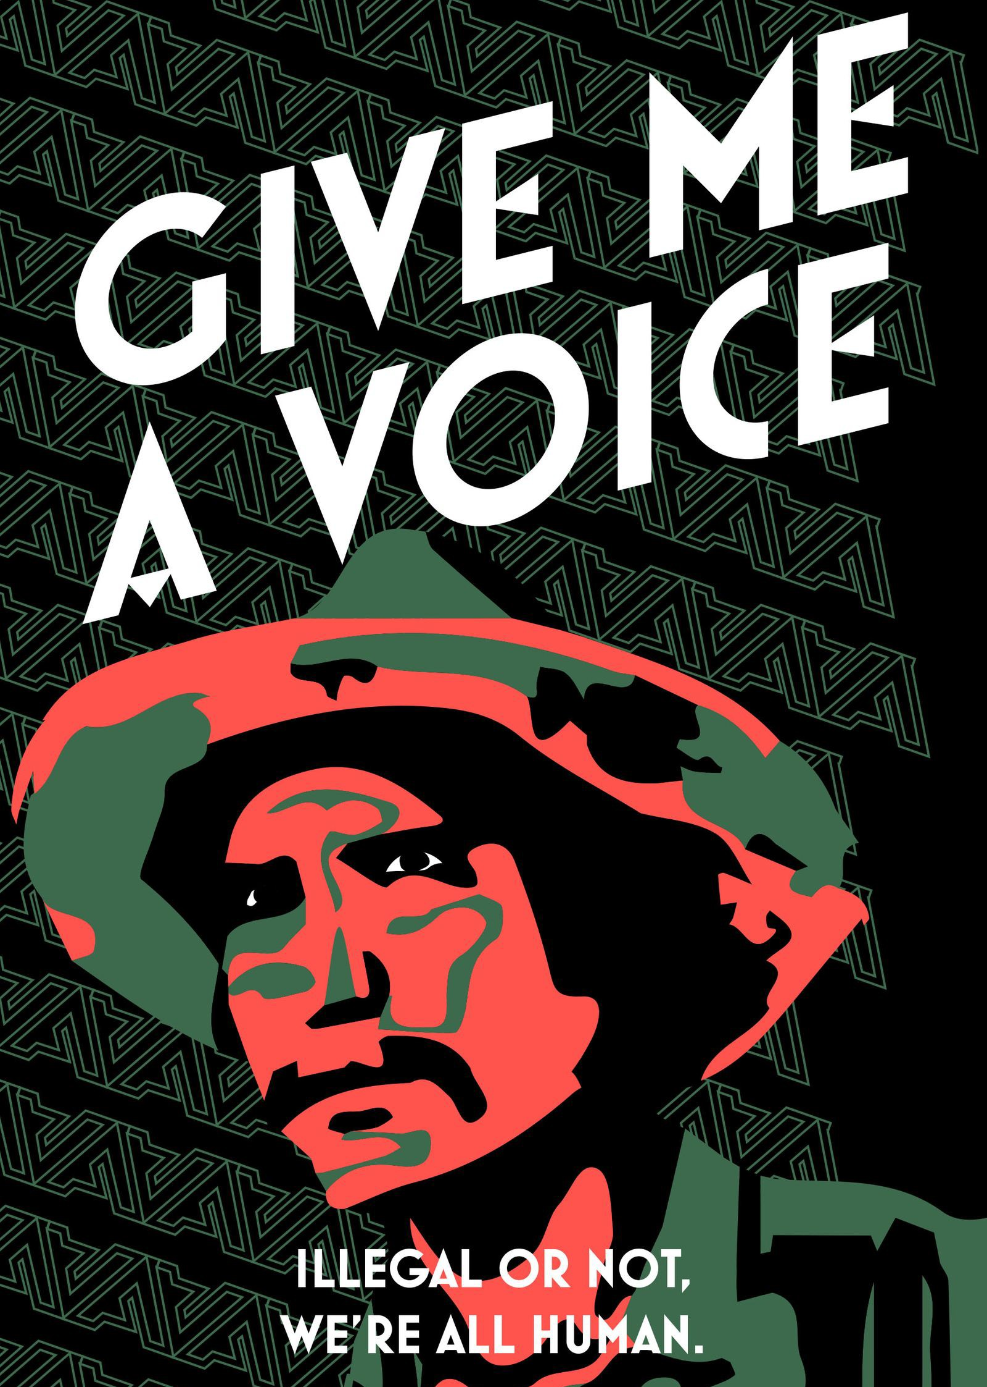
Methods
(4) In-Depth Interviews
Priority Questions
Core Questions
Back-up Questions
Confidential (Consent Forms) Open-Ended Phenomenology
Graphic: Paul Miele-Herndon, Immigration
Awareness Poster

Slide 5
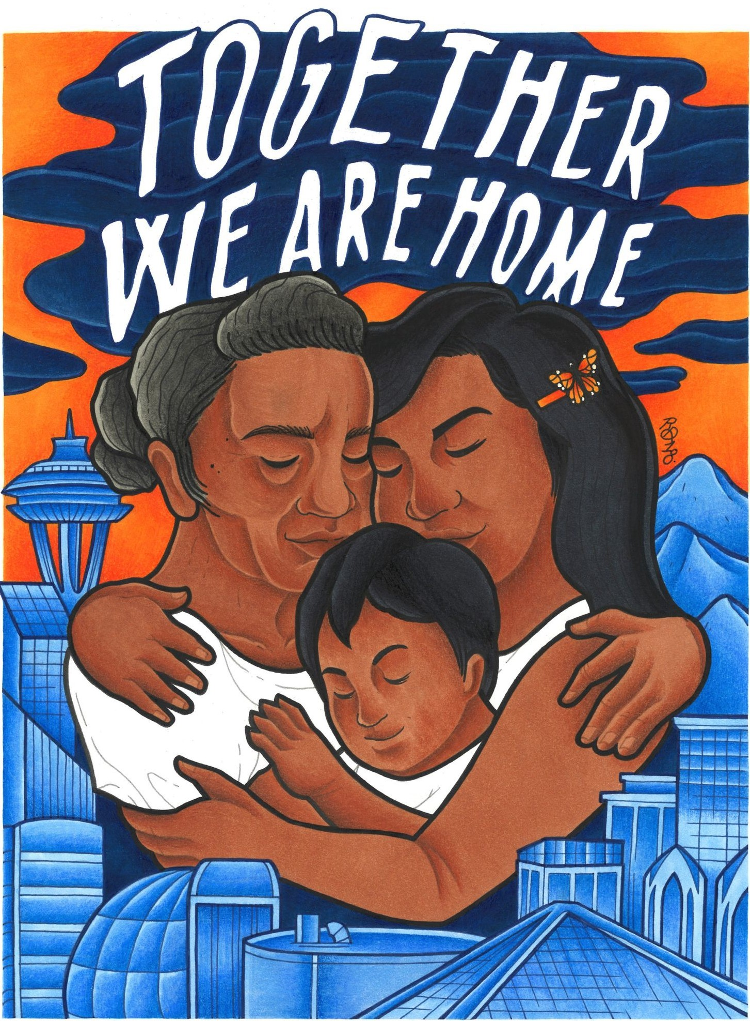
Example Questions:
Priority (5): What are some barriers you believe exist for the undocumented Latinx community?
Core (20): Have you or any of your relatives ever been held in detention camps/ been deported? Explain your experience.
Back-Up (5): What is something you wish you could tell those against immigration reform?
Graphic: Raychelle Duazo, Together We Are Home

Slide 6
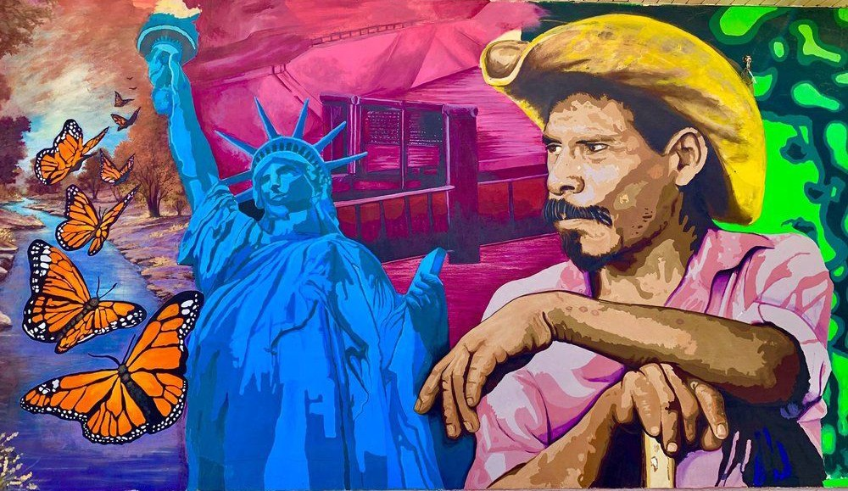
Results...
Graphic: Jesus "Cimi" Alvarado, A Tribute to Our Border Community

Slide 7
Participant I
38, Female, Mexican, High School Diploma, Middle Class, Undocumented, Bilingual
"My family had their cars taken at various times, on three different occasions for not having a license. Once as newlyweds, my husband and I were driving with all the new stuff we had just bought for our very first apartment together when we were pulled over. I was pregnant at the time and they took everything as they left us on the side of the road to watch."
"I am not able to get a good job because of my current status. I’ve gone to interviews where I’ve been immediately denied the position. It’s always so embarrassing. I'm almost forty years old and I’m only able to make $18 an hour, even though I offer bilingual services at this location."
"Undocumented people are not inherently bad, we are not criminals. We work, we pay taxes, and we have families, just like everybody else. Also, Latinos are not drug dealers or rapists. We come to this country in search of a better life, that is our only crime. We are good people with principles and ethics, we are good citizens, even though we are undocumented."

Slide 8
Participant A
36, Female, Mexican, Juris Doctorate Degree, Middle Class, U.S. Citizen, Bilingual
"Undocumented immigrants don’t qualify for full-scale medical coverage, they can only get emergency services, and that’s only if they’ve been a resident of the state for a certain period of time. They don’t qualify for welfare, any cash-aid programs, or Section 8 housing programs.
"Immigration law has never been logical and has a lot of bad rules, which most Americans don’t actually know. For example, you can be penalized for stuff that happened when you were a little kid. The reality is, most people would prefer to stay in their home countries, granted they are provided with a basic quality of life. However, when people experience a certain level of poverty, it creates more motivation to better their circumstances."
"There is a prominent fear surrounding “living in the shadows.” Your employability is impacted and there are a lot of people getting exploited by their jobs. This then makes undocumented people feel like they are not allowed to have basic human rights."

Slide 9
Participant F
63, Male, Mexican, Some High School Education, Low-Income, Undocumented, Bilingual
"Too many obstacles exist for us. Firstly, we don’t have social security, we don’t receive proper medical attention, we don’t receive fair wages, there is a prominent language barrier, and we aren’t granted enough educational opportunities. Immigrants come to this country to work hard and as a result, people tend to exploit us because they know we exist in the shadows of this country."
"Psychologically, I wasn't aware of how much of an impact living undocumented would have on my livelihood. You are definitely more susceptible to mental illness due to the fact that you’re far from loved ones and constantly fearing deportation."
"Immigration has been a great service to this country, something that they can't afford to lose, it’s like recruiting a workforce from around the world that is able-bodied and ready to commit. The United States contributes to the corruption in our homelands and then refuses to let us immigrate. However, the reality is that the United States will never be able to stop the influx of immigrants that come to this country in search of a better life."

Slide 10
Participant M
19, Male, Mexican, Some College Education, Lower-Middle Class, Undocumented, Bilingual
"Natural-born citizens do live an easier life because they often have generational wealth and a lot of knowledge about the country they’re from. You also automatically have better financial standing because you have a lot more support and opportunity."
"I am not accepted even though I have lived here all my life. Even when I apply to work and have the necessary qualifications, I am instantly rejected.This makes me feel like I can't do anything to better my situation, like I can’t aim higher or have my own goals. I constantly have to downgrade and settle for whatever else is available."
"When Trump said that other countries only bring their worst, that is definitely not true, it’s always the hardest working people that come here to persevere. You will never see someone from Latin America sitting on the sidewalk asking for money because we work for it. I think if people against immigration reform personally knew the immigrants that are constantly fighting to survive, their perspectives would change because they’d understand. We all just want better lives."

Slide 11
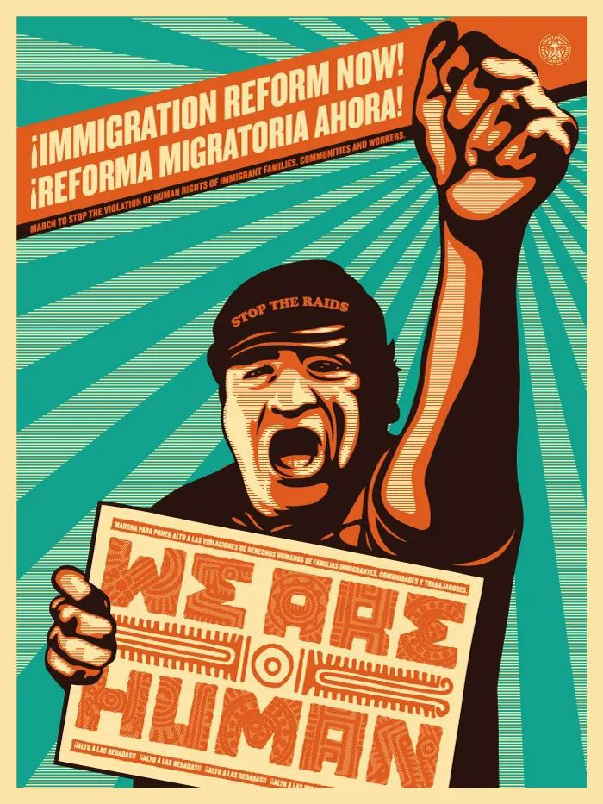
Conclusion
In conclusion, my results support my hypothesis because undocumented Latinx immigrants are indeed more likely to endure a more difficult life in the United States.
However, the underlying factors proved to be the lack of identity, opportunity, and benefits that exist for their documented counterparts, as demonstrated in the pulled conversational quotes.
Graphic: Shepard Fairey and Ernesto Yerena, Immigration Reform Now!

