Slide 1
Cooperating Teacher Training: Overview of Co-teaching and the Phase-in Schedule
(MSCP)
Completion time: 2 hours
Please refer to your copies of the Phase-In Schedule, 5D+ Framework, and 5D+ Rubric throughout this training.
Adapted from The Academy for Co-Teaching and Collaboration at St. Cloud State University

Slide 2
ROLES

Slide 3
The Cooperating Teacher
Help the teacher candidate feel comfortable and welcome
Review school policies and procedures
Encourage teacher candidate to get involved in school activities
Share materials and ideas
Assist the candidate in developing standards based lessons
Observe and provide constructive feedback
Know and implement the co-teaching strategies
Mentor and guide the teacher candidate
Model effective teaching strategies and professional behavior
Be flexible; allow the teacher candidate to try new ideas
Communicate expectations
Be understanding and patient
Maintain consistency and accountability
Copyright 2015, The Academy for Co-Teaching and Collaboration at St. Cloud State University and TWH Consulting,
Research Funded by a US Department of Education, Teacher Quality Enhancement Partnership Grant

Slide 4
The University Supervisor
Provide a systematic and consistent presence during the student teaching experience
Provide program information to the cooperating teacher and teacher candidate
Observe and provide feedback on a regular basis
Act as a confidant for both the cooperating teacher and teacher candidate
Be an advocate for the teacher candidate
Help the team build good communication and facilitate positive interactions
Set clear expectations; be honest about a student’s performance
Handle the difficult situations that might come up
Schedule three-way conferences at the beginning and end of the experience
Be knowledgeable in and supportive of the use of co-teaching strategies
Copyright 2015, The Academy for Co-Teaching and Collaboration at St. Cloud State University and TWH Consulting,
Research Funded by a US Department of Education, Teacher Quality Enhancement Partnership Grant

Slide 5
The Teacher Candidate
Come ready to learn; be enthusiastic and show initiative
Introduce yourself to team members and school personnel
Ask questions and discuss professional issues
Share ideas and work cooperatively; be flexible
Help with all classroom responsibilities…record keeping, grading, etc.
Know your content and be a continuous learner
Plan engaging, standards based lessons
Know and implement co-teaching strategies
Accept feedback and put suggestions for improvement into practice
Be proactive in initiating communication with your triad members
Demonstrate respectful behaviors
Be reflective about your practice
Be patient with yourself and your cooperating teacher
Be a sponge; learn all you can from everyone in the building
Copyright 2015, The Academy for Co-Teaching and Collaboration at St. Cloud State University and TWH Consulting,
Research Funded by a US Department of Education, Teacher Quality Enhancement Partnership Grant

Slide 6
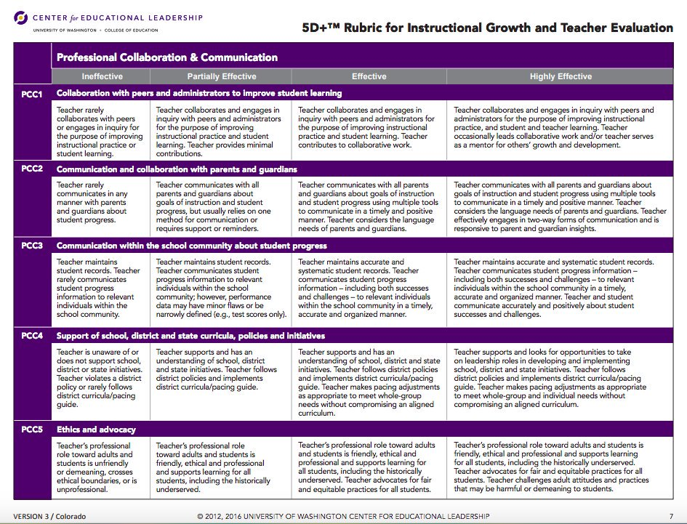
Co-Teaching Phase-in Schedule
Read over the Phase-in Schedule
TPAs
Forms
Roles
5D+ Focus for Instructional Growth
Co-teaching Strategies

Slide 7
Cal TPA
http://www.csustan.edu/teachered/teaching-performance-assessment
Student teachers must complete the Cal TPA this semester. Please see the link above to find out more.
Notes:
Explain TPAs

Slide 8
Phase-In Schedule: Weeks 1-2, 3-4
Old TPA Task 1: 1/27; Old TPA Task 2: 2/10
Triad Meeting/Meet and Greet- Introduction to MSCP and Student Teaching
Formal Observations #1, #2
5D+ Focus: Classroom Environment and Culture
Co-Teaching: One Teach/One Assist, One Teach/One Observe

Slide 9
Formal Observations
6 Formal observations are completed by the University Supervisor (US).
Student teacher (ST) sends US lesson plan 48 hours before the scheduled observation.
US provides feedback on the lesson, or asks questions.
ST responds back to US
US observes entire lesson taught by the ST. Cooperating teacher may remain in the classroom to observe at the same time and provide feedback, or use that time to work with a small group of students.
US and ST have a post-conference reflection of the lesson (20-30 min.) while the CT takes over the class.
CT should receive a copy of the formal observation from the US within 1-2 days.

Slide 10
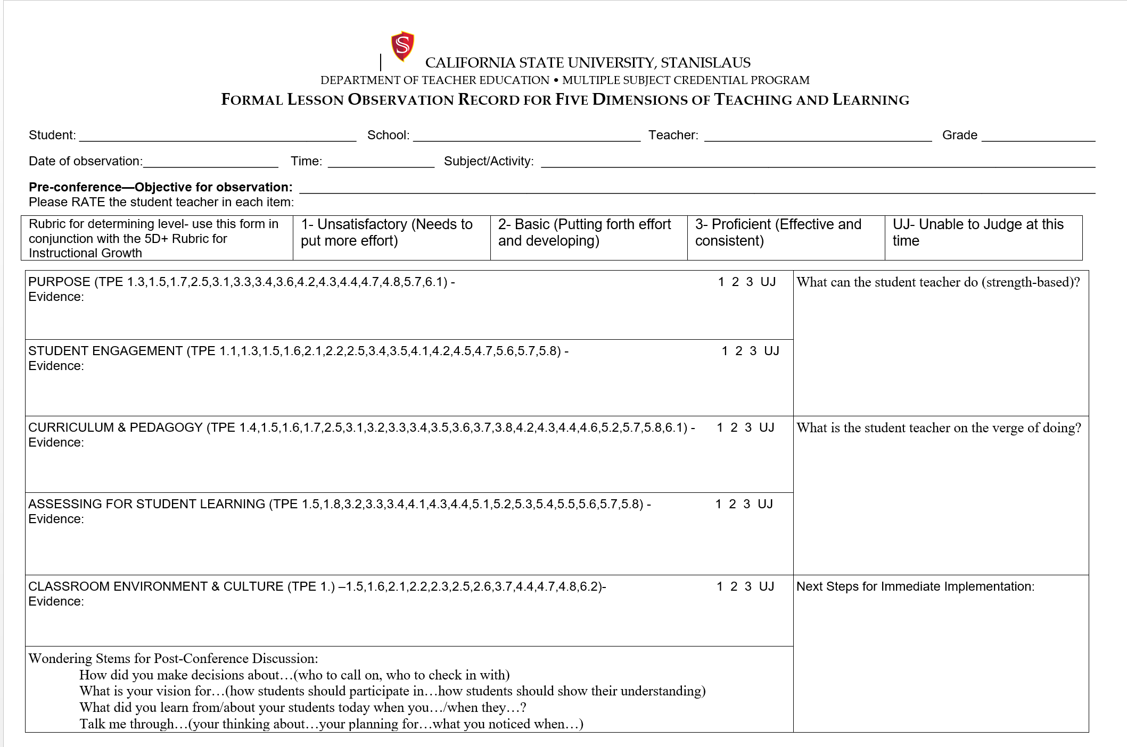
Formal Observation

Slide 11
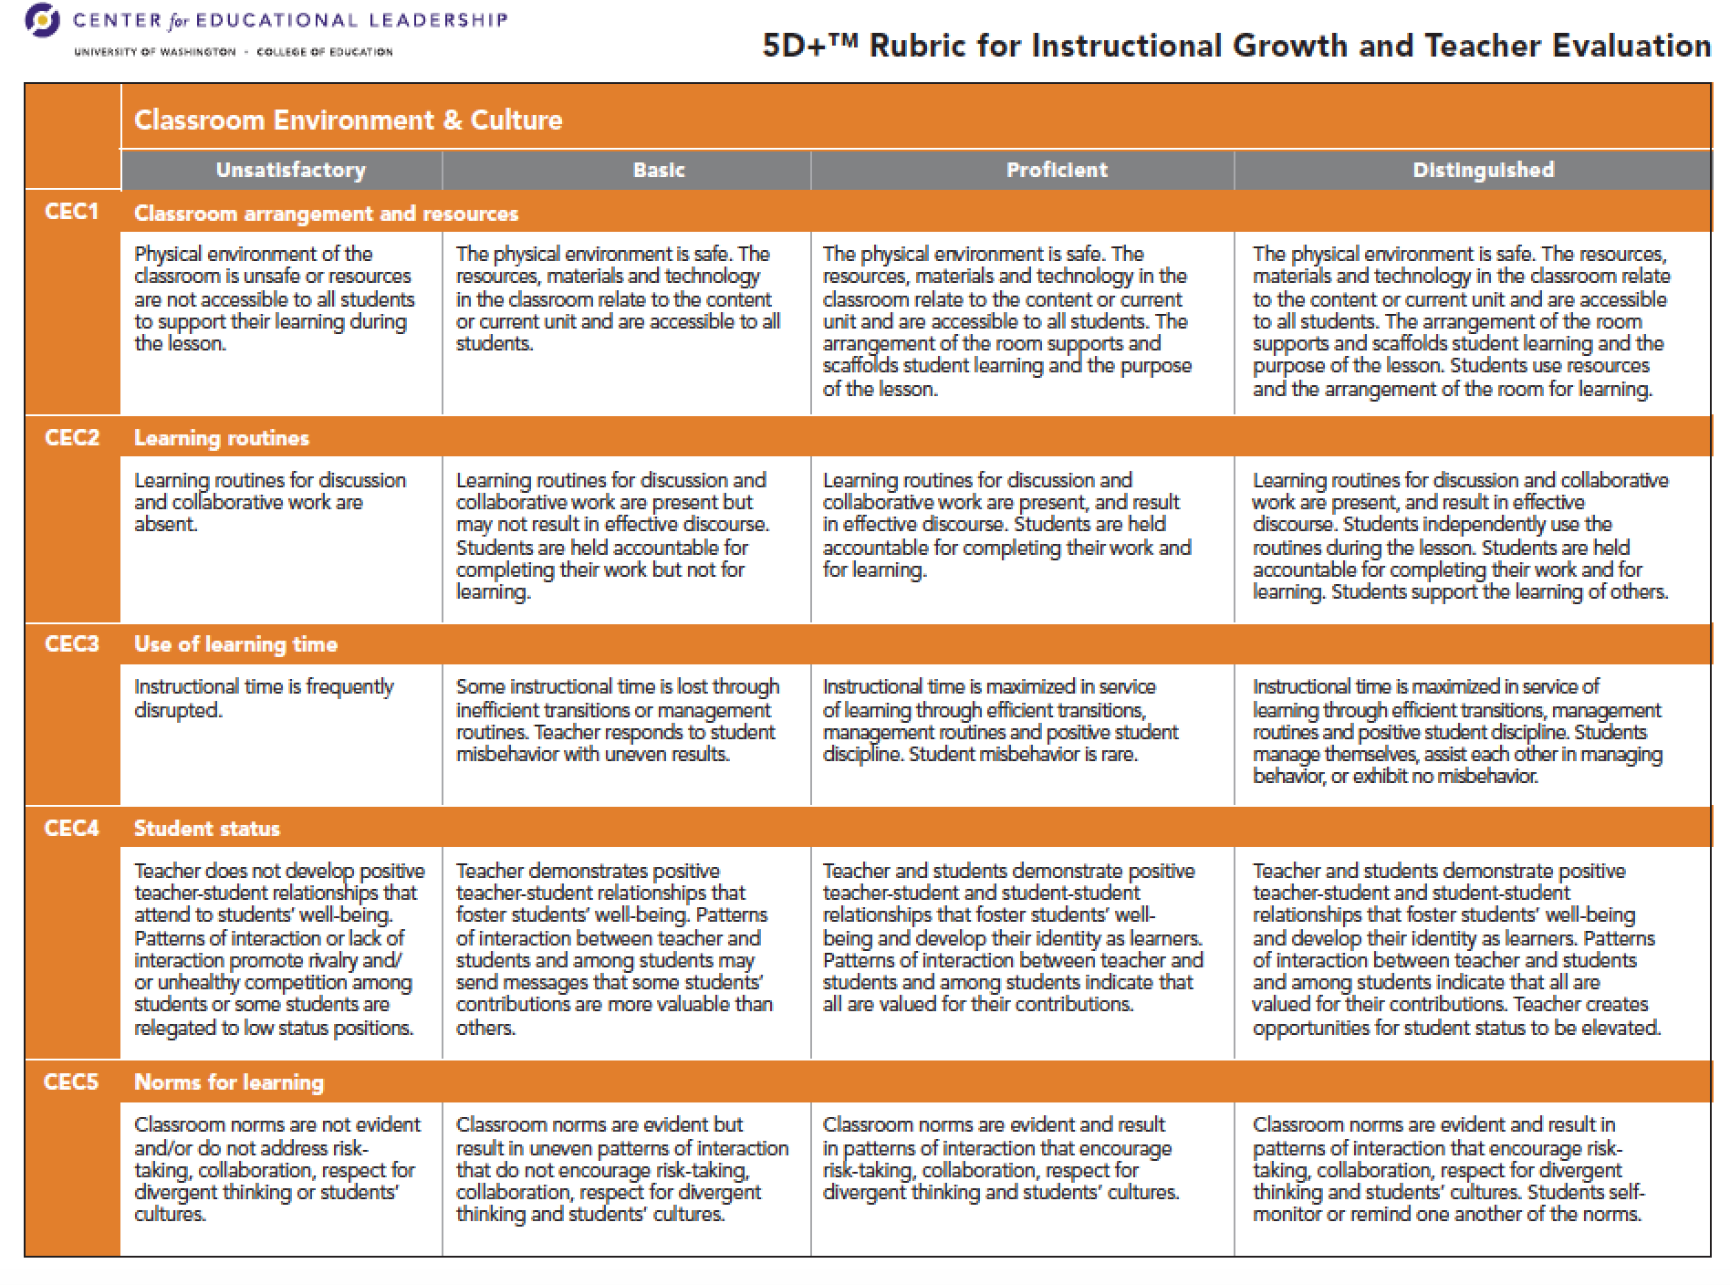
5D+ Focus
Read framework and overview of 5D+
CT’s: What does CEC2 look like in your classroom?
Notes:
Read framework and overview of 5D+
CT’s: What does CEC2 look like in your classroom?

Slide 12
Co-Teaching
…is defined as two teachers (cooperating teacher and teacher candidate) working together with groups of students--sharing the planning, organization, delivery and assessment of instruction, as well as the physical space.
Both teachers are actively involved and engaged
in all aspects of instruction
Copyright 2015, The Academy for Co-Teaching and Collaboration at St. Cloud State University and TWH Consulting,
Research Funded by a US Department of Education, Teacher Quality Enhancement Partnership Grant
Notes:
Ronda’s slide

Slide 13
Co-Teaching is an Attitude
...of sharing the classroom and students!
Co-Teachers must always
be thinking…
WE’RE
BOTH
TEACHING!
Copyright 2015, The Academy for Co-Teaching and Collaboration at St. Cloud State University and TWH Consulting,
Research Funded by a US Department of Education, Teacher Quality Enhancement Partnership Grant
Notes:
Ronda’s slide

Slide 14
Why Co-Teach?
Consistent classroom management,
Greater student participation and engagement,
Enhanced collaboration skills, and
Increase instructional options for all students
Copyright 2015, The Academy for Co-Teaching and Collaboration at St. Cloud State University and TWH Consulting,
Research Funded by a US Department of Education, Teacher Quality Enhancement Partnership Grant

Slide 15
Benefits to Cooperating Teachers End of Experience Survey (N=279)
Cooperating Teachers indicate that Co-Teaching led to:
Ability to reach more students, particularly those with high needs (93.5%)
Better relationship with their teacher candidate (91%)
Experienced professional growth (89.2%)
Enhanced energy for teaching (87.8%)
Hosting a candidate without giving up my classroom (87.1%)
Teacher candidate had a better experience than they would have through with a traditional model (81.7%)
Copyright 2015, The Academy for Co-Teaching and Collaboration at St. Cloud State University and TWH Consulting,
Research Funded by a US Department of Education, Teacher Quality Enhancement Partnership Grant

Slide 16
Benefits to K-12 Students Focus Groups (N=546)
Increased student engaged time
Able to work in smaller groups
Receive more individual attention
Get questions answered faster
Get papers and grades back faster
Students behave better
Fewer class disruptions (for passing out papers, having projects checked, other housekeeping tasks)
Copyright 2015, The Academy for Co-Teaching and Collaboration at St. Cloud State University and TWH Consulting,
Research Funded by a US Department of Education, Teacher Quality Enhancement Partnership Grant

Slide 17
What does CO-TEACHING look like…
Teacher Candidates are expected to:
Contribute ideas from the very beginning of the experience,
Engage with students, assisting with their learning from the very first day,
Be expected to take on full leadership in all 3 areas (planning, instruction & assessment),
Demonstrate competencies as a teacher, and
Have opportunities to teach alone
Copyright 2015, The Academy for Co-Teaching and Collaboration at St. Cloud State University and TWH Consulting,
Research Funded by a US Department of Education, Teacher Quality Enhancement Partnership Grant
Notes:
Candidates must understand that they will be provided with the opportunity to solo teach and have full responsibility for the classroom. They are also expected to develop a collaborative working relationship with their cooperating teacher and university supervisor.

Slide 18
Co-Teaching Strategies/Approaches
One Teach, One Observe
One Teach, One Assist
Station Teaching
Parallel Teaching
Alternative/Differentiated Teaching
Team Teaching
Copyright 2014, The Academy for Co-Teaching and Collaboration at St. Cloud State University,
Research Funded by a US Department of Education, Teacher Quality Enhancement Partnership Grant

Slide 19
One Teach, One Assist
One teacher has primary instructional responsibility while the other assists students’ with their work, monitors behaviors, or corrects assignments.
Copyright 2015, The Academy for Co-Teaching and Collaboration at St. Cloud State University and TWH Consulting,
Research Funded by a US Department of Education, Teacher Quality Enhancement Partnership Grant
Notes:
Discussion

Slide 20
One Teach, One Assist
One Teach, One Assist
Watch this video.

Slide 21
One Teach, One Observe
One teacher has primary instructional responsibility while the other gathers specific observational information on students or the (instructing) teacher.
Copyright 2015, The Academy for Co-Teaching and Collaboration at St. Cloud State University and TWH Consulting,
Research Funded by a US Department of Education, Teacher Quality Enhancement Partnership Grant
Notes:
Discussion

Slide 22
One Teach, One Observe
ST can collect TPA focus student descriptions
ST observes specific teacher moves: routines, pair-share, transitions, questioning, formative assessment…
Other?
Notes:
Review what the observing teacher (either cooperating teacher or teacher candidate) can be observing for.
Co-Teaching Actions handout.

Slide 23
Phase-In Schedule: Weeks 5-6
Old TPA Task 3: due 3/3
Formative Assessment (1)
Triad Meeting
Co-Teaching: Station Teaching and Supplemental or Differentiated Teaching
5D+ Domain: Purpose

Slide 24
The Student Teaching Triad Meeting
Teacher
Candidate
Cooperating Teacher
University Supervisor
Communication
What role does each person play?
Copyright 2015, The Academy for Co-Teaching and Collaboration at St. Cloud State University and TWH Consulting,
Research Funded by a US Department of Education, Teacher Quality Enhancement Partnership Grant
Notes:
In student teaching, a cooperating teacher and a university supervisor support the development of a teacher candidate. These three individuals form a triad.
Each member of the triad has particular roles that provide the foundation for a successful student teaching experience. Because the triad works together it is important to know the responsibilities and expectations for each member.

Slide 25
Formative Evaluation
This evaluation is completed at Weeks 5 and 10 at the same time as the Triad Meetings.
CT drafts scores based on a holistic evaluation of the past 5 weeks. Please reference the 5D+ rubric while completing your scores. A score of 3 on a subdimension means that you observe this action consistently
A score of 1 means that the ST is not doing it.
A score of 2 means that the ST is trying, but will need more work/effort to be consistent/successful.
The US will finalize the scores on the evaluation with the CT’s input.
Complete the GROWTH Plan together as a triad.

Slide 26
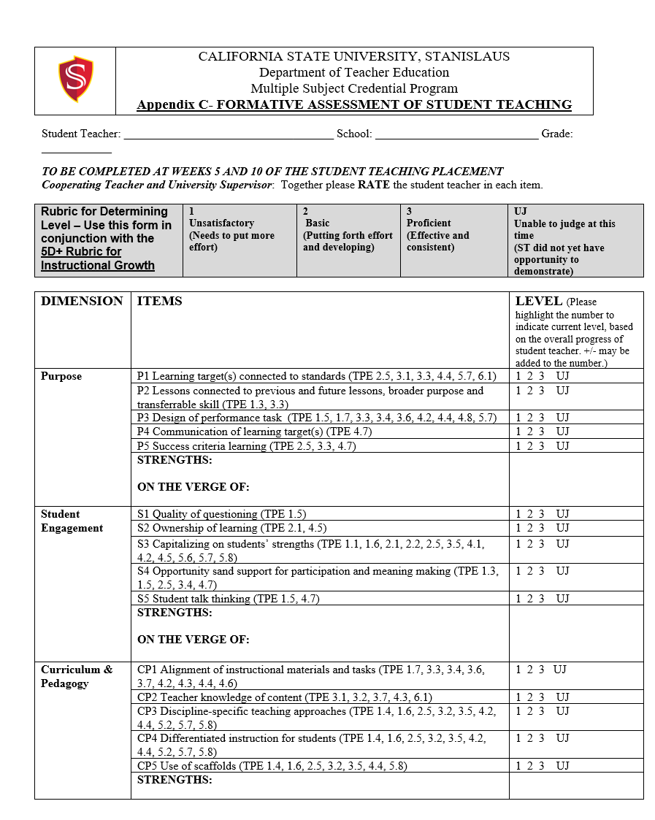
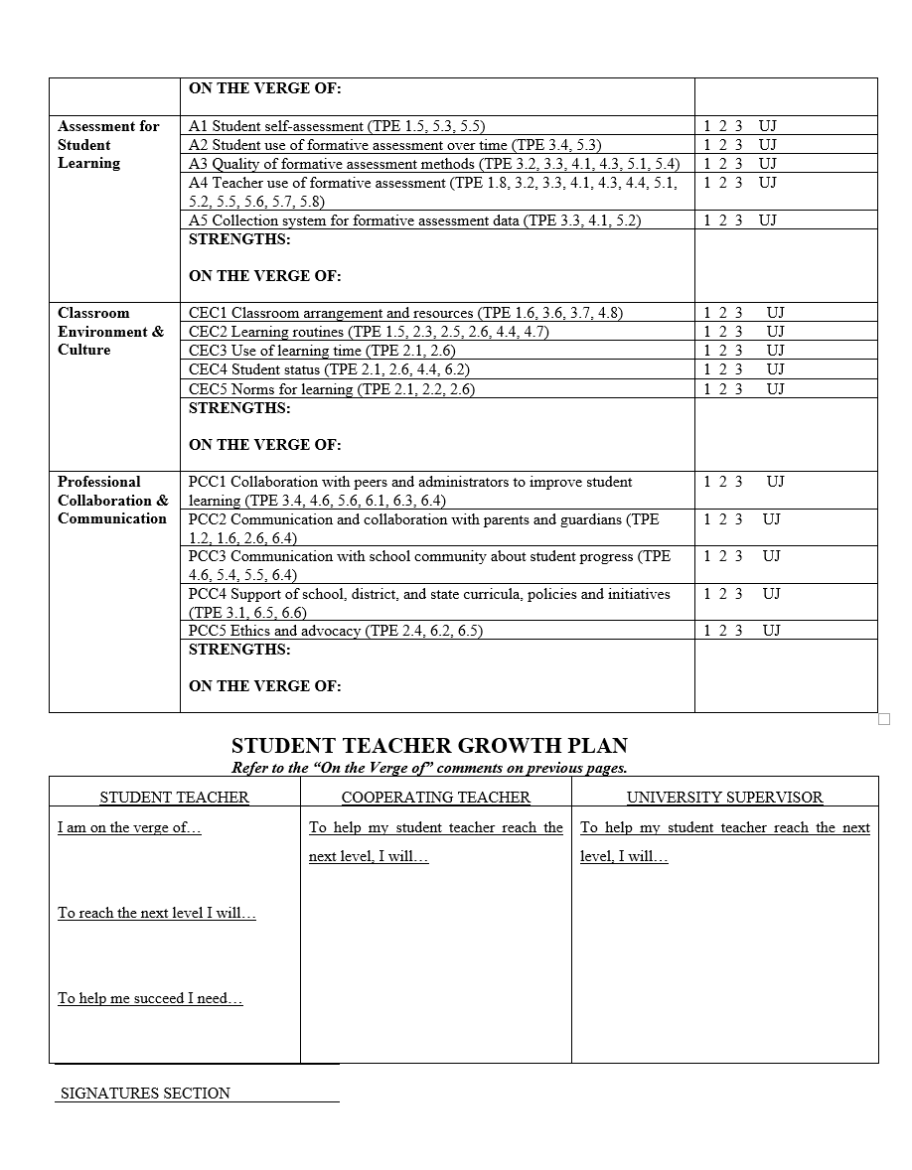
Formative Assessment

Slide 27
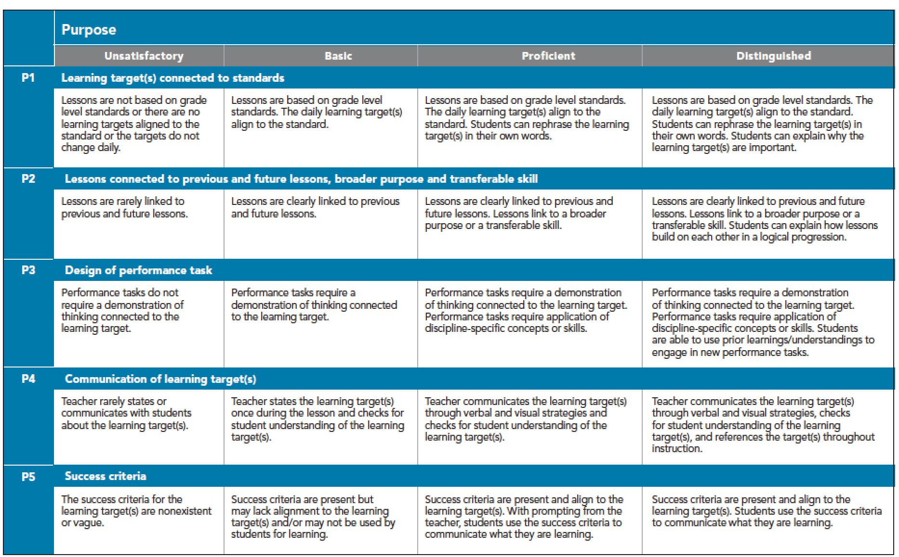
5D+ Focus
Very important to talk about success criteria for learning goals. This guides the assessment plan.

Slide 28
Station Teaching
The co-teaching pair divide the instructional content into parts.
Each teacher instructs one of
the groups, groups then rotate
or spend a designated amount
of time at each station.
Copyright 2015, The Academy for Co-Teaching and Collaboration at St. Cloud State University and TWH Consulting,
Research Funded by a US Department of Education, Teacher Quality Enhancement Partnership Grant
Notes:
HOW CAN YOU UTILIZE YOUR STUDENT TEACHERS- WHAT SKILLS CAN BE PRACTICED

Slide 29
Station Teaching
https://www.youtube.com/watch?v=nLhdUYnK6Ss Watch this video to see an example.

Slide 30
Supplemental Teaching
This strategy allows one teacher to work with students at their expected grade level, while the other teacher works with those students who need the information and/or materials extended or remediated.
Copyright 2015, The Academy for Co-Teaching and Collaboration at St. Cloud State University and TWH Consulting,
Research Funded by a US Department of Education, Teacher Quality Enhancement Partnership Grant

Slide 31
Alternative or Differentiated Teaching
Alternative teaching strategies provide two different approaches to teaching the same information. The learning outcome is the same for all students however the avenue for getting there is different.
Copyright 2015, The Academy for Co-Teaching and Collaboration at St. Cloud State University and TWH Consulting,
Research Funded by a US Department of Education, Teacher Quality Enhancement Partnership Grant

Slide 32
Weeks 7-8, 9-10
New TPA Cycle 1 due 3/7
Old TPA task 4 due 4/7
Formal Observation #3
Formative Assessment (2)
Triad Meeting
Co Teaching: Parallel Teaching
5D+ Domain: Student Engagement

Slide 33
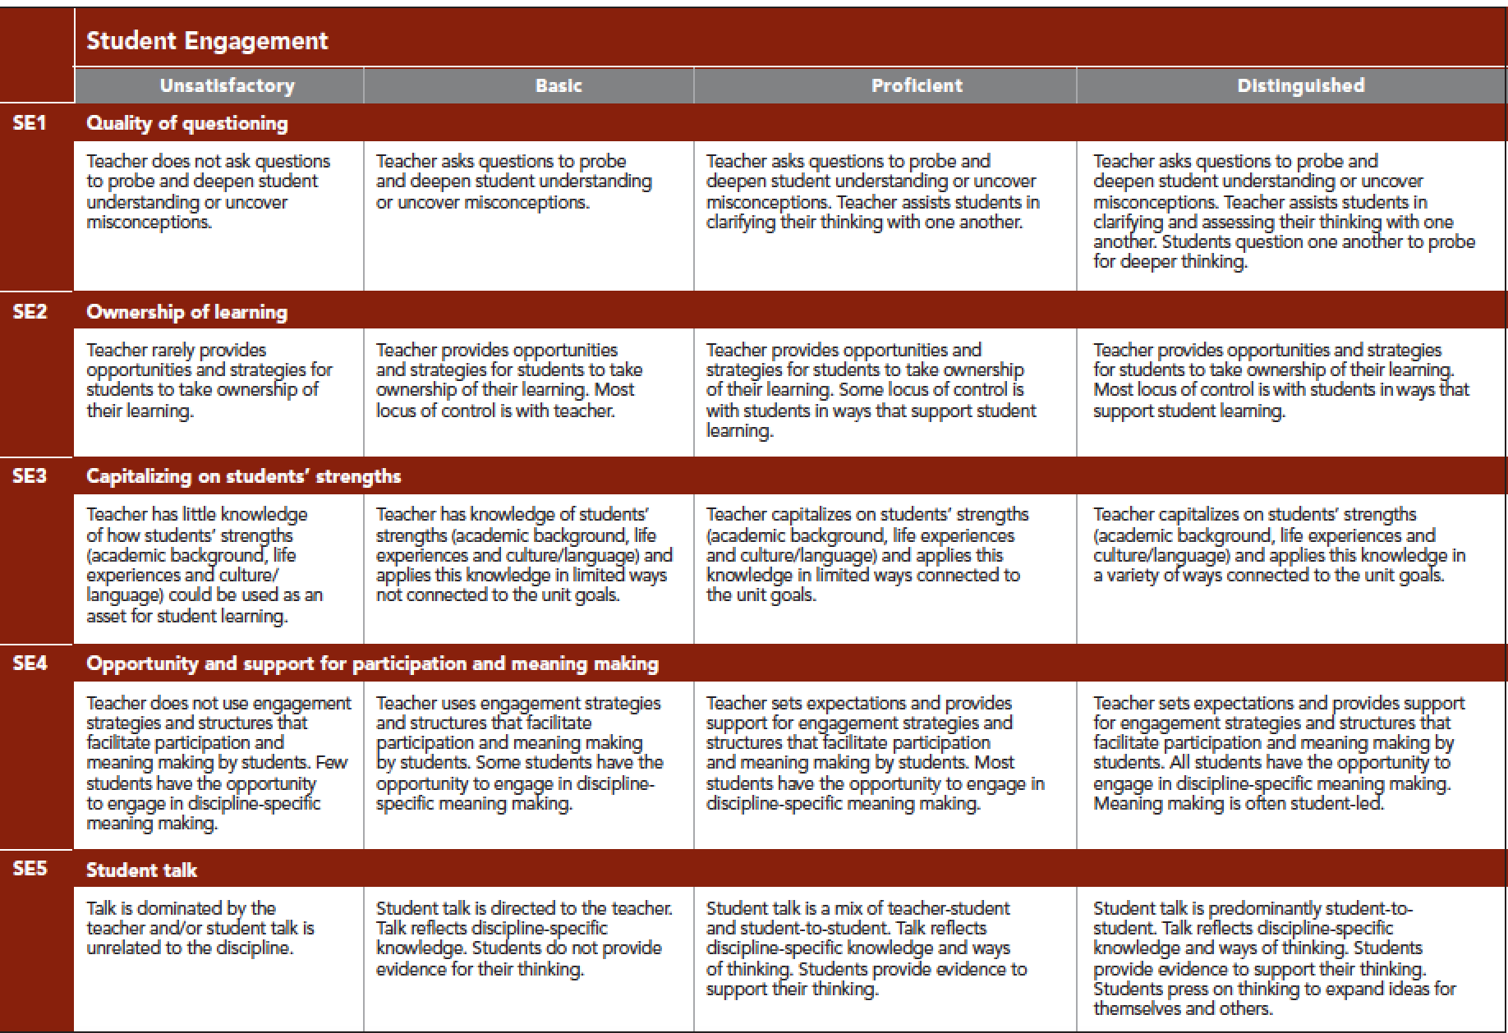
5D+ Focus
Read over this dimension. Note the progression from Basic to Proficient.
Notes:
UNPACK “DISCIPLINE SPECIFIC MEANING MAKING.”

Slide 34
Parallel Teaching
In this approach, each teacher instructs half the students. The two teachers are addressing the same instructional material using the same teaching strategies.
Copyright 2015, The Academy for Co-Teaching and Collaboration at St. Cloud State University and TWH Consulting,
Research Funded by a US Department of Education, Teacher Quality Enhancement Partnership Grant

Slide 35
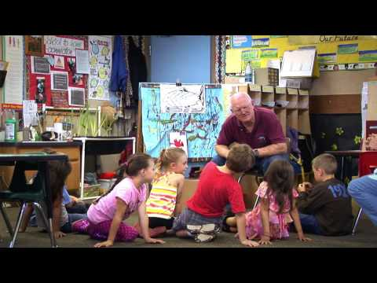
Parallel Teaching
Click on the image to watch the video.
Notes:
RONDA WILL ADD SCREEN SHOT OF VIDEO AND ASK CTs APPLICATION QUESTIONS

Slide 36
Weeks 11-12, 13-14
New TPA Cycle 2 due 4/18
Formal Observation #5
Co-Teaching: Team Teaching
5D+ Domain: Curriculum & Pedagogy and Assessment for Student Learning

Slide 37
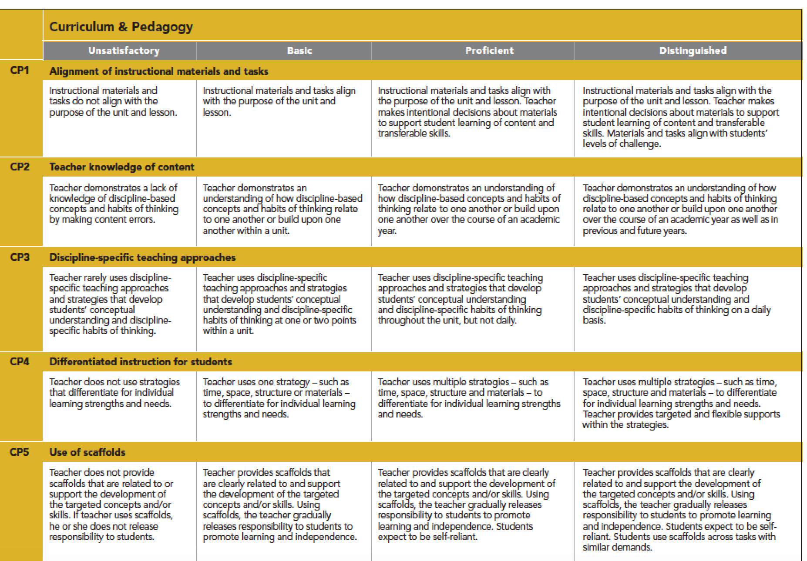
5D+ Focus
Read framework and overview of 5D+. What does CP2, CP3 look like in your classroom?

Slide 38
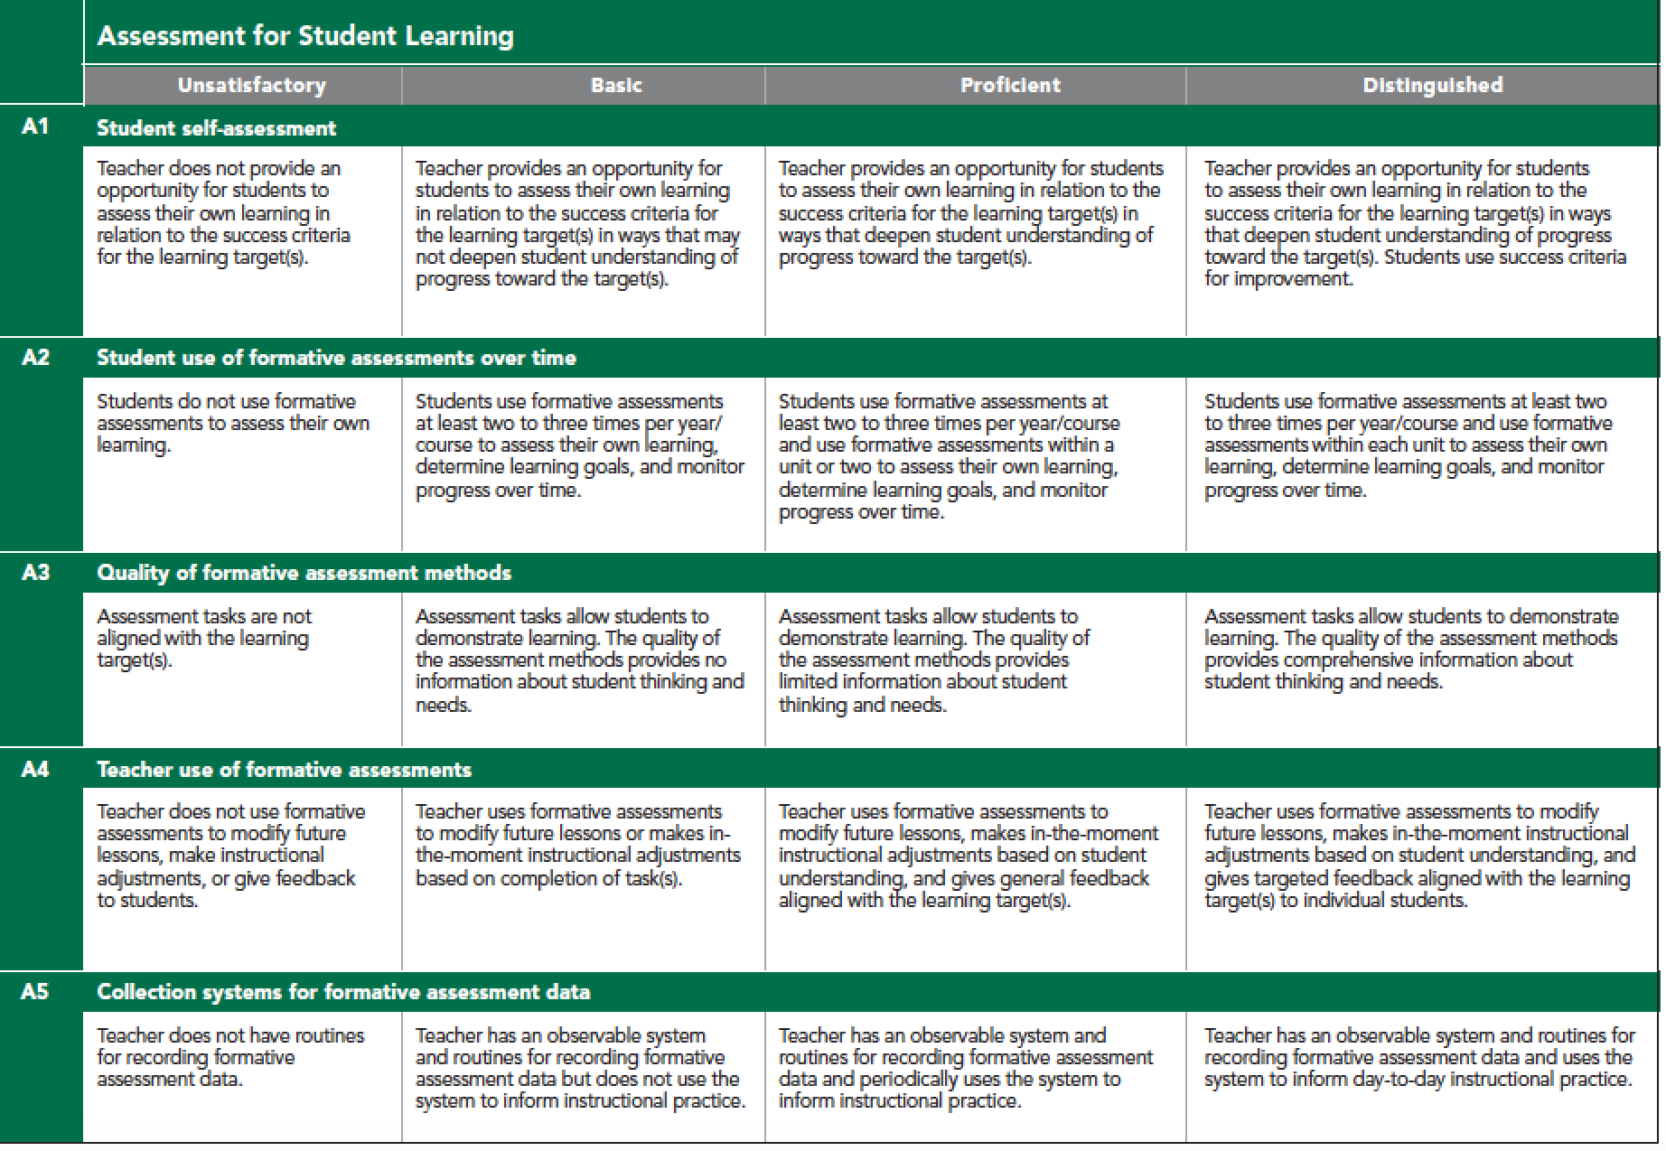
5D+ Focus
Read framework and overview of 5D+
Please note that your STs will be evaluated on these areas. So please provide opportunities for them to practice these skills.

Slide 39
Team Teaching
Well planned, team taught lessons, exhibit an invisible flow of instruction with no prescribed division of authority. Both teachers are actively involved in the lesson.
From a student’s perspective, there is no clearly defined leader, as both teachers share the instruction, are free to interject information, and available to assist students and answer questions.
How will you effectively implement “Team Teaching?”
What might be the benefits of “Team Teaching” for all?
Copyright 2015, The Academy for Co-Teaching and Collaboration at St. Cloud State University and TWH Consulting,
Research Funded by a US Department of Education, Teacher Quality Enhancement Partnership Grant
Notes:
HOW WOULD YOU DO THIS EFFECTIVELY AND WHAT MIGHT BE THE BENEFITS?

Slide 40
Week 15-16
Summative Assessment
Triad Meeting
Growth Plan for Induction- ST completes this.

Slide 41
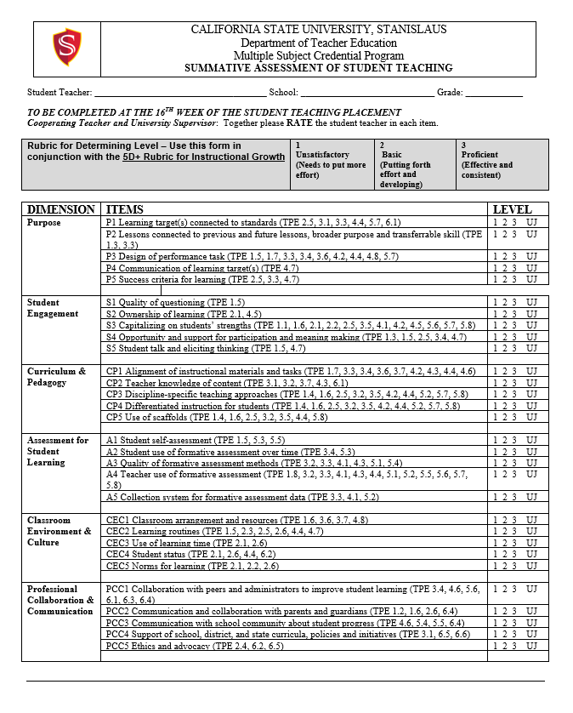
Summative Assessment

Slide 42
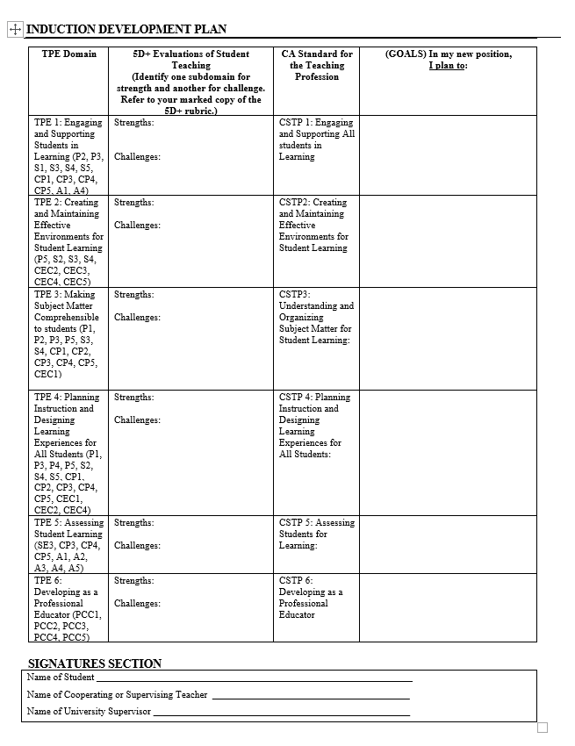
Growth Plan for Induction
Tell ST to complete and keep a copy for themselves.
ST will NEED this for Induction!

Slide 43
Key points to remember
Co-planning is an essential aspect of co-teaching.
Refer to the 5D+ rubric for evaluations and feedback.
Provide specific feedback to help your ST get to the next level.
Try various co-teaching strategies and really take advantage of the opportunities to meet the needs of your students.
Gradually release the instructional lead in coteaching (co-planning, teaching, and assessment)

