Slide 1

Course Redesign with Technology Showcase
Promising Course Redesign
September 25, 2015

Slide 2
Introductory Genetics BIOL 3350
Presenter: Dr. Janey Youngblom
September 25, 2015

Slide 3

Purpose
Introductory Genetics is a required course for all Biology majors and serves as pre-requisite course for other required courses in the major
Identified problems:
Course is impacted
Spring 2013- spring 2014, percentage of students with repeatable grades of F/D/W for all sections ranged from 30%-57%
Some problems in course based on student comments: abstractness of concepts, overwhelming use of lab organisms for illustrating concepts in textbook, lack of relevancy of content.

Slide 4
Purpose
Redesigned course will:
Bring course content to a personal level by providing option to analyze their own genetic data or anonymized human data
Provide interdisciplinary context to course content by engaging in ethical discussions and personal reflections of genetics concepts
Encourage conversations with family members regarding genetic inheritance and genetic conditions
Integrate valuable genomic analysis skills that will enhance their employment and graduate school prospects

Slide 5
Process
Students given option to get their own DNA tested through 23andMe, or use anonymous human data for analysis
Graded homework assignments using genomic analysis tools available on the internet to explore their genetic data and linking the activities to genetic concepts
Small group discussions using case studies to raise bioethical issues that integrate genetics concepts
Guest speakers will help connect genetic concepts to the real world outside the classroom

Slide 6
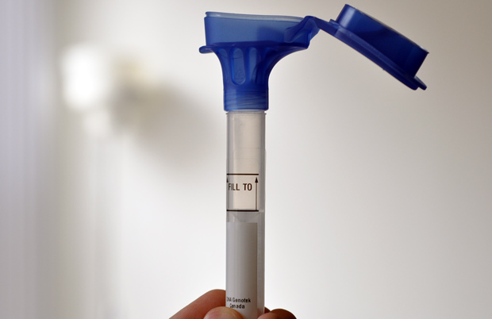
23andMe Spit tube for DNA sample

Slide 7
Process
IRB approval obtained on August 27, 2015
Informed consent session about 23andme testing provided by genetic counseling students on 9/15
Students took Genetics Concepts Assessment test 9/1. Will take it again at the end of the term
A guest speaker provided a personal story about a genetic condition on 9/22
Online pre-survey will be open for one week starting Sept. 28. Post survey available last week of semester
4 homework assignments spread out during the semester will involve using genomic analysis tools
Students analyzing their own genetic data from 23andMe will get their results at end of October

Slide 8
Evaluation
Pre and post-course Genetic Concepts Assessment test at beginning and end of the course to measure changes in their score relative to a control group of students in a different section of the same course
Students will take pre and post course surveys to assess their attitudes, opinions, and feedback about the course activities
Final course grades will be compared to grades in previous offerings of the course in other semesters, and the other concurrent section offered this fall
Post course interviews with students in the course will take place about 6 months after course ends to collect their feedback

Slide 9


Physical Chemistry I
Presenter: Elvin A. Alemán, Ph.D.
Department of Chemistry
September 25, 2015

Slide 10
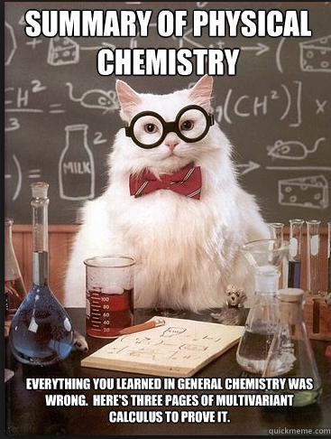
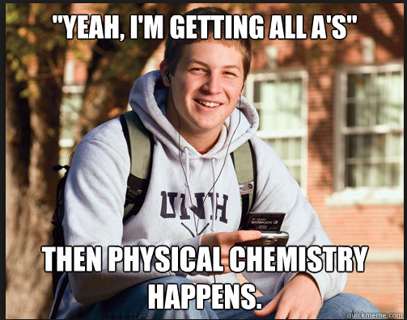
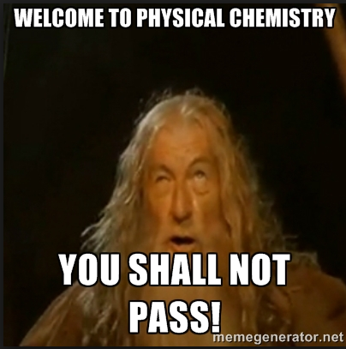

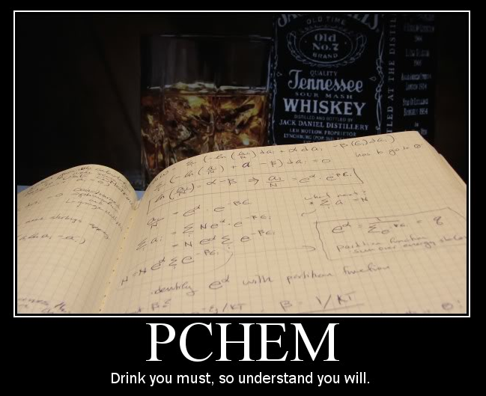

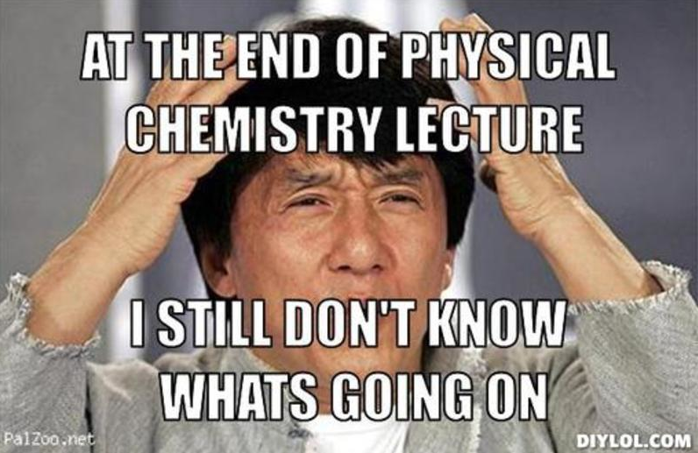
Physical Chemistry: MEMES

Slide 11
Purpose
PROBLEMS:
  Many Physical Chemistry textbooks and the professors that teach this course, such as myself, expect students to know more mathematics that is not offered in the calculus courses, but that are required for the Physical Chemistry course.
  I have to spend a great amount of lecture time to review and teach mathematics before I can start teaching physical chemistry in my Physical Chemistry course.
SOLUTIONS:
  I will create a series of videos to help the students to review (or to learn for the first time) mathematical concepts learned in calculus that will allow the students to comprehend and enjoy the material covered in class.

Slide 12

Process
ACTIVITIES
In my Physical Chemistry course, the students take a quiz every week and turn in homework problems, except the week of an exam.
I will incorporate homework problems to test the student’s mathematical skills after they watch the videos. They will turn in those problems together with the regular Physical Chemistry homework problems.
Recommended reading and practice problems will be assigned using a new supplementary workbook: “Applied Mathematics for Physical Chemistry” by James R. Barrante
      TIMELINE
      35 students will participate in these activities during the Spring 2016 semester
      I expect that every student, if they watch the videos and work the homework problems, will show a significant improvement in the total grades of the course. I anticipate that the percent of repeaters will decrease from 30% to 5%.

Slide 13
Evaluation
I have the data of how the students have performed on every problem in all the exams and quizzes in Physical Chemistry since 2012. Therefore, I will be able to compare how the students perform in the exams and quizzes before and after the videos were incorporated to the course.
A questionnaire will also be prepared to monitor students opinions regarding videos quality and instructor performance, and to obtain suggestions for improvements.

Slide 14
Video: Example
This is a draft version of how the videos will look to review mathematical concepts and applied mathematics for physical chemistry
For example: In Physical Chemistry, the students study the function U(T,V), internal energy.
The Total Differential of U(T,V) is defined
To solve for dU, the students must solve the partial derivatives and .
Partial Derivatives

Slide 15
KINS 4500- Exercise Physiology
Presenter: Jeff Bernard, Ph.D.
September 25, 2015

Slide 16


Purpose
The “Problem”
Students struggle to understand basic Exercise Physiology concepts such as:
  Metabolism
  Fuel utilization
  How these concepts can
  be applied in the lab
The Proposed “Solution”
Kinesiology Students learn by doing:
  Provide the technology needed to measure metabolic variables.
  Provide the opportunity to be both
  subject and tester.

Slide 17
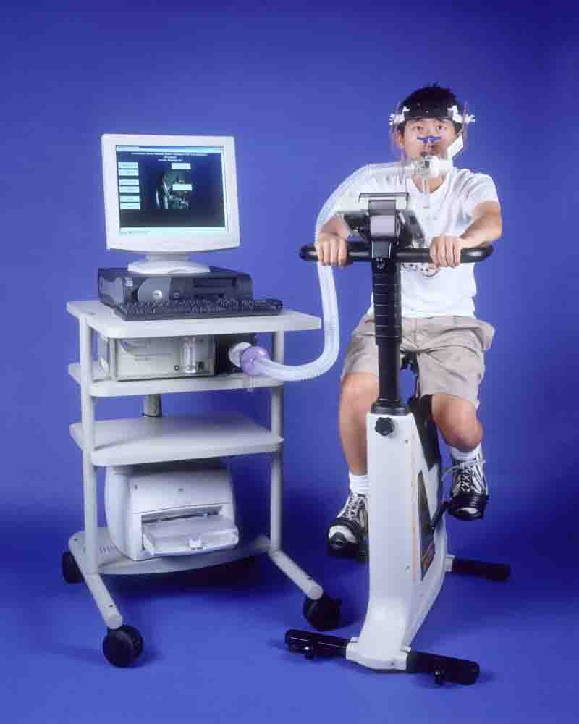

Process
Activities i.e. “The Technology”
Parvo Medics TrueOne2400 Metabolic System
  Submaximal and VO₂max
  Fuel utilization
  Lactate threshold
Timeline
Fall 2015 – Spring 2016
  5 Lab sessions each semester

Slide 18

Evaluation
How Will I know if the Technology Improves
Learning?
Testing theoretical application
  Compare test answers to previous semesters
  Pre/Post tests
Pass/Fail Rates

Slide 19
Generation of A Blackboard based HW Machine for Org. Chem I and Non-comprehensive Pre-Lec Notes for Org. Chem I and II Lec.
Nhu Y Stessman, Department of Chemistry
September 25, 2015

Slide 20
Purpose
Background:
Chem 3010, Organic Chemistry I Lec
High Failure Rate
Students not keeping pace with the lecture
Students focusing on writing and not engaging during Lecture
Proposed Solutions:
Generate an In-House Homework Machine using BB as a delivery system; Save Students’$$$
Create a Non-Comprehensive Supplemental Notes which keeps students engage during Lecture

Slide 21
Process
Homework Machine Using BB as a Delivery System.
Generate pools of different types of questions in BB
Multiple Choice; Fill in the Blank; Multiple Answer
Convert structures to SMILES NOTATIONS using a structural drawing freeware available On-Line.
C[C@H](OC(C)=O)CC
Incorrect answers:
C[C@@H](OCOC)CC; CC(OCOC)CC

Slide 22
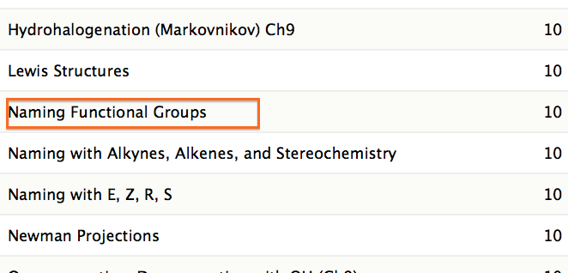
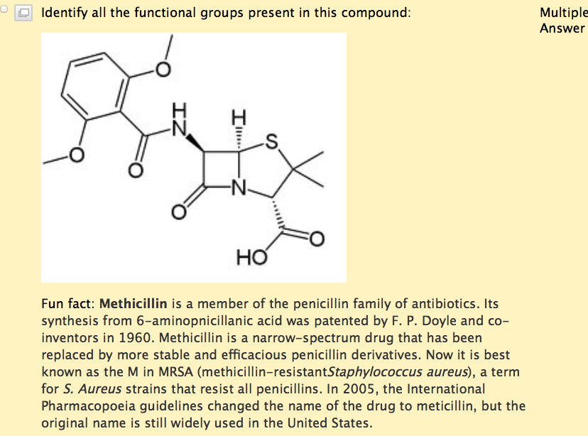
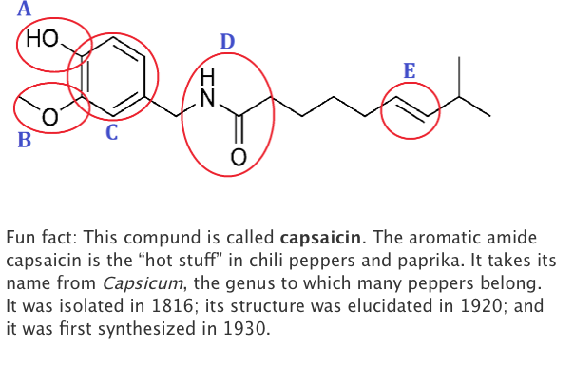
Process
A Sample of Pools of Questions in BB
Sample of Two Types of Questions
Fill in the Blank Multiple Answer

Slide 23
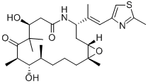
Process
A Sample of Non-Comprehensive Supplemental Notes
Enantiomers- A pair of enantiomers-a chiral compound will have one enantiomer
Ixabepilone (Ixempra) is a cytotoxic compound
for the treatment of advanced breast cancer

Slide 24
Evaluations

Slide 25
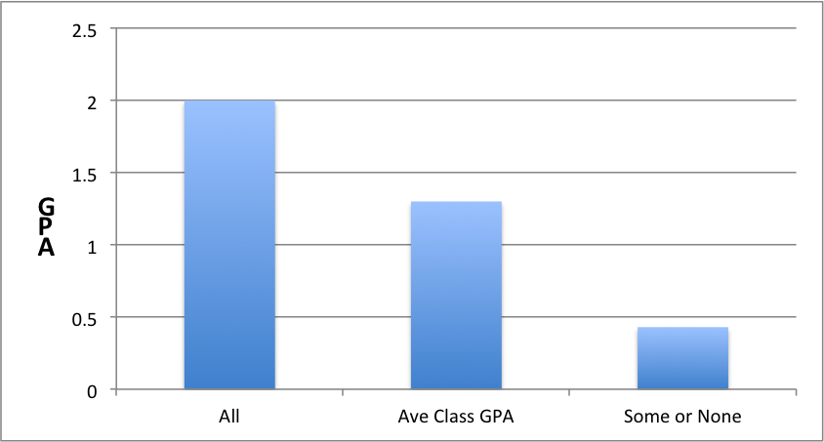
Evaluations
GPA Comparisons for Chem 3010 for BB Homework Assigments
All: Students completed all assignments
Some or None: Students completed some or none of the assignments.

Slide 26
Lessons Learned
Took longer than expected to generate questions for BB Homework
Use SMILES NOTATIONS to replace structures
Next Steps
Continue to add more questions to BB Homework under existing topics and create more topic areas.
Create a glossary for all BB organic structures that included names and SMILES
Acknowledgements: Thanks Carla Antypas for her assistance in BB Homework and thanks Graduation Rate/Student Success Initiative and CO eAcademy for Financial Support.

Slide 27
Chem 1110 & Chem 2010
Presenter: Scott C. Russell
September 25, 2015

Slide 28
Purpose
Issue:
  Many students entering General Chemistry II (CHEM 1110) lack the algebra skills necessary for success in the course.
Strategy:
  Give the students a math pre-test that has been demonstrated to correlate with level of success in General Chemistry II.¹
Intervene:
  Require students identified by the pretest as “at-risk” to view algebra tutorial videos and complete an online assessment.
  ¹Leopold, D.G.; Edgar, B. Degree of mathematics fluency and success in second-semester introductory chemistry. J. Chem. Ed. 2008, 624 – 731.

Slide 29
Process
Timeline:
The pre-test will be created based on the literature.¹ (Fall 2015)
Screencast tutorial videos will be created to help students see the algebra strategies needed to manipulate equations in the course. (Winter 2015)
Online assessment will be created to assess student abilities in manipulating such equations. (Winter 2015)
Implementation (Spring 2016).
Evaluation (June 2016).
¹Leopold, D.G.; Edgar, B. Degree of mathematics fluency and success in second-semester introductory chemistry. J. Chem. Ed. 2008, 624 – 731.

Slide 30
Evaluation
How will the success of this project be tracked?
A correlation between course benchmarks and the pre-test scores will be evaluated.
  Exam scores
  ACS Final Exam scores
  Online homework scores
  Overall course grade %
Evaluation of the overall effectiveness of this strategy.
  Compare course GPA from the spring 2016 semester to previous semesters.
  Compare scores on the American Chemical Society standardized final with those from previous semesters.

Slide 31
Additional Projects (Chem 2010)
Developed an online homework system for Quantitative Analysis (Chem 2010)
  Runs in Blackboard & has screencast tutorial videos
  Goal: Incentivize students to stay up with the course material in hopes of improving student success in this challenging course.
  Implementing this during Fall 2015
Developed virtual prelab videos and online prelab assessments for Quantitative Analysis
  Runs in Blackboard
  Students must complete these prior to starting an associated lab.
  Goal: Increase student preparedness for the challenging labs in Quantitative Analysis (CHEM 2010)
  Implementing this during Fall 2015.

Slide 32
Acknowledgements
Chancellor’s Office and eAcademy program for financial support.
CSU Stanislaus Provost’s Office for financial support
  Marge Jaasma
  Gary Torngren
  Sean Prevette

Slide 33
Questions?

