Slide 1
Student club & organization President & Advisor orientation 2015-2016
Office of Student Leadership & Development
University Student Union 103
(209) 667-3778
SLD@csustan.edu
www.csustan.edu/SLD
*In order for all links to work you must play this as a slide show.*

Slide 2
Purpose of orientation
Provide information about campus based services and departments
Introduce you to the programs and services of the Office of Student Leadership & Development
Inform you of the privileges and responsibilities of a registered student organization and of a student leader
Identify resources to assist your organization in program planning and operation
You will receive a link at the end of this training to begin the training for Stan Sync, which includes your charter application.

Slide 3
Office of Student Leadership & Development (SLD)
Responsible for charter and support of Student Clubs & Organizations
More than 80 Student Clubs & Organizations charter each year
As a registered Student Club or Organization, you have a special University relationship with privileges that individual students, departments and off-campus groups do not have
Take advantage of this relationship to accomplish your Club or Organization goals

Slide 4
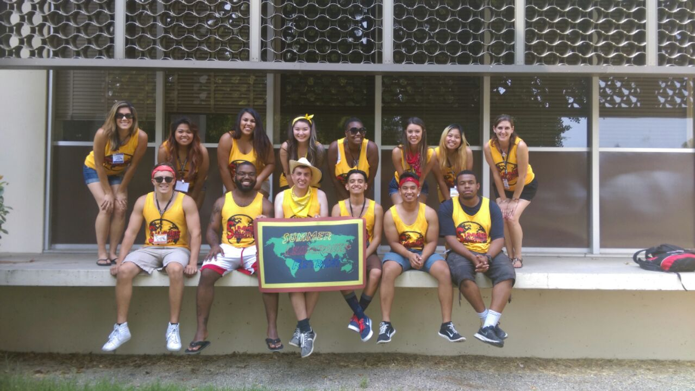
SLD Programs
Faculty Mentor Program
New Student Orientation
Student Leadership Awards
Summer Leadership Retreat
Warrior Leadership Series

Slide 5
SLD Advisors
Every chartered Student Club or Organization is assigned one SLD staff member as a primary contact. We serve as advisors to assist your organization and members.
We are here to help you succeed as a Student Club or Organization.
We are a resource for group development, leadership development, event planning and navigation of campus policies and procedures.
Presidents are our main point of contact. It is your responsibility to relay information to your officers and members on our behalf.
We will send frequent emails with important information; please read them in their entirety.

Slide 6
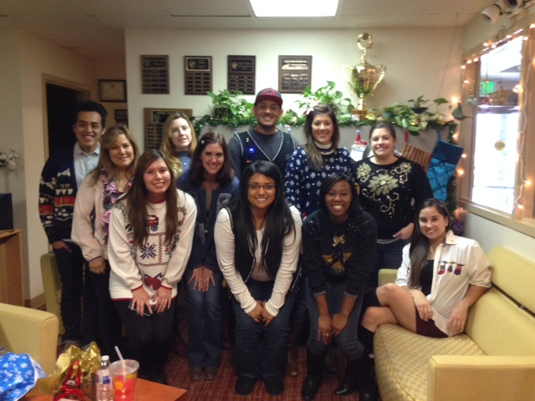
We welcome you to stop by, If an advisor is not available, please make an appointment so we can assist you with:
Campus Policies/Resources
Chartering Questions
Community Outreach
Effective Meetings
Event Planning
Fundraising
Marketing
Leadership Training
Officer Transition
Recruitment and Retention of Members

Slide 7
Privileges
Hold meetings and group functions on campus
Recruit members on campus
Use of University facilities and services; most Student Club or Organization events held on campus will have the facility use fee waived or reduced
Post material in appropriate locations around campus following posting guidelines
Participate in booth lottery for space out in the Quad

Slide 8
Privileges continued
Receive an organization mailbox in the SLD Office
Receive on-campus accounting services
Reserve event and meeting equipment from the University Student Union
Solicit funds or sell items on campus to raise funds for organizational or charitable purposes
Consultation services from the Advisors of the Office of Student Leadership and Development: Program planning, publicity, fund raising, leadership training, campus regulations, financial advisement, facility scheduling, and general advisement
Receive 4 Temporary Food Permits per academic year.

Slide 9
Policies and procedures
As a Student Club or Organization it is your responsibility to be familiar with University policies and procedures related to Student Clubs and Organizations.
Officers are responsible for educating all members and prospective members on these policies.
A detailed description of the policies can be found in the Student Club & Organization Handbook or on our website.
Violations of policies may result in conditional status for your group or loss of charter.

Slide 10
How we communicate with you
E-mail messages to your Student Club or Organization President and Advisor
Stan Sync
Notices in your club or organization mailbox, located in the SLD office, UU103
SLD website www.csustan.edu/SLD
Student Club & Organization Handbook’s are located on the SLD website at http://www.csustan.edu/sld/policies.html

Slide 11
Campus Security Authority
Campus Security Authorities are required to report certain criminal offenses as outlined by federal law; specifically the “Jeanne Clery Disclosure of Campus Security Policy and Crime Statistics Act (Clery Act).
*If someone has significant responsibility for student and campus activities, he or she is a campus security authority (i.e. Presidents and Advisors)
*The function of a campus security authority is to report to CSU Stanislaus University Police Department, those allegations of Clery Act crimes that he/she concludes were made in good faith.

Slide 12
CSA Continued
What a CSA is not
*Not responsible for determining authoritatively whether a crime took place
*Not responsible to try and convince a victim to contact law enforcement if the victim chooses not to do so.
*It is simply your duty to inform UPD what the crime was and where it took place.
For more information, visit: https://www.csustan.edu/upd/crime-statistics

Slide 13
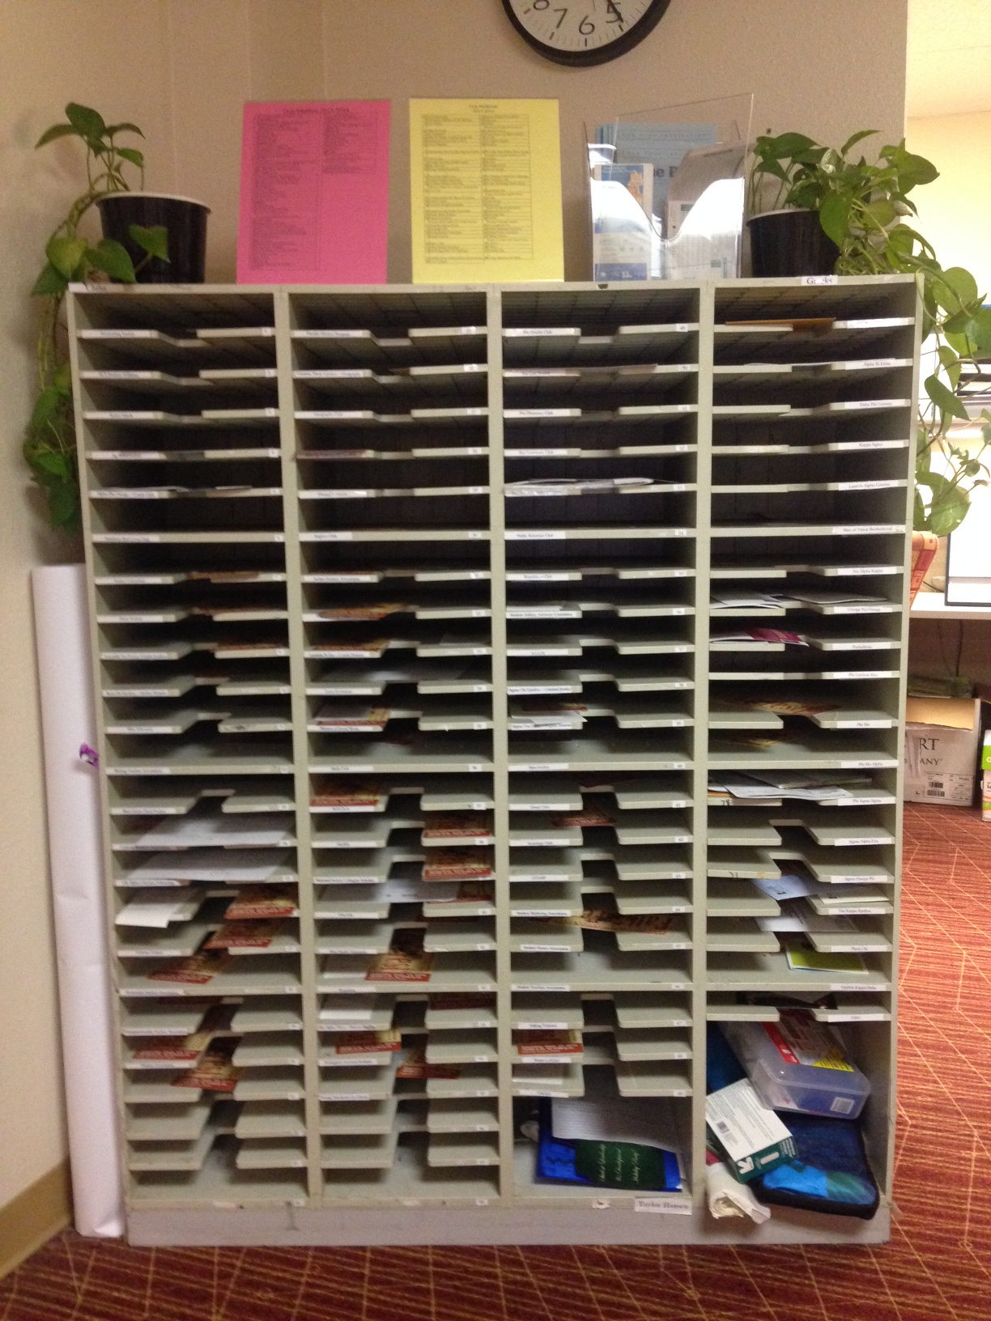
Mailboxes
Upon chartering, your group is assigned a mailbox in the SLD office
You must check your mailbox on a regular basis so you don’t miss important business or announcements. Mail will be thrown away if not picked up every two weeks
Mailing Address Format:
Name of Your Organization
Student Leadership & Development, UU103
CSU Stanislaus
One University Circle
Turlock, CA 95382

Slide 14
Use of the University Name by a student club or organization
Use of the University name within an organization’s name is not permitted. Recognized organizations are permitted to use the name of California State University, Stanislaus or Stan State only as a means of identifying the location of the organization. Such use should not imply University sponsorship or that the organization is an official agent of the University. Thus, the “Pottery Club of Stan State“ would be correct, but the “Stan State Pottery Club” would be incorrect

Slide 15
Charter process
Upon successful completion of the Orientation, you will receive a link to Stan Sync to begin the chartering process. Please have the following information ready: Email addresses, student ID #, mailing address and phone number for ALL your officers. Also, have a draft of your constitution ready to be uploaded. Email addresses of all your current members so they can be sent a link to join the Stan Sync page.
Upon completion of your charter application, you will be contacted by your SLD advisor for a one-on-one meeting.
Mandatory Training: Treasurers must complete in person Treasurer Training set up by the ASI Budget Analyst.
Student Event Coordinator must complete online training. The link will be provided through Stan Sync once the chartering process has been completed.
You will be contacted via email if additional information is needed.

Slide 16
Charter process continued
Charter Applications are good through an academic yearly basis.
Please note: Meeting, Event, & Activity requests will not be approved until the charter application is complete.
Mandatory Training for Officers and New Members: In order to comply with CSU system wide requirements, all student organization officers and new members must complete at least one Alcohol Education workshop and one Title IX workshop. The list of available in person workshops and/or online workshop links can be found on the Stan Sync.

Slide 17
New members & officers
It is your responsibility as Organization President to keep up to date records with the Office of Student Leadership & Development.
If you recruit New Members after submitting the Charter Application, please request log in information for them to create a Stan Sync account and to acknowledge policies.
If you obtain new Executive Officers after submitting the Charter Application packet, please update that information within Stan Sync 14 days of new officer appointments. Contact our office at 667-3778 if you have further questions.

Slide 18
Reserving Space on campus
Your Student Event Coordinator will need to create all event requests through Stan Sync.
SAFE Meetings
Safe and Fun Event (SAFE) Meetings will be held every Thursday at 9 am. This new approach will help assist student organizations with planning events on campus.
Student leaders are encouraged to come present/share their event plans/details with this group. The group will serve as a supplemental advisory group to assist with any details that the organization will need to account for pertaining to the event.
•Meetings
•Social Events
•Fundraising
•BBQ’s
•Guest Speakers
•Conferences
•Performances
•Tournaments
Only those officers that attend training will have access to make reservations through the Stan Sync system.
To access the Camps Calendar click HERE

Slide 19
Reserving Space on campus continued
Event requests must be made at least three days in advance for meetings or two weeks for events. If you have an emergency and need a space right away, please contact your SLD advisor.
All events must be approved through Stan Sync by your SLD Advisor prior to space being confirmed by the 25 Live Staff Scheduler.
For Stan Sync issues or concerns, contact your SLD advisor at 209-667-3778.

Slide 20
Food permit process
2015-2016
Temporary Food Permits (TFP) are offered FREE OF COST. However, Student Organizations are only allowed a maximum number of 4 TFP’s per academic year (August-May), so please plan accordingly.
All TFP’s must be submitted through your reservation request in Stan Sync no later than 10 calendar days prior to your event, or 5 business days for commercially packaged goods (i.e. chips, candy, cans of soda).

Slide 21
Posting guidelines
Prohibited Locations: building exteriors, doors, windows and entry ways, interior walls, restroom stalls, light posts, stairwells, trees, and on cars in parking lots.
Permitted Locations: Kiosks between the Library and Bizzini Hall, bulletin boards outside of offices, on A-frames outside of any main building, table tents inside Warrior Grille and Main Dining, posters/signs fastened by string (no tape) to the railings of Bizzini Hall and the Science Building.
Flyers may be posted in the Village on the bulletin boards with approval of Village staff. Flyers may also be posted on Student Union bulletin boards in the computer lab, game room, lobby entrance, or inside the SLD Office, or on stakes in the grass walkways. They must be placed at least one foot off the walkways.

Slide 22
Posting Guidelines Continued
All notices must be dated as posting is limited to two weeks. Facilities Services and SLD may remove expired items at the cost of the organization. Anyone may remove postings that exceed more than one per kiosk or open board.
Advertising or promoting alcohol will not be permitted on any signs or promotions at any time.

Slide 23
Off campus events
Organizations utilizing off-campus vendors and facilities are solely responsible for all contractual agreement obligations, thereby releasing the University and the student organization advisor from responsibility.
Any recognized student organization which undertakes the sponsorship of an event accepts responsibility for maintaining proper conduct of its participants. Officers of the organization are responsible for informing members of this requirement and all policies and procedures in the Student Organization Handbook. The Student Organization Handbook can be downloaded from the Office of Student Leadership and Development’s website: http://www.csustan.edu/sld/policies.html

Slide 24
Off campus events continued
The Student Conduct Code and the Campus Alcohol Policy stated in the Student Organization Handbook are applicable to events off-campus and such violations are subject to disciplinary action to individuals and/or the student organization.
Student organization officers and members are all responsible for following the policies and procedures as outlined in the Student Organization Handbook, therefore, the Office of Student Leadership and Development strongly advises that students seek advisement from Student Leadership and Development Advisors to clarify any questions prior to planning any event.
Student organizations sponsoring an off-campus event at a local venue may be required to provide proof of insurance. The university does not provide insurance coverage for student organizations sponsoring events held off-campus. The Office of Safety and Risk Management (OSRM) can provide information and guidance to student organizations seeking to purchase insurance for an off-campus event. For more information from OSRM you may contact the department by emailing risk@csustan.edu or calling (209) 667-3114.

Slide 25
On Campus Accounts
Main Financial Contacts:
ASI Budget Assistant
(209) 667-3820 or asibudgetanalyst@csustan.edu
Shirrell Wells, Accounting
(209) 667-3973 or swells1@csustan.edu
PLEASE NOTE: Your Student Organization Treasurer must complete in person the Treasurer Training before your Charter Application will be approved. See the SLD website for the complete list of dates and times.
General Account Information:
All Student Organization accounts are administered by Associated Students Incorporated (ASI) and Auxiliary Business Services (ABS).
ASI manages accounts for chartered Student Clubs & Organizations and monitors spending from these accounts.
ASI has ability to close your account without your consent due to non-compliance of the ASI Finance Policy or Trust Account Agreement.
Student Organizations cannot use off campus bank accounts, unless you are registered as a 501(c)3 organization. Such organizations must register this status with their SLD advisor.

Slide 26
On campus accounts
Student Clubs & Organizations are required to fill out a Student Organization Trust Agreement (included in your Charter Application) each year.
If you do not have a pre-existing account number, you will be assigned one from ABS.
You are assigned two different codes:
Cashnet Code- beginning with the letter K (for deposits)
Account Number- beginning with the letter C (for payments/withdrawals)
The President or Treasurer can obtain either code from the SLD Office.

Slide 27
Withdrawing funds from your account
Check Request forms permit students to withdraw funds from their account and guarantees the vendor/reimbursement payment is paid in full.
Check Requests are available online at www.csustan.edu/SLD under the forms and documents section.
All invoices, receipts, and a copy of the meeting minutes must be returned to the ASI Budget Analyst within one week after the completion of purchase. Failure to comply will result in your account being frozen.

Slide 28
Treasurer Training
Treasurers will receive in-person training through ASI. These dates will be every Tuesday from 4-5pm and every Wednesday from 2-3pm during the month of September.
All training will take place in the Warrior Conference Room located upstairs in the Student Union.
Treasurer Training Dates:
4:00-5:00pm: 9/1, 9/8, 9/15, 9/22, 9/29
2:00-3:00pm: 9/2, 9/9, 9/16, 9/23, 9/30

Slide 29
Best Practices for Running an Effective Organization

Slide 30
Running Effective meetings
Plan in advance & cover logistics. Arrive early to make sure the room is set up, and you have your handouts/supplies.
Set and provide a clear written agenda.
Establish ground rules such as:
Meetings will start/end on time
Everyone will participate
Comments will be non-judgmental
Assigned tasks will be done on time
Confidentiality will be maintained
Reinforce with visual aids.
Keep meeting records.
Set goals and objectives for your organization.

Slide 31
Parliamentary procedures
Robert’s Rules of Order was written by General Henry M. Robert, a U.S. Army engineer, and published in 1876. His work is the accepted authority for almost all organizations today.
Parliamentary procedure is a system of maintaining order within organizations. It provides an approved and uniform method of conducting meetings in a fair, orderly, and expeditious manner.
To view details and tips for parliamentary procedure, visit www.csuchico.edu/sll/studentOrganizations/parliamentaryProcedures.shtml

Slide 32
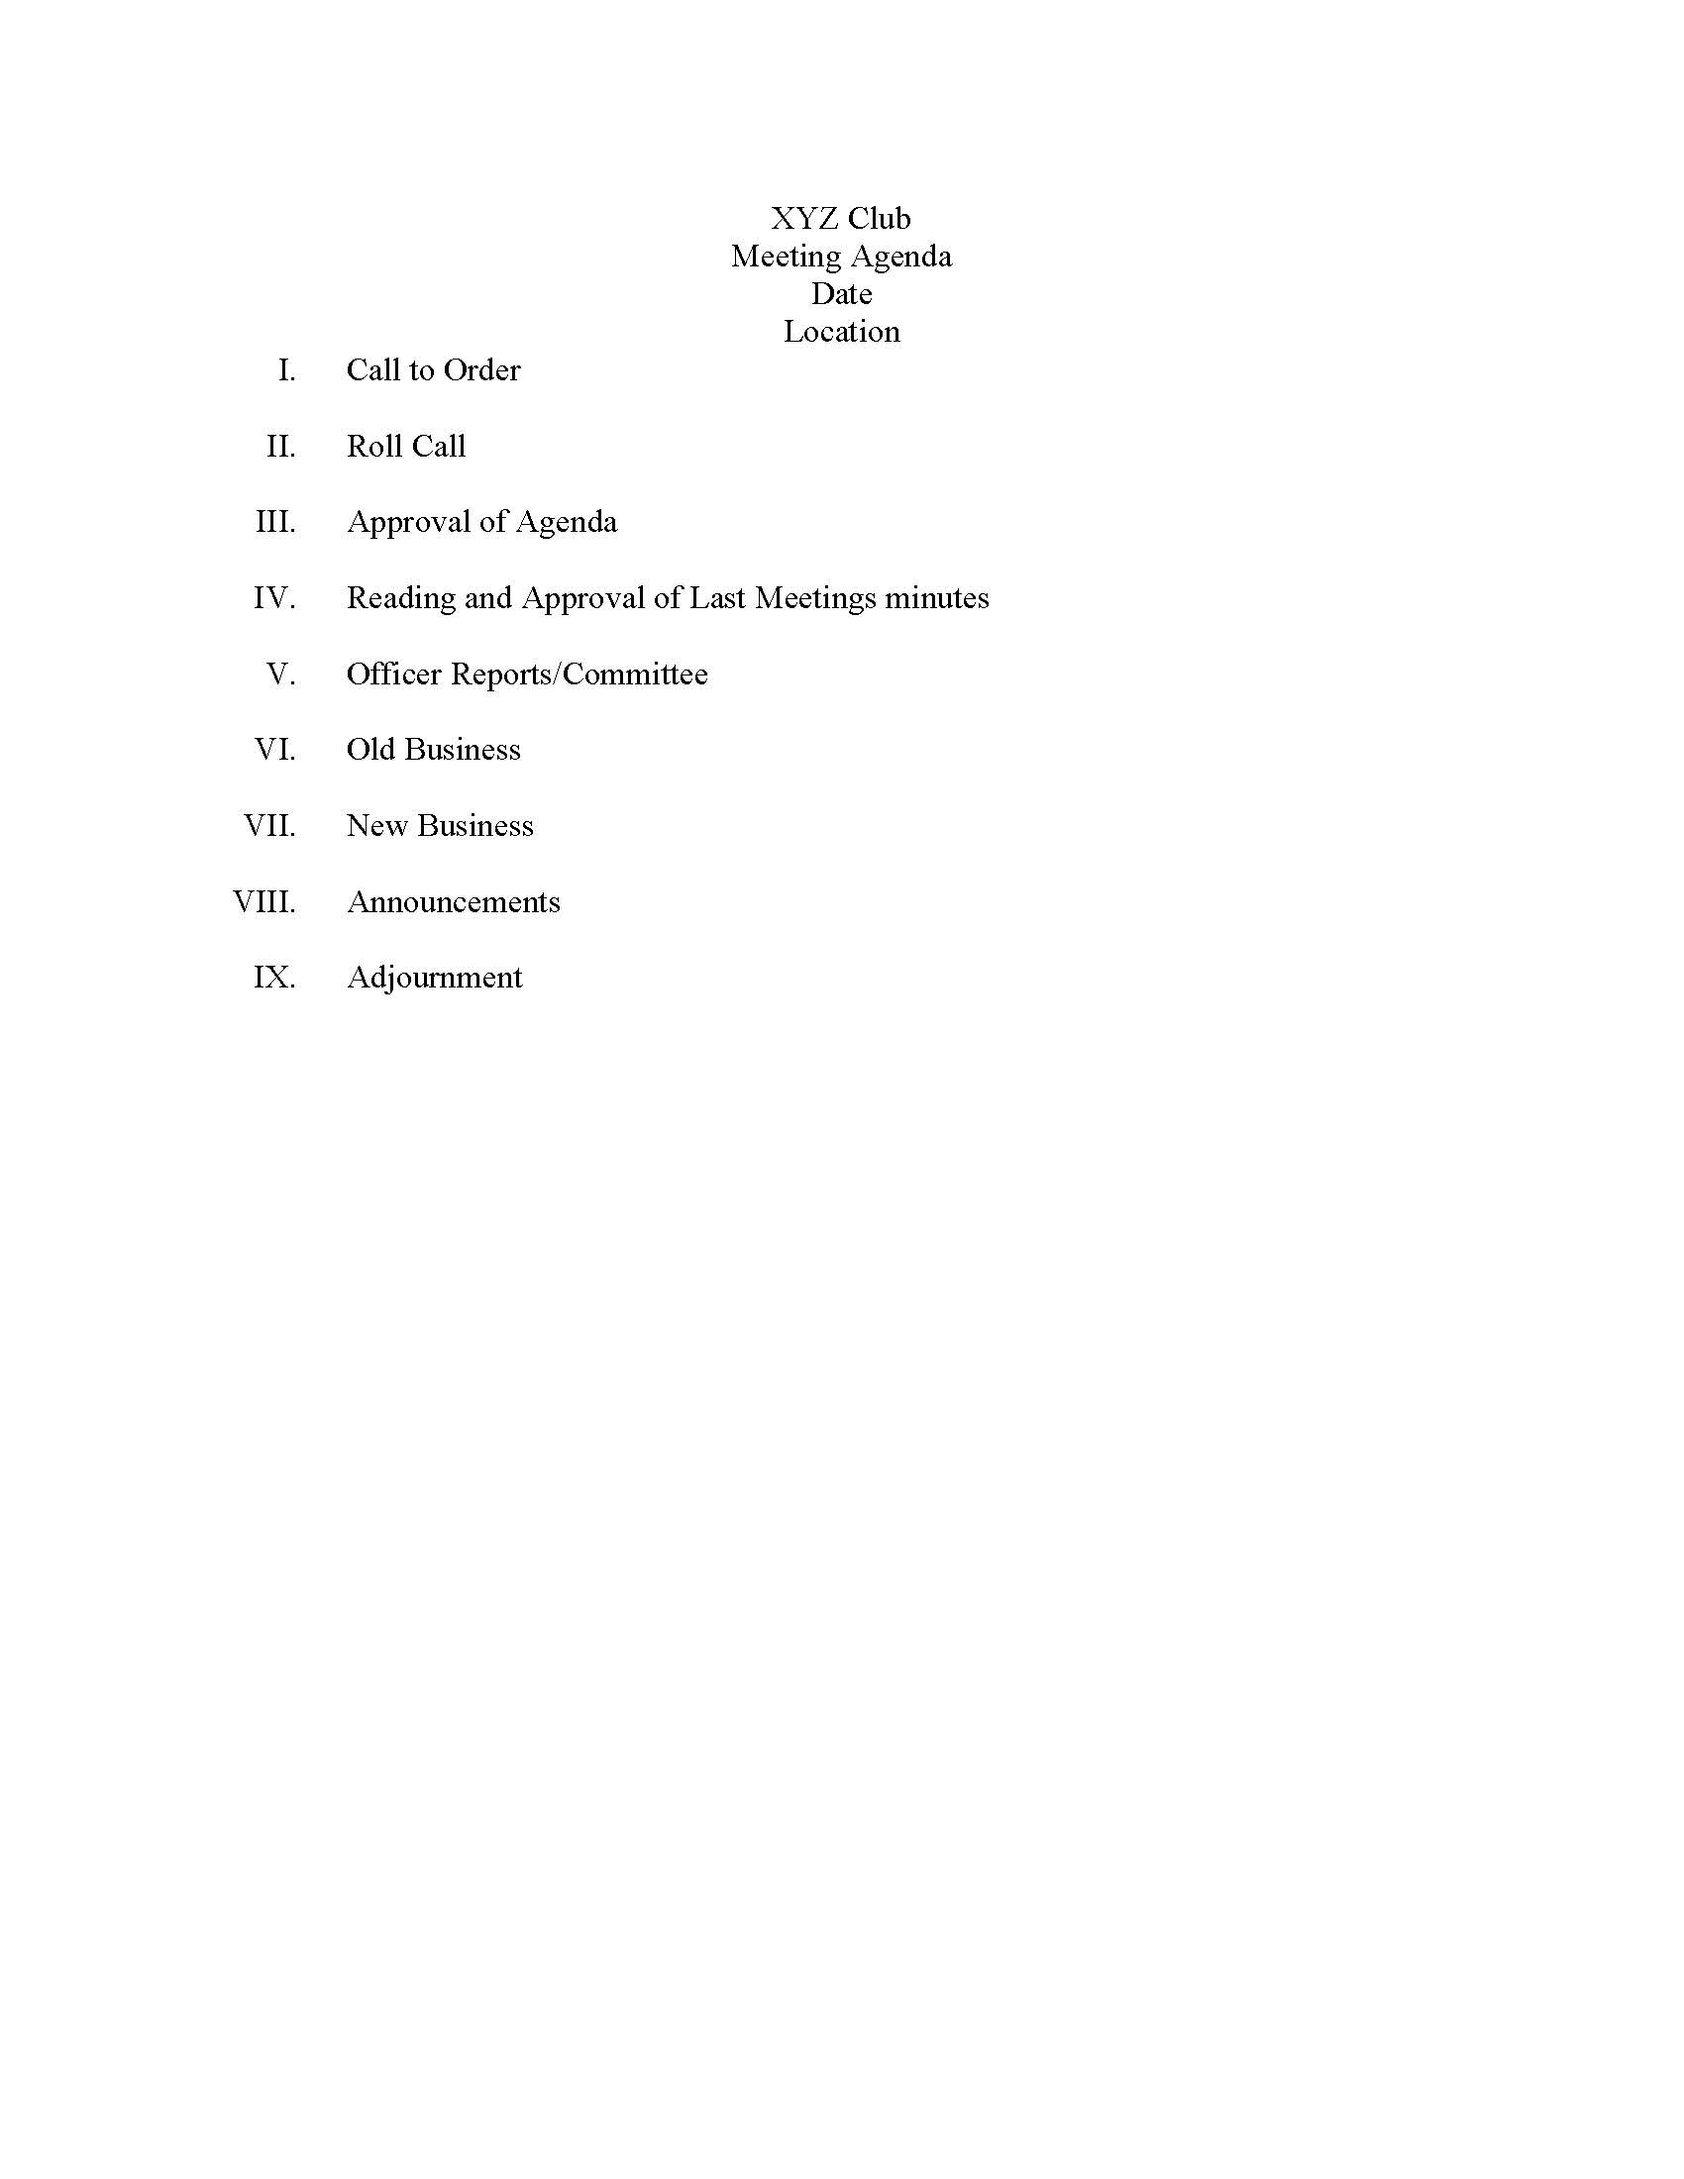
Sample Meeting agenda
Taking minutes is essential for running an effective student organization.
Minutes should be thorough so those who were not able to attend a meeting would understand the gist.
Minutes can be used to hold members or officers accountable for attendance, event planning, or volunteering.
Minutes are required for all reimbursements or charges to student organization bank accounts.

Slide 33
Recruitment Tips and Tricks
Things to think about when recruiting members…
Why recruit new members?
Think about the future of the organization
Meet new friends
New Members bring in new ideas and talents
New Members help the organization grow
Why would people join your organization?
Explain the benefits of membership
Showcase leadership opportunities
Display your Purpose and Mission of the organization
How are you different from other organizations?

Slide 34
Recruitment Plan
A recruitment plan is essential in order to make your efforts effective:
Set Goals! How many members? Are there specific students you are trying to reach?
Brainstorm methods…How will you reach your recruitment goals?
Budget resources: Giveaways, advertising, supplies, etc.
Create a calendar: When are you going to recruit? Where are you going to recruit?
Delegate tasks: All members should be a part of recruitment.
Implement the plan: Recruitment is a full-time commitment, make sure you are having fun with it!
Evaluate the outcome: Did you reach your goals? What would you change for next time?

Slide 35
Retention
Maintaining your new members is as important as recruiting new members. Be sure you are taking the steps to keep your new members involved and invested in your student organization.
Provide new member training
Create a mentoring plan for new members or for those members moving into a leadership position
Have involvement opportunities or tasks ready for all members
Provide opportunities for all members to give input and feedback
Use social activities to create bonds between all members

Slide 36
Goal Setting
Have your organization create long term (academic year) and short term (semester) goals.
A good template to utilize to help your organization set goals is the S.M.A.R.T goal setting technique.
Specific: Answer the questions of what, why, who, where and which
Measureable: How much? How many? How will I know when it has been accomplished?
Achievable: Is your goal realistic and attainable? How will I know the goal was accomplished?
Relevant: This drives the team/organization forward. Does your goal seem worthwhile? Right for our time? Match our efforts and needs?
Time: The amount of time needed to achieve your goal. 6 weeks? 6 months? 1 year?

Slide 37
Orientation Complete
To complete your orientation and obtain your Charter Application
CLICK HERE
(you must be in slideshow for the link to work)

