Slide 1
ARE YOU @ RISK?
Notes:
Thank you for taking the time to go through the Alcohol Education presentation “Are you at Risk”, presented by the Peer Health Educators.

Slide 2
Learning Objectives
Raise awareness of safer behaviors regarding alcohol use
Assess drinking patterns and influence positive change, where necessary
Increase awareness of the consequences of alcohol misuse
Develop skills and confidence when responding to (potential) alcohol overdose situations
Notes:
Are You @ Risk is a workshop that focuses on alcohol safety for college students.
The learning objective of this presentation are:
To raise awareness of safer behaviors regarding alcohol use
To help students assess drinking patterns and influence positive change, where necessary
To increase awareness of the consequences of alcohol misuse
To help students develop skills and confidence when responding to (potential) alcohol overdose situations

Slide 3
Assessment Questions
*Please use a separate piece of paper to record your answers.
Notes:
Throughout this presentation you will be asked to answer 10 questions that focus on your current drinking patterns and alcohol-related behaviors. In order for you to participate in the assessment you will need to have a piece of paper and a pen or pencil. Please number the paper 1 through 10. When you answer each question, you will need to write down the letter that corresponds to your answer. For example, for question 1, if your answer is “a) never,” you only need to write “a”. There is a corresponding number with each question answered and at the end of the presentation you will calculate your answers. The end result is that you will be able to calculate the risk associated with alcohol-use. It is important to answer each question honestly and carefully. You are not required to submit your answers – this is just for your awareness.

Slide 4
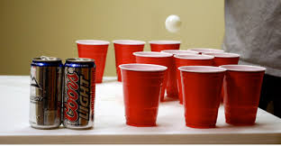
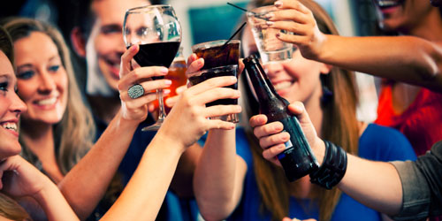
Drinking in College
Many students enter college with already perceived drinking attitudes and behaviors
They have perceived notions of drinking in college such as “That’s what college students do”
All college students experience the effects of drinking in college – whether they drink or not
Notes:
Drinking has become a ritual that students often see as an integral part of their college experience
Students enter into college with established drinking habits, some habits have the risk of leading to alcohol abuse and some cases alcohol related death.
Many students justify their poor drinking habits with “that’s what college students do”
Research has shown that more than 80% of college students drink alcohol, and almost half reported they were binge drinking in the past 2 weeks
All college students experience the effects of drinking in college – whether they drink or not.

Slide 5
Question 1
How often do you have a drink containing alcohol?
Never
Monthly or less
2-4 times a month
2-3 times per week
4 or more times a week
[Press enter when ready to proceed]
Notes:
Remember to write the corresponding letter to your answer. For example, if your answer is “a) never,” write “a”.

Slide 6
Reported Use VS. Perceived Use
Alcohol | Actual Use | Perceived Use
Never Used | 32.4% | 5.3%
Used, but not in the last 30 days | 20.1% | 2.5%
Used 1-9 days | 42.2% | 34.9%
Used 10-29 days | 5.3% | 38.3%
Used all 30 days | 0.0% | 18.6%
Any use within the last 30 days | 47.5% | 91.8%
Notes:
This graph represents reported alcohol use within the past 30 days compared with how often students PERCEIVE the typical student on campus using alcohol within the same period of time. As you can see, there is a great divide between students' perception and the facts. This is a problem because when students think or “PERCEIVE” that their peers are drinking more, they’re inclined to do the same to fit in with what they believe is the norm.
For example, as seen on the chart students perceived that 5.3% of students have never used alcohol, when actually 32.4% reported that they have never used alcohol.

Slide 7
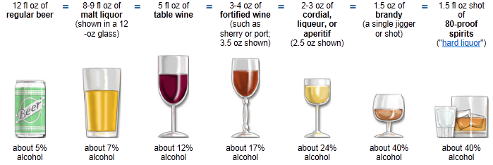
1 “Drink”
1 Standard Drink
National Institute on Alcohol Abuse and Alcoholism 2012
Notes:
Many people are surprised to learn what counts as a standard drink. Although these drinks are different sizes, each contains approximately the same amount of alcohol and counts as a single standard drink.
When we’re served a large red cup of beer, an over-poured glass of wine, or a single mixed drink, its possible that the drink could contain much more alcohol than what is considered a “standard drink.”
Although the standard drink amounts are helpful for following the health guidelines, they often do not reflect normal serving sizes – particularly in a college environment.

Slide 8
Question 2
How many drinks containing alcohol do you have on a typical day when you are drinking?
1 or 2
3 or 4
5 or 6
7 to 9
10 or more
[Press enter when ready to proceed]

Slide 9
Question 3
How often do you have six or more drinks on one occasion?
Never
Less than monthly
Monthly
2-3 times per week
4 or more times a week
[Press enter when ready to proceed]
Notes:
Remember, this is asking you how many “standard” drinks you have on one occasion.

Slide 10
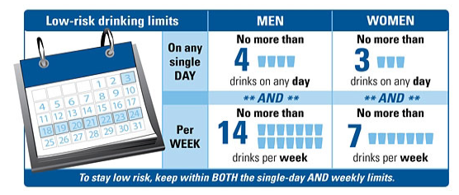
Low-Risk Drinking Limits
National Institute on Alcohol Abuse and Alcoholism 2012
Notes:
According to the Dietary Guidelines for Americans, moderate drinking is up to 1 drink per day for women and up to 2 drinks per day for men. Low-risk drinking levels, as defined by the National Institute on Alcohol Abuse & Alcoholism (or NIAAA) define low-risk drinking as no more than 3 drinks a day AND no more than 7 drinks per week for women, and no more than 4 drinks a day AND no more than 14 drinks per week for men.
It’s important to know that “low-risk” doesn’t mean “no-risk”. Even within these limits people can have problems if they drink too fast, are taking medications that interact with alcohol, or are
managing a health condition that can be affected by alcohol consumption such as diabetes or heart disease. It’s also important to note that you should not drink any alcohol if you’re planning on driving or are pregnant or trying to become pregnant.

Slide 11
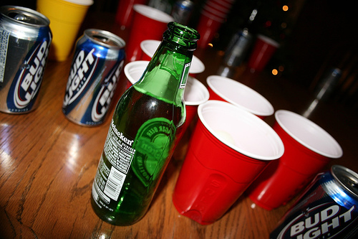
Binge Drinking
1 in 6 US adults binge drink.
Binge drinkers do so about 4 times a month.
The average number of drinks per binge is 8.
Notes:
The National Institute on Alcohol Abuse and Alcoholism defines binge drinking as a pattern of drinking that brings a person’s blood alcohol concentration (BAC) to 0.08. This typically occurs after 4 drinks for women, and 5 drinks for men. Take note this is just over the “low-risk” drinking limits we just discussed.
1 in 6 US adults binge drink.
Binge drinkers do so about 4 times a month.
The average number of drinks per binge is 8.

Slide 12
Question 4
How often during the last year have you found that you were not able to stop drinking once you had started?
Never
Less than monthly
Monthly
2-3 times per week
4 or more times a week
[Press enter when ready to proceed]

Slide 13
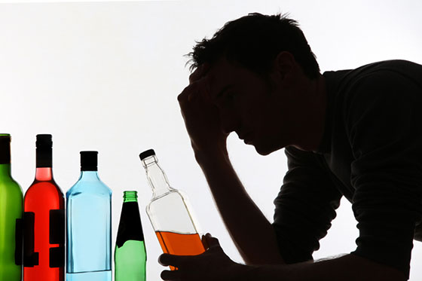
Signs & Symptoms of Misuse
Notes:
Experts can make a distinction between alcohol misuse and alcoholism. Unlike alcoholism, alcohol misusers have some ability to set limits on their drinking, however, their alcohol use is still self-destructive and dangerous to themselves, and can progress into alcoholism. Some common signs of alcohol misuse include:
1) Repeatedly Neglecting Responsibilities (such as performing poorly at work, poor or failing grades in school, or skipping out on commitments because you’re hung over)
2) Alcohol Use in Dangerous Situations (such as drinking and driving, drinking with prescription medication against the advice of your doctor)
3) Legal Problems Due to Drinking (such as getting arrested for fights, drunk and disorderly conduct, domestic disputes, or DUI)
4) Continued Drinking Despite Relationship Problems, or
5) Drinking to De-Stress
Many drinking problems start when people use alcohol to relieve stress.

Slide 14
Question 5
How often during the last year have you failed to do what was normally expected from you because of drinking?
Never
Less than monthly
Monthly
2-3 times per week
4 or more times a week
[Press enter when ready to proceed]

Slide 15
Question 6
How often during the last year have you needed a first drink in the morning to get yourself going after a heavy drinking session?
Never
Less than monthly
Monthly
2-3 times per week
4 or more times a week
[Press Enter when ready to proceed]

Slide 16
The Morning Drinker
There is not much difference between drinking alcohol at 9 in the morning and 9 at night.
“The hair of the dog”
Drinking in the morning to alleviate the symptoms of a hangover
There are dangers associated with drinking in the morning
Notes:
There is not much difference between drinking alcohol at 9 in the morning and 9 at night.
The hair of the dog – is a drink that people consume in order to lessen the effects of their hangover
If people have consumed an excessive amount of alcohol the night before they can have many unpleasant physical symptoms the next day.
Although drinking alcohol in the morning after a heavy drinking session may alleviate the symptoms of a hangover it is not recommended. It only puts off the symptoms and it can too easily become a habit
Some of the dangers of drinking in the morning are:
Feeling the need to drink in the morning to face the day is a sign of psychological dependence on alcohol
Drinking in the morning can easily lead to drinking all day
Drinking in the morning can make an individual more accident prone
Reduced productivity. Struggle to maintain responsibilities
Drinking in the morning is usually done alone, this means that the individual is drinking to feel the effects of alcohol not be social.

Slide 17
Question 7
How often during the last year have you had a feeling of guilt or remorse after drinking?
Never
Less than monthly
Monthly
2-3 times per week
4 or more times a week
[Press enter when ready to proceed]

Slide 18
Question 8
How often during the last year have you ben unable to remember what happened the night before because you had been drinking?
Never
Less than monthly
Monthly
2-3 times per week
4 or more times a week
[Press enter when ready to proceed]

Slide 19
Question 9
Have you or someone else been injured as a result of your drinking?
No
Yes, but not in the last year
Yes, during the last year
[Press enter when ready to proceed]

Slide 20
Drinking Consequences of CSU Stanislaus Students
Did something they later regretted | 25.6%
Forgot where they were or what they did | 24.1%
Got in trouble with the police | 2.1%
Someone had sex with them without their consent | 1.6%
Had sex with someone without their consent | 0.4%
Had unprotected sex | 15.6%
Physically injured themselves | 11.2%
Physically injured another person | 1.2%
Seriously considered suicide | 2.5%
2.3% of CSU Stanislaus students reported driving after having 5 or more drinks in the last 30 days
22.0% of CSU Stanislaus students reported driving after having any alcohol in the last 30 days
Notes:
According to the National College Health Assessment conducted in Spring 2013, 67.6% of CSU Stanislaus students drank alcohol in the last 12 months.
The chart displayed shows some of the outcomes that those students experienced under the effects of alcohol. These outcomes include such things as regrets, injury and unprotected sex.

Slide 21
Question 10
Has a relative or friend, or a doctor or other health worker, been concerned about your drinking or suggested you cut down?
No
Yes, but not in the last year
Yes, during the last year
[Press enter when ready to proceed]

Slide 22
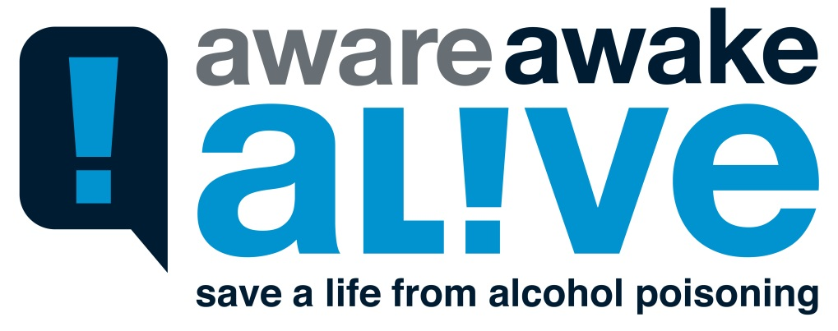
Carson's Story
Notes:
Please click on “Carson’s Story” to view the Aware Awake Alive video to learn about Carson, a freshman from Cal Poly SLO who died from alcohol overdose.

Slide 23
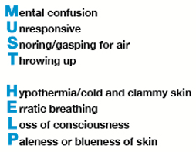
Don’t wait – CALL 911 if you suspect alcohol poisoning
Notes:
Alcohol depresses nerves that control involuntary actions such as breathing and the gag reflect, which prevents choking. It is common for someone who drank an excessive amount of alcohol to vomit since alcohol is an irritant to the stomach. There is then the danger of choking on vomit, which could cause death by asphyxiation in a person who is not conscious because of intoxication.
You should also know that a person’s blood alcohol concentration (BAC) can continue to rise even while he or she is passed out. Even after a person stops drinking, alcohol in the stomach and intestine continues to enter the bloodstream and circulate through the body. It is extremely dangerous to assume a person will be fine by sleeping it off.
The signs of alcohol poisoning are:
- mental confusion
- unresponsive – unable to be roused or awakened
- snoring or gasping for air
- throwing up
- hypothermia or low body temperature, usually identified by cold and clammy skin
- erratic breathing which includes slow breathing (fewer than 8 breaths per minute) and irregular breathing
(10 seconds or more between breaths)
- loss of consciousness
- paleness or blueness of skin
A person showing any of these signs requires immediate medical attention. Don’t wait. If you suspect someone has alcohol poisoning, call 911 immediately.

Slide 24
Assessment Scoring
Questions are graded on a point scale.
Questions 1-8 are scored:
= 0 points
= 1 points
= 2 points
= 3 points
= 4 points
Questions 9 & 10 are scored:
= 0 points
= 2 points
= 4 points
Add the numbers from each question together.
Notes:
The assessment is simple to score. Each response has a scoring range from 0 to 4 points. All of the response scores should be added together to determine the final score. After you have calculated your score hit “enter” to continue the presentation.

Slide 25
What does your score mean?
Total scores of 8 or more generally indicate hazardous and harmful drinking.
It should be noted that since the effects of alcohol vary with average body weight and differences in metabolism, a score of 7 will increase the sensitivity for women and men over 65 years of age.

Slide 26
Resources
CSU Stanislaus Psychological Counseling Services – MSR 210
(209) 667-3381
Alcoholics Anonymous - Central Valley Intergroup 24 Hour Hotline: (209) 572-2970 Toll Free: (866) 507-6237
National Institute on Alcohol Abuse and Alcoholism
(301) 443-3860
Substance Abuse and Mental Health Services Administration Help Hotline
1-800-622-HELP (4357)
CSU Stanislaus Student Health Center
(209) 667-3396
Notes:
If your score was alarming to you in any way, you can reach out to any of these resources and talk to someone about your current alcohol use patterns. The Psychological Counseling Center is located in the MSR building, Office 210, and is a free service for CSU Stanislaus students.

Slide 27
References
http://www.niaaa.nih.gov/
(National Institutes of Health - National Institute on Alcohol Abuse and Alcoholism)
www.collegedrinkingprevention.gov
(College Drinking – Changing the Culture)
www.abovetheinfluence.com
(Above the Influence)
www.cdc.gov
(Centers for Disease Control and Prevention)
www.who.int/
(World Health Organization)
www.bacchusnetwork.org
(BACCHUS Network)
www.friendsdrivesober.org
(Friends Drive Sober)
www.leginfo.ca.gov
(Official California Legislative Information)
https://ncadd.org/index.php
(National Council on Alcoholism & Drug Dependence, Inc.)
Notes:
If you are interested in where we have obtained are information here is a list of references that we use. Should have more questions you can visit the Health Education office located in the Student Health Center and talk with our University Health Educator Megan Rowe.

Slide 28
Workshop Complete
To complete your orientation and obtain access to the final step: the assessment questionnaire
CLICK HERE
(you must be in slideshow for the link to work)

