Slide 1

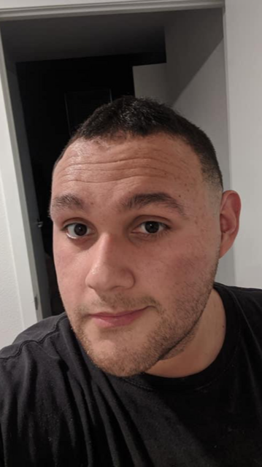
In Loving Memory Of
Anthony Gonzales
09/23/93-03/15/21

Slide 2
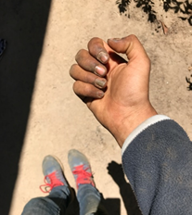

Introduction
Whose hands are these?
Are these the hands of a scholar?
Notes:
Thank you for joining us today. We know that each of you is actively involved in meeting the needs of students who are experiencing food and housing insecurity. We hope this information is helpful to your important work.
Who's hands are these? Are these the hands of a scholar?
The Central Valley is the bread basket of the United States, sustained through the labor and exploitation of mostly non-English speaking migrants. In this region, immigrants are both constantly made available and as well constantly made disposable. The irony is, even while sustaining the bread basket of the country, the individuals in those fields face higher than average food and housing insecurity rates. Many of the students at CSU Stanislaus, a Hispanic Serving Institution (HSI), come from a household where the main source of income is dependent on farm or agricultural related labor. With climate change, housing costs, living costs on the rise, and wages stagnant, students who come from an agricultural dependent background are experiencing food and housing insecurity at unparalleled levels.
Yet amidst all the hardship, these students are tenacious in the face of their struggles. These struggles include being malnourished while going to school which inflicts a great deal of mental distress. Food and housing insecurity is made worse by barriers such as high cost of parking, intergenerational poverty, family responsibilities and LGBTQ.
We are going to share the research we conducted about food and housing insecurity at Stan State. We will give you pictures and stories of our students' struggles.

Slide 3
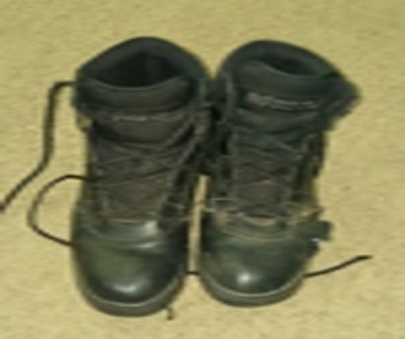
FHI: Food and Housing Insecurity on the CSU Stanislaus Campus
Notes:
The purpose of this project was to raise awareness of the problems that students who face food and housing insecurity deal with on a daily basis while trying to succeed at Stan State. There was a great deal of literature about the problem in general, but very little information from the voices and perspectives of students who are experiencing food and housing insecurity including no information or data specific to perspectives of Stan State student. This project was also meant to give Stan State students who experience food and housing insecurity an opportunity to conduct research to promote action regarding this issue. We want raise awareness of the lack of permanence of the programs at Stan State.

Slide 4
Research Team
Britt Welker
Brittany Orhategaray
Rachel Riojas
Jennifer Smith
Angela Vignau
Jasmin Centeno
Juana Nieto
Kassandra Barba
Anthony Gonzales
Marissa Seaman
Willie Stewart III
Hitesh Kumar
Michelle Garibay
Manny Nunez
Patricia Moran
John Garcia
Jane Rousseau
Kelvin Jasek-Rysdahl
Michael Taylor
Celina Serna
Zachary Gurr
Notes:
Our project began in May of 2019 when we were recruited by university professors affiliated with the Center for Public Policies Studies to join them as part of a research team of students who had or were experiencing food and housing insecurity and university professors. It is important to state that the experiences and consequences of food and housing insecurity are not the outcome of the COVID-19 pandemic. These problems existed before the pandemic and it is likely that they will be with us after the pandemic is over.
There were 18 co-researchers on this team. This included three faculty researchers and 15 students. These are the people who are part of this research team.

Slide 5
Methodology
Qualitative Research – March/April, 2020
PAR Research
Flexible Diary Method
Themes:
Mental Distress; 2) Physical Distress; 3) University Barriers; 4) Family Responsibilities; 5) Intergenerational Poverty; 6) First Generation Students; 7) Societal Expectations; 8) Survival Mode; 9) Community Disadvantages (barriers); 10) Cultural & Diversity; 11) LGBTQ
Notes:
Most research is conducted by university researchers who control knowledge and serve as the experts thus know the questions that need to be asked. Our research is based on the belief that students struggling to meet their basic needs are the experts of their situations and ultimately hold the answers (and questions) to their situations.
Participatory Action Research offers an alternative approach to traditional research which fundamentally embraces the concept of approaching issues from the perspective of those most affected by them. Our research approach therefore was based on building partnerships between students and the Stanislaus State faculty and administrators who are attempting to create effective interventions to prevent students from becoming food and housing insecure.
Our PAR team spent six months engaged in understanding student experiences with food and housing insecurity with the purpose of identifying our guiding research question. Three of these months was spent sharing stories and building trusting relationships. Based on those discussions, this group decided that the most pressing issue was sharing the lived experiences of the students at Stan State who live with food and housing insecurity.
Ultimately the team made the decision that the co-researchers would also be the participants of the study. We used a Flexible Diary Method to capture the data of the pressing issues of food and housing insecurity at Stan State. The participants were provided with options for capturing their stories (data). First, they had the option of “devices”: notebook, computer, and/or camera. Next, they had the option of mediums: written text, photographs, sketches, artifacts, etc. Their instructions for data collection was to use their devices and mediums to tell/document their experience related to 11 themes (that the research team created/defined as a theoretical framework for understanding food and housing insecurity):
While the story/experience was being told, notes were taken by the research facilitators. Co-researchers asked questions for clarification purposes and were also provided the opportunity to “relate” to the experience that is being described. Once all stories had been told (all data presented), the research team decided if more data need to be collected. If more data were needed, the participants were provided with another data collection period and the same process will follow until the point of saturation.
All of the quotes and pictures in this presentation are the data that were collected as part of the flexible diary method.
The data were analyzed as a team. The research team organized the data around the 11 theme (the theoretical framework) and used Neuman’s (2003) five part plan for qualitative data analysis: sorting; open coding, axial coding, selective coding, and elaboration.
We have introduced you to the way we conducted this study, now we want to tell you about what we found. We will walk you through the findings but we want you to know that as we identify the themes at the end we will connect the themes to the issue.

Slide 6
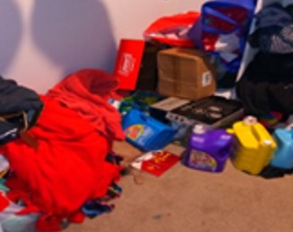
Mental Distress
Mental distress concerns involve a range of factors that encompass psychological and emotional well-being.
Because of the negative impacts, students experience hopelessness, stigma and shame.
These affect students’ academic performance and productivity level at a negative rate compared to those who are not facing food and housing insecurities.
Notes:
Mental distress can be as chaotic as a messy room. The image of disorganization reflects the disorganization going on inside our mind. A good measure of mental wellness can be how organized surrounding are, representing some excess time for cleaning which can come few and far between.
The research team developed a definition of each theme that is based on their lived experiences. This is the definition of Mental Distress developed by the student co-researchers. All who had experienced or were experiencing mental distress as a result of food and housing insecurity. Mental distress encompasses psychological and emotional well-being. Students experience hopelessness, stigma and shame. It negatively affects their academic performance and productivity.
Many students are not only going to school full-time on the CSU Stanislaus campus, but also have a job, trying to engage in extracurricular activities, internships, etc as well as family responsibilities among other things. All of these things on top of struggling to afford rent and not being able to afford food.
There is not enough time in the day for everything that needs to be done. Even if we had the time, the incapability that mental distress exhibits can leave you not able to complete simple things.
Students have too many things going on to able to complete things like cleaning.
This struggle should not be praised; it is the result of inescapable poverty.

Slide 7


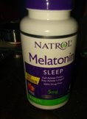

Several participants talked about their struggles with depression:
“I understand being poor, that has become my new normal, but not being able to make any money at all is even more stressful. It is a sense of no control at all.”
“ In a way I feel like I don’t belong at CSU Stan, this has influenced the mentality that I have of “I just want my degree so I can put it on my resume”.
I’ve spoken about my food and housing insecurities to a few of my friends (and they tell me) that I just have to find a job. I’m also getting tired of the phrase “If they can do it, you can do it.”
"As college students we are expected to suffer to some extent, but some push too hard, and use it as an excuse to ignore or devalue what we are experiencing."
Notes:
In our study, our universal finding was depression, anxiety, and shame across the board. Here are some examples of what students are experiencing.
“I understand being poor, that has become my new normal, but not being able to make any money at all is even more stressful. It is a sense of no control at all.”
“ In a way I feel like I don’t belong at CSU Stan, this has influenced the mentality that I have of “I just want my degree so I can put it on my resume”.
I’ve spoken about my food and housing insecurities to a few of my friends (and they tell me) that I just have to find a job. I’m also getting tired of the phrase “If they can do it, you can do it,”
"As college students we are expected to suffer to some extent, but some push too hard, and use it as an excuse to ignore or devalue what we are experiencing."

Slide 8
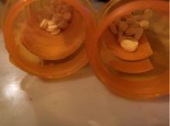
Continued…
"I went thru a depression funk but the intensity was something I had never experienced, ... there was a week that I cried everyday throughout the day, and I didn’t understand why I was crying. I hated how negative I was being, but I couldn’t stop. This has led to isolating myself and it’s hard for me to be vulnerable."
"(My doctor) asked me about the possibility of therapy along with psychiatry, but as a student who goes to school full-time and works part-time I have no time."
Medication for depression
Notes:
Our students feel hopeless and pure desperation.
One student talked about the impact of food and housing insecurity on mental health.
The left quote represents the severity of how mental distress can affect students.
Play the first quote
The quote on the right represents the dead end we feel.
Play the second quote

Slide 9
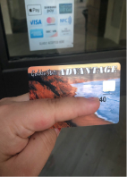
Physical distress
Physical distress concerns involve a range of stratifying factors that include no health insurance, poor nutrition, physical exhaustion and substance abuse.
These factors may produce escalating illnesses and high medical bills. Many students who cannot afford medicine or doctor visits resort to self-medication through drug and alcohol abuse. This can be exasperated by poor nutrition or malnutrition.
If these issues are not addressed this can lead to repercussions such as risky behaviors, physical illness and overall degrading health.
Notes:
This is the definition for physical distress. In our study, the universal struggle of all food and housing insecure students was the distress that it caused to their physical health as well. The student co-researchers defined what this is in terms of its impact. This can look like many things including lack of energy, inability to concentrate in class, poor nutrition, extreme weight gain or loss, substance abuse, not being able to afford medical visits, medication, treatments, etc as well as other risky behavior being completed for monetary need.

Slide 10
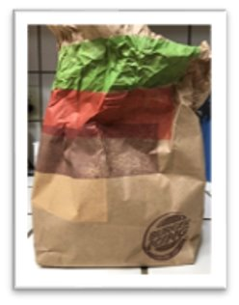
Physical Distress​
A lot of the times there is .. not enough food in the house(and) not enough money to buy groceries so, fast food has become the norm in my house … I have eaten fast food so much that it makes me sick. . . Mentally it makes me sluggish and not as coherent, giving me mood swings and depressing tendencies.
Notes:
Our healthy choices cost so much more. A salad costs $7-$10 but we can get a $1 burger that fills us up. Fast food is so convenient with our busy schedules, and healthy food costs so much more.
Fast food is often times the only option and it is not a good one. Food insecurity is not just about a lack of food, it can be about the quality of food and the lack of options that your budget can afford.
Physical distress and mental distress play off each other and can result in long term health crisis's.
Play recording
Students who are food and housing insecure face physical and mental distress and our research indicated that University Barriers exacerbate these issues.

Slide 11
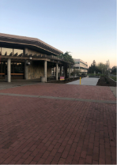
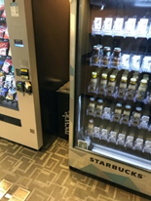
University Barriers
University barriers are the result of restricting campus policies.
These directly impact students by forcing them to seek other employment due to university hour limitations causing students to focus less on academics.
The high cost of food provided on campus causes students to either not eat or spend money that they do not have.
This either increases debt or leaves students hungry. Students must negotiate between attending class, workshops, etc. and other pressing needs.
Notes:
The next major theme to emerge from the research focused on university barriers.
This is the definition of university barriers that we developed. University barriers are the result of restricting university policies. Some of these are system-wide such as financial aid rules and some are campus specific such as access to food. For many of us the only money we have for food is our EBT cards which we can't use on campus. Some times on our campus the food distribution is in a highly stigmatizing place. It is embarrassing to walk around campus with a food box.
Play the quote
One student even had to throw most of the food from the food box away after it spoiled because it sat in her hot car most of the day. – A heavy box full of metal cans IS NOT ACCESSIBLE
These barriers reflect lack of prioritization of food and housing insecurity.

Slide 12
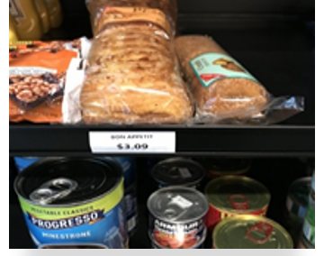

University Barriers
"I will avoid buying food on campus because it is so expensive and I just don’t have the money to spend. If that means I don’t eat then I don’t eat. Sometimes I sit in class struggling to focus on what we are doing because I’m starving."​
"The fees to use the atm is $3.00 and another $3.00 from my bank. The parking passes are $200.00 and that is money that can be spent on food."​
"Sometimes my budget only allows for me to have one snack while I’m at school sometimes 10-12 hours. "
Notes:
Play Quotes

Slide 13
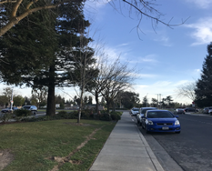
University Barriers
This represents the distance away from campus I walk to find parking. The fees for parking are $200.00 a semester and I have to make a choice that food and family responsibilities are more important.
Notes:
Stan State is a commuter school and parking can be a barrier and a form of discouragement. Access to the bus system is not enough because many students are commuter students. Using the bus is not a reasonable option for students with family responsibilities, jobs, and many other obligations.
Play quote
Students need to drive to the campus because there are no public transit options available between counties in the Stan State service area. This means that parking is a very important concern for students struggling with food and housing insecurity. Parking is a huge cost that many students cannot afford which means they must park farther away and allot more time out of their day for parking.
This is not only a barrier, but it shows this divide between who can afford this and who can't.

Slide 14
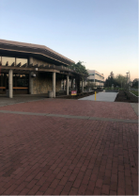
University Barriers
Many people do not expect to be driving on average 40-60 minutes to and from a university. For me I have to leave very early for school sometimes 7-8 am just to beat traffic, and find a decent parking place outside of campus. It would cost me $200 to park on campus, so I park on the streets.
I leave my house early so that I hopefully can find a parking spot. Some days it can take almost a half-hour just to make it class and that is speed walking. I have to navigate my choices carefully always keeping me under some sort of pressure and stress. These worries and concerns are more than just normal student concerns this on some days are running on basic survival just to get through the day.
Notes:
Play the recordings

Slide 15
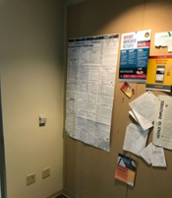
Where is the microwave?
The lack of accessibility causes students to feel excluded.
The microwave is located approximately 50-70 yards away from the arranged eating area for the students. And as you can see the room has employee information in the room. Meaning to me that it was never really set up for students but for faculty. This is possibly why it is 50-70 yards away from students eating area.
Notes:
Students who struggle with food and housing insecurity bring food from home because it is too expensive to purchase food on campus so they need a microwave. Microwaves are few and far between. When you can find a microwave it is obviously not intended for the hungry student. Microwaves should be much more accessible for students.
This highlights the inaccessibility of simple needs. Microwaves are only found in places that are or feel like faculty and staff lounges.
Other resources that may feel inaccessible include: hydrations stations and healthy food vending machines.
Play the recording.

Slide 16
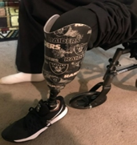
Family Responsibilities
This picture was shared by a participant of their disabled parent being at home alone as they are an hour away at school for extended hours of the day and how stressful this is. This leaves this participant feeling “like I shouldn’t focus on my education”:
Notes:
The next major theme to emerge from the research focused on family responsibilities.
As food and housing insecure students, we never leave our worries behind. We have full worrisome lives. We want better, and are sacrificing for better... but many times this is what we are leaving behind. Food and housing insecure students often have multiple family responsibilities.
This picture was shared by a participant of their disabled parent being at home alone as they are an hour away at school for extended hours of the day and how stressful this is. This leaves this participant feeling “like I shouldn’t focus on my education”:
The common misconception that college students are living at home with mom and dad does not represent the situation of many college students. And for those living at home this does not equate to having zero bills or worries. Many of us have bills, kids, and other responsibilities than just college.
The university is set up for the "normal" incoming students straight out of high school, but the students at Stan State do not fit this conventional image. A "student ready" campus would recognize this and there would be more flexibility and accessibility.

Slide 17
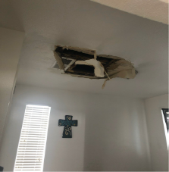
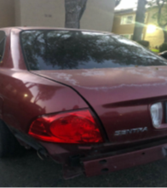
Intergenerational Poverty
I have had to choose between paying for repairs or using my money for food and rent.
Notes:
The next major theme to emerge from the research focused on intergenerational poverty.
Intergenerational poverty is having to make choices between college textbooks and necessities like car repairs. These are choices people should not have to make.
We can’t help what we were born into but no one should be punished for trying to make a better life for themselves. Stanislaus State has the responsibility to help us in times of desperation and there are too few opportunities for those in desperate need. The reason people go to school is to get ahead and get out of poverty and that is extremely difficult to do without resources like a car, affordable housing, savings to use in case of an emergency, access to healthy food options, etc. Some people do not have the support system to help them with these things and it is vital that the school assists with students who are trying to escape poverty.
This picture came from a student who has 2 little kids at home. When we say car repairs, food and rent... its serious, other people depend on us as well.
Play the recording.
Campus Cares emergency funding is only accessible if you take out all of your loans.

Slide 18

First Generation College Student
This picture represents over-working as a first-generation college student. During the summers, I worked as a seasonal field worker which is really exhausting. I had to wake up at 3:30 in the morning, make my lunch and go to work. I was exposed long hours in the sun as well as chemicals (i.e., pesticides). I was also exposed to poor health conditions. My knees, back and hands hurt, I couldn’t do anything but to continue working. I feel overworking is a necessity in order to cover my personal and family responsibilities. During the semester, I was always looking for job opportunities on campus. Sometimes I could not socially connect with my classmates, professors and/or family because I would think about this constantly. As a student, I would not participate in class, programs and/or clubs at school because I just felt physically and mentally exhausted.
Notes:
The next major theme to emerge from the research focused on being a first generation college student.
Many students who experience food and housing insecurity are the first in their family to attend a four-year college or university to attain a bachelor’s degree. Some of the consequences experienced due to being a first-generation student are the lack of guidance and support available from family. Major impacts first generation students face are overworking, feeling disconnected from other students, and feeling shame, and lowered self-esteem. Other impacts include guilty feelings for not being able to help the family. Being overly focused on the family situation may take over the ability to focus on school. These impacts may result in lower educational performance.
Play the recording

Slide 19
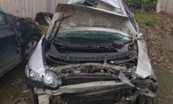
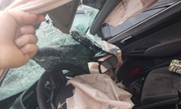
First Generation College Student
I don’t know a lot about FAFSA, but for 2019-2020 I qualified for work study. I was excited to get a work study job in January when school started back up. A friend of mine told me about an internship position on campus. I reached out to the director of that program, and said I needed an internship position and a work study position. The work study position had to go through HR (Human Resources) but it would be posted online shortly but it took forever for it to finally be posted. I looked every day, several times a day. The day the job posted I applied and told the director I had applied, and then nothing was ever said about the work study job. I was beginning to feel paranoid. I understand that I do not know everything that goes on behind the scenes. HR needed to be involved in the transaction and things take time. But I had not worked for many months, which is detrimental to my life. When you don’t have enough to begin with, any set back can be devastating.
Notes:
Play the recording.
There are a host of issues that first-generation college students who are food and housing insecure deal with. This quote highlights the difficulty of navigating an unknown system. You don't know about FAFSA, work study, applying for jobs, or other financial aid opportunities. It pushes students who are food and housing insecure to get loans which will have impacts beyond college. This quote highlights the sense that students who are food and housing insecure and the first in their family to go to college never understanding what was going on others did know what was going. Students felt disconnected to campus and did not have anyone to guide them. It was overwhelming to be in such a different environment. Even learning the college lingo, “registrar” “academic advising” “SAP” was difficult. Another student expressed that they were in AVID in high school and said that it taught some things but when getting to college there was still a lot to figure out. A first generation student does not have parental guidance and has to figure everything out on their own. Students have to find mentors and build a relationship with their academic advisor and major advisor. Learning about all of this by word of mouth is unreliable which creates an uneven playing field.
There are some programs such as financial aid that are very complicated and they do not provide support about how to navigate the system.
They can also be restrictive and create barriers for students who attempt to ask for help. First generation college students need guidance; and the resources for navigating college seem unavailable and few and far between. When a student feels disconnected, they don’t know who to go to and where to ask for help.
Transitioning from high school to college is hard enough, but when you throw in being the first in your family to go to college and the stress of not having enough food or worrying about how to pay for rent, it makes it that much harder to academically succeed.

Slide 20
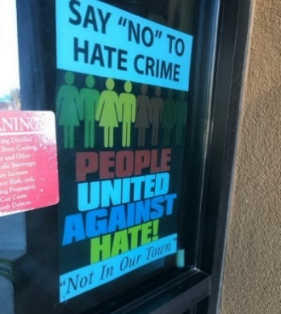
LGBTQ+
Another reason I resist to live with my family is because of their beliefs about the LGBTQ community. I have to suppress my feelings in that environment because I know they are not accepting of that. Some of their comments include: “It’s not normal,” “It’s weird,” “It’s a disease.” There’s just so much hostility ... and I don’t want to live in that environment of animosity (LGBTQ). It stresses me out to the point that I become depressed and can’t do daily chores without forcing myself to.
Notes:
The impact of being food and housing insecure for LGBTQ+ students is the next major theme to emerge from the research.
Studies find that between 20 and 45% of homeless youth identify as LGBTQ, at least 2 to 4 times more than other youth and young adults than other non-LGBTQ
LGBTQ young adults had a 120 percent higher risk of reporting homelessness compared to youth who identified as heterosexual and cisgender. Estimates show that LGBTQ youth comprise up to 40 percent of the total unaccompanied homeless youth population, even though they make up five to 10 percent of the overall youth population.
This is shameful and creates compounding barriers.
Our research also shows that LGBTQ individuals experience more issues that contribute to food and housing insecurity. Families who do not accept their children as LGBTQ leave these students to navigate college and life on their own. This can make students more vulnerable to being food and housing insecure. Within this broad category of people, there can be differences within it. Suppressing feelings and sexuality create stress, anxiety, and overall mental health. Being LGBTQ makes it so that one must be careful about what they can and cannot say due to the possibility of discrimination. Certain groups on campus are openly discriminating or denouncing students. This puts people at a disadvantage as well as the likelihood of feeling heavy amounts of fear, hopelessness, stigma, shame, and a feeling of not belonging, which pushes them further from their peers and the university.
Play recording

Slide 21
Impact of Food and Housing Insecurity on Academic Outcomes
Sometimes I sit in class struggling to focus on what we are doing because I’m starving.
During the semester, I was always looking for job opportunities on campus. Sometimes I could not socially connect with my classmates, professors and/or family because I would think about this constantly. As a student, I would not participate in class, programs and/or clubs at school because I just felt physically and mentally exhausted.
Notes:
The impact of these nine factors are related to academic success. They place food and housing insecure students into "survival mode."
Students who experience food and housing insecurities, face disadvantages. Personal disadvantages are things that make it more difficult to reach goals and be successful. The personal disadvantages faced are unique to food and housing insecure students. Disadvantages include a lack of resources, money, and choices. The consequences may include not being able to utilize vital resources such as going to the doctor, obtaining food, and school and personal supplies (textbooks, backpacks, clothes). There is a constant need to prioritize which basic needs to meet. These are things others do not have to face. On top of this, students also lack adequate time to study. Some of the consequences include negative impacts on their mental and physical well being. There is a negative impact on their ability to learn that prevents them from reaching their full potential which affects their grades, GPA, choice of major, scholarships, class schedules, and overall graduation goals.
Play Quotes

Slide 22
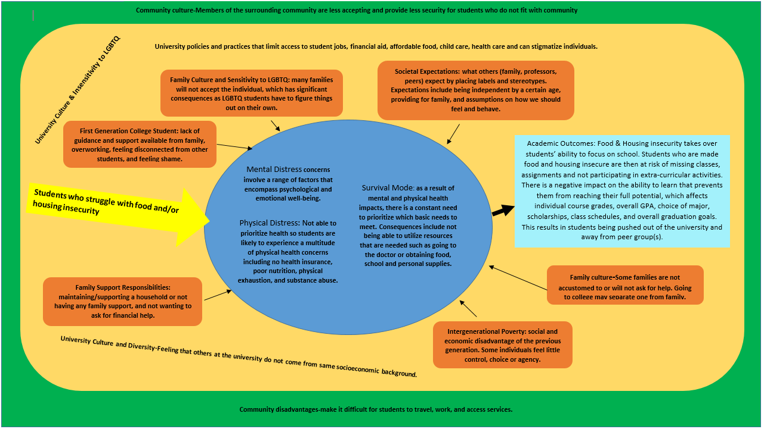
Transition slide (logic model)
Notes:
This slide encompasses everything we just talked about but shows how these factors affect student who are dealing with food and housing insecurity.
This is the logic model that highlights the core components of Food and housing insecurity. Look at it, take it in. (20 second pause)
Around the blue circle, there are 6 exacerbators that we have talked about, in the blue circle are things that students feel from within due to outward exacerbators. This ultimately affects a students ability to succeed at CSU Stanislaus.

Slide 23
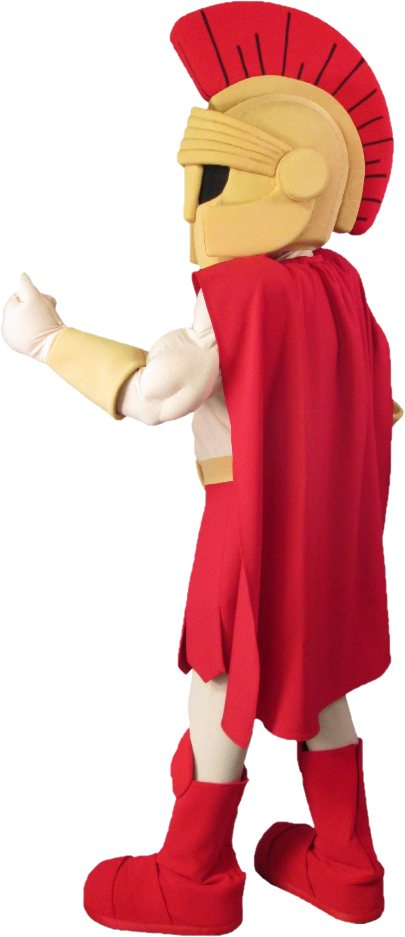
Actions
Prioritize programs that address food and housing insecure programs in the university's budget.
Make food assistance programs more known
Make sure faculty and staff are more aware of the hurdles faced by food and housing insecure students.
Address the financial constraints more effectively
Make the campus more accessible and welcoming for students dealing with food and housing insecurity
More funding or support for students experiencing intergenerational poverty
More after-graduation resources.
Notes:
Students who are made food and housing insecure struggle in college, and need resources that address these issues and erase the stigma. It is vital that the university helps its students who are trying to succeed; and here are just a couple of the many ways the University can do that.
We listed over 70 specific actions that would be beneficial for food and housing insecure students and this slide lists some of the broad ideas we have come up with.
Read the slide
Next, we are going to dive deeper into some more specifics of what we have prioritized.

Slide 24

FHI Student Participatory Planning Group
Definition: Participatory planning involves all relevant stakeholders (including those most affected by the issues in focus) in program assessment, planning and decision making processes. The key to this approach is not just consulting with this stakeholder group, but partnering with them to provide access to relevant information, supporting them to engage the system user perspective, and considering their perspectives alongside all other decision makers.
Primary goal: Ongoing responsibility to see that all PAR recommendations are implemented, and the group can further speak to adequacy of existing food and housing insecurity supports and resources on campus through ongoing engagement with FHI students on campus
Notes:
For students experiencing food and housing insecurity to have a meaningful effect on the institutional response, they need to be involved through participatory social planning and evaluation approaches.
Our research shows that the experiences of food and housing insecure students are unique to these students. Other students, faculty, staff, and community members do not have the knowledge to provide informed direction to the basic needs programs at Stan State.
Participatory social planning and evaluation is used by those who know that involving all stakeholders (and most importantly those most affected by the issues in focus) is tremendously important. The key to this approach is not just informing or consulting this stakeholder group, but including them in decision-making processes by providing access to relevant information, supporting them to engage the system user perspective, and considering their perspectives alongside all other decision makers.
Therefore, our first recommendation is to form a Food and Housing Insecure Student Advisory Group that collaborates directly with Student Affairs through providing direct input to decision making functions regarding the implementation of recommendations from this report.

Slide 25
Structure of Food and Housing Insecure Student Planning Group
4-5 passionate food and housing insecure students
Paid position – Approximately 10 hours a month. Students may have the option to be paid through gift cards to avoid their hours impeding work study commitments.
Situated within Student Affairs/Basic Needs Program
FHI Student Planning Group will sit on the Basic Needs Committee – provided the ability to collaborate and build partnerships
Approach: Engagement with other food and housing insecure students – ASI and student groups (Hunger Network)
  require resources to engage with larger body of food and housing insecure students, tabling, surveys, meetings/event participation
Notes:
This is a structure that we have created that we feel would work to benefit food and housing insecure students and the University.
Walk them through it. - What we think this program should look like.

Slide 26
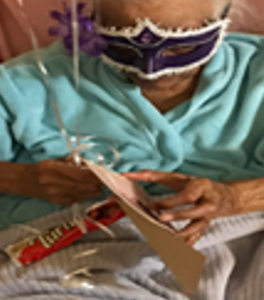
Food and Housing Insecurity Psychological and Physical Distress
Primary Goal: To strengthen and support mental and physical health services at CSU Stanislaus and to target and specialize in assisting students with food and housing insecurity
Notes:
Our second recommendation is to expand the psychological health services to better fit the needs of students with FHI.
Our research supports other research that clearly reveals that food and housing insecurity takes a physical and mental toll on students and it is vital that we recognize and do something to meet this need. We need to have conversations about food and housing insecurity to not only erase the stigma, but to gain important knowledge and resources.
Given the understanding of the stressors that food and housing insecurity place on mental health and physical health, the Basic Needs Program (serving as a hub for services/supports) must be prepared and equipped to support food and housing insecure students’ mental and physical health needs. Just as food boxes and the food pantry are vital to meeting food and housing insecure students’ first order needs, the Basic Needs Programs must have accessible counselors and medical professionals who are knowledgeable about and professionally trained to provide support and intervention to food and housing insecure students facing mental health and/or physical health concerns or crises.

Slide 27
Recommendations
(Psychological/Health services)
Integrate Basic Needs, Health and Psychological Counseling Services: designate two counselors from Psychological Counseling Services (PCS) and two medical professionals to focus on the needs of FHI students.
Become more active in creating educational/ therapeutic programming “collectively targeting” food and housing insecure students.
  Ongoing facilitated support group for students experiencing FHI – food and fellowship.
Provide adequate staffing, more flexible hours, virtual sessions, and more training.
Regularly post information and updates on services and resources. Information needs to be easily found on the University website.
  Update PCS webpage to provide information about the connection between FHI and mental health and how PCS can assist students with their mental health needs.
Basic Needs Program should be supplied with gift cards that can be provided to students that allows them to purchase food from local grocery & transportation
Notes:
We recommend that...
At minimum, two counselors from Psychological Counseling Services (PCS) and two medical professionals from the Health Center be designated as Basic needs Counselors/Health liaisons who are responsible for outreach to and intervention for Food and Housing Insecure (food and housing insecure) students.
The University’s Basic Needs Program, in partnership with PCS and Health Center, must become more active in creating educational/ therapeutic programming “collectively targeting” food and housing insecure students.
The University needs to provide adequate staffing, more flexible hours (weekend hours), virtual sessions, and more training to help counselors fully understand the needs of food and housing insecure students.
When the food pantry is low on food, the Basic Needs Program should be supplied with gift cards that can be provided to students that allows them to purchase food from local grocery stores & transportation.
The University must regularly post information and updates on services and resources that are available for mental health and physical health. This information needs to be easily found on the University website

Slide 28

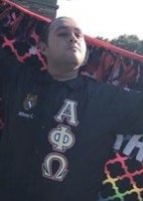

In Loving Memory
Anthony Gonzales (1993-2021)
Gone but never forgotten
Notes:
We began this research project 2 years ago. We became a source of love and comfort to one another. Unfortunately this spring we lost one of our co-researchers in a tragic accident and we dedicate this project to him... Anthony Gonzalez.

Slide 29
We may all be Warriors but some of us are fighting harder than others.
Notes:
It is not possible for us to get all of our research into this presentation. We hope that you will have an opportunity to look through the full report.
It is our hope that this is a starting point of more conversations about our research and how students who are food and housing insecure can be more effectively engaged in the university's efforts to take down barriers that prevent their success.
Thank you for taking time to meet with us today.
We now welcome questions and comments.
Who would like to answer that question? Please use Raise Hand feature to let me know that you would like to help answer a question. Please raise your hand if you would like to react to that comment.

