Slide 1
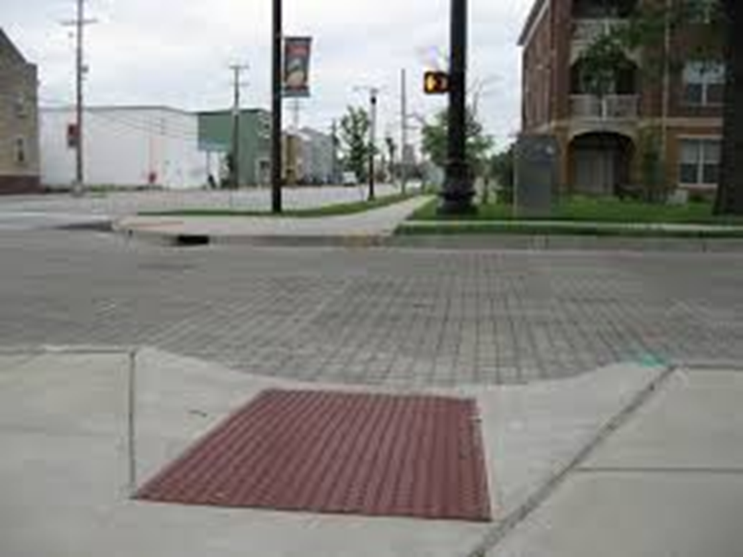
Universal Design Level II

Slide 2
Objectives:
Review UDL Principles for LMS content pages and multimedia
Recognize how to make Microsoft, Google and Apple applications accessible
Recognize and discuss UDL principles and techniques for providing equal access
Recognize techniques for closed captioning in YouTube and Zoom
Write a short accessibility plan for future classes.

Slide 3
Review:
The Americans with Disabilities Act and
Section 508 of the Rehabilitation Act of 1973
Provides the underlying mandate for designing courses that are accessible to students with:
Visual
Auditory
Physical impairments
Students with information processing differences.

Slide 4
Who should we think about?
students with vision impairment
students with hearing impairment
students with mobility impairment
students with learning differences
How do we think about these students?
If it is visual, make it audible
text & images need to be in a format that works seamlessly with assistive technology.
If it is audible, make it visual;
videos, lectures, and meetings:
format that works seamlessly with assistive technology.

Slide 5
Content Pages Layout
Alt Text
Pictures, graphics
Paragraph Styles create titles, subtitles, and other types of headers in your document.
Don't use "Font Sizes" for making text bigger or smaller.
number lists and/or bullet list tool
Don't do this manually.
Links
descriptive Faculty Development Center
don't paste in the full link like this: https://www.csustan.edu/campus-maps/john-stuart-rogers-faculty-development-center
(screen readers read all those numbers and letters individually. It's terrible to listen to.)
Highlight, right click, hyperlink

Slide 6
Multimedia
Audio and Video
Don’t set to auto play
Caption or provide transcripts (varying programs do this differently)
No flashing content
Live broadcasts include a means for displaying synchronized captions

Slide 7
Documents Presentations Spreadsheet
Provide a descriptive title
PSY-P1001_Intro_Psychology_Section_00000_Spring2016_Syllabus_JDoe.docx
Use appropriate language for the audience
Arrange a clear document structure
Provide alternative text for visual content
Write descriptive labels for links
Apply color sparingly
Screen reader sample: https://www.youtube.com/watch?v=dEbl5jvLKGQ
https://youtu.be/VvWCnFjAGgo

Slide 8
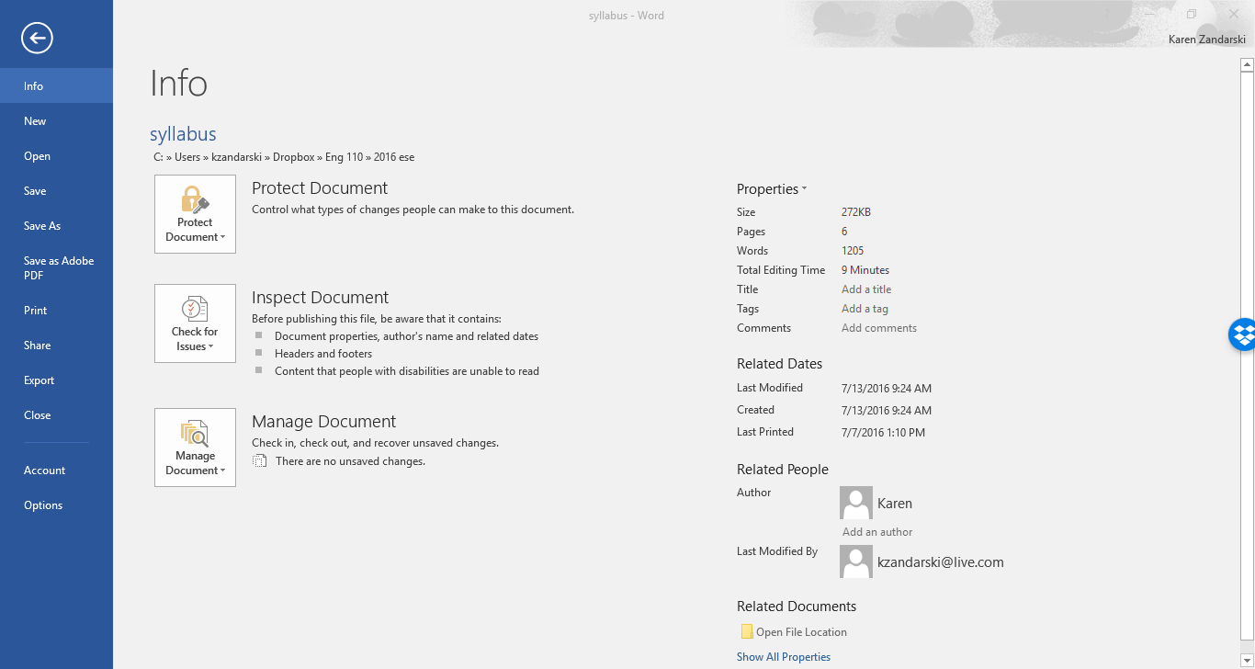
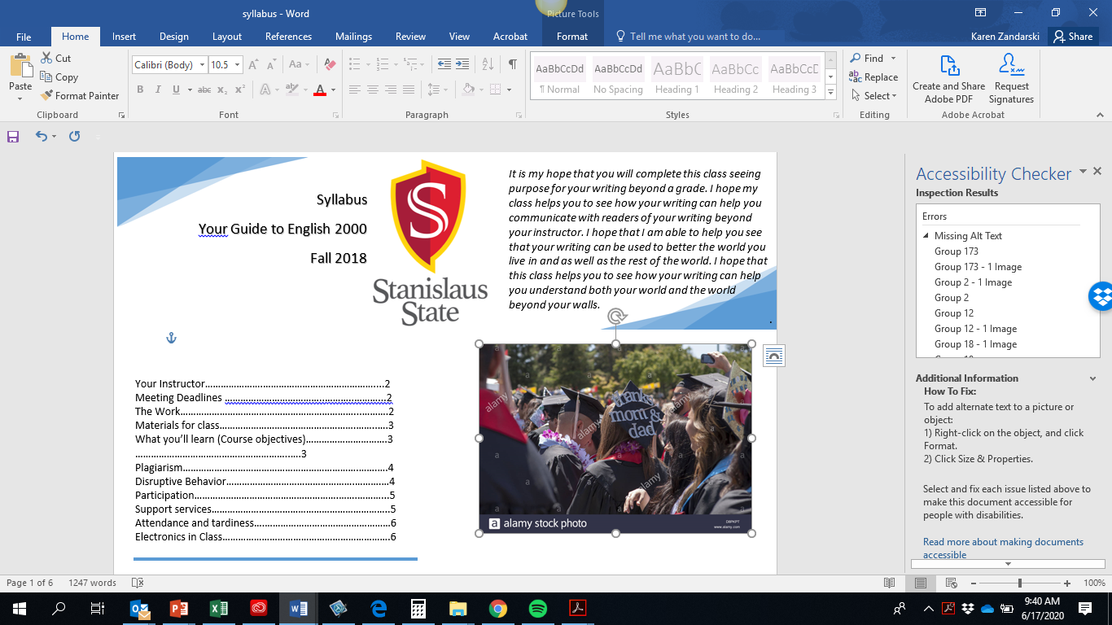
Double check your documents

Slide 9
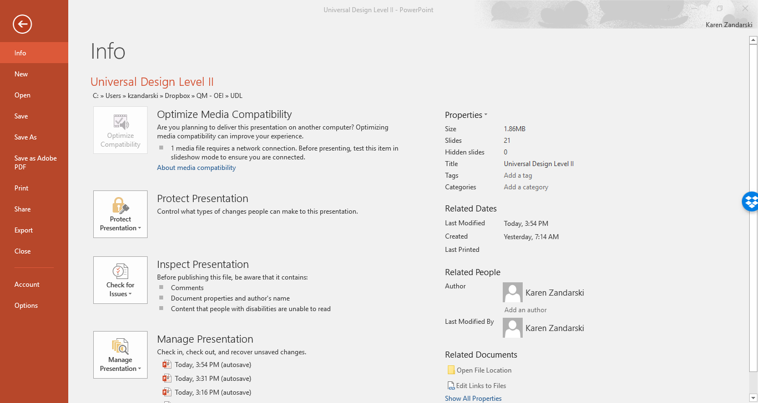
PowerPoints

Slide 10
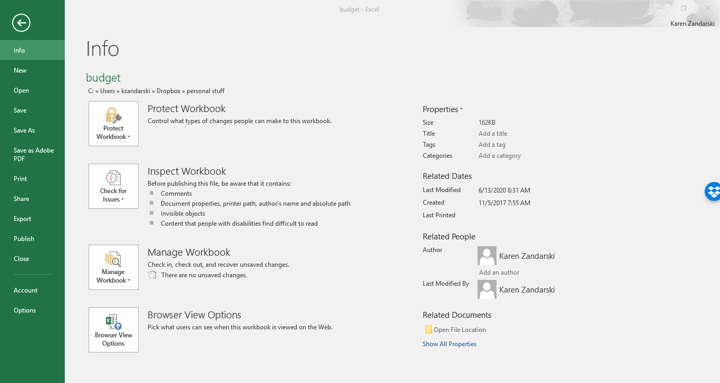
Excel

Slide 11
Pictures:
Alt Text
Highlight
Right click
Format and properties
Alt text
Description 10 words or less
No ‘image of’
Formatting Tables
Select the header row.
Right click in that row and choose Table Properties.
Select the Row tab.
Check “Repeat as header row at the top of each page.”
Additional Resources Microsoft guide

Slide 12
Google Documents and presentations
Alt Tag Images
Select image
Right click
Alt text
Enter description
ok
Tables
screen reader will automatically read first row as header
Additional resource: Accessibility Checker:
Google Help Grackle Documents

Slide 13
Apple
Alt Tag Images (Word for 2016)
Select image
Picture Format tab will appear on the ribbon.
Open Format Pane
Select Layout and Properties icon.
Alt Text option by selecting the arrow.
Description (not the title). Enter the text
Tables
Select Insert
Table from the format ribbon.
Select the number of columns and rows using the grid.
Ensure your table has a header row.
Accessibility checker
Review Tab

Slide 14
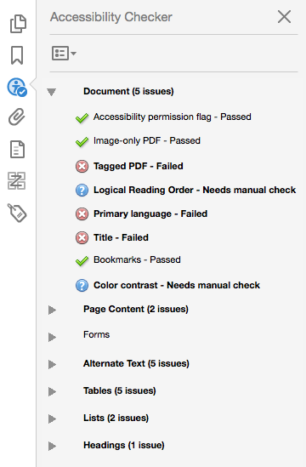
PDFs
If a document is accessible when made it will be accessible when converted to a PDF
Accessibility Checker (Acrobat Pro)
Select Tools
Accessibility
Full Check
follow the prompts.

Slide 15
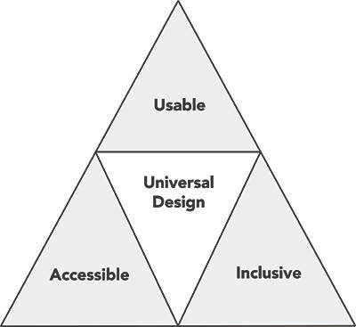
UDL Equal Access
a framework for designing curricula that enable all individuals to gain knowledge, skills, and enthusiasm for learning. UDL provides rich supports for learning and reduces barriers to the curriculum while maintaining high achievement standards for all.”
multiple means of representation
multiple means of action and expression
multiple means of engagement.
CAST Guidelines

Slide 16
Class Climate
Adopt practices that reflect high values with respect to diversity, equity, and inclusion.
Welcome everyone.
Avoid stereotyping.
Be approachable and available.
Motivate all students.
Address individual needs in an inclusive manner.
On the syllabus, list URLs and other contact information for tutoring and writing centers, disability services, and other campus services that may be helpful.
Avoid segregating or stigmatizing any student.

Slide 17
Interaction
Encourage regular and effective interactions between students and the instructor, employ multiple communication methods, and ensure that communication methods are accessible to all participants.
Offer multiple options for communication and collaboration.
Require inclusive cooperative learning.

Slide 18
Physical Environments and Products
For on-site instruction ensure that facilities, activities, materials, and equipment are physically accessible to and usable by all students and that diverse student characteristics are addressed in safety considerations.
Ensure physical access to facilities.
Arrange instructional spaces to maximize inclusion and comfort.
Ensure that everyone can use equipment and materials.
Ensure safety.

Slide 19
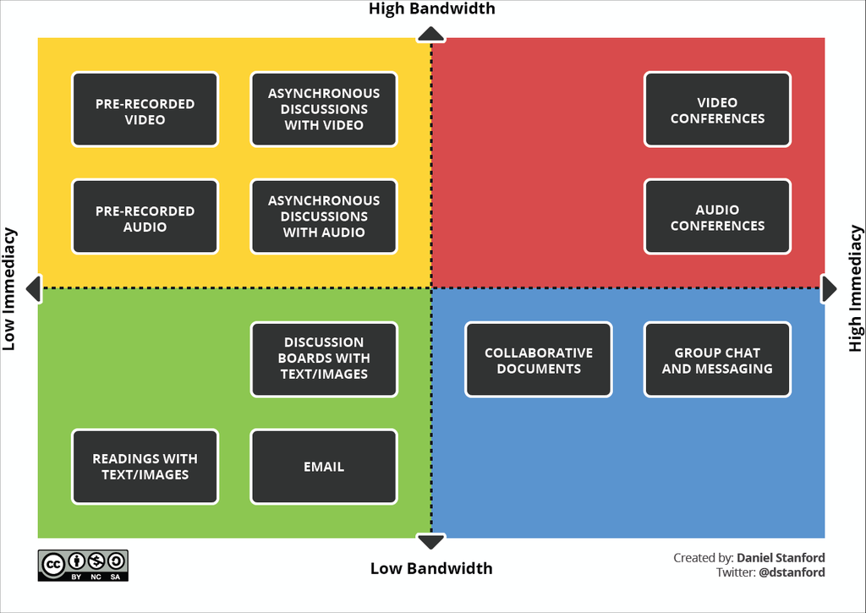

Slide 20
Delivery Methods
Use multiple instructional methods that are accessible to all learners.
Make content relevant.
Select flexible curriculum.
Provide cognitive supports.
Provide multiple ways to learn.
Deliver instructions clearly and in multiple ways.
Use large visual and tactile aids.
Make each teaching method accessible to all students.

Slide 21
Information Resources and Technology
Ensure that course materials, notes, and other information resources are engaging, flexible, and accessible for all students.
Select materials early.
Provide content in accessible, universally designed formats.
Accommodate a variety of reading and technology, skills.
Ensure the availability of appropriate assistive technology.

Slide 22
Feedback and Assessment
Regularly assess students’ progress, provide specific feedback on a regular basis using multiple accessible methods and tools, and adjust instruction accordingly.
Set clear expectations. Test in the same manner in which you teach.
Minimize time constraints when appropriate.
Offer regular feedback and corrective opportunities.
Provide multiple ways for students to demonstrate what they have learned.
Monitor and adjust.
Provide sample test questions, exemplary work, and study guides.

Slide 23
Captioning in YouTube:
Sign into YouTube
From the menu on the left select subtitles
Select the video to edit
Select subtitles
Select options
Choose upload a script, transcribe and auto sync or edit auto generated.

Slide 24
Captioning in Zoom
Account
Sign in to the Zoom web portal
Navigation panel
Account Management
Account Settings.
Click the Meeting tab.
Verify that Closed Caption is enabled.

