Slide 1
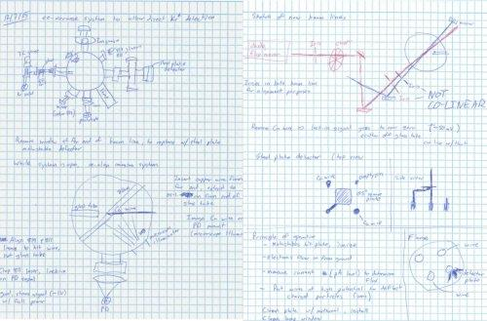
Keeping a Lab Notebook
CVMSA “Workshop” #4
Dr. Mark A. Grobner
CSU Stanislaus Dept. of Biological Sciences

Slide 2

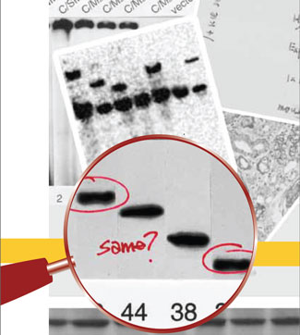

Examples of the Importance of the Lab Notebook
https://www.youtube.com/watch?v=TSZcXtVM-jQ
http://www.scientificamerican.com/article/a-medical-madoff-anesthestesiologist-faked-data/
http://www.the-scientist.com/?articles.view/articleNo/27192/title/Fixing-Fraud/

Slide 3
Anesthesiologist Scott Reuben
Claimed studies he conducted showed the worth of COX2 drugs
  Celebrex
  Vioxx
Attempts to review data when fraud was proposed yielded shoddy kept or no lab books

Slide 4
Fixing Fraud
Graduate student presented data of transgenic plants
  Plants should have been housed in an FDA containment chambers
  No adult plants were found although data from the plants was presented at the dissertation defense
  Plants were found in a greenhouse, not contained as required by FDA

Slide 5
Fixing Fraud
In the wake of concealment of the transgenic plants and data student left school
  The lab was set back more than a year, trying to validate the presented data
  The lab notebook was incomplete in many instances, without vital PCR settings that might help colleagues recreate work.

Slide 6
Surely nobody of any import bothered with the lab notebook…
I can think of a few

Slide 7
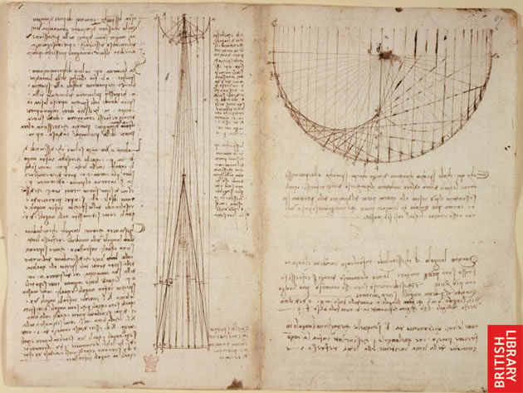
Leonardo da Vinci’s notebook
Studies of reflections from concave mirrors. Italy, probably Florence, from 1508.
British Library Arundel MS 263, f.86v-87
We can read and understand Leonardo’s notebooks from 500 years ago

Slide 8
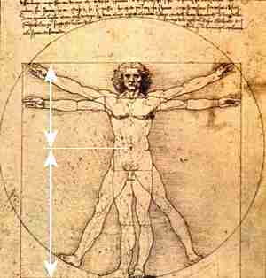
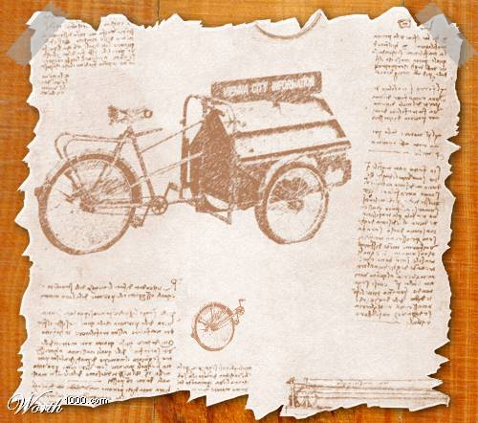
Leonardo da Vinci’s Notebook

Slide 9
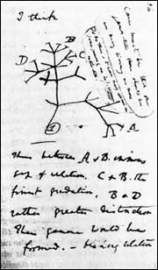
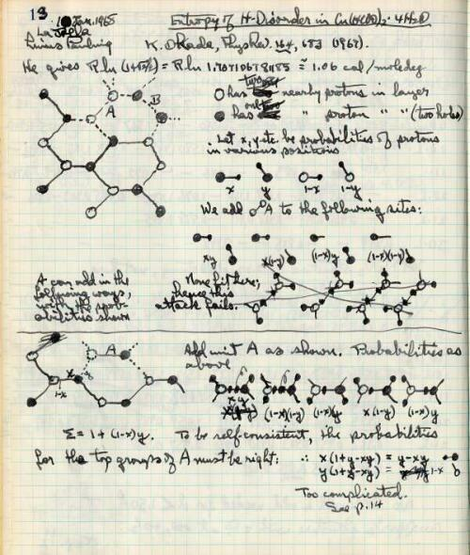
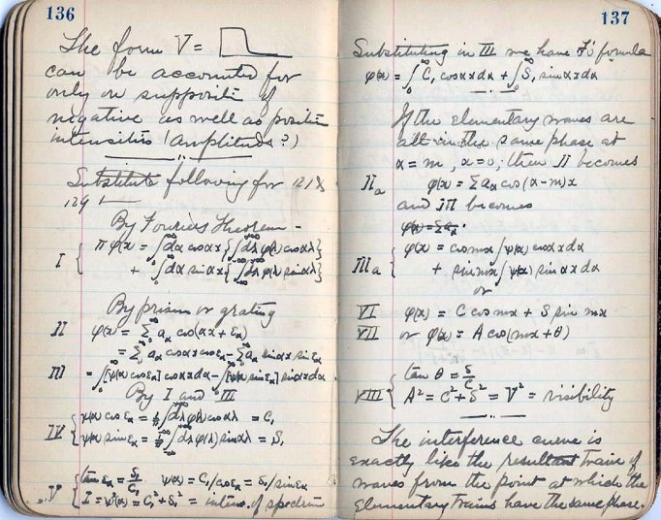
Darwin, Einstein, and Pauling
Darwin’s notebooks: http://darwin-online.org.uk/EditorialIntroductions/vanWyhe_notebooks.html
Darwin
Einstein
Pauling

Slide 10
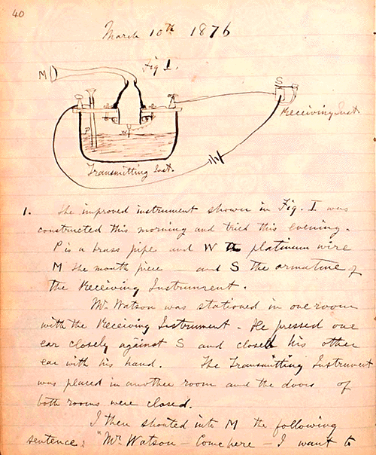
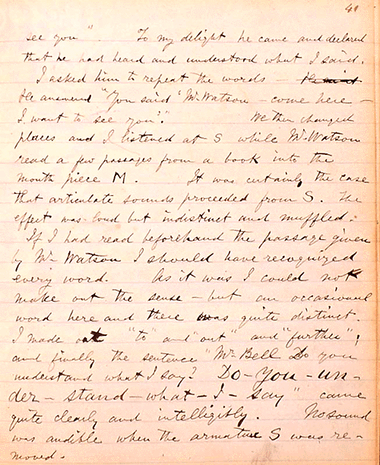
Alexander Graham Bell’s notebook
March 10th 1876: “Mr. Watson – Come here – I want to see you”.

Slide 11
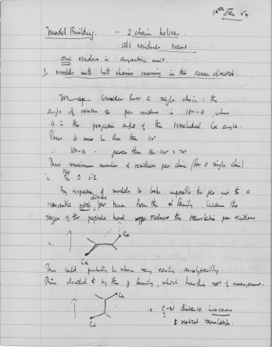
Francis Crick’s notebook
Model building
Centrifuging egg white
Methods set forth clearly

Slide 12
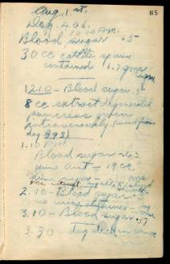
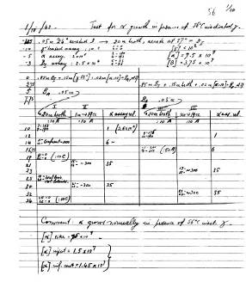
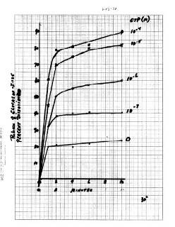
Results in Nobelists’ notebooks
Charles Herbert Best –
Blood sugar
Salvador Luria –
Bacteriophage growth
Martin Rodbell –
Glucagon release

Slide 13
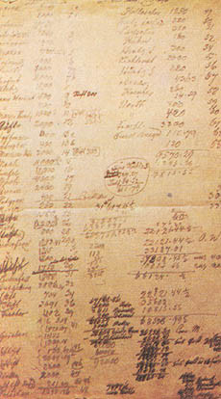
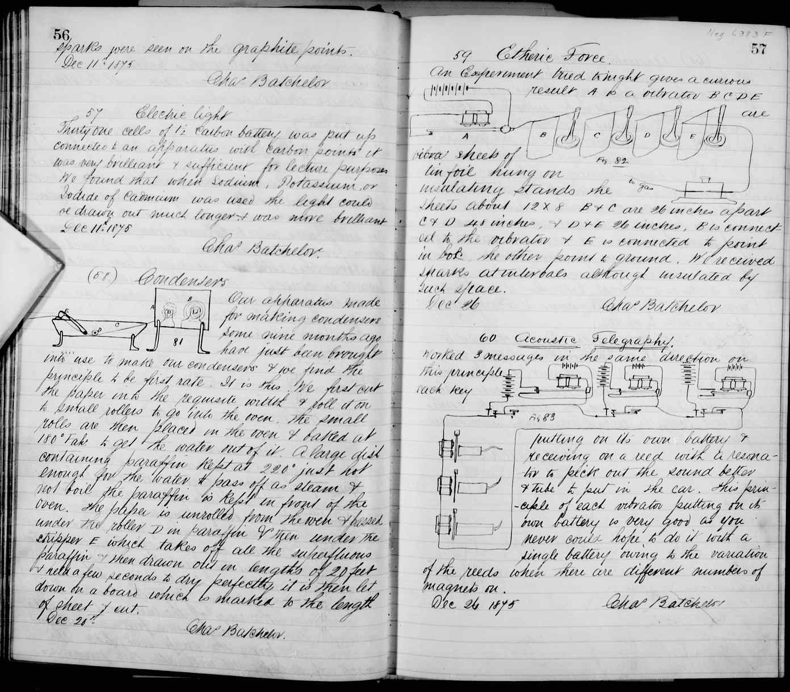
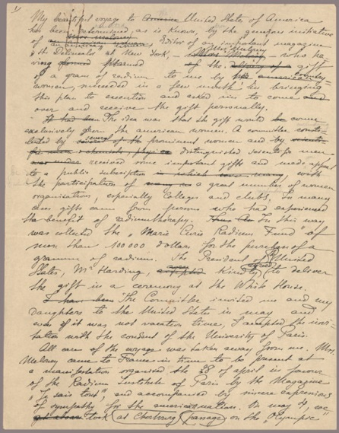
Mendel, Edison, and Curie
Gregory Mendel
Thomas Edison
Marie Curie

Slide 14
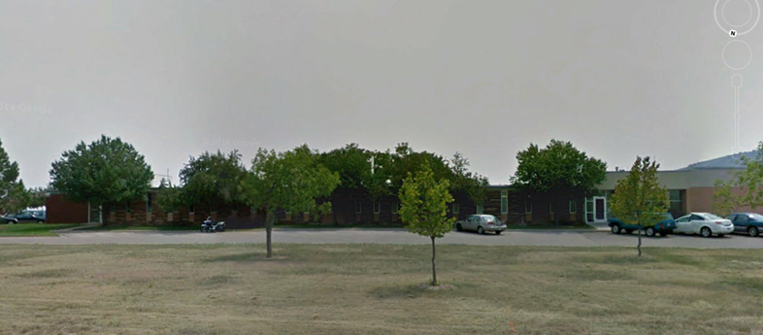
Why keep a laboratory Notebook?
CSU Metabolic Research Laboratory

Slide 15
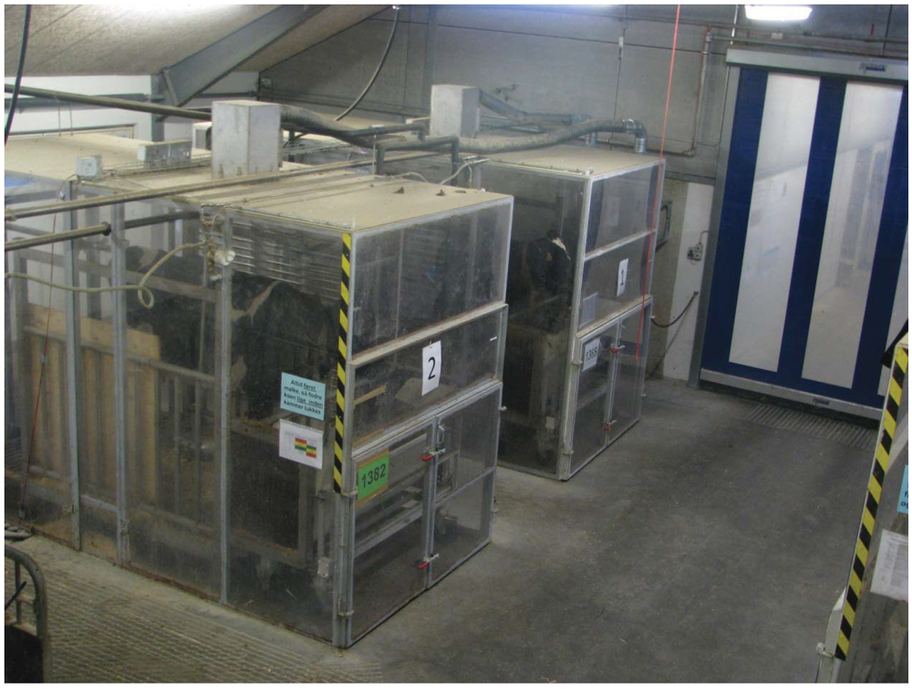

Slide 16
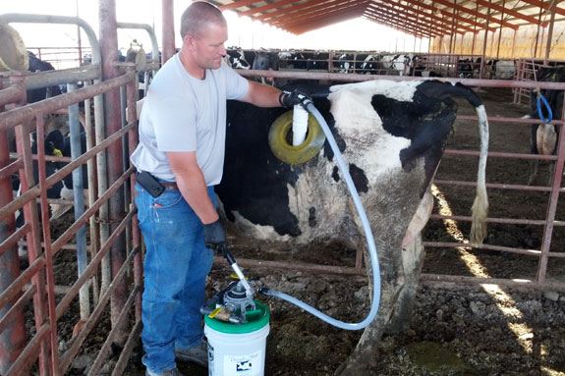

Slide 17
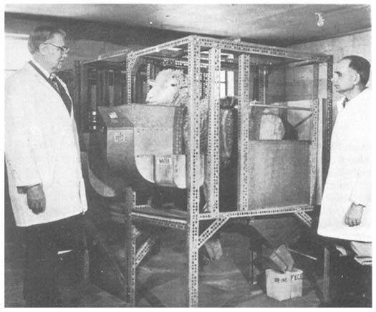

Slide 18
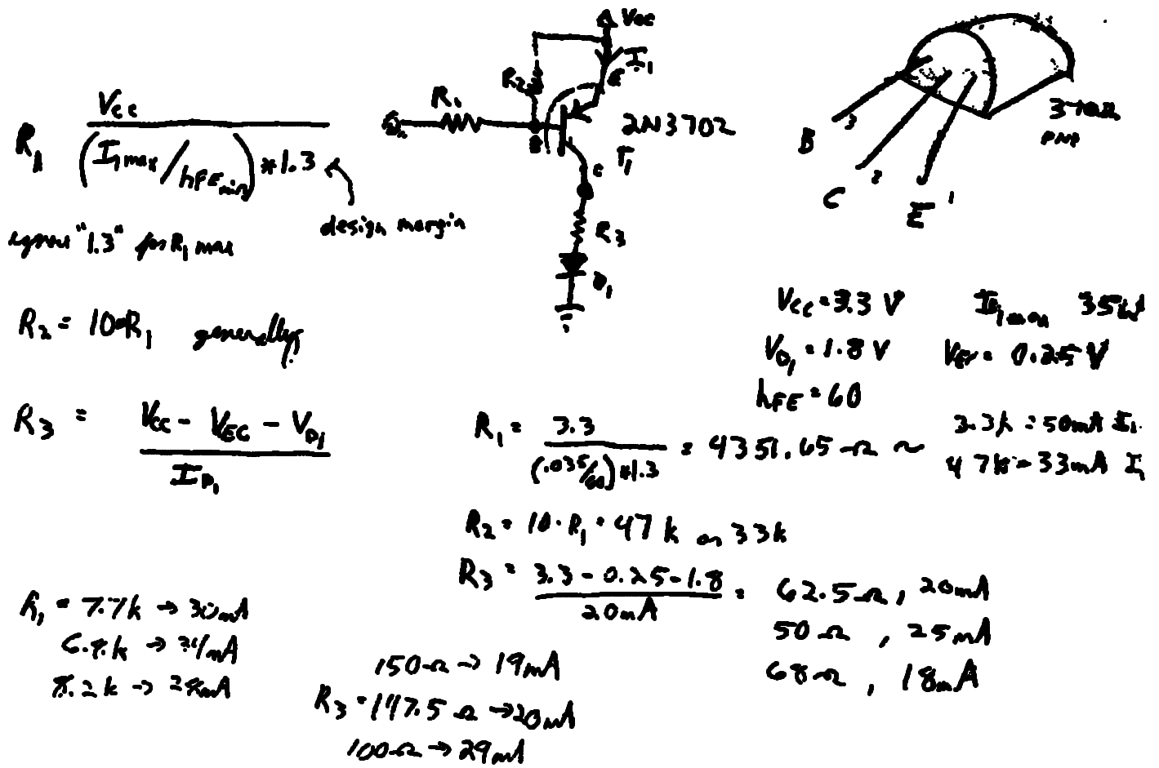
Why Keep a Lab Notebook?
The business of a lab is RESULTS and COMMUNICATING them! The lab notebook is the all-important document of each lab member’s work and contribution to the mission of the lab.
Our Scientific obligation
DATA must be clear and findable.
RESULTS must be repeatable.

Slide 19
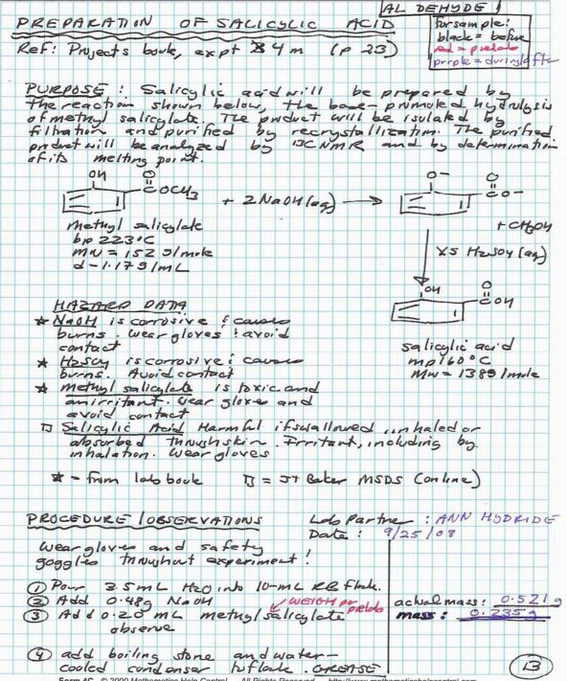
Why Keep a Lab Notebook?
Lab notebooks can be critical in establishing patent rights, first rights to publication of results, evidence of inventions, etc.
Organizes how you do Science
Formulate ideas clearly
Specify materials & methods
Plan experiments well
Obtain maximum value from data

Slide 20


Lab Notebooks are NOT an Option
Your lab PI should require you (and all lab staff) to keep lab notebooks! If not, ask her/him why not!
There are many reasons to keep a lab notebook, but only one – laziness– for not keeping one.

Slide 21
Your turn
With a partner or two, brainstorm a list of lab notebook DOs and DON’Ts.
For example, what is essential to include in lab notebook? How do we format one? What about making corrections? Who owns it? And so on…

Slide 22
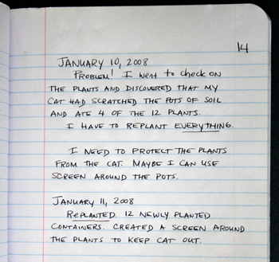
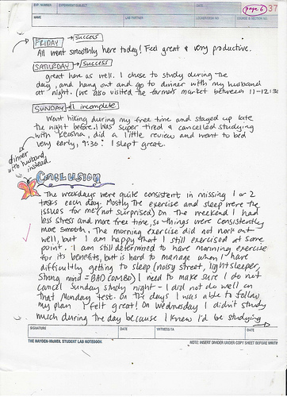
Helpful hints for a good lab book

Slide 23
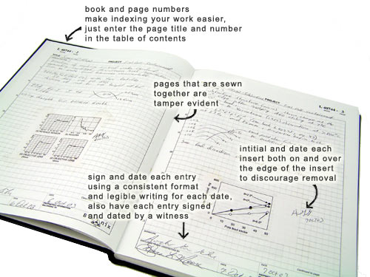
Some “DOs”

Slide 24
Lab Notebook DOs
Must be bound with printed, consecutive page numbers.
All entries must be in chronological order, all entries dated, start and stop times explicitly clear.
All entries in permanent ink; any corrections like blatant errors or misspellings should be made with single strike-throughs like this.
It is preferable to make corrections such as updated experimental designs or procedures on the current page, and reference the previous page with a reason why the correction was necessary.

Slide 25
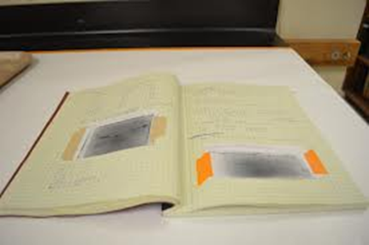
Lab Notebook DOs
5. Attachments (pictures, print-outs, etc.) should be stapled/taped to the notebook, signed and dated on the attachment and underlying page.

Slide 26
Lab Notebook DOs
Cross out ANY blank space on the page.
Finished pages signed and witnessed by a third party; finished pages are left unaltered forever.
Date every page, include day, month, year
  November 10, 2014
  11/10/14 may be ambiguous (10 Nov, or 11 Oct?)
In patent cases, keep notebooks safely stored for 25 years.

Slide 27
Lab Notebook DOs
Save the first few pages of a new notebook for a table of contents.
Summarize each day’s work.
  All essential facts should be recorded so that the work can be repeated accurately (detail, detail, detail)
    Methods, equipment, conditions, times, temperatures, pH, …
    Materials
      Include source: Company, catalog #, lot # if commercial
      Quality, yields, characterizing data…
    Protocols, experimental design, calculations

Slide 28
Lab Notebook DOs
Use past tense.
Explain abbreviations and special terms.
Outline new experiments precisely so others can follow your method. Record all calculations and measurements.
Record lab meeting discussions.
Provide details, results, thoughts on what results mean.

Slide 29
Lab Notebook DOs
Record conclusions: Facts vs Opinion
Fact: no reaction was observed; vs Opinion: these two chemicals don’t react.
Fact: Expected results were not obtained; vs. Opinion: No good
Fact: Under these circumstances, the reaction was unsuccessful; vs. Opinion: failed.

Slide 30
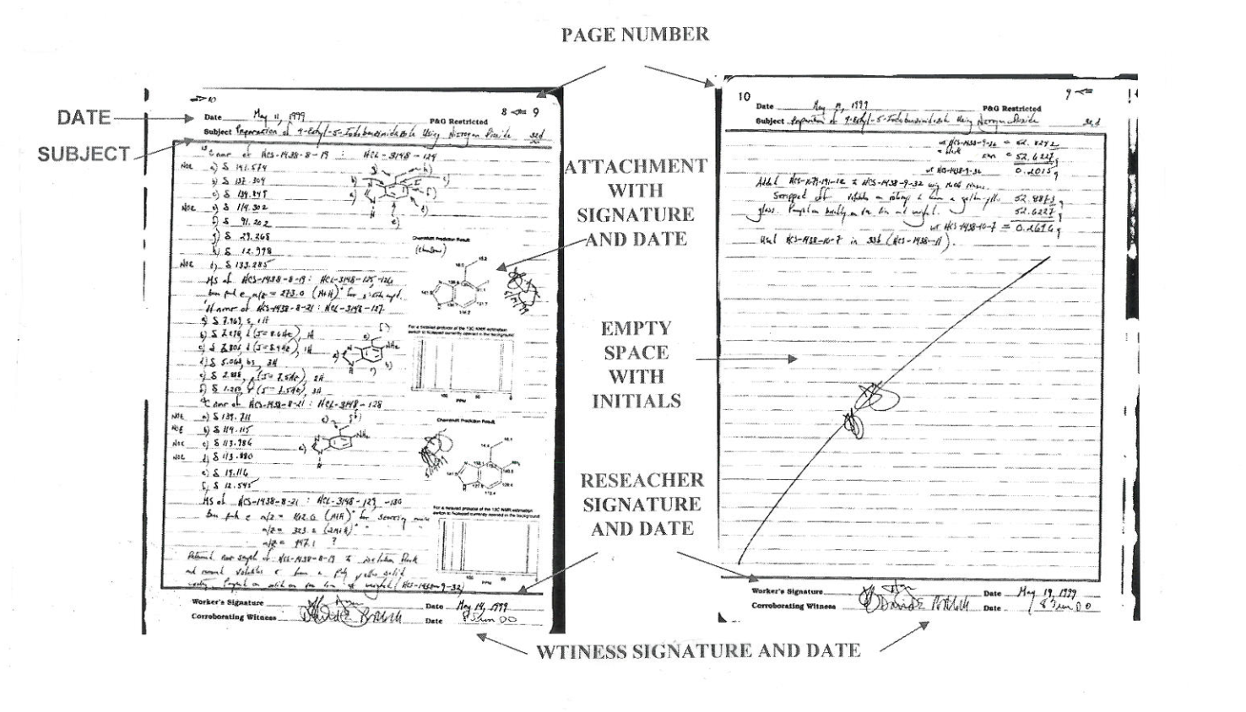
EXAMPLE NOTEBOOK PAGES
Version 10/01/2009

Slide 31
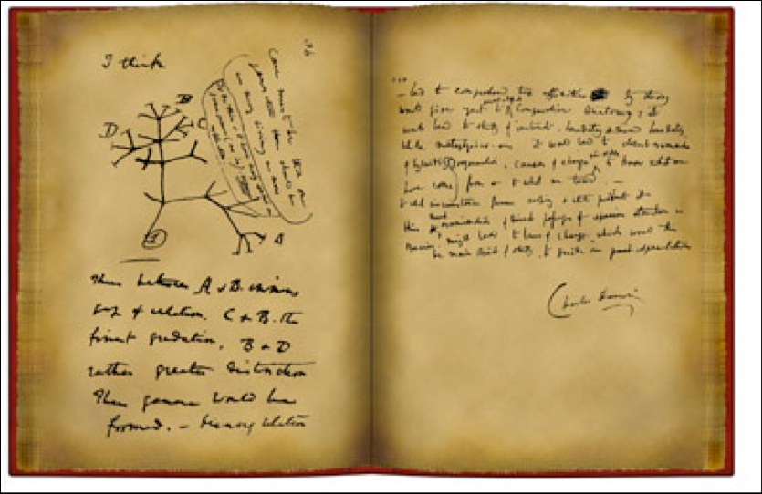

Slide 32
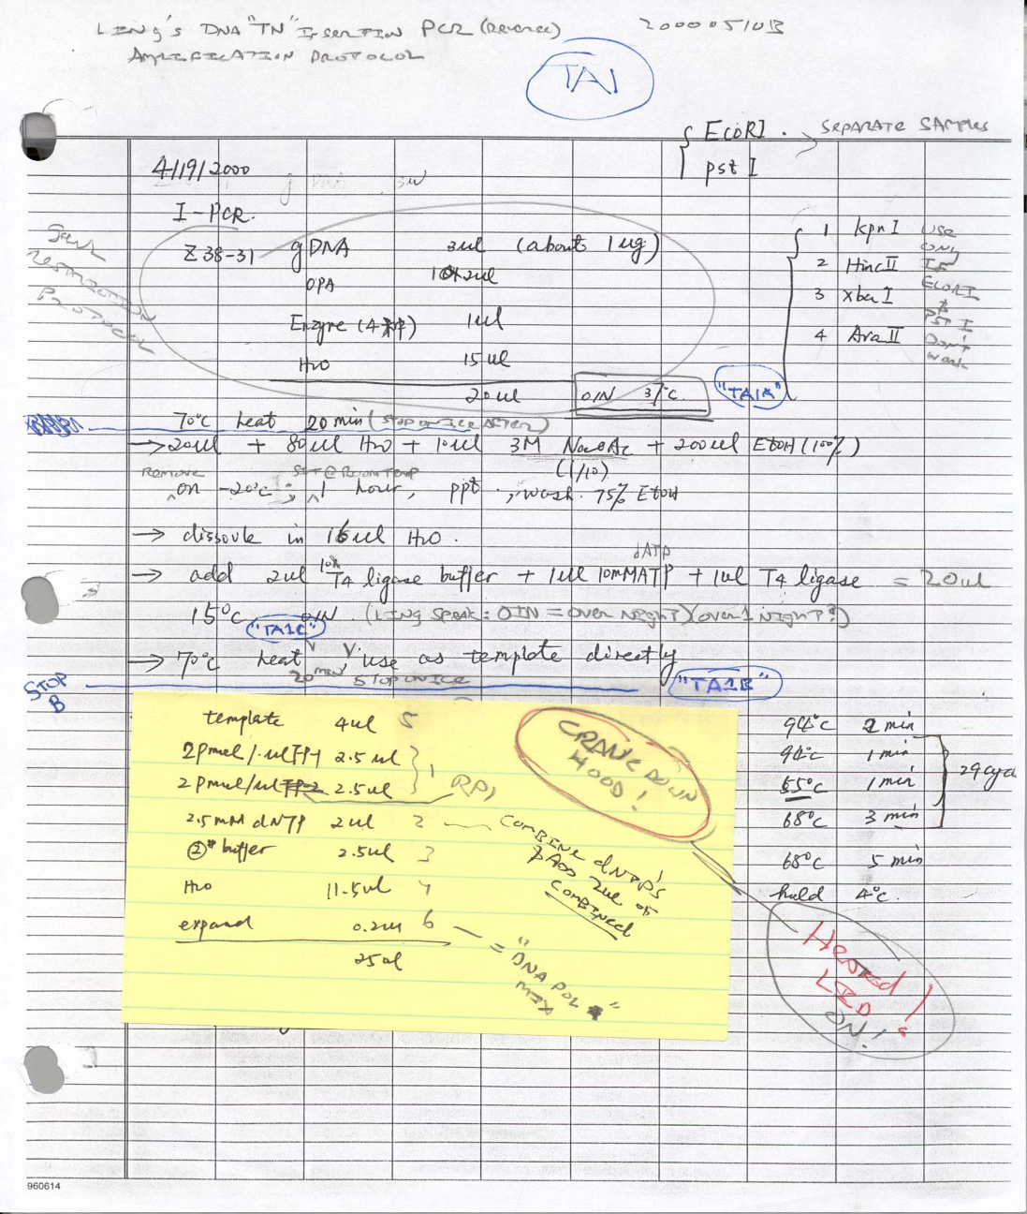
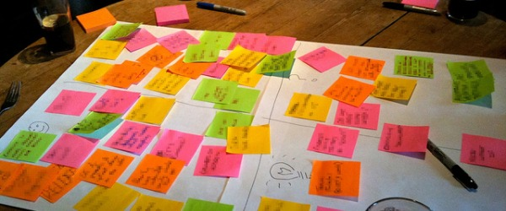
Helpful hints to avoid in your lab notebook

Slide 33
Lab Notebook DON’Ts
Don’t leave blank spaces on any page.
Modifications after the page is finished is bad practice.
Never remove originals, attachments, or use white-out or correction fluid.
Never withhold your lab notebook from your PI! The lab notebook belongs to the lab, not you.
Neatness is not essential, but the notebook should be legible.

Slide 34
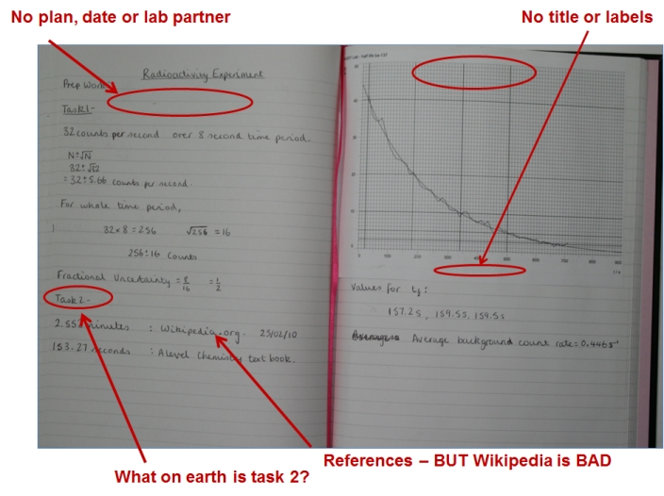

Slide 35

What about electronic lab notebooks?
Computers are everywhere! Why not simply enter your lab notebook entries into a computer, the lab database, Dropbox, Google Docs, etc?

Slide 36
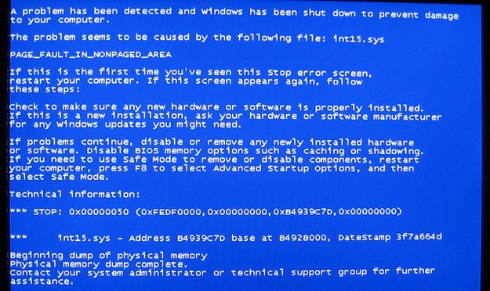
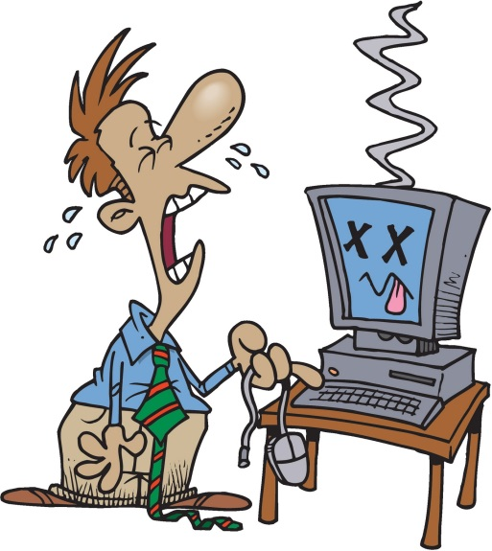
What about electronic lab notebooks?
Computers get lost or stolen, hard drives crash, OIT support is limited, data gets hacked, etc.
If you use electronic lab notebooks, this should be a backup only. ALWAYS record data in the lab notebook in hard copy form!

Slide 37
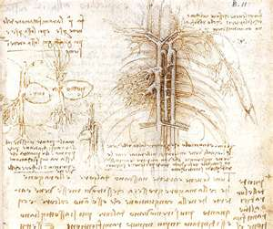
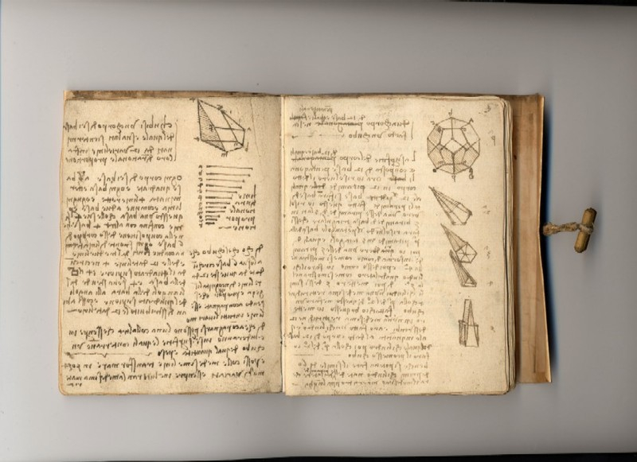
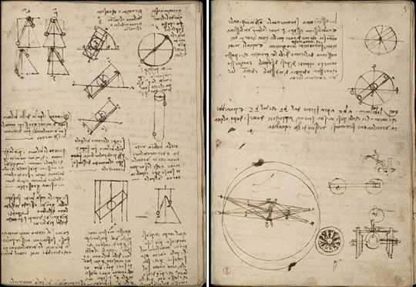
Da Vinci
Notes
1500s

Slide 38
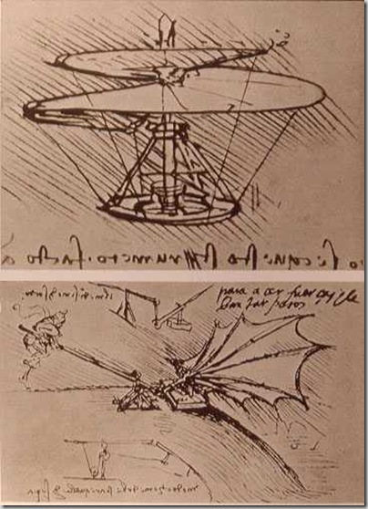
Helicopter
By
Da Vinci
1493
Lifting Wing

Slide 39
References
GLP Recordkeeping http://users.stlcc.edu/departments/fvbio/Lab_Practices_GLP_STLCC.htm
Good Laboratory Notebook Practice http://www.mddionline.com/article/good-laboratory-notebook-practice-0
Laboratory Notebook Guidelines http://www.bookfactory.com/special_info/lab_notebook_guidelines_A4.html
Advice on keeping a laboratory notebook http://www.swarthmore.edu/NatSci/cpurrin1/notebookadvice.htm
Guidelines for Keeping a Laboratory Record http://www.ruf.rice.edu/~bioslabs/tools/notebook/notebook.html#entry
Resource: HHMI guide to Scientific Management

Slide 40
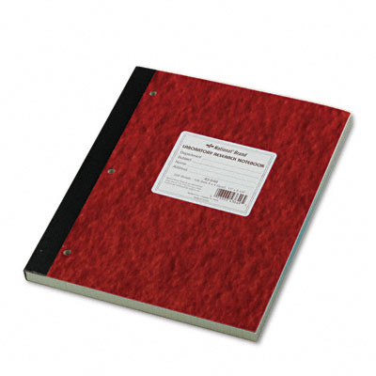
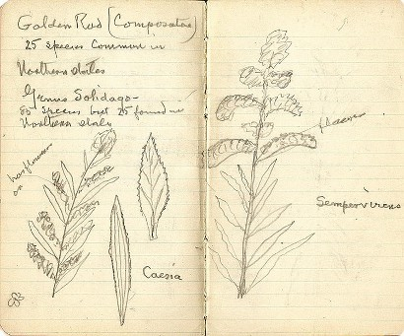
In Conclusion:
Your professional life may depend on the validity and thoroughness of your lab notebook!

Slide 41
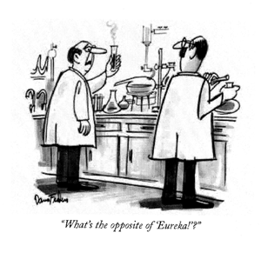

Slide 42


