Slide 1
ATI Accessible Technology Initiative
Tawn Gillihan, OIT
www.csustan.edu/ati
tgillihan@csustan.edu
209.667.3470

Slide 2
PART I
Why You?
Laws & Policies
Section 504 vs 508
Understanding Disability
Types of Digital Content
Bottom Line

Slide 3
Accessible Technology Initiative
Our use of technology must provide comparable functionality, affordability, timeliness, and must be delivered in as seamless a manner as possible.
Visit the new ATI website at http://www.csustan.edu/ati

Slide 4
WHY YOU?

Slide 5
Your Role in Accessibility
Program Director/Manager
Designer
Understand the law
Equip designers with time and training
Approval process for web and digital content
Remediation plan
Annual reporting
Respond to legal challenges
Understand the audience
Design with accessibility in mind
Test before posting
Evaluate and remediate existing content
Document remediation activities
Ask for help

Slide 6
Why Promote Accessibility/Usability?
Our use of technology must provide comparable functionality, affordability, timeliness, and must be delivered in as seamless a manner as possible.
Student Success
Legal Action
Laws & Policies

Slide 7
Laws & Policies

Slide 8
ADA Laws & ATI Policies
The Americans with Disabilities Act of 1990 (ADA)
Section 508 of the 1973 Rehabilitation Act
CSU Executive Order 926
CSU Coded Memos AA-2015-03, AA-2014-08
Notes:
The ADA was enacted in 1990 to prevent discrimination against people with disabilities and mandates providing accessible options in government offices, public institutions, and businesses. Its focus was originally about physical access but in 1998, increasing use of the Internet by government and education necessitated the addition of Section 508 to the 1973 Rehabilitation Act, which requires accessibility in electronic and online contexts. The State of California has ruled that the CSU and its campuses must comply with Section 508 and the CSU has affirmed this with its Accessible Technology Initiative

Slide 9
Comparable Access to Education
Functionality
Affordability
Timeliness
Ease of Delivery
Notes:
Our use of technology must provide COMPARABLE functionality, affordability, timeliness, and must be delivered in as seamless a manner as possible.

Slide 10
Sections 504 vs. 508

Slide 11
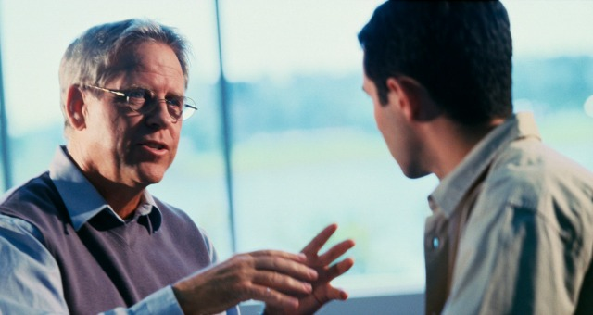
Section 504
DRS
Specific accommodations for students
Testing, note-taking, interpreters, etc.
Accessible instructional materials
Managed by Disability Resource Services
One-to-one service model

Slide 12
Section 508
ATI
Institution-wide accessibility
Based on Universal Design for Learning
Accessible websites, instructional materials, & ICT procurement
Managed by HR and OIT
Many-to-many service model

Slide 13
Understanding Disability

Slide 14
Apparent Disabilities
Vision Loss & Blindness
Hearing Loss & Deafness
Mobility Limitations
Typically registered with DRS
6% of CSU enrollment

Slide 15
Non-Apparent Disabilities
Traumatic Brain Injury
PTSD
Learning Disability
Mental/Emotional Health Issue
Chronic Health Condition
Often not registered with DRS
11% of enrollment in higher ed

Slide 16
Types of Digital Content

Slide 17
Word Documents
Provide alt-text for images, clean design with good whitespace, and proper use of headings

Slide 18
Forms
Simple layouts with labeled data fields and correct tab order

Slide 19
PowerPoint Presentations
Readable fonts and font size, and good color contrast

Slide 20
Videos
Provide captions that are accurate and synched with the narration

Slide 21
PDFs
PDFs should not be flat images; they should be usable by screen readers

Slide 22
Podcasts & MP4s
Provide transcripts of audio recordings

Slide 23
Bottom Line

Slide 24
Digital Content
Include captions on all videos
Add alt-text to images
Use good color contrast

Slide 25
Websites
Add alt-text to images
Descriptive text for URLs
Check for broken links
Approve digital content before posting
Test and remediate

Slide 26
Course Accessibility
Order textbooks early
Order electronic formats
Post materials to the LMS
Caption videos
Use principles of UDL
Design and present to include largest number of students

Slide 27
PART II
Accessible Digital Content
Accessible Instructional Materials
Examples of Design
Student Video
Assistance & Information

Slide 28
Creating Accessible Electronic Content

Slide 29
Write Clearly
Use the simplest language appropriate for your content
Use illustrations, icons, etc. to supplement text
Check spelling, grammar, and readability
Be careful with abbreviations, jargon, complex language, or anything that might confuse the reader
Avoid jargon – it excludes many
AVOID THE USE OF ALL CAPS AS IT CAN BE DIFFICULT TO READ

Slide 30
Use True Columns
Create columns with the Column Wizard
Choose the number of columns desired
Don’t use tabs to create columns

Slide 31
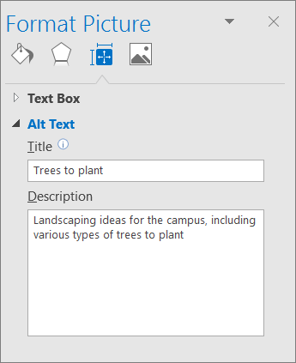
Adding Alt Text to Images
Right-click the image
Alt text helps people who can’t see the screen to understand what’s important in images and other visuals.
In alt text, briefly describe the image and mention the existence of the text and its intent.

Slide 32
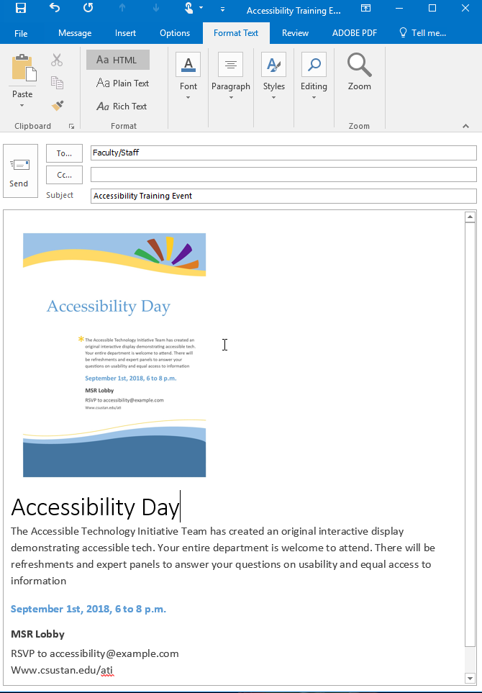
Images vs Text? – Text Wins!
Avoid using text in images as the sole method of conveying important information.
If you must use an image with text in it, repeat that text in the document.
If you can only use one or the other, always choose TEXT!
Images are not Accessible in Outlook
Text is Accessible
In Outlook

Slide 33
Use Good Semantic Structure - Styles
Start in Word and use the Styles features to code the document
Organize your content using true headings and levels
Use true bulleted and numbered lists
Provide a table of contents for long documents
Provide a title page for long documents
Use true columns rather than tabs to create structure

Slide 34
Remember Users with Visual Disabilities
Do not use color alone to convey information (e.g., “Items in red are due this week”)
Make sure that color contrast is strong between text and background
Use adequate text size and a readable font (e.g., Verdana, 12 pt)

Slide 35
Keep Spreadsheets Simple
Spreadsheets should be simple
Create a logical reading order
Don’t rely on color to convey information

Slide 36
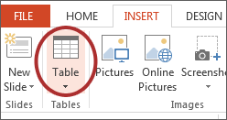
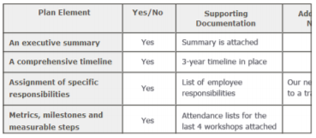
Be Careful with Data Tables
Provide headers for data tables
Use a simple table structure
Do not use tables to create a visual layout
Consider a text alternative to a table

Slide 37
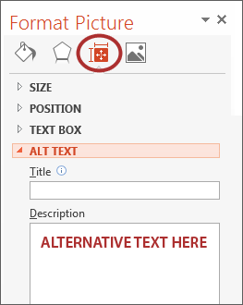
Provide Alternative Text for Visual Elements
Add ‘Alt text’ to the image format Description field
Content and function alternative to the image
Avoid ‘image of’ or ‘picture of’ in description
Keep it simple
Use for images, charts, graphs, tables, etc.

Slide 38
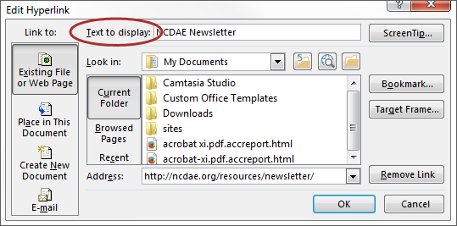
Ensure Links are Descriptive
Avoid using ‘Click Here’, ‘More’, ‘Continue’, etc.
Only show the URL if the document is being printed
Use a descriptive phrase

Slide 39
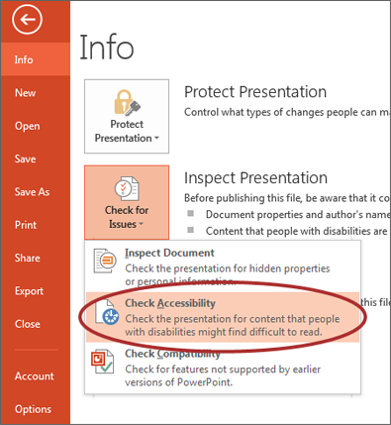
Run Accessibility Checker
Microsoft Office and Adobe include an accessibility resource that identifies accessibility issues.
Select File> Info.
Select the Check for Issues button and choose Check Accessibility.
The Accessibility Checker task pane will show accessibility errors, warnings, and tips on how to repair the errors.
Select specific issues to see Additional Information at the bottom of the task pane.

Slide 40
Provide Captions and Transcripts for Media
Videos and live audio must have captions and a transcript
A transcript is sufficient for archived audio
Captions should be accurately reflecting the text in the video
Text should be equivalent
YouTube auto-captioning is not sufficient

Slide 41
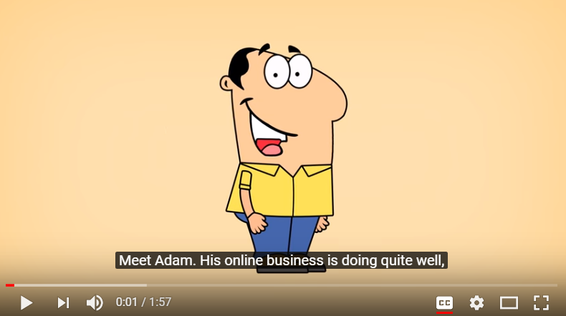
When Should Videos be Captioned?
An accommodation is requested
Shared multiple times and/or over an extended period of time
In an academic course
On a public facing web page

Slide 42
Captioning
OIT – professional captioning services
No charge for academic content
Fee-based for non-academic content
1-3 day turnaround
Glenn Pillsbury – academic captioning
Tawn Gillihan – non-academic captioning

Slide 43
Accessible Instructional Materials

Slide 44
What Are the Challenges?
For Instructors:
Late notice from students
Unrecognized non-apparent disabilities
Limited time to remediate documents and multimedia
More...

Slide 45
ATI & Instructional Materials
Best Practices:
Timely adoption of textbooks and other instructional materials
Post an accessible syllabus and course materials to the LMS
List your course’s media/technology tools requirements early
Captioning for videos and podcasts

Slide 46
ATI & Instructional Materials
Best Practices:
Notify students of any online conferencing tools used in the course
Use consistent file types and multimedia tools
Identify the preferred web browser if appropriate
Provide information on student resources

Slide 47
ATI & Instructional Materials
Best Practices:
Select course materials that have electronic formats
Submit course booklists well ahead of time
Be aware of conversion timelines for print materials (six weeks)
Make sure electronic documents are not scanned images of text

Slide 48
Syllabus Statement
Include a disability statement in the syllabus
If you have a disability and need accommodations, please register with the disability student services office. Staff will determine eligibility for services based on the documentation provided and approve appropriate accommodations. Please feel free to set up an appointment with me to discuss your approved accommodations that are needed for this course. (provide links to the disability services office(s) on your campus and related campus accessibility policy, e.g. Disability Resource Services (DRS).

Slide 49
Examples of Design

Slide 50
Examples of Inaccessible Design
Color Blindness
Color Contrast/Font Size
Category 1
Category 2
Category 3

Slide 51
Examples of Accessible Design
Color Blindness
Color Contrast
Category 1
Category 2
Category 3

Slide 52
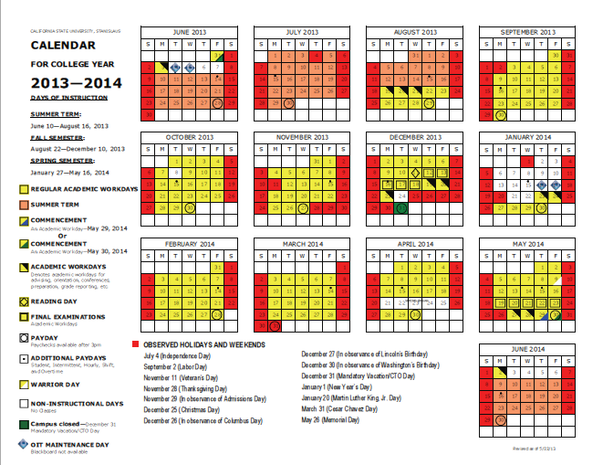
Inaccessible Digital Content

Slide 53
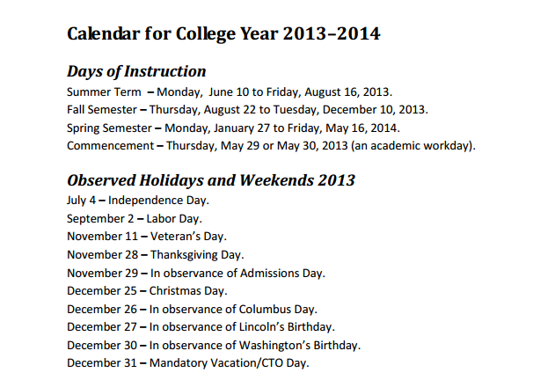
Equally Effective Digital Content
Accessible for a screen reader software application, OCR, and assistive hardware technologies

Slide 54
Clean Layout vs Confusing Layout

Slide 55
Student Videos

Slide 56
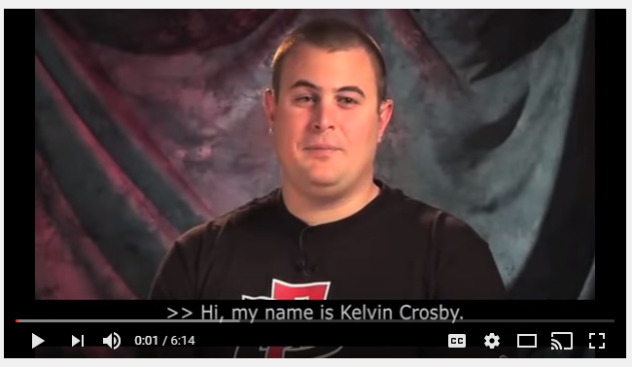
From Where I Sit Video Series
Kelvin Crosby,
(San Diego Kelvin Crosby From Where I Sit, 2013) is a 6 minute video about a deaf/blind student in the classroom, and information on accessible instructional materials for the classroom.

Slide 57
From Where I Sit Video Series
The Stories and Faculty Response

Slide 58
Assistance & Information

Slide 59
Resources for Faculty
OIT Learning Services
Disability Resource Services
Library
Bookstore - FacultyEnlight Tool
ATI Website at ww.csustan.edu/ati

Slide 60
Learning Services
Scanning
Slideshows
Audio/Sound Clips
Video editing
Audio/Video
DVD creation
Graphic design
Captioning
Transcripts
Alt Media

Slide 61
Separate but Equal is an Issue of Social Justice
The failure to address issues of accessibility for persons with physical, sensory, and cognitive disabilities ultimately threatens to segregate people with disabilities as the permanent second–class citizens of the information age.

Slide 62
For More Information & Assistance
ATI Coordinator:
Tawn Gillihan
Email: tgillihan@csustan.edu
Phone: (209) 667-3470
Office: L151G
Instructional Designer:
Glenn Pillsbury
Email: gpillsbury@csustan.edu
Phone: (209) 664-6511
Office: L151G
DRS Director:
Marvin Williams
Email: mewilliams@csustan.edu
Phone: (209) 667-3888
Office: L165
Visit the ATI website at http://www.csustan.edu/ati

