Slide 1
Accessible Technology Initiative
QOLT
October 2017 – Tawn Gillihan, OIT
www.csustan.edu/ati

Slide 2
Accessible Technology
Our use of technology must provide comparable functionality, affordability, timeliness, and must be delivered in as seamless a manner as possible.

Slide 3
Why Promote Accessibility/Usability?
Our use of technology must provide comparable functionality, affordability, timeliness, and must be delivered in as seamless a manner as possible.
Student Success
Legal Action
Laws & Policies

Slide 4
Laws & Policies

Slide 5
ADA Laws & ATI Policies
The Americans with Disabilities Act of 1990 (ADA)
Section 508 of the 1973 Rehabilitation Act
CSU Executive Order 926
CSU Coded Memos AA-2015-03, AA-2014-08

Slide 6
Section 504 vs. 508
Section 504
Disability Resource Services
Individual Student Accommodation
Not Shared
Section 508
Accessible Technology Initiative
Institution-Wide Accessibility
Removes Barriers for a Diverse Group of Learners

Slide 7
Understanding Disability

Slide 8
Apparent Disabilities
Vision Loss & Blindness
Hearing Loss & Deafness
Mobility Limitations
Typically registered with DRS
6% of CSU enrollment

Slide 9
Non-Apparent Disabilities
Traumatic Brain Injury
PTSD
Learning Disability
Mental/Emotional Health Issue
Chronic Health Condition
Often undisclosed
Often unregistered with DRS
10% of all students in higher education

Slide 10
Additional Limitations
Different learning styles
Language/Culture
Limited access to technology
Aging-related limitations
Distance learning
Unaware of resources
Stress

Slide 11
Accessible Instructional Materials

Slide 12
What Are the Challenges?
For Instructors:
Late notice from students
Unrecognized non-apparent disabilities
Limited time to remediate documents and multimedia
More...

Slide 13
ATI & Instructional Materials
Timely adoption of textbooks and other instructional materials
Post an accessible syllabus and course materials to the LMS
List your course’s media/technology tools requirements early
Captioning for videos and podcasts

Slide 14
Best Practices for Online Courses
Syllabus
Include a disability statement in the syllabus
Notify students of any online conferencing tools used in the course
Use consistent file types and multimedia tools
Identify the preferred web browser if appropriate
Provide information on student resources
Notes:
Syllabus Statement: If you have a disability and need accommodations, please register with the disability student services office. Staff will determine eligibility for services based on the documentation provided and approve appropriate accommodations. Please feel free to set up an appointment with me to discuss your approved accommodations that are needed for this course. (provide links to the disability services office(s) on your campus and related campus accessibility policy, e.g. Disability Resource Services (DRS). Include links to the LMS or the location of online course materials.

Slide 15
Best Practices for Online Courses
Instructional Materials
Select course materials that have electronic formats
Submit course booklists well ahead of time
Be aware of conversion timelines for print materials (six weeks)
Make sure electronic documents are not scanned images of text

Slide 16
Best Practices for Online Courses
Universal Design for Learning
Use large visuals, such as font size and images, on slides
Include ALT tags on ALL visual elements
Caption or provide a transcript for all audio or video files
Create accessible Word/Excel/PowerPoint documents

Slide 17
Universal Design for Learning

Slide 18
Universal Design for Learning
The concept of “Universal Design for Learning” advocatesthat developing course materials that are universally accessible are enrichments that can benefit all learners.
Works for the widest pool of users
Easier to design it well the first time than to go back and fix it
People with disabilities don’t have to wait or ask for special help
Benefits everyone, even people without a disability

Slide 19
Examples of Inaccessible Design
Color Blindness
Color Contrast/Font Size
Category 1
Category 2
Category 3

Slide 20
Examples of Accessible Design
Color Blindness
Color Contrast
Category 1
Category 2
Category 3

Slide 21
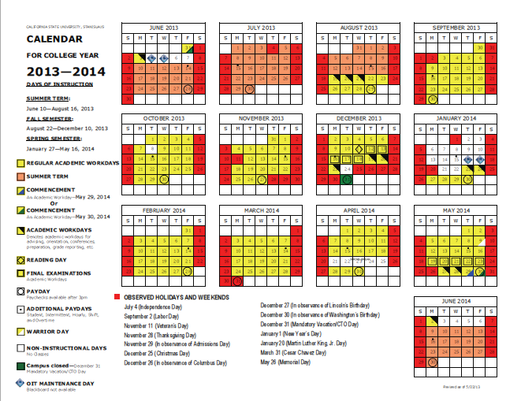
Inaccessible Digital Content

Slide 22
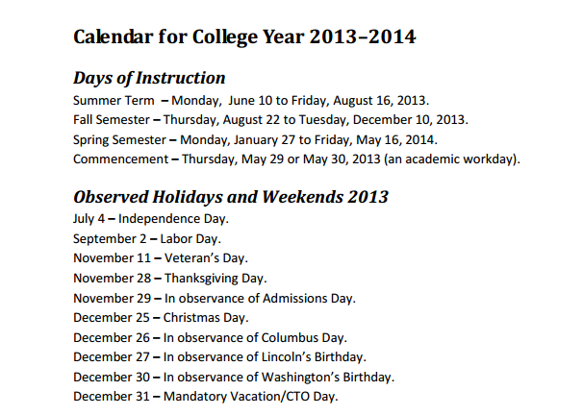
Equally Effective Digital Content
Accessible for a screen reader software application, OCR, and assistive hardware technologies

Slide 23
Assistance & Information

Slide 24
Resources for Faculty
OIT Learning Services
Disability Resource Services
Library
Bookstore - FacultyEnlight Tool
ATI Website www.csustan.edu/ati

Slide 25
Learning Services
Scanning
Slideshows
Audio/Sound Clips
Video editing
Audio/Video
DVD creation
Graphic design
Captioning
Transcripts
Alt Media

Slide 26
Resources for Students
For Academic Help
Tutoring Center
Writing Center
Lynda.com
Program for Academic & Career Excellence (PACE)
Student Support Services
Faculty Mentor Program (FMP)
For Help with Apparent and Non-Apparent Disabilities
Disability Resource Services (DRS)
Psychological Counseling Services
Student Health Center (SHC)
Library Assistive Technology

Slide 27
Documents & Multimedia Tutorials
Word Documents
Excel Spreadsheets
PowerPoint Presentations
PDFs
Video Captioning
STEM

Slide 28
Separate but Equal is an Issue of Social Justice
The failure to address issues of accessibility for persons with physical, sensory, and cognitive disabilities ultimately threatens to segregate people with disabilities as the permanent second–class citizens of the information age.

Slide 29
So What is Assistive Technology?
Assistive Technology is a bridge between electronic information and users. It includes any kind of software or hardware that provides alternate ways of accessing electronic information, such as Text-to-Speech, Voice Recognition, Screen Magnification, Screen Readers, and more.
Assistive Technology Available in the Library at Stanislaus State:
MAGic Screen Magnifier
Dragon Naturally Speaking Voice Recognition Software
Kurzweil 1000 Scanner
JAWS Screen Reader
ClearView Optelec Reader
Can assistive technology interact with electronic content? Not Automatically! Content must be designed to interact well with technology.

Slide 30
Instructional Materials
List the course’s media/technology tools requirements early
Include ALT tags on ALL visual elements
Caption or provide a transcript for all audio or video files (try Camtasia)
Create accessible Word/Excel/PowerPoint documents
Post instructional materials to the LMS in advance

Slide 31
Web Accessibility (Including Digital Content)
All images have alt text
Color isn’t the only indicator of meaning
Text has sufficient contrast
Use simple tables for data, not for layout, and include headers
No flashing or scrolling elements on the page
Keyboard commands are functional
Tab order is logical
Use of STYLES for headings, paragraphs, lists, emphasis, etc.
Descriptive labels for hyperlinks

Slide 32
Summary
Plan for a diverse group of users with special needs to include as many users as possible

Slide 33
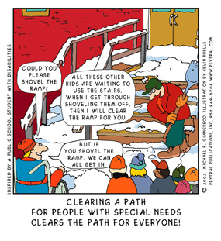
Usability: A Clear Path for Everyone
Student: Could you please shovel the ramp?
Adult: All these kids are waiting to use the stairs. When I’m done with the stairs, I’ll clear the ramp for you.
Student: But if you shovel the ramp first, we can all get in.

Slide 34
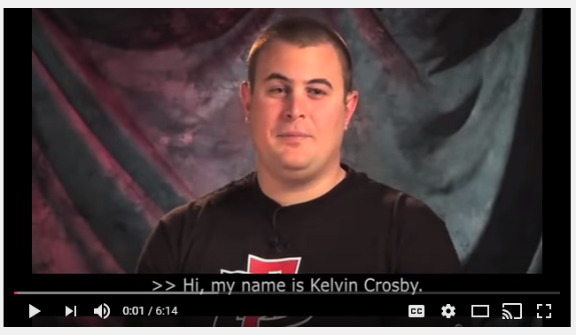
From Where I Sit Video Series
Kelvin Crosby,
(San Diego State, 2013) is a 6 minute video about a deaf/blind student in the classroom, and information on accessible instructional materials for the classroom.

Slide 35
From Where I Sit Video Series
The Stories and Faculty Response

Slide 36
For More Information & Assistance
Visit the new ATI website at http://www.csustan.edu/ati
Contact the ATI Coordinator
Tawn Gillihan
Email: tgillihan@csustan.edu
Phone: (209) 667-3470
Office: L151G

