Slide 1
Accessible Technology Initiative
Online Course Development
Tawn Gillihan, OIT
www.csustan.edu/ati

Slide 2
Accessible Technology
  Our use of technology must provide comparable functionality, affordability, timeliness, and must be delivered in as seamless a manner as possible.
Visit the new ATI website at http://www.csustan.edu/ati

Slide 3
Why Promote Accessibility/Usability?
  Our use of technology must provide comparable functionality, affordability, timeliness, and must be delivered in as seamless a manner as possible.
Student Success
Legal Action
Laws & Policies

Slide 4
Laws & Policies

Slide 5
ADA Laws & ATI Policies
The Americans with Disabilities Act of 1990 (ADA)
Section 508 of the 1973 Rehabilitation Act
CSU Executive Order 926
CSU Coded Memos AA-2015-03, AA-2014-08
Notes:
The ADA was enacted in 1990 to prevent discrimination against people with disabilities and mandates providing accessible options in government offices, public institutions, and businesses. Its focus was originally about physical access but in 1998, increasing use of the Internet by government and education necessitated the addition of Section 508 to the 1973 Rehabilitation Act, which requires accessibility in electronic and online contexts. The State of California has ruled that the CSU and its campuses must comply with Section 508 and the CSU has affirmed this with its Accessible Technology Initiative

Slide 6
Comparable Access to Education
Functionality
Affordability
Timeliness
Ease of Delivery
Notes:
Our use of technology must provide COMPARABLE functionality, affordability, timeliness, and must be delivered in as seamless a manner as possible.

Slide 7
Section 504 vs. 508
Section 504
  Disability Resource Services – Marvin Williams
  Individual Student Accommodation
  Not Shared
Section 508
  Accessible Technology Initiative – Tawn Gillihan
  Institution-Wide Accessibility
  Removes Barriers for a Diverse Group of Learners

Slide 8
Understanding Disability

Slide 9
Apparent Disabilities
Vision Loss & Blindness
Hearing Loss & Deafness
Mobility Limitations
Typically registered with DRS
6% of CSU enrollment

Slide 10
Non-Apparent Disabilities
Traumatic Brain Injury
PTSD
Learning Disability
Mental/Emotional Health Issue
Chronic Health Condition
Often undisclosed
Often unregistered with DRS
At least 11% of all students in higher education

Slide 11
Additional Limitations
Different learning styles
Language/Culture
Limited access to technology
Aging-related limitations
Distance learning
Unaware of resources
Stress

Slide 12
Creating
Accessible Electronic Content

Slide 13
Write Clearly
Use the simplest language appropriate for your content
Use illustrations, icons, etc. to supplement text
Check spelling, grammar, and readability
Be careful with abbreviations, jargon, complex language, or anything that might confuse the reader
AVOID THE USE OF ALL CAPS AS IT CAN BE DIFFICULT TO READ

Slide 14

Use Good Semantic Structure - Styles
Start in Word and use the Styles features to code the document
Organize your content using true headings and levels
Use true bulleted and numbered lists
Provide a table of contents for long documents
Provide a title page for long documents
Use true columns rather than tabs to create structure

Slide 15
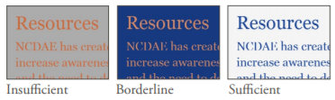
Remember Users with Visual Disabilities
Do not use color alone to convey information (e.g., “Items in red are due this week”)
Make sure that color contrast is strong between text and background
Use adequate text size and a readable font (e.g., Verdana, 12 pt)

Slide 16


Keep Spreadsheets Simple
Spreadsheets should be simple
Create a logical reading order
Don’t rely on color to convey information

Slide 17
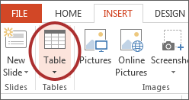
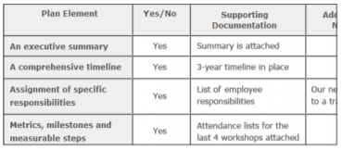
Be Careful with Data Tables
Provide headers for data tables
Use a simple table structure
Do not use tables to create a visual layout
Consider a text alternative to a table

Slide 18
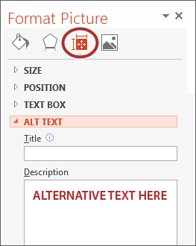
Provide Alternative Text for Visual Elements
Add ‘Alt text’ to the image format Description field
Content and function alternative to the image
Avoid ‘image of’ or ‘picture of’ in description
Keep it simple
Use for images, charts, graphs, tables, etc.

Slide 19

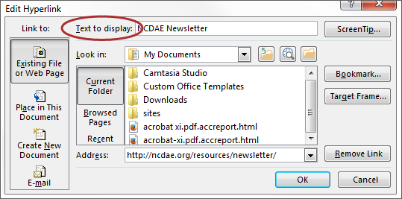
Ensure Links are Descriptive
Avoid using ‘Click Here’, ‘More’, ‘Continue’, etc.
Only show the URL if the document is being printed
Use a descriptive phrase

Slide 20
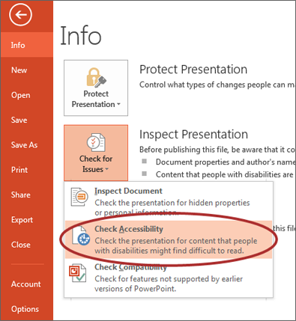
Run Accessibility Checker
Microsoft Office and Adobe include an accessibility resource that identifies accessibility issues.
Select File> Info.
Select the Check for Issues button and choose Check Accessibility.
The Accessibility Checker task pane will show accessibility errors, warnings, and tips on how to repair the errors.
Select specific issues to see Additional Information at the bottom of the task pane.

Slide 21
Provide Captions and Transcripts for Media
Videos and live audio must have captions and a transcript
A transcript is sufficient for archived audio
Captions should be accurately reflecting the text in the video
Text should be equivalent
YouTube auto-captioning is not sufficient

Slide 22
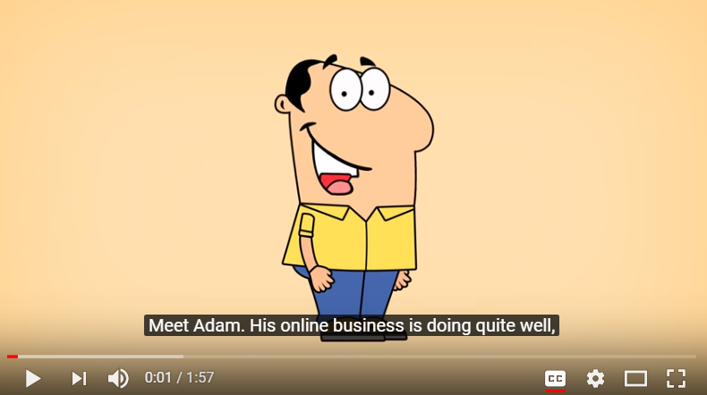
When Should Videos be Captioned?
An accommodation is requested
Shared multiple times and/or over an extended period of time
In an academic course
On a public facing web page

Slide 23
Captioning Instructional Materials
OIT has a budget to have materials that are required for classroom instruction captioned by a professional captioning service, Automatic Sync Technologies.
Contact Glenn Pillsbury (gpillsbury@csustan.edu) to discuss how to take advantage of this service.

Slide 24
Accessible Instructional Materials

Slide 25
What Are the Challenges?
  For Instructors:
  Late notice from students
  Unrecognized non-apparent disabilities
  Limited time to remediate documents and multimedia
  More...

Slide 26
ATI & Instructional Materials
Timely adoption of textbooks and other instructional materials
Post an accessible syllabus and course materials to the LMS
List your course’s media/technology tools requirements early
Captioning for videos and podcasts

Slide 27
ATI & Instructional Materials
  Notify students of any online conferencing tools used in the course
  Use consistent file types and multimedia tools
  Identify the preferred web browser if appropriate
  Provide information on student resources

Slide 28
ATI & Instructional Materials
  Select course materials that have electronic formats
  Submit course booklists well ahead of time
  Be aware of conversion timelines for print materials (six weeks)
  Make sure electronic documents are not scanned images of text

Slide 29
Syllabus Statement
Include a disability statement in the syllabus
If you have a disability and need accommodations, please register with the disability student services office. Staff will determine eligibility for services based on the documentation provided and approve appropriate accommodations. Please feel free to set up an appointment with me to discuss your approved accommodations that are needed for this course. (provide links to the disability services office(s) on your campus and related campus accessibility policy, e.g. Disability Resource Services (DRS).

Slide 30
Examples of Design

Slide 31
Examples of Inaccessible Design
Color Blindness
Color Contrast/Font Size
Category 1
Category 2
Category 3

Slide 32
Examples of Accessible Design
Color Blindness
Color Contrast
Category 1
Category 2
Category 3

Slide 33
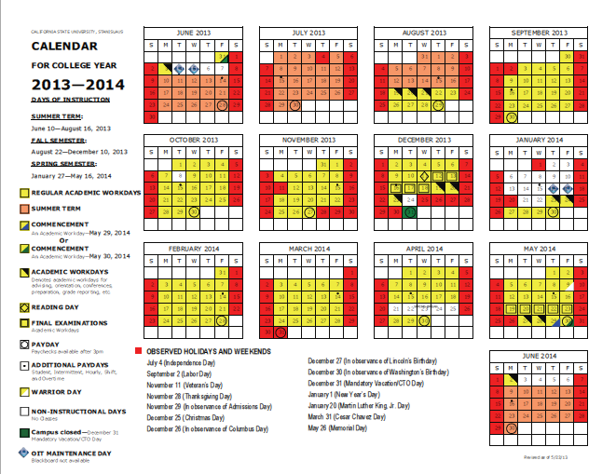
Inaccessible Digital Content

Slide 34
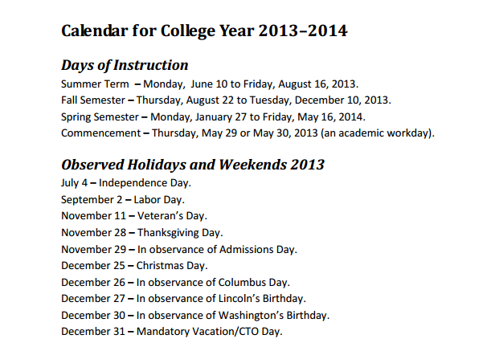
Equally Effective Digital Content
Accessible for a screen reader software application, OCR, and assistive hardware technologies

Slide 35


Clean Layout vs Confusing Layout

Slide 36
Student Videos

Slide 37
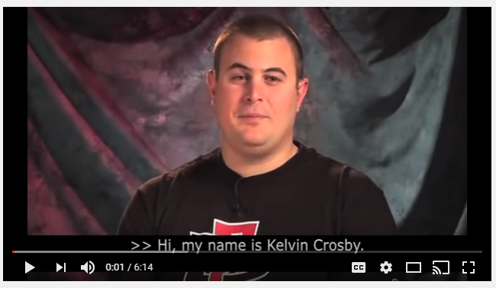
From Where I Sit Video Series
Kelvin Crosby,
(San Diego State, 2013) is a 6 minute video about a deaf/blind student in the classroom, and information on accessible instructional materials for the classroom.

Slide 38
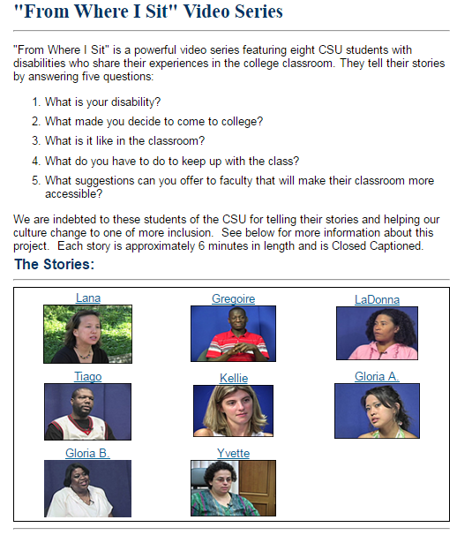
From Where I Sit Video Series
The Stories and Faculty Response

Slide 39
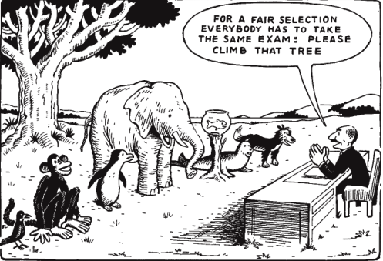
Separate but Equal is an Issue of Social Justice
The failure to address issues of accessibility for persons with physical, sensory, and cognitive disabilities ultimately threatens to segregate people with disabilities as the permanent second–class citizens of the information age.

Slide 40
Assistance & Information

Slide 41
Resources for Faculty
OIT Learning Services
Disability Resource Services
Library
Bookstore - FacultyEnlight Tool
ATI Website at ww.csustan.edu/ati

Slide 42
Learning Services
Scanning
Slideshows
Audio/Sound Clips
Video editing
Audio/Video
DVD creation
Graphic design
Captioning
Transcripts
Alt Media

Slide 43
For More Information & Assistance
ATI Coordinator:
Tawn Gillihan
Email: tgillihan@csustan.edu
Phone: (209) 667-3470
Office: L151G
Instructional Designer:
Glenn Pillsbury
Email: gpillsbury@csustan.edu
Phone: (209) 664-6511
Office: L151G
DRS Director:
Marvin Williams
Email: mewilliams@csustan.edu
Phone: (209) 667-3888
Office: L165
Visit the ATI website at http://www.csustan.edu/ati

