Slide 1
Creating Accessible Electronic Content
Accessible Technology Initiative at Stanislaus State

Slide 2
Write Clearly
Use the simplest language appropriate for your content
Use illustrations, icons, etc. to supplement text
Check spelling, grammar, and readability
Be careful with abbreviations, jargon, complex language, or anything that might confuse the reader
AVOID THE USE OF ALL CAPS AS IT CAN BE DIFFICULT TO READ

Slide 3
Use Good Semantic Structure - Styles
Organize your content using true headings and levels
Use true bulleted and numbered lists
Provide a table of contents for long documents
Provide a title page for long documents
Use true columns rather than tabs to create structure

Slide 4
Remember Users with Visual Disabilities
Do not use color alone to convey information (e.g., “Items in red are due this week”)
Make sure that color contrast is strong between text and background
Use adequate text size and a readable font (e.g., Verdana, 12 pt)

Slide 5
Keep Spreadsheets Simple
Spreadsheets should be simple
Create a logical reading order
Don’t rely on color to convey information

Slide 6
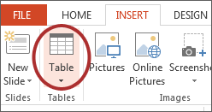
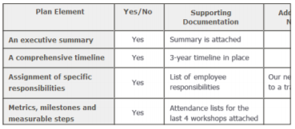
Be Careful with Data Tables
Provide headers for data tables
Use a simple table structure
Do not use tables to create a visual layout
Consider a text alternative to a table

Slide 7
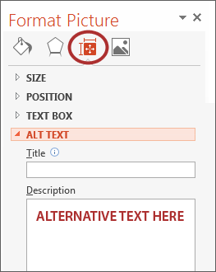
Provide Alternative Text for Visual Elements
Add ‘Alt text’ to the image format Description field
Content and function alternative to the image
Avoid ‘image of’ or ‘picture of’ in description
Keep it simple
Use for images, charts, graphs, tables, etc.

Slide 8
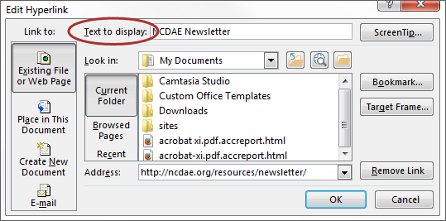
Ensure Links are Descriptive
Avoid using ‘Click Here’, ‘More’, ‘Continue’, etc.
Only show the URL if the document is being printed
Use a descriptive phrase

Slide 9
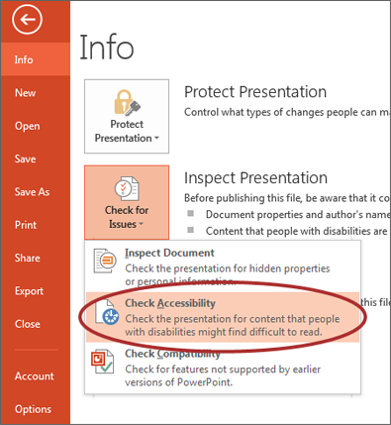
Run Accessibility Checker
Microsoft Office and Adobe include an accessibility resource that identifies accessibility issues.
Select File> Info.
Select the Check for Issues button and choose Check Accessibility.
The Accessibility Checker task pane will show accessibility errors, warnings, and tips on how to repair the errors.
Select specific issues to see Additional Information at the bottom of the task pane.

Slide 10
Provide Captions and Transcripts for Media
Videos and live audio must have captions and a transcript
A transcript is sufficient for archived audio
Captions should be accurately reflecting the text in the video
Text should be equivalent
YouTube auto-captioning is not sufficient

Slide 11
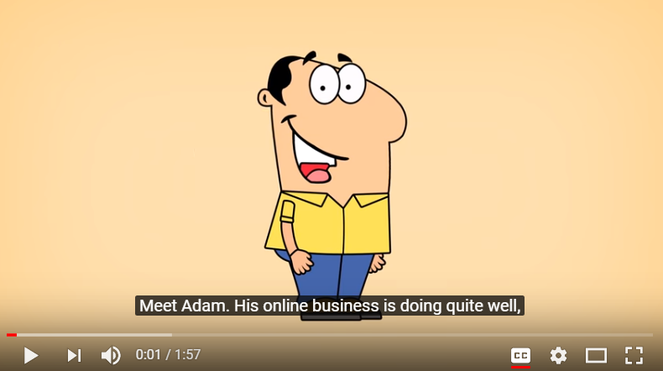
When Should Videos be Captioned?
An accommodation is requested
Shared multiple times and/or over an extended period of time
In an academic course
On a public facing web page

Slide 12
Captioning Instructional Materials
OIT has a budget to have materials that are required for classroom instruction captioned by a professional captioning service, Automatic Sync Technologies.
Contact Glenn Pillsbury (gpillsbury@csustan.edu) to discuss how to take advantage of this service.

Slide 13
For Assistance or More Information
Accessible Technology Coordinator Tawn Gillihan (209) 667-3470 tgillihan@csustan.edu

