Slide 1
ARC Retention, Tenure and Promotion From Paper to Electronic
Marsha Robinson, Administrative Analyst/Specialist
Patricia Hughes, Lead Administrative Support Coordinator,
Department of Psychology

Slide 3
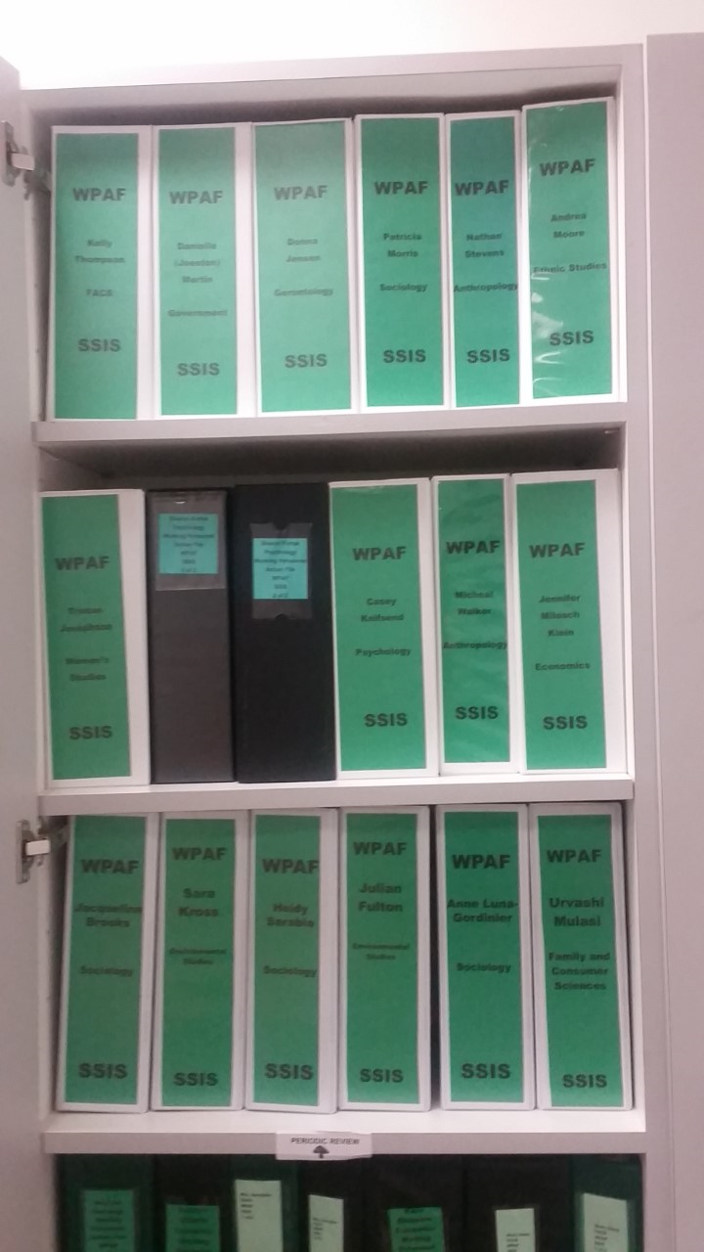
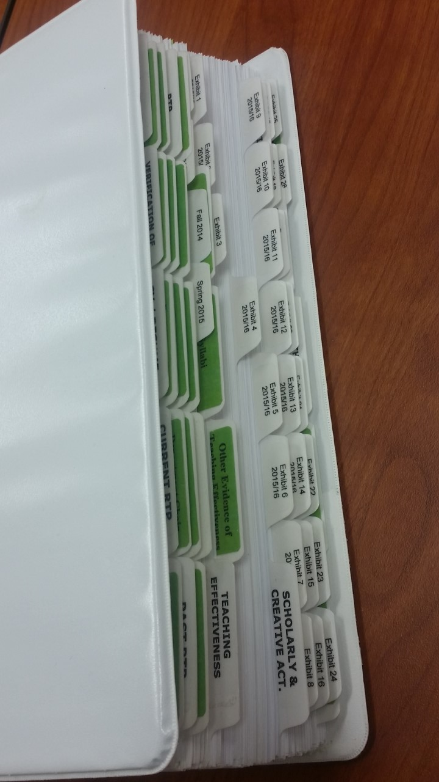
BINDERS, BINDERS BINDERS!!!

Slide 4
COLLEGE OF SOCIAL SCIENCES & INTERDISCIPLINARY STUDIES
2016 - 2017 KEY DATES
RETENTION TENURE & PROMOTION CALENDAR OF DEADLINES
 |  |  | RETENTION |  | TENURE AND PROMOTION
DEPARTMENT PRIMARY COMMITTEE LTR DELIVERED TO CANDIDATE: |  |  | SEPTEMBER 30 , 2016 |  | NOVEMBER 1, 2016
Dean's office will submit transmittal letters to the Academic Department's Administrative Support Coordinator with a start date of September 30, 2016
PRIMARY COMMITTEES Recommendations and WPAF's due to the Dean's Office |  |  | SEPTEMBER 30, 2016 |  | NOVEMBER 1, 2016
Administrative Support Coordinators are to distribute Primary Committees Letter of Recommendation to faculty on the date specified above. It is imperative that these letters be delivered to the candidate up to or on this date. The Faculty 10 day rebuttal period will not change.
Faculty 10 day rebuttal period |  |  | 9/30/16 - 10/10/16 |  | 11/1/16 - 11/10/16
SECONDARY COMMITTEE BEGINS REVIEW (RETENTION: 13 WPAF's; TENURE/PROMOTION 6 WPAF's) |  |  | 10/10/2016 - 11/4/16 |  | 11/10/16 - 12/9/16
SECONDARY COMMITTEES: |  |  | Secondary Retention Committee letters due to the Dean's Office no later than November 4, 2016 |  | Secondary Tenure, & Promotion Committees letters due to the Dean's Office no later than December 9, 2016
Secondary Committee recommendation letters distributed to faculty |  |  | November 14, 2016 |  | December 15, 2016
Faculty 10 day rebuttal period |  |  | 11/14/16 - 11/23/16 |  | 12/15/16 - 1/18/17 due to Winter Break
Dean Bodvarsson reviews P4's / Promotion WPAF's |  |  | 11/28/16 - 12/13/16 |  | 1/18/17 - 2/24/17
Dean Bodvarsson submits letters to Marsha |  |  | December 13, 2016 |  | February 24, 2017
Dean's Letter of Recommendations distributed to faculty |  |  | Thursday, December 15, 2016 4th year probationary |  | Monday, March 6, 2017
Faculty 10 day rebuttal period |  |  | 12/15/16 - 1/3/17 |  | 3/6/17 - 3/16/17
PROVOST: P4 / TENURE, AND PROMOTION WPAF's due to the Provost |  |  | January 6, 2017
Dean Bodvarsson reviews P3's and P5's |  |  | 12/12/16 - 1/10/17
Dean Bodvarsson submits other retention letters (p3's and p5's) to Marsha |  |  | January 11, 2017
Dean's Letter of Recommendations distributed to faculty - (all other probationary years) |  |  | January 18, 2017 (AY begins) (all other probationary years)
Faculty 10 day rebuttal period |  |  | 1/18/17 - 1/30/17
Faculty WPAF's forwarded to the Provost by SSIS |  |  |  |  | March 17, 2016 Tenure and PromotionProbationary Faculty
Provosts letter of decision to faculty |  |  | February 10, 2017 4th Year Probationary Faculty |  | May 19, 2017
PERIODIC REVIEW |  |  | WPAF'S DUE TO THE DEAN'S OFFICE- April 7, 2017
POST TENURE REVIEW |  |  | WPAF'S DUE TO THE DEAN'S OFFICE- April 7, 2017
= Lead Administrative Staff person
 | (STAFF: The original Primary Committee Recommendation Letter, along with the original transmittal letter, is to be placed in the front pocket of the WPAF's before they are returned to the Dean's Office.

Slide 5
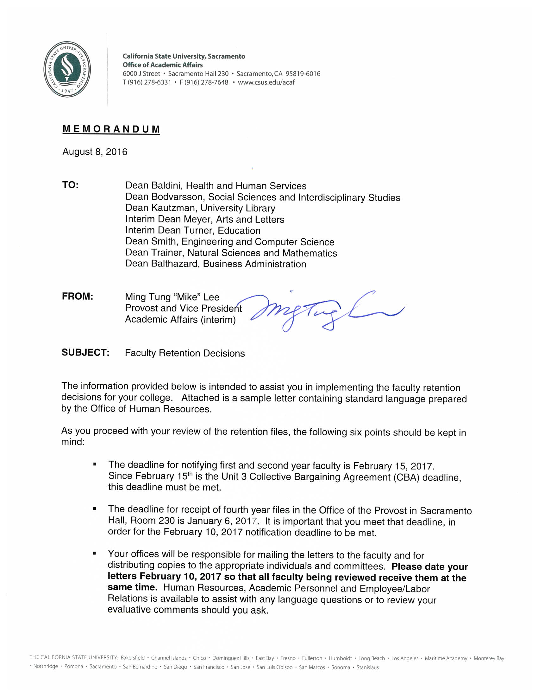

Slide 6
WORKSHOP ON THE RTP PROCESS FOR PROBATIONARY FACULTY IN THE COLLEGE OF SS & IS: RETENTION
Wednesday, September 7, 2016
Riverside Hall RM 1015
Friday, September 9, 2016
Amador Hall RM 256
Notes:
Welcome to the SSIS WPAF Refresher File Workshop.
This is a Refresher Course on how to put together the WPAF’s for the Retention Process.
It was suggested by members of the Secondary Committee to help facilitate a smoother process when they review the files.
This workshop will not address RTP policies. This workshop is strictly on putting together the WPAFs.
Would like everyone to go around the room and just introduce themselves, their department, and one question that they are just dying to know before they leave here today.
If I don’t know the answer to your question, I will write it down and we will find out the answer and get back to you.

Slide 7
