Slide 1
Groundwater Recharge Station Project Project Number 21-381
Notes:
The California State University

Slide 2
Introductions
Rhonda Willson
Construction Administrator, Procurement & Contract Services
209-667-3730
rwillson@csustan.edu

Slide 3
Presentation Overview
Notice to Contractors
Scope of Work
Sample Forms
Important Information
Questions

Slide 4
Notice to Contractors
The Trustees of the California State University will receive sealed bid proposals in the Mary Stuart Rogers Building, Room 270, for furnishing all labor and materials for construction of the Groundwater Recharge Station Project, Project Number 21-381, for the California State University, Stanislaus.
Proposals will be received in the above-mentioned room until 2:00 p.m. on Thursday, October 19, 2023, in accordance with the contract documents, at which time the proposals will be publicly opened and read.
The engineer for the project is Adam Merrill, Principal Engineer with Siegfried Engineers; amerrill@siegfriedeng.com (209) 337-7717.
Campus construction budget estimate for the project is $1,750,000.00.
Project Duration is 120 calendar days
Liquidated damages are $3,000.00 per day
All questions are due in writing on Monday, October 9, 2023, by 5:00 PM.

Slide 5
Notice to Contractors cont. d
Each bidder offering a proposal must comply with Bidding provisions of Article 2.00 et seq. in the Contract General Conditions. Bidders must be prequalified with the Trustees and submit their prequalification applications no less than ten (10) business days prior to the bid due date.
To apply, Bidders shall go to the following “PlanetBids” website, register, log in and then select the Prequalification tab. “California State University, Office of the Chancellor, Vendor Portal” (https://www.planetbids.com/portal/portal.cfm?CompanyID=15331 ).
Direct any prequalification questions to the Trustees’ Prequalification Administrator at cocm.prequal@calstate.edu.
Note: You cannot bid without attending the mandatory job walk and submitting your prequalification letter to the Construction Administrator. You will need to email your pre-qualification letter to rwillson@csustan.edu in order to receive the bid packet.
Failure to request the formal bid packet and usage of the watermarked documents in the bid book will result in an automatic rejection and you will be deemed non-responsive for the bid event.

Slide 6
Notice to Contractors cont. d
Plans and specifications may be seen at the Capital Planning & Facilities Management office of the University or the e-ARC Plan Rooms.
Plans and specifications may be obtained after the required non-refundable payment of $160.00 per physical set or $75.00 per digital set has been made, by requesting them from ARC at www.e-ARC.com/ca/modesto , or calling the ARC Modesto location at (209) 524-2924 and asking for the PlanWell Department.
The Trustees require the successful bidder to achieve three percent (3%) DVBE participation in contracting construction projects as established in the bidding documents, and bidders shall identify the DVBEs to be used to satisfy this requirement in their bids. Bidders shall contact the Trustees’ DVBE Coordinator at rwillson@csustan.edu .
Each bidder shall be familiar with all the provisions of the Contract General Conditions and Supplementary General Conditions, especially the Insurance Requirements for the CSU Builders Risk Insurance Program (BRIP) and for the CSU Owner-Controlled Insurance Program (OCIP). This project will be enrolled into the BRIP.

Slide 7
Notice to Contractors cont. d
This project is a public works project and is subject to prevailing wage rate laws (Contract General Conditions, Article 4.02). All contractors and all tiers of subcontractors who will work on this project shall register to bid and work on public works projects with the Dept. of Industrial Relations and maintain current this registration pursuant to Labor Code section 1725.5. For more information, go to http://www.dir.ca.gov/Public-Works/PublicWorks.html .
It will be the responsibility of each bidder to obtain a bid proposal package in sufficient time to fulfill requirements therein. Bid proposal packages are obtainable only by prequalified contractors, who have attended the mandatory pre-bid conference and are licensed in the State of California with an “A” or “B” license, and who are registered with the DIR to bid public works projects.
The bid packages must be requested from the University by contacting Rhonda Willson via email at: rwillson@csustan.edu . You must provide your CSU Prequalification letter as part of this request.

Slide 8
Scope of Work
The project consists of modifications to the existing lawn area, as delineated on the project drawing set. Demolition includes excavation and removal of the existing landscaping, tree(s), irrigation, and subgrade to accommodate a groundwater recharge basin. New work includes installation of a pump system consisting of three pumps within a fenced enclosure with privacy slats. The pump system shall be connected to the existing Warriors Pond discharge pipe with the option to bypass the proposed pump system.
All new controls shall be connected to the existing system for control and monitoring by central plant facility staff.

Slide 9
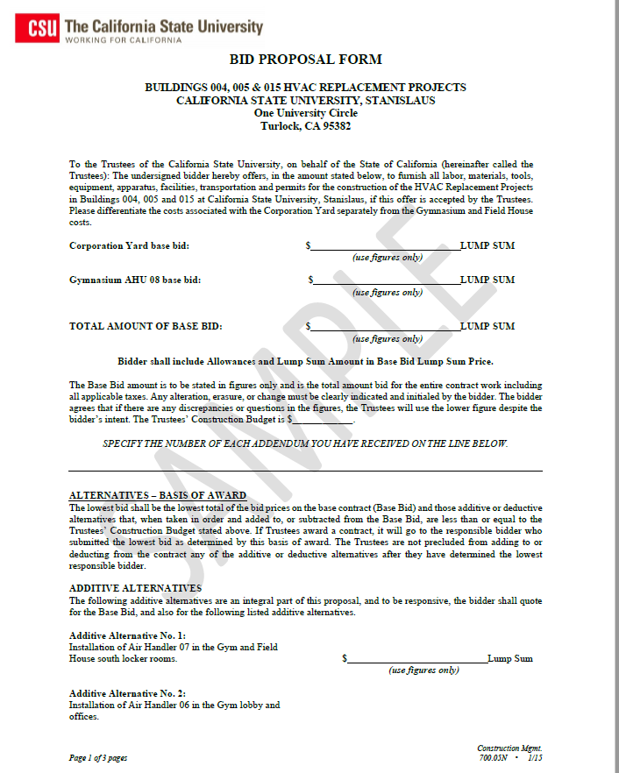
Sample Forms

Slide 10
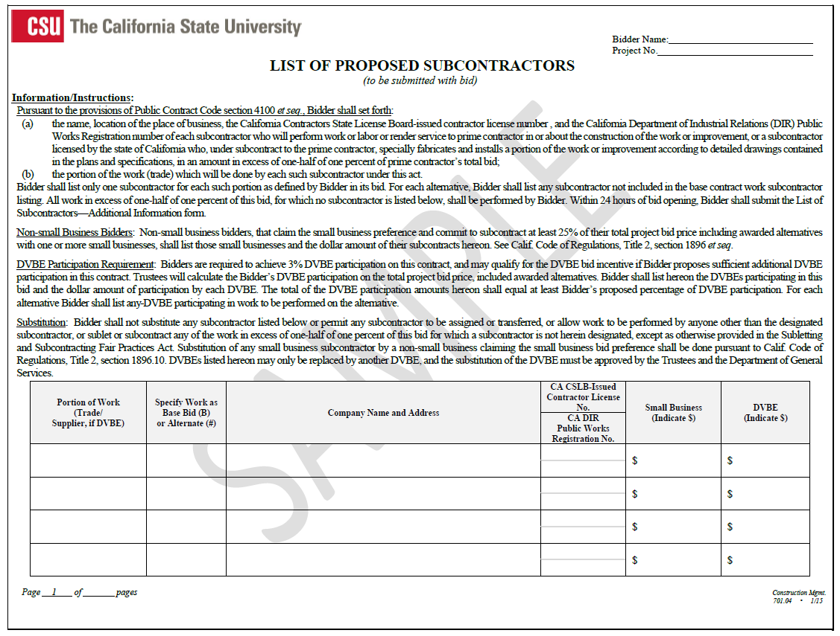
Sample Forms cont. d

Slide 11
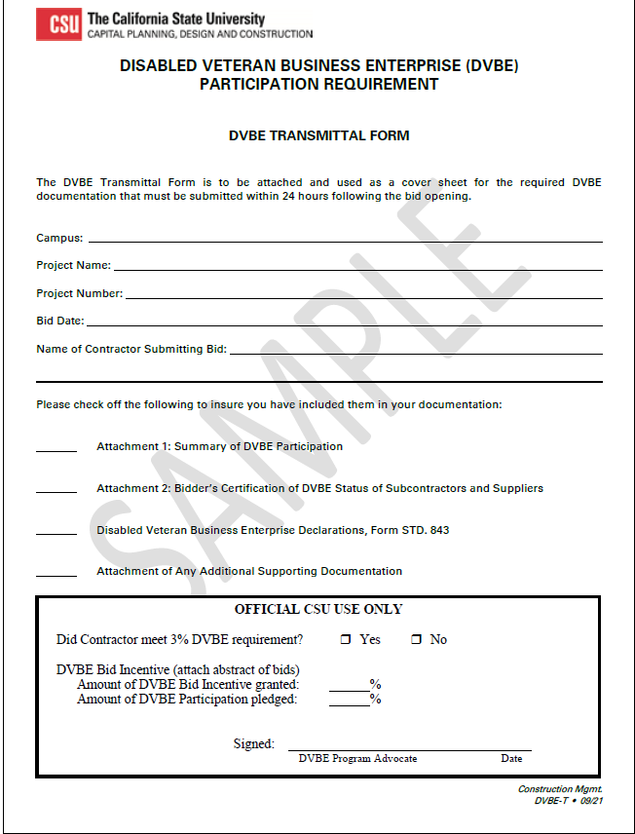
Sample Forms cont. d

Slide 12
Important Information
Clarification during Bidding: The Bidder shall examine the Site, Plans, Bid Documents and Specifications in preparing the bid and shall report to the Architect and/or the University any omissions, discrepancies, or errors found.
Information obtained verbally from any source has no contractual authority, may not be relied upon, and shall have no standing in any event that may occur.
2.06(c) Bidder’s Security: All Bidders shall present bids under sealed cover and have enclosed an amount equal to at least ten (10) percent of the total amount bid, including alternatives (if additive), as bid security.
Bidders may submit the bid security in one (1) of the following forms:
Cashier’s check or Certified check - Made payable to the Trustees
Bidder’s bond.
The Trustees shall not consider any bid unless Bidder encloses one of these forms of bid security. If the bid security is a bond, a corporation authorized as an admitted surety insurer to issue surety bonds in California shall execute that bond, and it shall be executed on the form prescribed by the Trustees.

Slide 13
Important Information cont. d
Preference for Small Businesses: The Trustees shall give a small business preference or bid advantage of five percent up to a maximum of $50,000 to contracting firms that have been certified as a “Small Business” by the Office of Small Business & DVBE Services, in the Procurement Division of the Department of General Services.
Small Business Five Percent Bid Advantage: The Trustees calculate the five percent small business preference as a percentage of the lowest responsive bidder’s bid. For bid evaluation purposes only, if the lowest responsive bidder is a California certified small business, the Trustees will not calculate the five percent bid advantage for any bidders.
Preference for Non-small Businesses: The application of the five percent small business bidding preference is also extended to any non-small business that commits to subcontracting at least 25% of its net bid price to California certified small businesses and/or microbusinesses.

Slide 14
Important Information cont. d
2.13 Disabled Veteran Business Enterprise Participation Requirement and Incentive:
California state law requires that its state agencies achieve three (3) percent participation for disabled veteran business enterprises (DVBE) in state contracts. Failure of the Bidder to comply with the DVBE requirement will cause the Trustees to deem the bid nonresponsive and the Bidder to be ineligible for award of Contract.
Incentive
In accordance with Government Code section 14838(f) and Military and Veterans Code sections 999.5(a) and 999.5(d), the Trustees are granting a bid incentive for bid evaluation purposes only to Bidders that exceed the three percent DVBE participation requirement. The level of DVBE incentive will correlate to the level of participation; that is, the more DVBE participation proposed, the higher the incentive. The bid incentives are as follows:
DVBE Participation Incentive
3.00% to 3.99% None
4.00% to 4.99% 1%
5.00% to 5.99% 2%
6% or more 3%

Slide 15
Important Information cont. d
The DVBE incentive may not exceed $100,000.
When used in combination with the Small Business Preference, the cumulative adjustment amount shall not exceed $100,000.
If the lowest responsive, responsible bid is a California certified small business, for bid evaluation purposes only, the only bidders eligible for the incentive will be California certified small businesses.
3.01 Award of Contract: If the Trustees deem the acceptance of the lowest responsible bid or bids is not in the best interests of the State, the University may reject all bids. If the Trustees accept the bid and award the Contract, the Trustees’ award shall be made to the lowest responsible Bidder whose proposal complies with all the requirements prescribed (Public Contract Code section 10780). Such award shall be made within sixty (60) Days after the opening of the proposals.
3.03 Contract Bonds: The successful Bidder shall furnish, for each Contract counterpart signed, two surety bonds in the form prescribed by the Trustees. Each bond shall be in an amount equal to 100 percent of the awarded Contract price and executed by an admitted surety insurer licensed in the State of California and listed in the latest published United States Treasury Department list of “Companies Holding Certificates of Authority as Acceptable Sureties on Federal Bonds and as Acceptable Reinsuring Companies.”

Slide 16
Important Information cont. d
4.08 Contractor’s Responsibility for the Work: The Contractor shall be responsible for all Work performed under this Contract, and no subcontractor will be recognized as such. For purposes of assessing responsibility to the Contractor, all persons engaged in the Work shall be considered employees of the Contractor. The Contractor shall give its personal attention to the fulfillment of the Contract and keep all phases of the Work under its control.
4.15 Contract Time
a. Time of the Essence.
All time limits specified in this Contract are of the essence of the Contract.
b. Starting and Completion Date.
The Trustees shall designate in the Notice to Proceed the starting date of the Contract on which the Contractor shall immediately begin and thereafter diligently prosecute the Work to completion. The Contractor agrees to complete the Work on the date specified for completion of the Contractor’s performance in the Contract unless the Trustees adjust such time in writing, by change order. The Contractor may complete the Work before the completion date if it will not interfere with the Trustees or their other contractors engaged in related or adjacent Work. The Trustees shall regard the Work as completed on the acceptance date noted on the Trustees’ Notice of Completion, and the Trustees consider this acceptance date as the date that starts the guarantee period as defined in Article 8.06, Guarantee

Slide 18
Thank you

Slide 19
www.calstate.edu
Notes:
The California State University
www.calstate.edu

