Slide 1
Health Inequity in California's Heartland: Exploring the Role of Poverty
John Capitman*
Nickerson Professor of Public Health
Executive Director, Central Valley Health Policy Institute
California State University, Fresno
CSU Stanislaus Social Work Department Annual Conference
Poverty Reduction Strategies in the Central Valley – Voices from the Field
Thursday, February 24
*With assistance from: Armando Cortez, Mathilda Ruwe, Marlene Bengiamin, Diana Traje, and Kudzai Nyandoro, Central Valley Health Policy Institute, Cal State University Fresno, and Steve Sedlock, Kenneth Studer, and Rexford Anson-Dwamena, Virginia Network for Geospatial Health Research, Inc.
Notes:
I WANT TO THANK, ARMANDO, MATHILDA AND MARLENE FOR THEIR CONTRIBUTIONS TO OUR REPORT
ALSO WITH SUPPORT FROM PLACE MATTERS, WE HAVE HAD THE CHANCE TO WORK WITH VIRGINIA NETWORK FOR GEOSPATIAL HEALTH RESEARCH
A FULL REPORT ON THESE DATA WILL BE COMING OUT IN THE FALL

Slide 2
Overview
Definitions and Theoretical Explanation for Health Inequity
Evidence for Health Inequity in the San Joaquin Valley
Exploring the role of concentrated poverty in explaining Valley health outcomes
Key Valley issues in health reform
Questions and Discussion

Slide 3
DEFINITIONS: Health Outcome Inequities, Health Care Inequities
Health Inequity: unfair ((a) not caused by underlying biology or exclusively individual choices, AND (b) caused by policy-related systemic differences in exposure) differences between socially-defined groups in health outcomes (length and quality of life, satisfaction with health, clinical measures of health status).
Health Care Inequity: unfair ((a) not caused by underlying health differences or exclusively individual choices AND (b) caused by policy-related systemic factors) differences between socially-defined use in the access to quality health services.

Slide 4
Summary of Findings: Social Factors and Health—Evidence for Disparities
Health disparities occur worldwide—groups with more economic and political power have better health
In US, target groups (remember from last time?—people of color, working class, women, kids and elders, persons with disabilities, sexual minorities etc.) have unfair, worse health and health care.
For example: African Americans, Latinos, American-Indian/Alaska Native and some Asian American groups experience:
  Higher Mortality At All Ages (Kids to Elders)
  Higher Acute and Chronic Condition Prevalence
  Higher Rates and Earlier Onset of Disability
  Less access to appropriate Health Care
  Lower Quality Health care
  Less Satisfaction with Health and Health Care
Patterns of group differences are complex---for example, (1) women live longer, but more time with disability and caregiving, (2) some racial/ethnic sub-groups have lower mortality than whites in some age groups but data biased by population age or immigration status.

Slide 5
What causes racial/ethnic or other health disparities?
Multi-Causal Web Framework:
patient, provider, care system, and community factors
Krieger (2003) “eco-social” framework
deprivation, toxic physical environments, social traumas, targeted marketing of toxic products, inadequate or degrading medical care
Kawachi and others (Harvard) social capital framework
social relations and psychosocial stress
Marmot and others (British) materialist framework
concrete material deprivation, public disinvestment in services for disenfranchised groups

Slide 6
What Causes Health Inequities?
Health Care
Disparities
Unequal
Social/Economic
Environment
Health Inequities
Unequal Access to
Health Care

Slide 7
Inequities in Health and Well-being: Why Place Matters
Mounting evidence: people of color, rural and inner-city residents, and less affluent have worse life outcomes (survival, chronic disease, well-being, appropriate care).
Traditional Approach: Cause→ genetics, individual behavior. Solutions---Help individuals adopt better behavior
Mounting evidence: social, environmental, economic development, and infrastructure factors---social determinants—explain group differences in life outcomes
New Approach: Cause→ places, policies, and environments in addition to individual differences. Solutions-- Help communities have better living conditions and opportunities
Notes:
More than a century of research on inequality in health outcomes by race, class, place and gender…..individual genes and behavior usually the target….thus individual change approach
BUT RESEARCH SHOWS THAT GROUPS OF PEOPLE WHO SHARE GEOGRAPHY AND ASSOCIATED LIVING CONDITIONS HAVE SIMILAR LIFE CHANCES…..
MUTIPLE POLICIES AND SYSTEMS---
POOR AIR, HOUSING, OPEN SPACE, JOBS, SCHOOLS, SERVICES ALL PLAY OUT IN PLACES……
THIS CREATES DIFFERENCES IN RISKS PEOPLE FACE AND IN THEIR OPPORTUNITIES FOR VIGOROUS AND FULFILLING LIVES…..
INSTEAD OF HARANGUING OR CAJOLING INDIVIDUALS TO SWIM UPSTREAM, RISE ABOVE THE ODDS AND ADOPT NEW BEHAVIOR,
The new approach----fix living conditions and life opportunities….give people the chance to take responsibility for their own well-being

Slide 8
Health and Well-being Disparities: San Joaquin Valley Findings
A decade of reports: Valley has worse health and well-being outcomes than California and nation.
Bengiamin et al Healthy People 2010 shows worse outcomes than state, failed national standard for 9 out of 10 health indicators, little progress over last decade.
Multiple reports highlight barriers to health and well-being for many Valley communities
Notes:
New healthy people report to come out soon….
From air and water, to schools and programs, the health care and mental health….the litany of our woes has been repeated often….and we lack a unifying framework or way of talking about these issues

Slide 9
Poverty and Health in the San Joaquin
Selected CHIS findings
Median Income Condition | <$15k | $15-$30k | $30k-$60k | >$60k
Fair or Poor Health % | 37 | 31 | 20 | 10
Psychological Distress % | 13 | 10 | 9 | 8
Diabetes –ever dx % | 16 | 12 | 8 | 5
Heart Disease—ever dx % | 9 | 10 | 5 | 4
Usual care MD office % | 39 | 47 | 70 | 80
Insured all last year % | 68 | 70 | 83 | 94

Slide 10
Place-Based Approach
How do Valley places differ on health and well-being outcomes?
What explains these differences?
CVHPI Data Warehouse:
  birth, death by zip code over 7 years
  hospitalization by zip code over 9 years
  race/ethnicity, median income, density by zip code
  economic, education, environmental
Analysis by place –traditional epidemiology methods
Analysis by place- spatial analysis methods
STABLE Multi-year MEASURES, BEFORE the RECESSION

Slide 11
Years of Potential Life Lost by Place
Overall mean=42.47
Range=17-75 years lost/1,000

Slide 12
Community Features and YPLL
More years of life lost in segregated Latino communities (15 years/10,000)
More years of life lost in segregated African American and Asian communities (6 years/10,000)
More years of life lost in poor communities (26 years/10,000)
Complex multivariate relationships
*significant at p=.05
Notes:
SEE APPENDIX SLIDES 29-31
Segregation-latinos…<60%
Segregation aa/asiaon <14%
Median Household Income----- less the 28, greater than 60

Slide 13
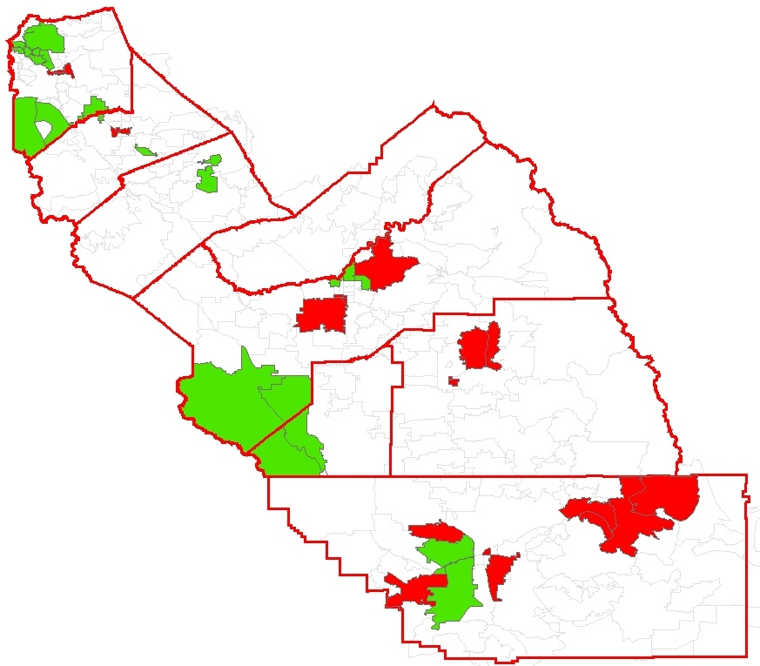
Top 15 Highest YPLL | RED
95202 / 95203 | San Joaquin
95205 | San Joaquin
93728 | Fresno
93706 | Fresno
93301 | Kern
93307 | Kern
93721 / 93701 | Fresno
93268 | Kern
93619 | Fresno
93205 / 93240 93283 / 93255 | Kern
95354 | Stanislaus
93244 / 93286 | Tulare
95351 | Stanislaus
93223 | Tulare
93263 | Kern
Top 15 Lowest YPLL | GREEN
95304 | San Joaquin
95242 | San Joaquin
93239 / 93204 | Kings
95377 | San Joaquin
93611 | Fresno
95368 | Stanislaus
93311 | Kern
93730 / 93711 | Fresno
95348 | Merced
93720 | Fresno
93234 / 93210 | Fresno
95219 | San Joaquin
95366 | San Joaquin
95382 | Stanislaus
93312 | Kern
Notes:
NOTE 93706---EXAMPLE OF COMMUNITY WITH BOTH HIGH LATINO AND HIGH AA/ASIAN POPULATION AND HIGH YPPL----CONFERENCE IN FALL FOCUSED ON 93706

Slide 14
Avoidable Hospitalizations
Mean=154.28
Range-48-480 avoidable admissions /10,000
*significant at p=.05
Notes:
NOTE THE ADVD HOSP INCLUDES ELDERS….AND THAT RATES INCREASE WITH AGE

Slide 15
Community Features and Avoidable Hospitalizations
More ACSC admits in segregated African American and Asian communities (11 admits/10,000)
More ACSC admits in high poverty communities (75 admits/10,000)
More ACSC admits in elder communities (39 admits/10,000)
Complex multivariate relationships
Notes:
ACSC—AMBULATORY CARE SENSITIVE CONDITIONS
Segregation-latinos…<60%
Segregation aa/asiaon <14%
Elder…>10%
Median Household Income----- less the 28, greater than 60

Slide 16
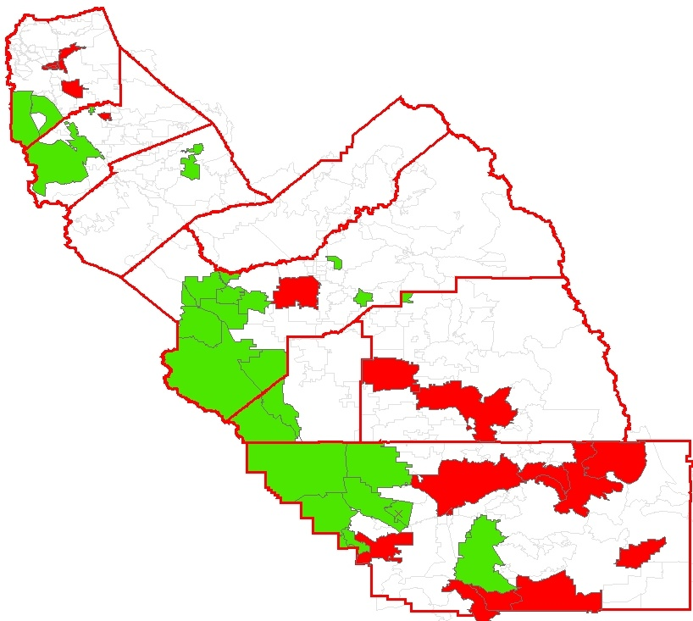
Top 15 Highest AH | RED
93205 / 93240 93283 / 93255 | Kern
93301 | Kern
93308 | Kern
93268 | Kern
95202 / 95203 | San Joaquin
95205 | San Joaquin
95212 | San Joaquin
95204 | San Joaquin
93505 | Kern
95350 | Stanislaus
93706 | Fresno
95336 | San Joaquin
93243 / 93560 | Kern
93257 | Tulare
93274 | Tulare
Top 15 Lowest AH | GREEN
95304 | San Joaquin
95377 | San Joaquin
93239 / 93204 | Kings
93608 / 93668 93660 / 93640 | Fresno
93206 / 93224 93249 / 93251 93280 | Kern
93203 | Kern
93234 / 93210 | Fresno
95363 | Stanislaus
95368 | Stanislaus
93241 | Kern
93648 | Fresno
93314 | Kern
93646 | Tulare
95348 | Merced
93611 | Fresno
Notes:
Note low rates in some of the less populated western edge communities and some affluent neighborhood…..

Slide 17
Equity in Health and Well-being
Before the Recession
Huge differences in health outcomes between Valley communities, and patterns vary by condition.
Lower income communities have more premature death and more avoidable hospitalizations
Communities with more Latinos are not at greater risk for premature death and more avoidable hospitalizations, but communities that are more immigrant are.
While premature death is more common in poorer community, racial/ethnic disparities are more pronounced in more affluent communities.
While premature death increases in lower income communities, premature death disparities are lower in poorer communities. While avoidable admissions are higher in poorer communities, Latinos are at relatively greater risk in more segregated
Community features are complexly inter-related, making models relatively unstable
Notes:
NOTE LIMITATIONS
BEFORE THE RECESSION, MODELS ARE COMPLEX AND MORE VARIABLES NEEDED, NEED GROUND TRUTH, NEED TO LEARN MORE ABOUT SMALLER PLACES AND GROUPS

Slide 18
Explaining Community Differences in Health Outcomes
Multivariate analyses of place differences:
  Inconclusive because of place-based correlations
  Don’t say much about the process
Social theory suggests that at least some place effects on health are:
  psychologically mediated (stress),
  complexly linked to social relations (social capital)
  complexly linked to living context (materialist)
  Two Hypotheses: 1) Social Composition/Policies produce low income/segregated communities with lower perceived neighborhood quality, 2) Perceived neighborhood quality is associated with negative health outcomes, controlling for other factors

Slide 19
Explaining Community Differences in Health Outcomes
Created 105 zip clusters/communities
Cluster analysis of all 105 communities using YPPL, ACSC Admissions, % Latino, Density, and Median Income
Selected 1 community from each cluster/spread across 8 counties
Systematic social observation (“drive-by survey”)
Conducted random digit dialing telephone survey of community residents….about 150/community
Survey questions addressed: neighborhood quality, life satisfaction, health status, civic engagement, perceived discrimination

Slide 20
Summary of Findings
In communities with higher poverty and worse health outcomes, there was more objective disorder, even though urban neighborhoods had more assets.
In communities with higher poverty, worse health outcomes, and more objective disorder, people perceived their neighborhoods as having poorer quality.
People who perceived their neighborhoods as worse had lower life satisfaction, poorer self-rated health, less civic engagement, more perceived discrimination for their group, and more experiences of personal discrimination

Slide 21
Affordable Care Act
Key Components 2010
Persons 23-26 remain on parents’ plan
Federally funded high risk
Tax credit for small employers to purchase coverage
Private insurance reforms
New requirements on non-profit hospitals
Federal support to states for exchange, Medicaid changes, insurance regulation changes
New investments in safety net infrastructure, public health and health worforce
Notes:
Private insurance reforms (lifetime cap, cancellations, pre-existing conditions for children, preventive services with no co-pay, reporting on loss ratio and cost increase)

Slide 22
Affordable Care Act
Key Components 2014 and Beyond
Uninsured/Low Income
Medicaid expanded to 133% of FPL with 100% match
Subsidized coverage for 133-400% of FPL
State exchange for legal residents, 133-400% of FPL and others
Safety net improvements
Medicare
Reduced subsidy for Medicare Advantage plans
Phased in elimination of the Part D “donut hole”
Benefit improvements
Reimbursement reform demonstrations
Comparative effectiveness, payment , and quality initiatives
Privately Insured
States implement individual mandate to hold qualifying insurance.
Employer mandate to provide qualifying insurance or pay tax
Insurance improvements implemented by states
Notes:
Safety net improvements (increased Medicaid rates, FQHC funding, community long-term options, medical home care options, innovations center)
Benefit improvements (annual physical, no co-pay for preventive services, transitional care benefits)
Bundled payments, value-based pricing, primary care team, and other reimbursement reform demonstrations,
Individual and group market insurance and qualifying plan requirements implemented by states (guaranteed issue, community rating, maximum out-of-pocket at several established levels, minimum benefits, payment increases

Slide 23
ACA Implementation:
San Joaquín Valley Concerns
Finance care for undocumented
Address SJV needs in Medi-Cal expansion
Develop Patient-Center Medical Homes and network care coordination programs
Expand health care work force---specialty care, self-care supports
Insurance regulation/exchange operations
Behavioral health integrated with safety net primary care
Notes:
California is on track to become one of the first states to develop the insurance exchange and insurance regulation changes required by ACA. By October 2010 a bill authorizing the exchange had been signed. Government and provider groups are diligently exploring their roles in implementing the new law. Despite early efforts to implement ACA by 2014, California’s short-term is harder to gauge. Still mired in the recession, the state seems poised for another round of draconian cuts in Medi-Cal and other safety net programs. The recession has had even more dire consequences for the Valley, where unemployment and lack of health care access have grown even more than statewide, while county and city budgets for health and human services have been slashed. Valley safety net hospitals face huge losses linked to uncompensated care and inadequate Medi-Cal rates, while other safety net providers are reeling with massive increases in demand. Meanwhile, several Valley counties are in the thick of planning or implementing Medi-Cal and indigent care changes, and a new multi-county Medi-Cal managed care program is just getting started. In this context, Valley health care stakeholders focus on maintaining and enhancing our under-funded and over-stretched health system, even while preparing to implement the new law. Using the CAUSE principles, we describe at least six issues that need to be addressed through Valley advocacy for state policy choices and local efforts to participate in federally-administered components of ACA.
Finance Care for the Undocumented: At least 232,000 people or 8% Valley residents are both undocumented immigrants and uninsured. Although these persons make up 42% of the uninsured in Valley, they are excluded from ACA’s Medi-Cal expansions and private insurance subsidies. Inadequate access to continuous and effective care for this population has a significant negative impact on the overall health of our region Because so many Valley children—nearly 1/3 ---live in a home with at least one undocumented adult, it is in the best interest of all residents to ensure access to basic health care for this population.
Consider Valley Context in Medi-Cal Expansion: Given our relatively higher dependence on Medi-Cal than other portions of California and a relatively higher proportion of residents living near Federal poverty limits, the ACA expansion of Medi-Cal will be particularly important for our region. State eligibility determination and enrollment policies can dramatically shape the degree to which new patients are brought into the health care system. The Central Valley will need these systems to be culturally and linguistically responsive and geared to the needs of rural and urban fringe residents. Ongoing and enhanced attention to member participation in decision-making in existing and new managed care plans and administrative and clinical enhancements to support high volume service access sites will be crucial during ACA implementation. Finally, California has the opportunity to develop policies that direct a higher proportion of ACA increases in Federal support for Medi-Cal to the most under-served communities.
Medical Homes/Care Coordination: The strong network of Federally Qualified Health Centers and related community clinics in the region have been noteworthy leaders in demonstrating components of the patient centered medical home approach. But most Valley safety net primary care providers are under-funded and have faced few past fiscal or regulatory incentives to fully develop these approaches. Given our vast geography, poverty and historic shortages and mal-distribution of health care resources, rapid progress toward patient-centered medical home programs is more important here than in other regions and coordinated multi-institutional and regional efforts to support these programs should be pursued. California will have the option to develop a Medi-Cal medical home program and Valley stakeholders can encourage adoption of this approach.
Health Care Workforce: ACA devotes new funding to physician and other health professional education and provides new incentives for emerging practitioners to begin their careers in under-served communities. Establishing a medical school (at University of California Merced) in the region, and supporting enhancements to post graduate training are importance elements of a comprehensive strategy. New funding for community health workers, public health, telemedicine and electronic health records also suggest the need for increased local education and professional development options.
Insurance Exchange and Insurance Regulation: While California has made important first steps in establishing the insurance exchange and regulating private plans, there are many more decisions to make. New California legislation establishes the basic structure of the exchange, but does not include a specific plan for its financing after initial federal funding, nor does it lay out expectations for the exchange in terms of public engagement in decision-making and communications. Communication strategies used by the exchange need to be responsive to the cultural and language needs of Valley residents, and the governance process for the exchange needs to include representation of Valley communities and populations. The new legislation does not establish any clear guidance on the criteria to be used in selecting and regulating plans within the exchange. Valley patients and others could advocate for restrictions on plans that raise rates excessively or fail to adapt benefit and coverage decisions to special needs in rural and under-served areas. California has yet to seriously debate other changes in health insurance regulation as required by the ACA. As these debates develop, there will be opportunities to strengthen or water down other key insurance reforms in the national law, such as the use of community rating, limitations on loss ratios, consumer disclosure, and denials of coverage.
Behavioral Health: All Valley counties are facing a growing gap between demands for mental health and substance abuse services and the availability of such care. Despite the Mental Health Services Act, behavioral health services have been more developed as a specialty service sharply separated from traditional primary care and few Valley primary care settings. Targeted initiatives to expand behavioral health in the Federally Qualified Health Centers and other settings can offer more appropriate service options for this population and relieve pressure on over-burdened hospital emergency rooms and public safety settings.

Slide 24
Discussion
Individual and community level poverty are powerful influences on health and well-being in the California’s heartland.
Poverty, racial/ethnic composition, immigrant concentration and poverty are linked in complex ways across the region’s diverse communities.
Quality of life---infrastructure, development, housing etc.—is lower in less affluent communities….people know it…and they report acting and feeling worse.

Slide 25
Discussion
Affordable Care Act offers enormous opportunities---to improve access and quality of care AND to invest in primary prevention
Bringing needed care to concentrated immigrant and low-income communities will remain a central challenge for the region
Behavioral health as a key factor in community health---and a key shortage area
Opportunity for social work in addressing a) prevention and self-care, b) improving behavioral health access and quality c) promoting culturally appropriate care---FOCUS on inter-disciplinary training and mulit-level approach

Slide 26
For more information,
Please visit our website: cvhpi.org
Participate in the Health Policy Leadership Program--- Information/ Applications at website
Or contact me: jcapitman@csufresno.edu tel: 559-228-2157

Slide 27
Race/Ethnicity and Health Outcomes
 | SJV | SJV
 | YPLL (per 1,000) | Avoidable Hospitalizations (per 10,000)
All | 42.47 | 154.28
Latino | 43.39 | 317.50
Non-Latino | 41.39 | 57.69
White | 61.47 | 207.35
African American/Asian | 70.60 | 210.30^
^Avoidable hospitalizations for African American only
Notes:
NOTE HIGHER LOST LIFE AND MUCH HIGHER AVOIDABLE HOSPITALIZATION FOR LATINOS AND AA/ASIAN
YPPL numbers are notably higher for state as a whole and for Latinos….reflect infant deaths and adults 45-65 chronic conditions most
No current data for Avoidable hospitalizations for state as a whole…..last published data were for 1999-2003 and shows us lower than state—but this does not correct for age distribution…these rates are very high compared to other studies that consider places with age distributions more like central vall----statewide for colorado mean=50, statewide for Maine….mean=43…..our rates for elders are notably higher than state
SEE APPENDIX FOR MORE ABOUT EACH MEASURE

Slide 28
Community Features and YPLL
San Joaquin Valley (8 counties – 117 clusters) | Years of Potential Life Lost (per 1,000)
Median Household Income
Low (16661 – 27270) N = 7 | 57.79*
(27271 – 39125) N = 41 | 46.33
Medium (39126 – 48739) N = 31 | 40.82
(48740 – 60033) N = 26 | 37.72
High (60034 – 85691) N = 12 | 31.31
% Births by Immigrant Parent(s)
Low ( <= 30% ) N = 39 | 39.92
Mid ( 30% - 48% ) N = 39 | 41.80
High ( > 48% ) N = 39 | 44.59
*significant at p=.05

Slide 29
Community Features and ACSC
San Joaquin Valley (8 counties – 117 clusters) | Avoidable Hospitalizations (per 10,000)
Median Household Income
Low (16661 – 27270) N = 7 | 204.14*
(27271 – 39125) N = 41 | 149.22
Medium (39126 – 48739) N = 31 | 154.89
(48740 – 60033) N = 26 | 153.18
High (60034 – 85691) N = 12 | 126.47
% Births by Immigrant Parent(s)
Low ( <= 30% ) n = 39 | 171.42*
Mid ( 30% - 48% ) n = 39 | 152.27
High ( > 48% ) n = 39 | 133.98
*significant at p=.05

Slide 30
Multivariate Findings– Premature Death
Premature Death
r²=.37
F (3,112) = 23.9**
Model (beta, p)
Median Income -.656**
% Hispanic -.117^{ns}
% Immigrant Moms .300**
Premature Death Ethnic Difference
r²=.13
F (3,112) = 14.4*
Model (beta, p)
Median Income .293*
% Hispanic .661**
% < age 25 -.315*
Notes:
Analysis of Variance—Weighted for population size
YPPL=density, income, segregation, immigrant and their interactions

Slide 31
Multivariate Findings– ACSC Admissions
ACSC Admissions
r²=.561
F (3,112) = 35.8**
Model (beta, p)
Median Income -.570**
% Hispanic .570^{ns}
% Immigrant Moms -.262 *
% > age 65
ACSC Admissions Ethnic Difference
r²=.783
F (3,112) = 132.6**
Model (beta, p)
Median Income -.123⁺
% Hispanic .816**
% > age 65 .239**
Notes:
Analysis of Variance—Weighted for population size
YPPL=density, income, segregation, immigrant and their interactions
Also many complex interactions between ethncity/immigration/age

Slide 32
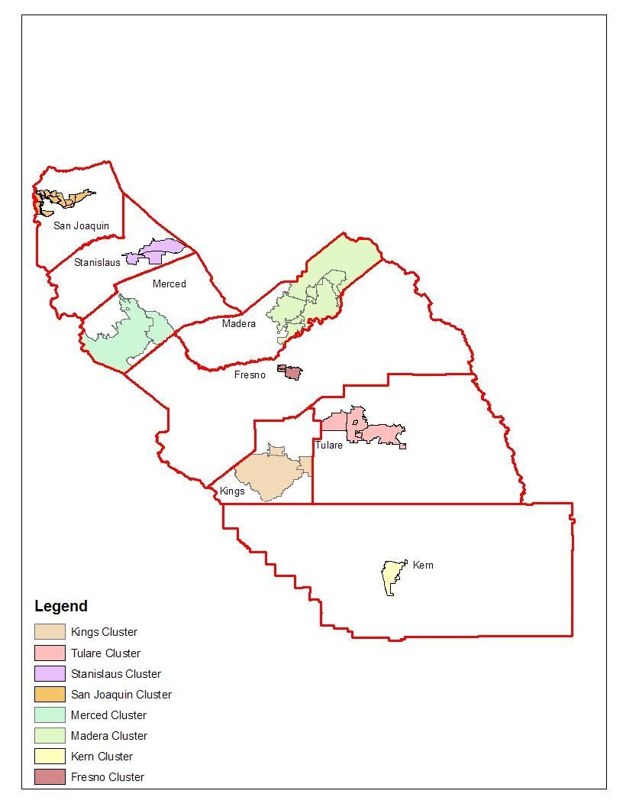

Slide 33
Description of Selected Community Clusters

Slide 34
Community Clusters: Disorder and Asset Scores

Slide 35
Community Cluster Survey Neighborhood Disadvantage
 | Community Cluster | N | Neighborhood Disadvantage
 |  |  | Mean [SD]
High Density Urban | North Stockton | 121 | 2.989 [3.377]
 | South Fresno Core | 146 | 3.961 [3.359]
 | E. Bakersfield/Lamont | 144 | 4.194 [3.384]
 | N. Visalia/Exeter | 125 | 2.632 [3.388]
Low Density Rural | Waterford/Hughson | 121 | 2.719 [3.366]
 | Corcoran | 140 | 4.411 [3.408]
 | Los Baños/Dos Palos | 156 | 2.165 [3.372]
 | The Mountains | 126 | 2.396 [3.367]

Slide 36
Multivariate Findings: Neighborhood Quality and Life Outcomes

