Slide 1
Budget Office Forms
Position Funding Change (PFC) Form
Budget Transfer (BT) Form
Payroll Expenditure Transfer Form (PTF)

Slide 2
Follow Your Division/Area’s Established Process
This is a general training on the completion of forms.
Academic Affairs and Student Affairs have centralized procedures established to follow.
Other divisions and areas may also have specific processing or approval routing determined by them to follow.
Consult your division/area’s budget lead for any specific instructions that may be applicable.

Slide 3
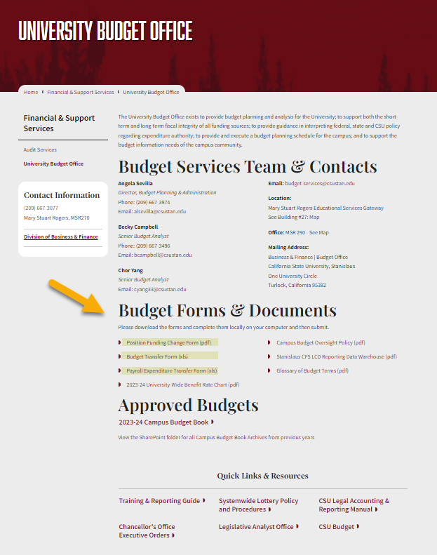
Website for Forms
https://www.csustan.edu/financial-support-services/university-budget-office

Slide 4
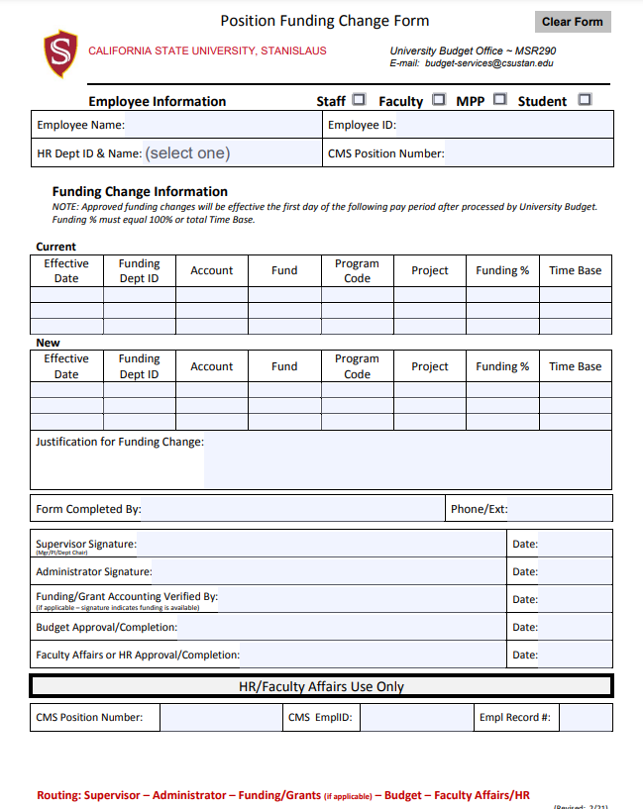
Position Funding Change Form
Notes:
Notes:

Slide 5
Position Funding Change Form
Top Section:
Employee Information
Employee Name: provide full name
Employee ID: Employees correct Identification in CHRS/LCD Data*
HR Dept ID & Name: This is where the employee reports to, not necessarily from where the funding source is.
CMS Position Number: Employees correct position number*
*Use Job Data to look up Employee IDs and Position numbers. If you do not have access, please check with your Department’s or Division’s Budget Analyst as these have changed with CHRS conversion.

Slide 6
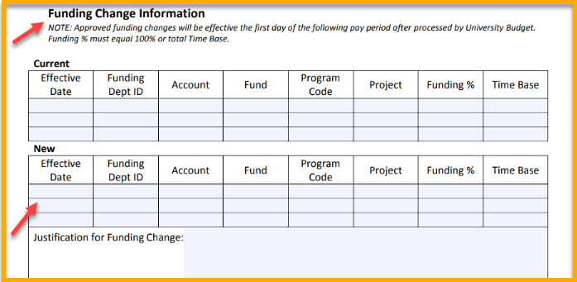
Position Funding Change Form
Funding Change Information:
Complete the following areas:
Current
Complete with full chart-string information. If split funded include all chart-fields and make sure percentage adds to 100%.
New
The new effective date should be no sooner than the first day of the following pay period after form is submitted.
Justification for Funding Change:
State the reason for the change.

Slide 7
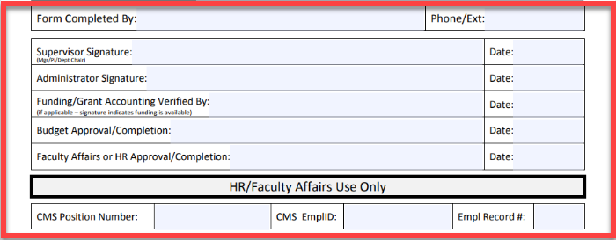
Position Funding Change Form
Contact person and signing Authorization:
Form Completed By: Name of who completed this form and their contact information is very important.
Signatures: Signing authorization is required.
If a grant, you need the Grant Administration Office to confirm.
HR/Faculty Affairs Use Only:
Do not add information in these boxes below HR/Faculty Affairs Use Only

Slide 8
Budget Transfer Form

Slide 9
Budget Transfer Form
A Budget Transfer is used for moving Current Budget amounts (yellow arrow).
If you need to move amounts in the Actuals column (red arrow), please contact the Accounting Office. Payroll Expense Transfers are an exception and we’ll be reviewing them next.

Slide 10
Budget Transfer Form
A Budget Transfer requires back-up. At a minimum, there should be a Data Warehouse report that shows where the amounts are moving from.
Follow your division’s process for approval routing.

Slide 11
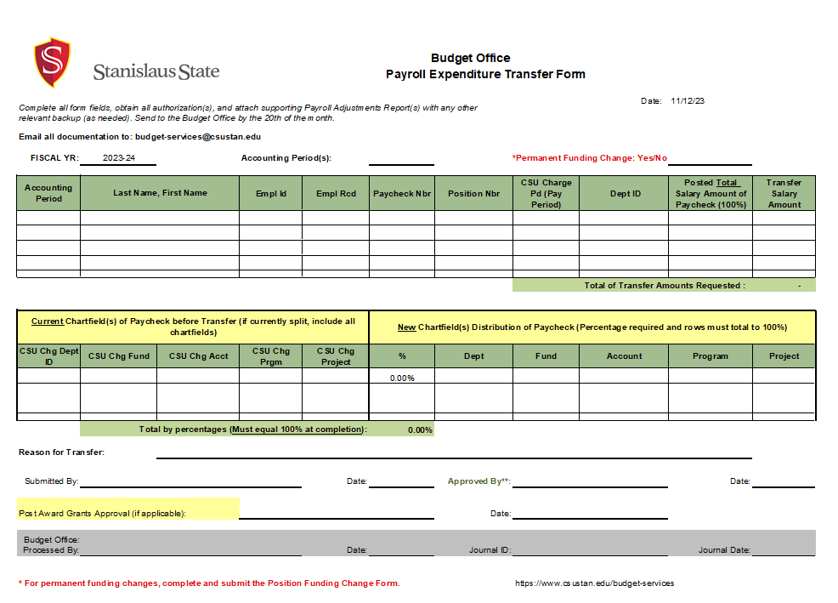
Payroll Expense Transfer Form

Slide 12
Payroll Expense Transfer Form
Before completing the form, run the Stanalytics Payroll Adjustments Report
Data in the report is arranged in the same order as the Payroll Transfer Form (PTF) form
Instructions for completing the form and running the report are in the file by tabs

Slide 13
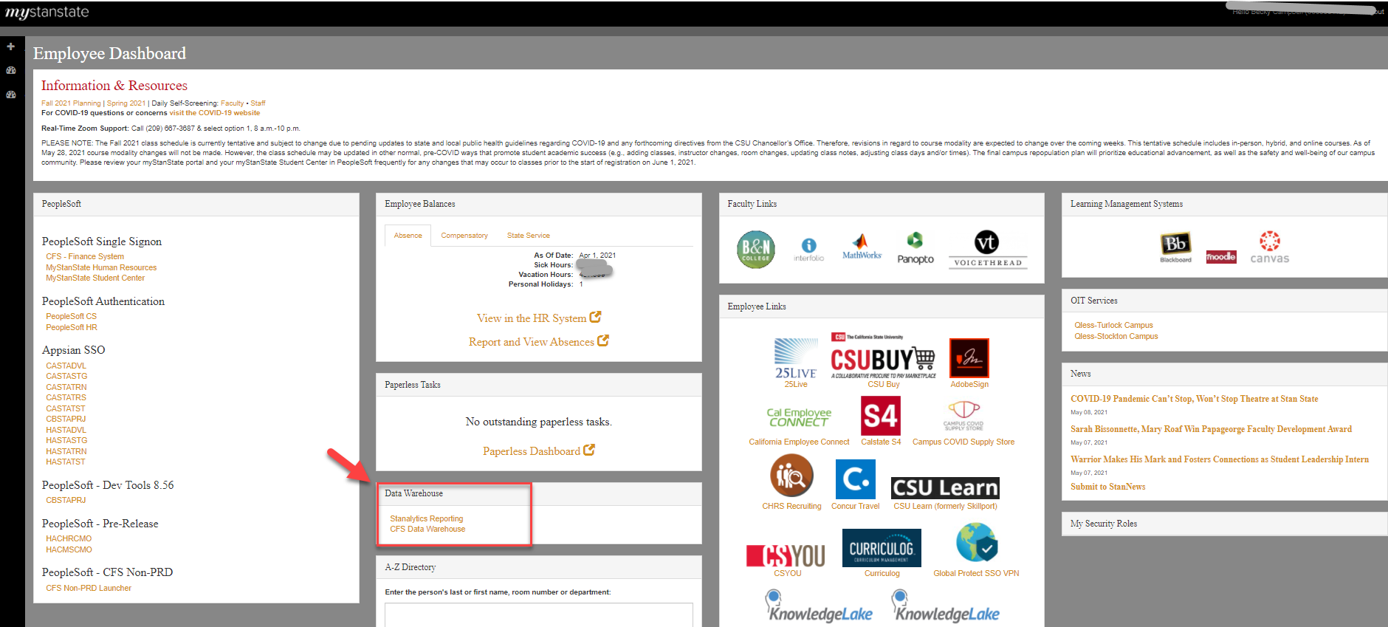
Payroll Adjustment Reports
Where do we find that report? Answer: Stanalytics!
Step 1: Go to My.csustan.edu and log in.
You’ll find the link in the same Data Warehouse box as our other CFS Data Warehouse reports.

Slide 14
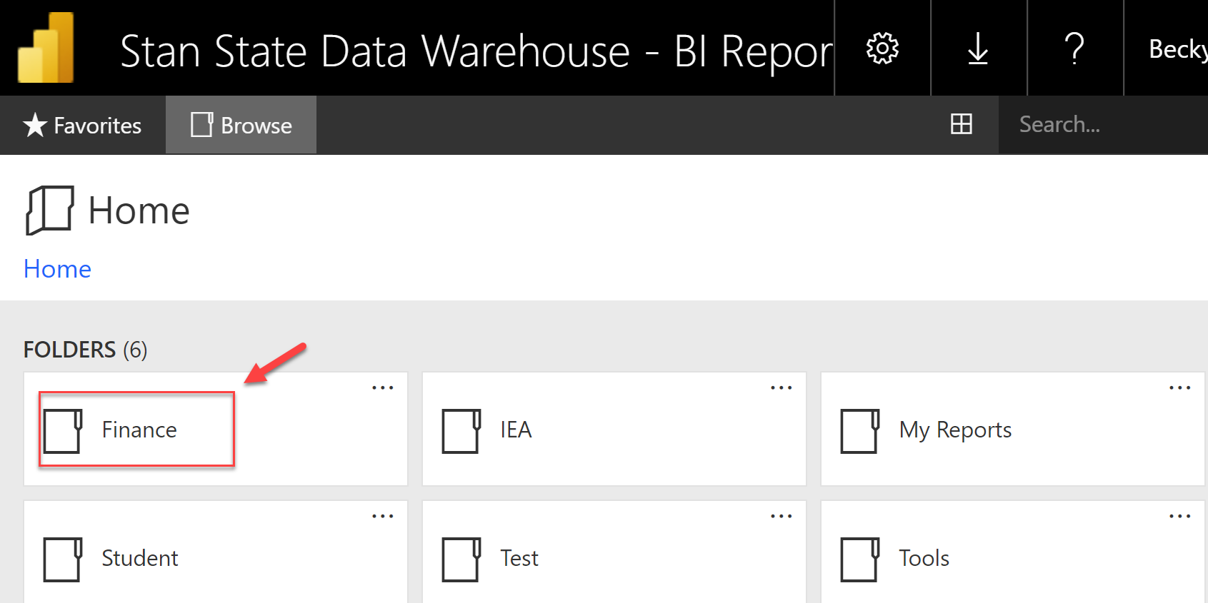
Payroll Adjustment Reports
Step 2:
Choose the folder that says “Finance”

Slide 15
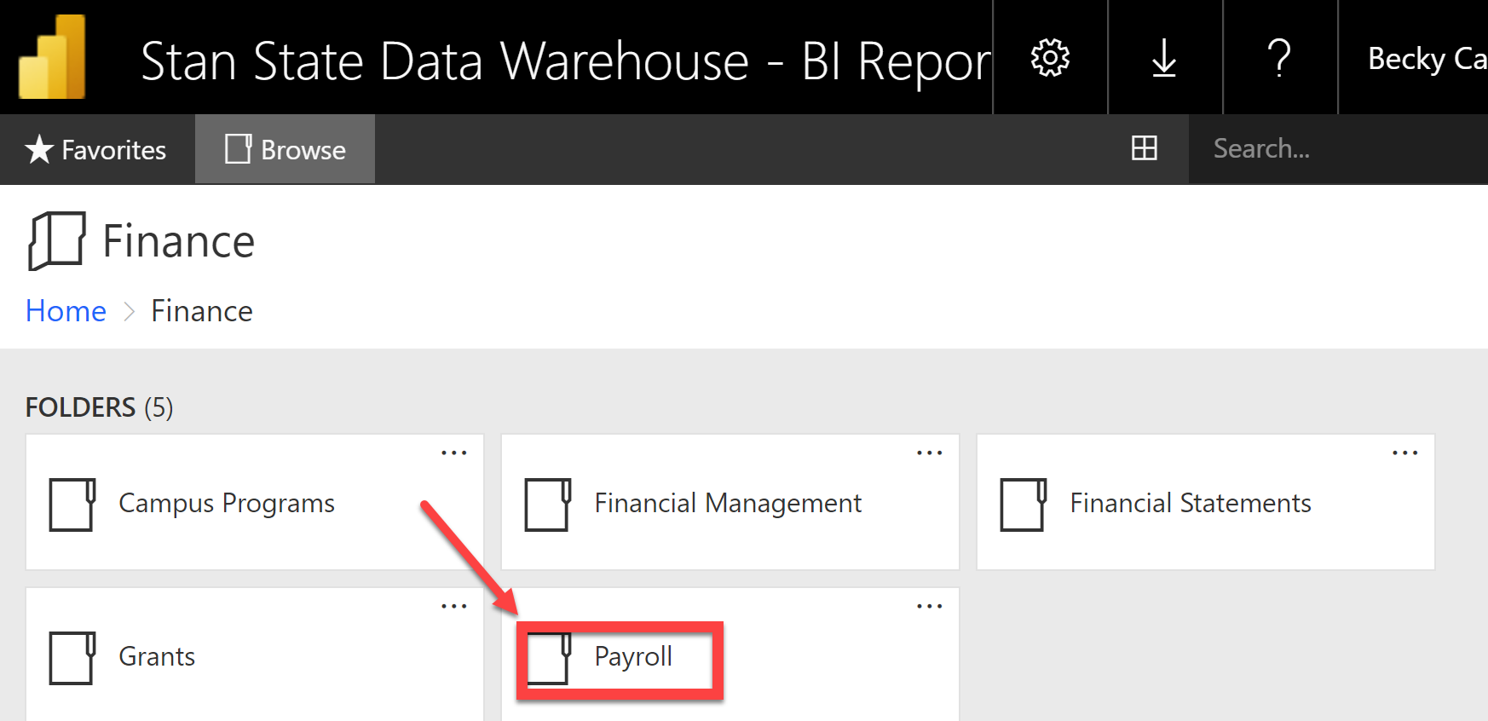
Payroll Adjustment Reports
Step 3:
Choose the folder that says “Payroll”

Slide 16
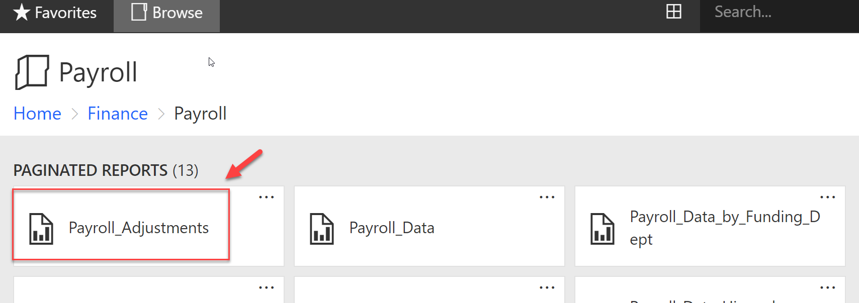
Payroll Adjustment Reports
Step 4:
Choose the first report to the left, “Payroll_Adjustments”

Slide 17
Payroll Adjustment Reports
Step 5:
Use the dropdown arrows to create your report. Select criteria from all four boxes
Fiscal Year; Beg Acct Period; End Acctg Period and Name
Then click on “View Report” box

Slide 18
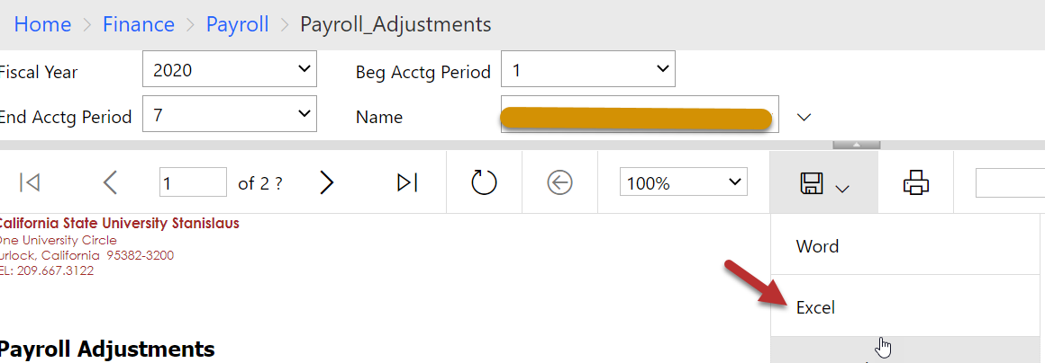
Payroll Adjustment Reports
Step 6:
Click on the drop-down arrow in the save icon to export to an Excel report.

Slide 19
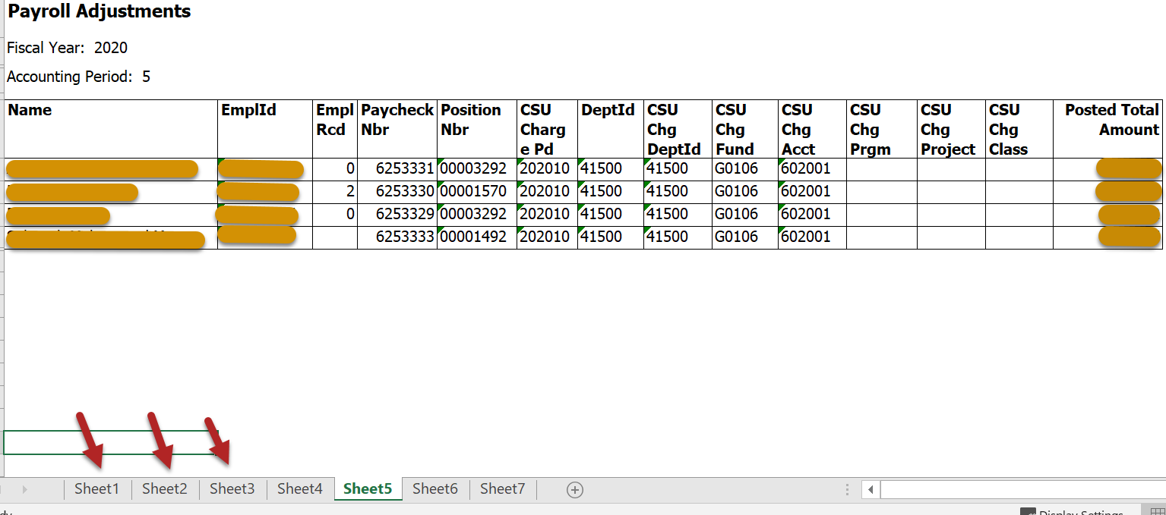
Reading Report
In our example, we chose multiple periods and multiple student names. Below is how they look in Excel

Slide 20
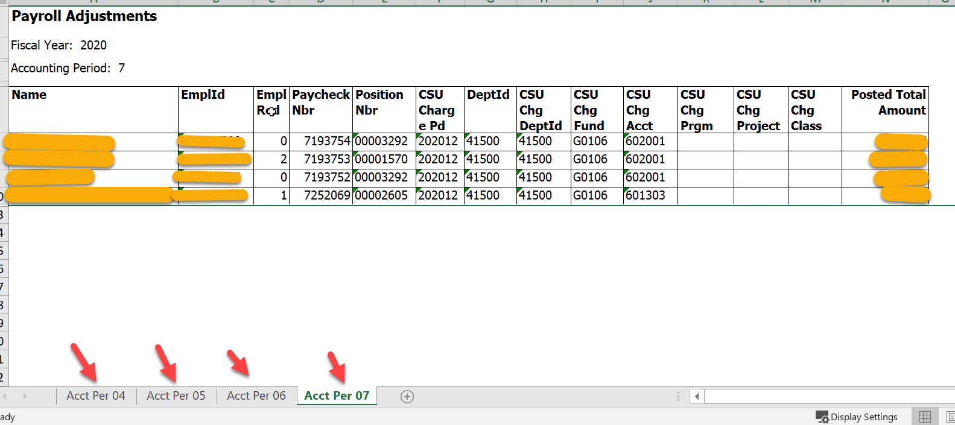
Reading Report
In the example, notice the multiple names all on one page with the columns in the same order as our Payroll Expense Transfer form.
Also, notice that there are several tabs. Each of these tabs is a different accounting period. I normally rename the tabs to “Acct Per 04”, “Acct Per 05”, etc.

Slide 21
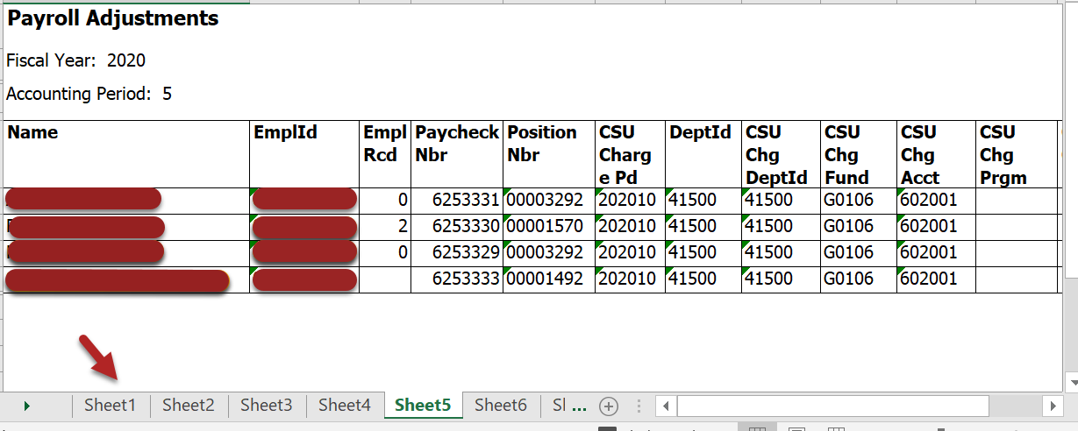
Reading Report
A little advice:
I normally open up the Payroll Expense Transfer form and complete it while this report is also open. Once, I’m finished with the form, I do the following:
“right click on its tab, select “move or copy”.
Choose from the drop down menu in the “move or copy” box to select the workbook name of your Payroll Adjustment reports.
Check the “Create a copy” box
Click on “ok”

Slide 22
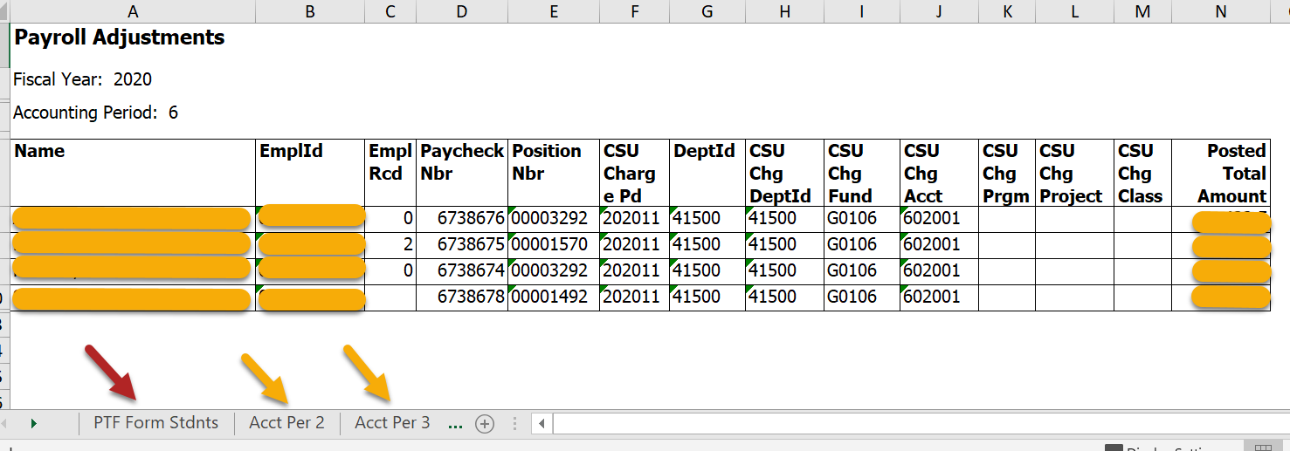
Reading Report
The end results is a completed Payroll Expense transfer form with the back up payroll report tabs all in one workbook.

