Slide 1
ShareLink Pro In Classrooms
LS Tech Tips

Slide 2
ShareLink Connects The Room Wirelessly
ShareLink Pro is a way to wirelessly connect to the room and project your content from your wireless device, via App or Web Browser.
In a Standard Classroom, ShareLink is available when:
The projector is on without the document camera being on or
If the doc is on but with HDMI selected with nothing connected via HDMI.
Then you will see the screens to the right being projected. They describe the ShareLink Pro system and how to connect to it.
These instructions will walk you through the steps to use this wireless system.

Slide 3
Step 1: Log In
On the screens you will notice that Sharelink provides you with a Code and Host Name, here circled red. You will enter these into your wireless device’s App or web browser.
Notes:
Zoom session with instructor and students joining from any location, no in-classroom presence

Slide 4
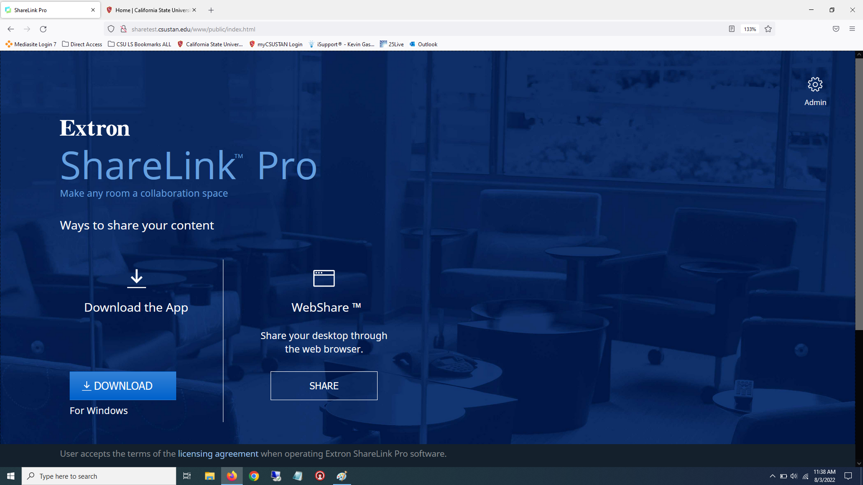
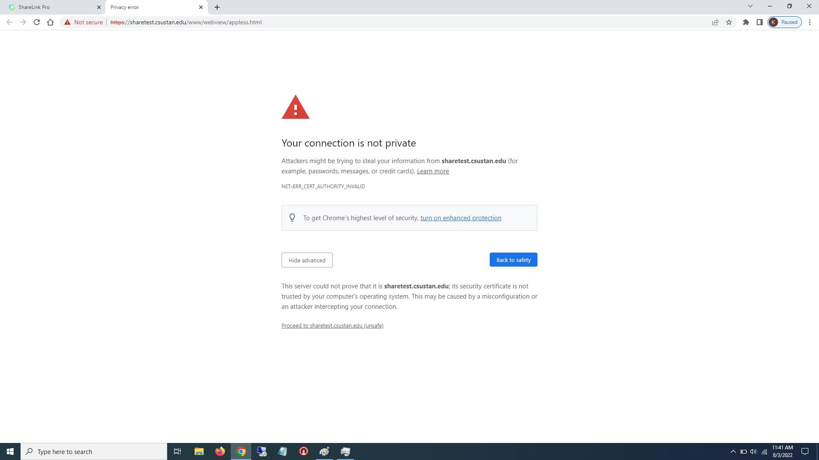
Step 2: ShareLink Page
Entering the Host Name URL into the device’s browser will take you to this Log In Page. Either download and install the App, or click the SHARE button to proceed to use your device’s web browser to share.
Be Aware that since you are sharing, your browser or OS will show a “not private” message. This will be worded differently depending on the Browser you are using, but to continue you can click the Advanced button and then click the “proceed” link, as shown here.
Notes:
Zoom session with instructor and students joining from any location, no in-classroom presence

Slide 5
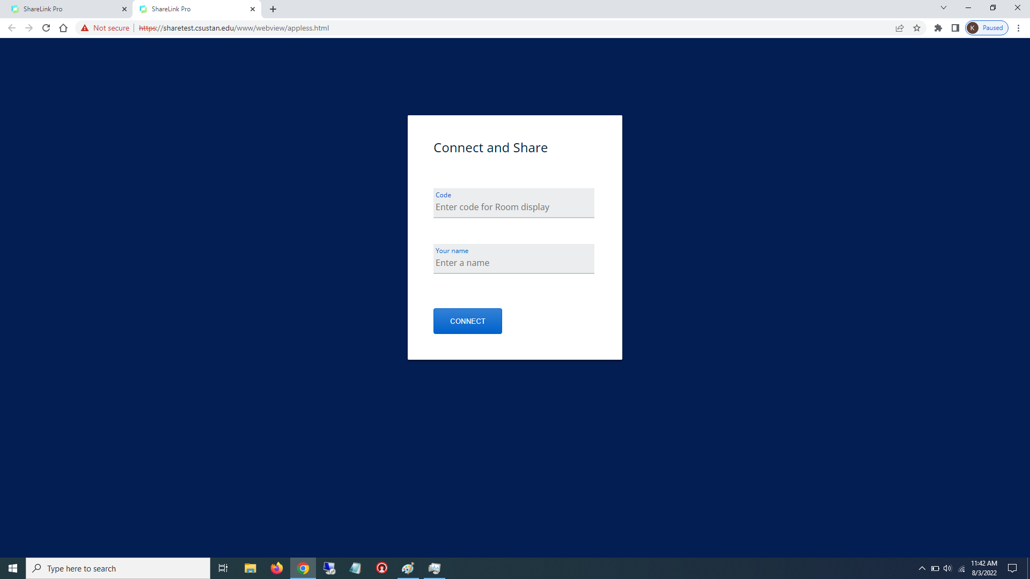
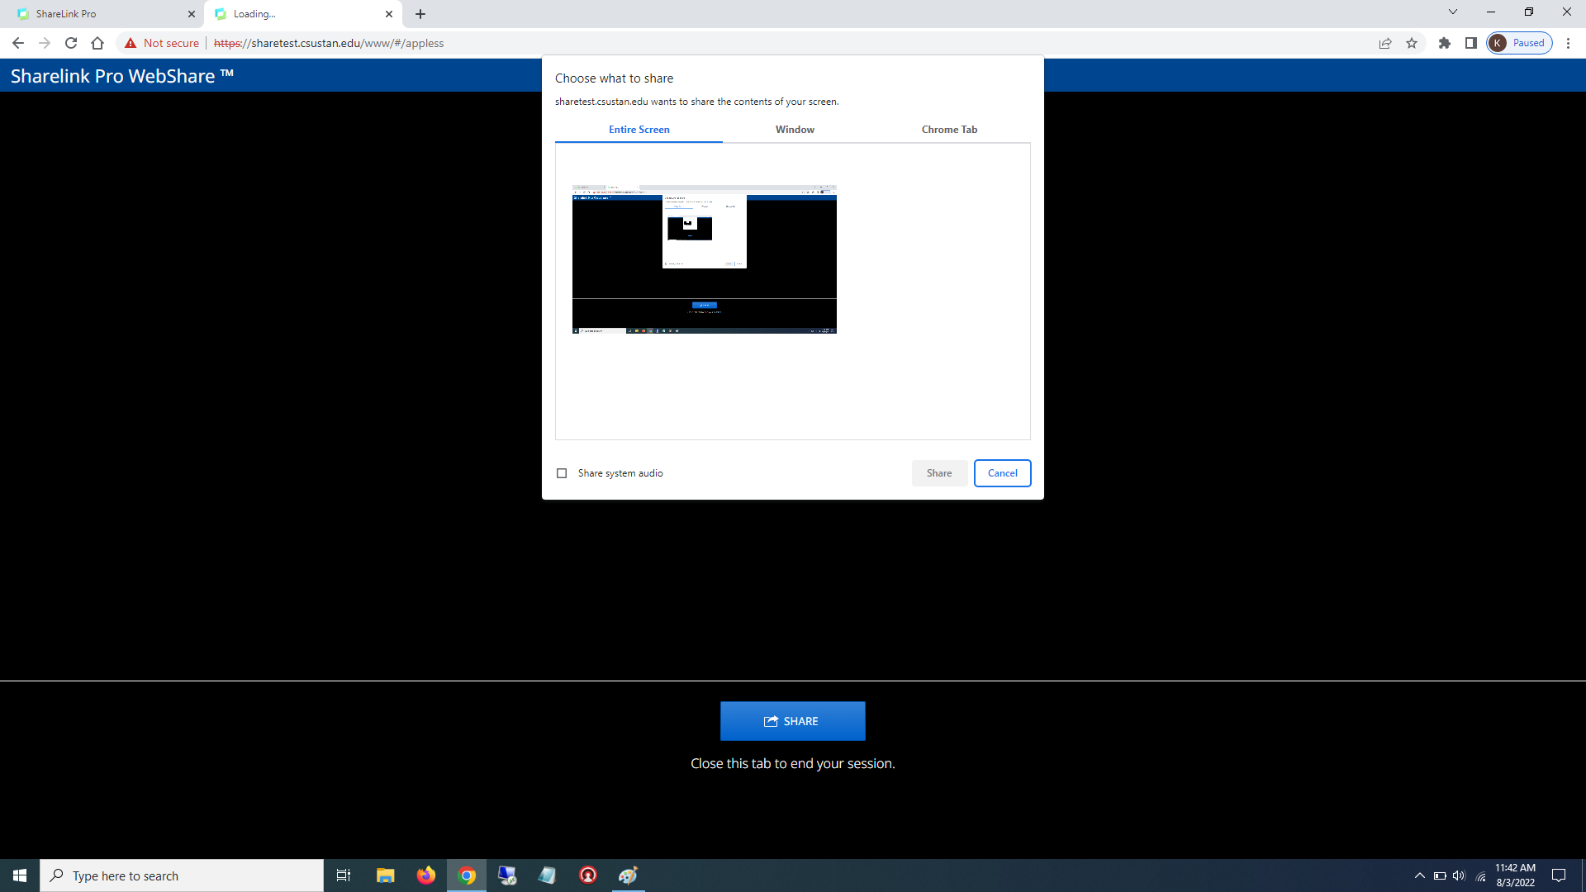
Step 3: Connect And Share
Now simply type in the CODE from the ShareLink screen on the projector (Page 3), followed by your own name and push CONNECT.
Now on the following screen, select what window, screen or application you are wanting to share. Then click the blue SHARE button to start sharing.
Notes:
Zoom session with instructor and students joining from any location, no in-classroom presence

Slide 6
Step 4: Share
You should now be able to share what you want in the room wirelessly.
When you are finished, click the “stop sharing” button on your device’s App or Browser window.
For additional assistance, please call #(209) 667-3171
Notes:
Basic classrooms provide limited technology including screen, projector, and document camera. Basic classrooms support in-person instruction and student attendance.

