Slide 1

School of Nursing Simulation Program
Wendy Matthew, RN, MSN, CHSE
School of Nursing Simulation Coordinator

Slide 2
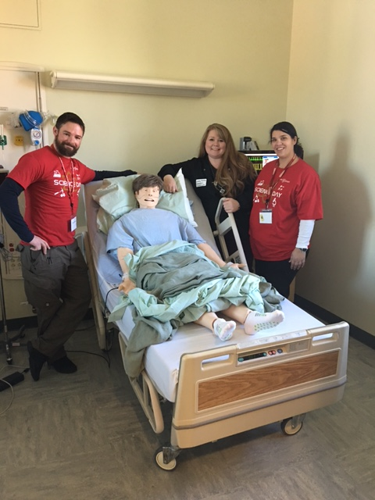
Simulation Facilitators
The CSU Stanislaus School of Nursing Simulation Program has a supportive simulation team and dedicated faculty that strive to create the very best learning opportunities for nursing students. Our goal being to create confident, competent nurses that promote patient safety and produce excellent patient outcomes.
Simulation is integrated into the School of Nursing curriculum to provide experiential learning opportunities throughout the program.
From left to right:
James Bowles- Simulation Technician & Instructional Support
Wendy Matthew- Simulation Coordinator Nursing faculty
Jennifer Serratos- Nursing Faculty

Slide 3
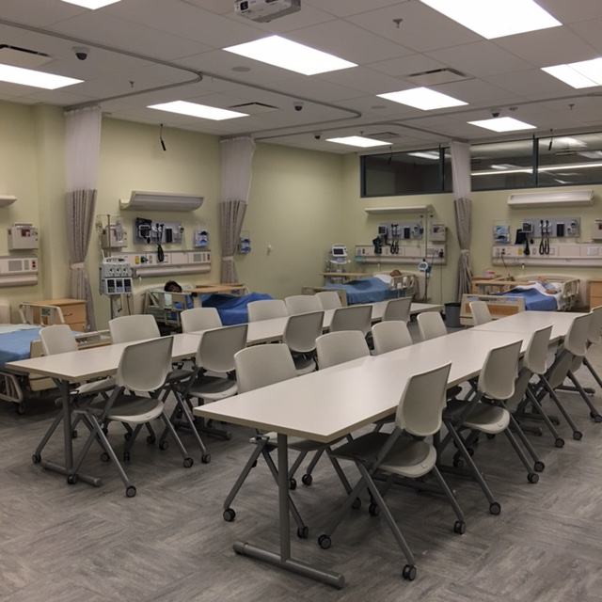
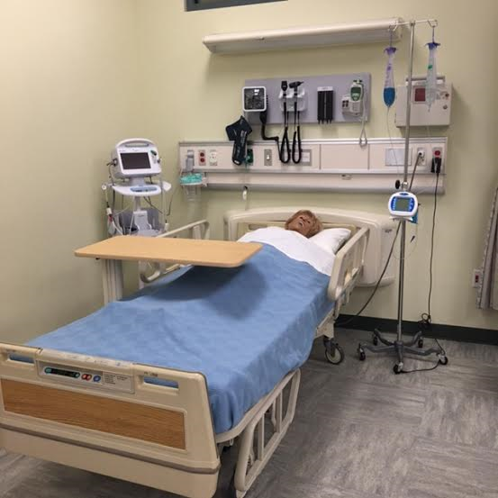
Low Fidelity Simulation Lab
Room 222
8 beds
Core Course: Fundamentals
Lecture
Skills Demonstrations
Skills Practice
Low Fidelity Manikins allow students to practice basic nursing skills such as foley insertion, wound care, NG tube insertion, injections, etc.

Slide 4
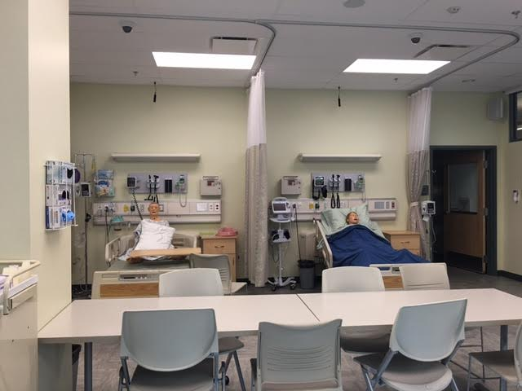
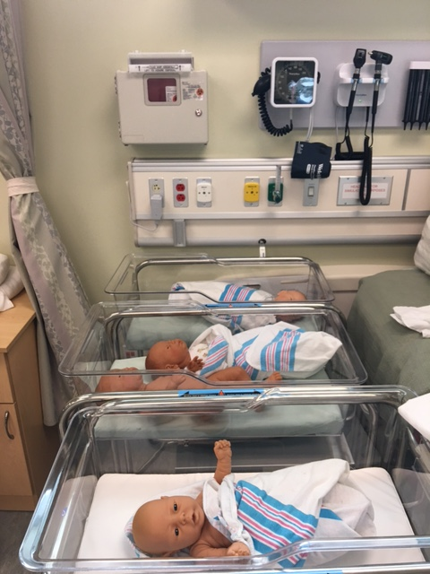
Mid Fidelity Simulation Lab
Room 228
7 beds & pediatrics section
Multi Purpose Lab:
Lecture
Skills Check Offs
Seminar
Skills Faire
Mid Fidelity Manikins allow for nursing skills practice and they can also provide heart sounds, lung sounds, bowel sounds, and verbal cues in response to student actions and interventions.

Slide 5
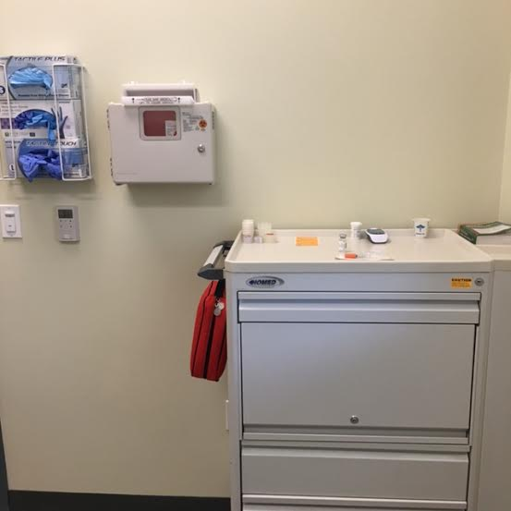
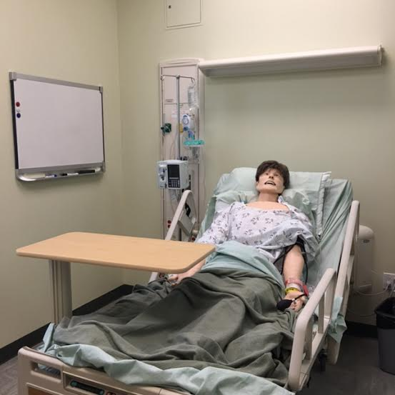
High Fidelity Sim Man Suite
Room 203C & 203D
2 beds
Sim Man Essential
Patient Care for Adult Population
High Fidelity Manikins provide our students with the most realistic simulation opportunities. The manikins breath, talk, blink, and have palpable pulses from carotids to pedals. The manikins also have heart, lung, and bowel sounds. They can be intubated and defibrillated. The manikin/ student interactions make very rich learning opportunities.

Slide 6
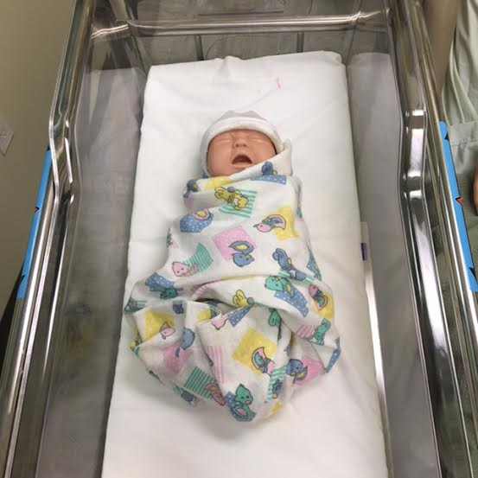
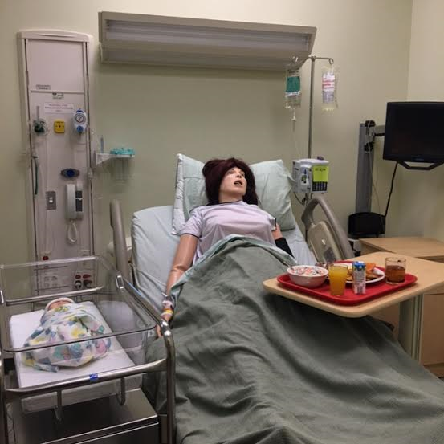
High Fidelity Sim Mom Suite
Room 203B
1 Birthing Bed & 1 Bassinet
Sim Mom
Patient Care for Obstetrics
Newborn Care
Birthing simulator that offers our students the opportunity to provide care before, during and after birth. Patient labs, test results, fetal monitor and other pertinent patient information available via patient monitor.

Slide 7
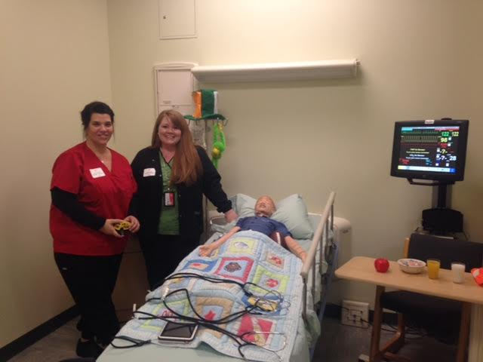
High Fidelity Sim Junior Suite
Room 203A
1 Gurney
Sim Junior
Patient Care for Pediatrics
Sim Junior offers our students the opportunity to care for a 6 year old child. The manikin can be run wirelessly using Sim Pads that allow facilitators to control the manikin remotely.

Slide 8
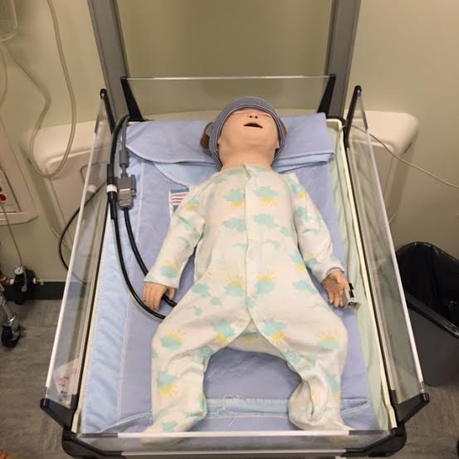
High Fidelity Sim Baby Suite
Room 203A
1 infant warmer
Sim Baby
Patient Care for Pediatrics
Sim Baby offers our students the ability to care for a 6-9 month old infant. Sim Baby can mimic many various illnesses. He cries, breathes with chest rise, has bodily sounds such as heart, lungs, bowels. He can experience seizures and turn cyanotic.

Slide 9
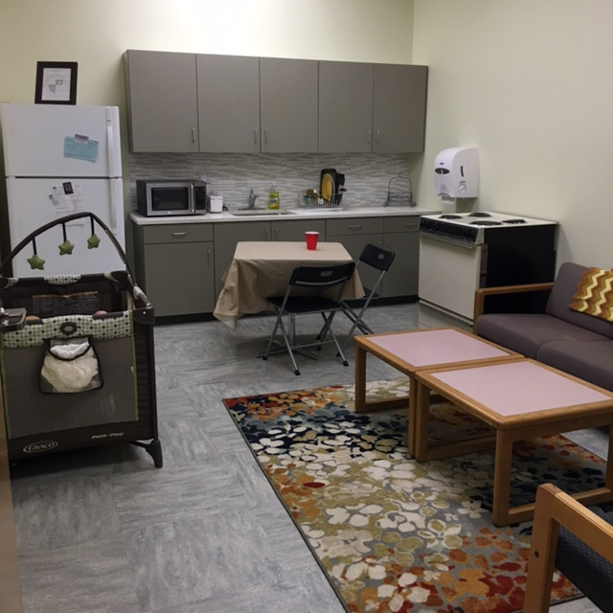
Simulation Apartment
Room 220
Apartment
Care for Community
Therapeutic Communication
The simulation apartment offers our students the ability to simulate home visits, utilize therapeutic communication, and complete assessments for both the client and their home.

Slide 10
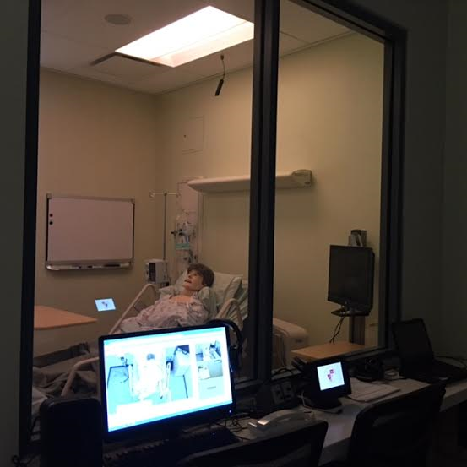
High Fidelity Facilitator View
Each room in the High Fidelity Suite is equipped with cameras, speakers, and one way mirrors.
Facilitators control the manikins, patient monitors, recordings, and sound from a control room on the opposite side of the one way mirror.
This set up allows facilitators to easily control the environment and view student performance.

Slide 11
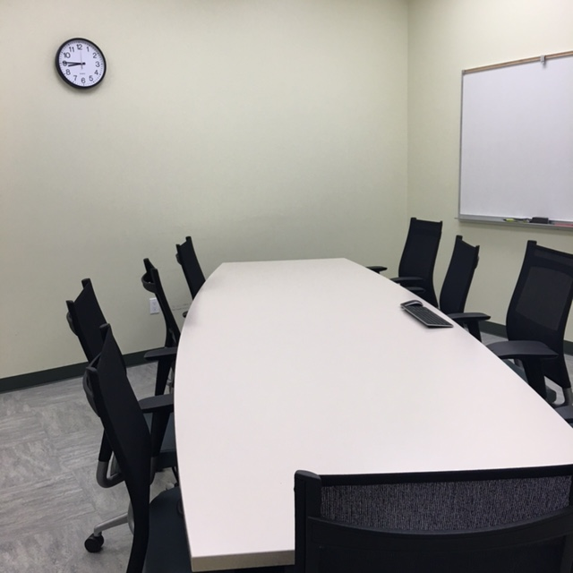
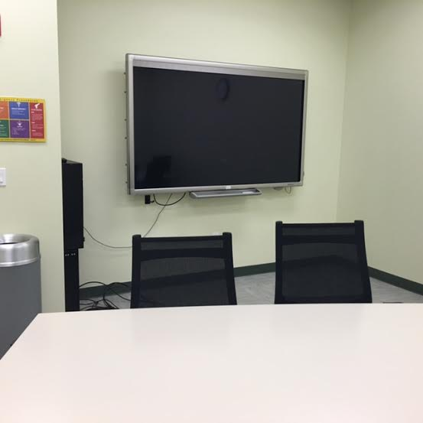
Debriefing Room
Room 218
Debrief
Seats 12-15
The debriefing room provides the space for reflection of the simulation experience to occur. The students are able to react, reflect, investigate, discuss, integrate, and assimilate, which is foundational for learning to occur.
The students can playback their scenario to view their performance. They can also watch their peers live, while the simulation is taking place.

Slide 12
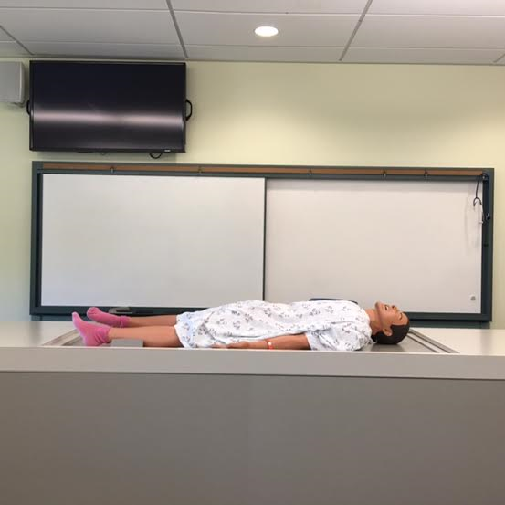
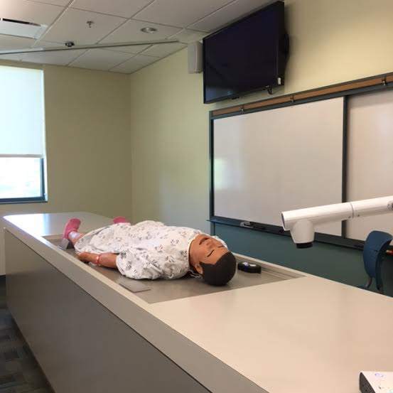
Classroom Podium
Room 205
Podium
In Class Simulation
This manikin is housed inside the podium at the front of the classroom. The manikin can be brought to the top by a simple push of a button. This allows hands on experiences during theory courses. The room is equipped with a patient monitor and the camera can zoom to any area of the podium for better viewing abilities.

Slide 13
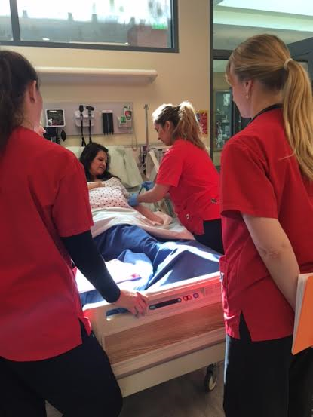
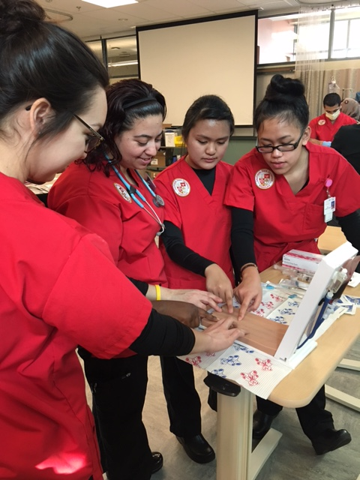
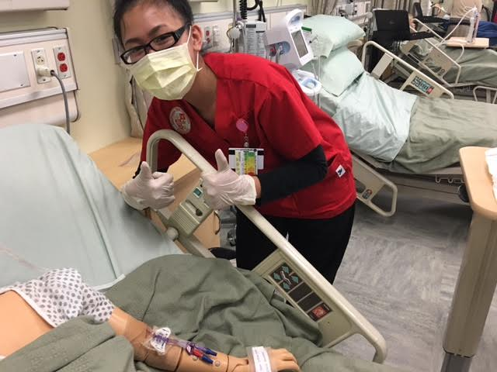
CSU Stanislaus Nursing Students rock!

