Slide 1
Network Access on Android
Onboard configuration of Android Devices on eduroam network

Slide 2
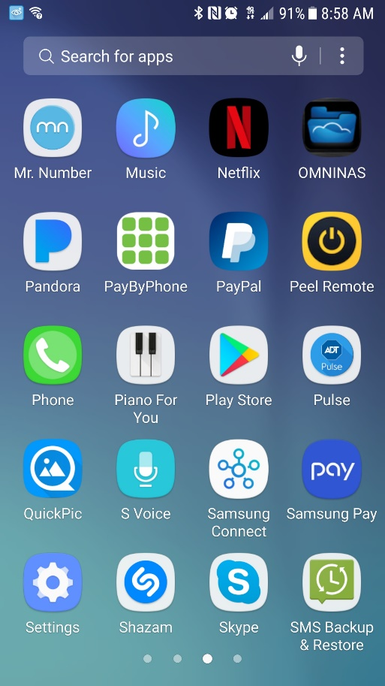
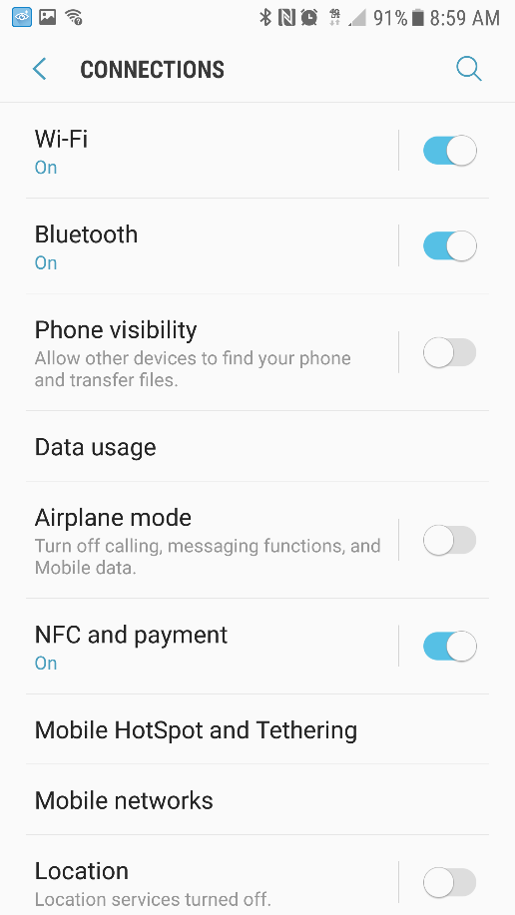
Android Network Access Configuration
Tap the “Settings” Button
Tap “Wi-Fi” under “Connections”

Slide 3
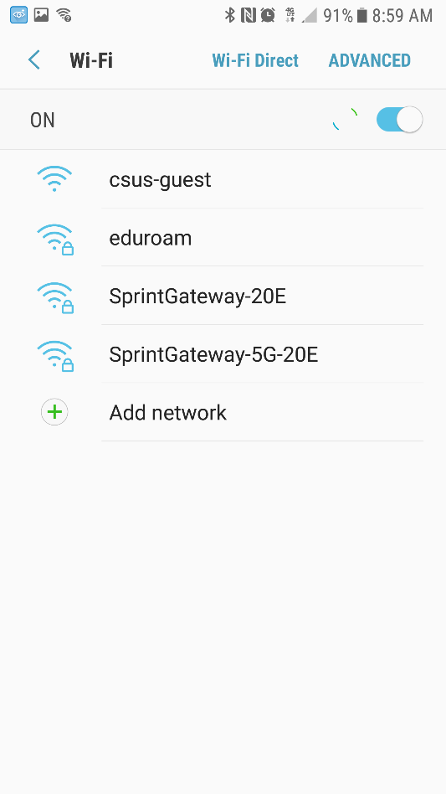
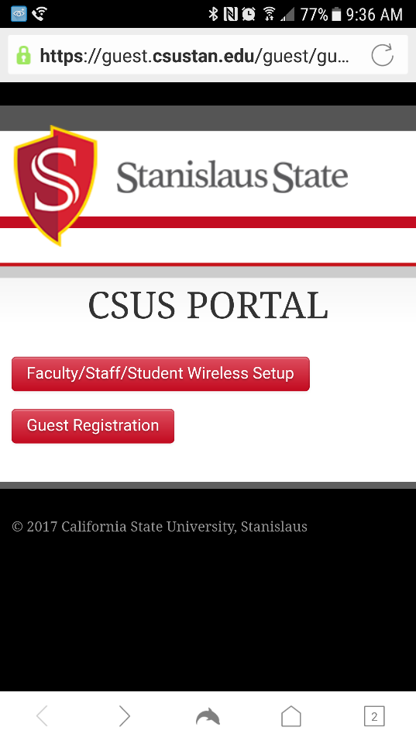
Android Network Access Configuration
A captive portal should automatically pop up.
Tap ‘Faculty/Staff/Student Wireless Setup” to continue
Tap “csus-guest” in the list of wireless networks

Slide 4
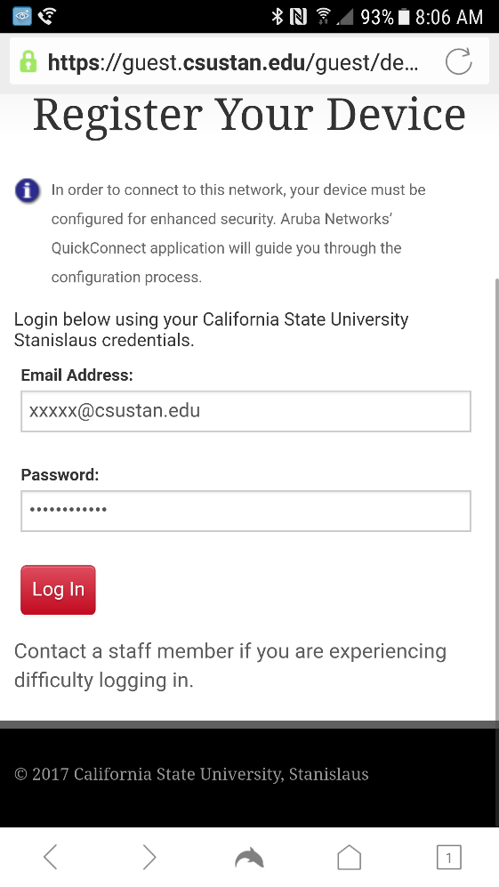
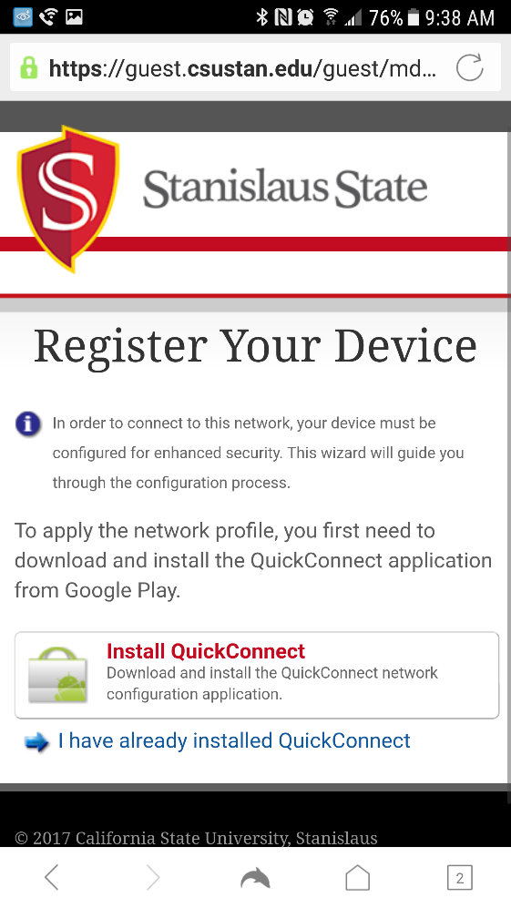
Android Network Access Configuration
Log in using your full university email and password. Tap “Log In” to continue.
Tap the “Install QuickConnect” link.

Slide 5
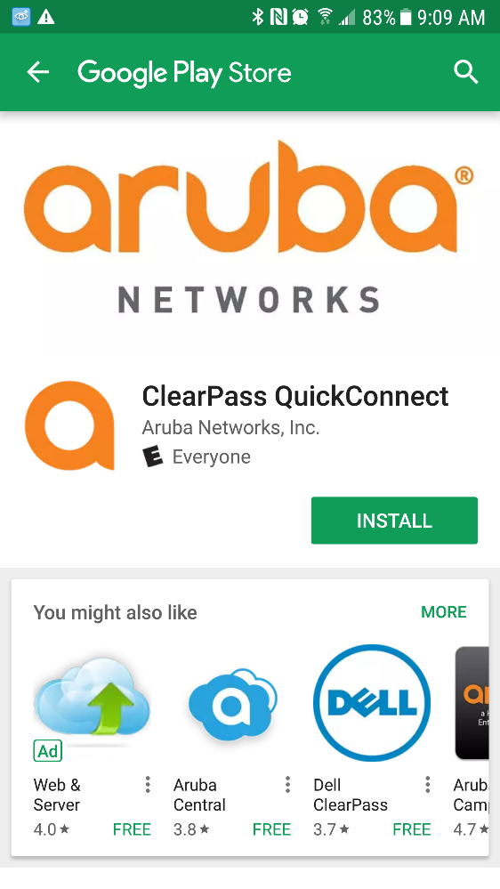
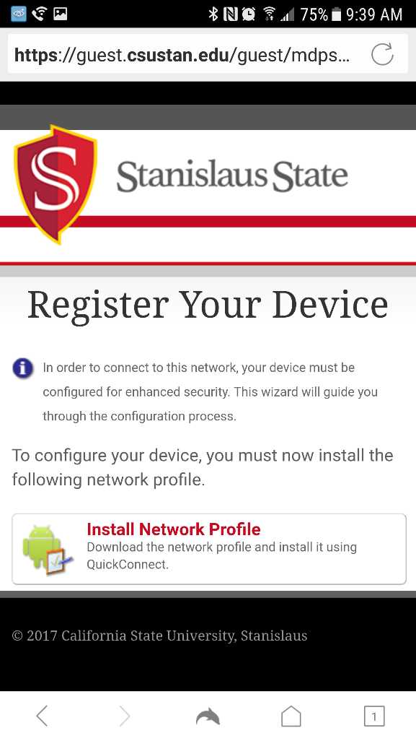
Android Network Access Configuration
You will be redirected to the Google Play Store.
Tap on “Install”
Tap on the “Install Network Profile”. You may need to navigate to run the file that was downloaded

Slide 6
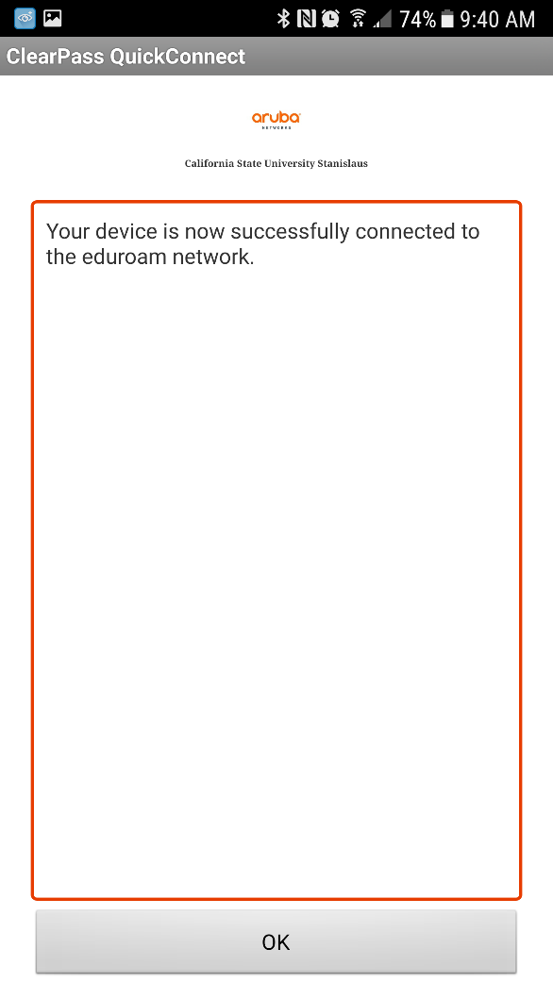
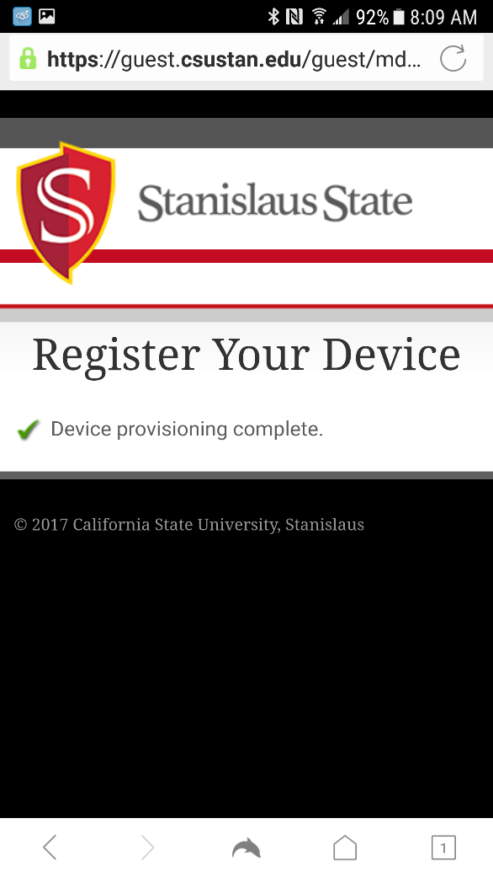
Android Network Access Configuration
Congratulations, your device should now be connected to the eduroam network.
If you received any errors during the process, please contact the Technology Support Desk at 209-667-3687 or TechSupport@csustan.edu
The following window will appear with the progress of the installation. Tap “OK” when done.

